Slide 1
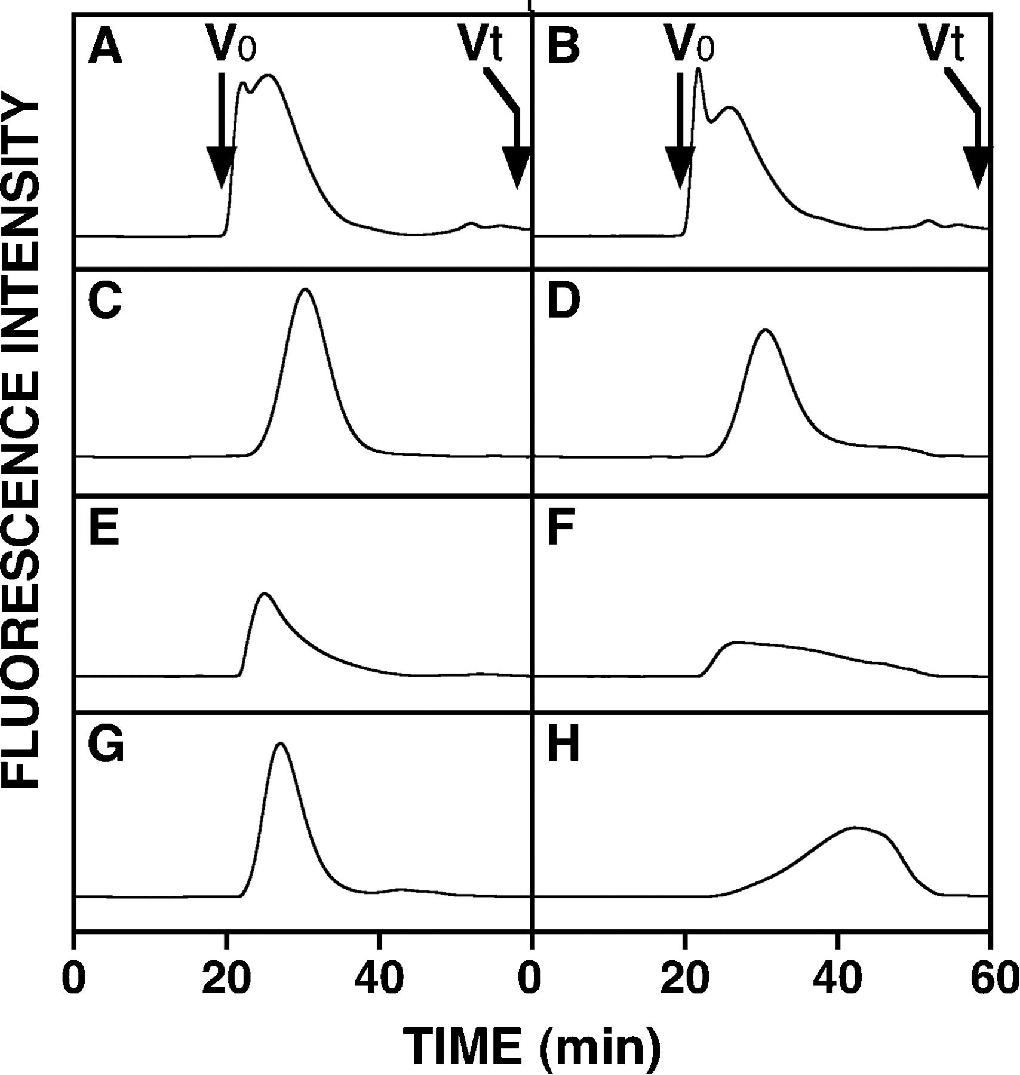
Fig. 1 Gel filtration HPLC analysis of the FITC-labeled GAG isoforms digested with HYAL4. FITC-labeled HA (A and B), ...
Notes:
Fig. 1 Gel filtration HPLC analysis of the FITC-labeled GAG isoforms digested with HYAL4. FITC-labeled HA (A and B), CS-A (C and D), CS-C (E and F), and CS-D (G and H) were analyzed by gel filtration HPLC on a column of Superdex 200 before (A, C, E, and G) and after (B, D, F, and H) incubation with the purified HYAL4 protein, and monitored by measuring the fluorescent intensity of FITC with excitation and emission wavelengths of 490 and 520 nm, respectively. V0, void volume; Vt, total volume.
Unless provided in the caption above, the following copyright applies to the content of this slide: © Oxford University Press 2009

Slide 2
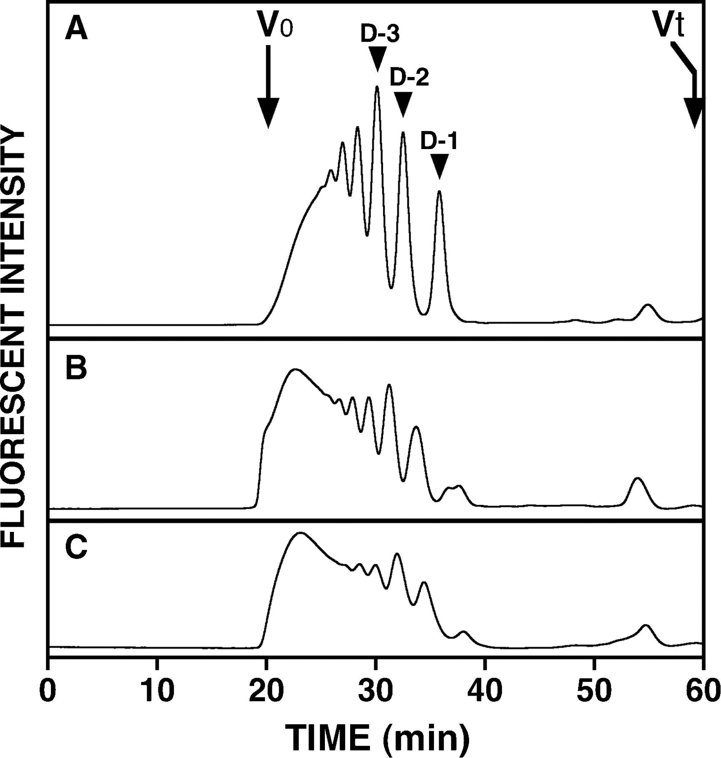
Fig. 2 Comparison of the digestibility of various GAGs to CSHY and fractionation of the reaction products. Ten ...
Notes:
Fig. 2 Comparison of the digestibility of various GAGs to CSHY and fractionation of the reaction products. Ten micrograms each of commercial CS-D (A), CS-C (B), or CS-A (C) was incubated with CSHY under the same conditions, and each digest was derivatized with 2AB. An aliquot (750 ng) of each 2AB-derivatized digest was analyzed by gel filtration HPLC on a column of Superdex peptide. Peaks indicated by arrowheads in panel A were collected, digested with CSases, and analyzed by anion-exchange HPLC to identify the structure of the major component in each fraction. V0, void volume; Vt, total volume.
Unless provided in the caption above, the following copyright applies to the content of this slide: © Oxford University Press 2009

Slide 3
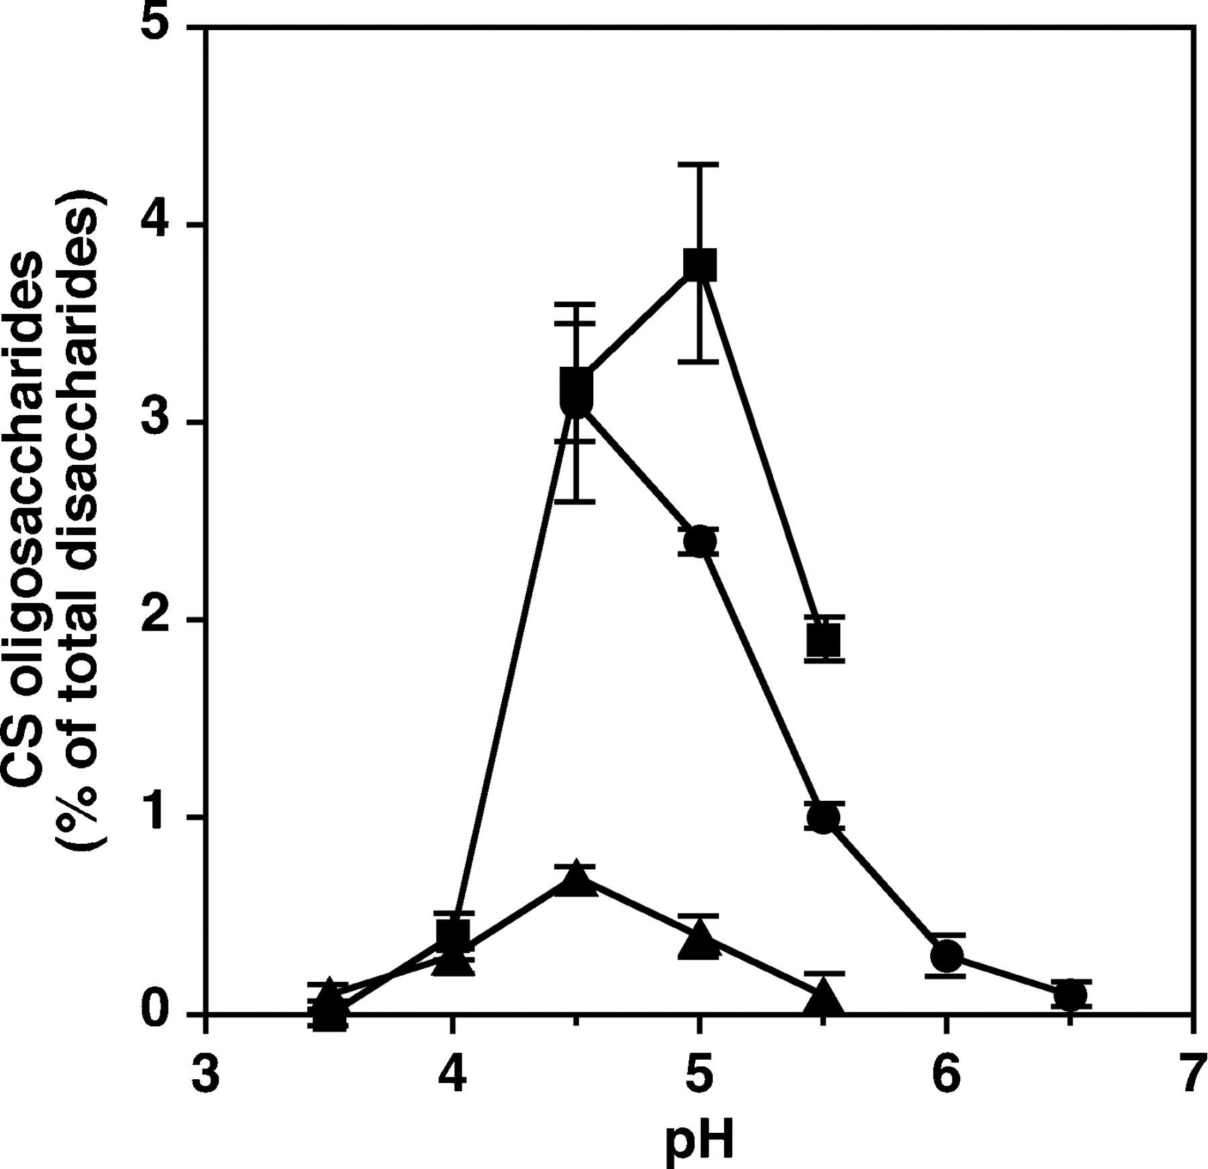
Fig. 3 Effects of pH on the hydrolytic activity of CSHY. CS-D was incubated with purified CSHY in 50 mM phosphate ...
Notes:
Fig. 3 Effects of pH on the hydrolytic activity of CSHY. CS-D was incubated with purified CSHY in 50 mM phosphate (circles), acetate (squares), or citrate (triangles) buffers, pH 3.5–6.5, containing 150 mM NaCl. The digests were labeled with 2AB, digested with CSase AC-II, and then analyzed by anion-exchange HPLC on an amine-bound silica column. Degradation of CS-D was assessed by calculations based on the proportion (in percentage) of 2AB-labeled di- and tetrasaccharides formed as described under Material and methods.
Unless provided in the caption above, the following copyright applies to the content of this slide: © Oxford University Press 2009

Slide 4
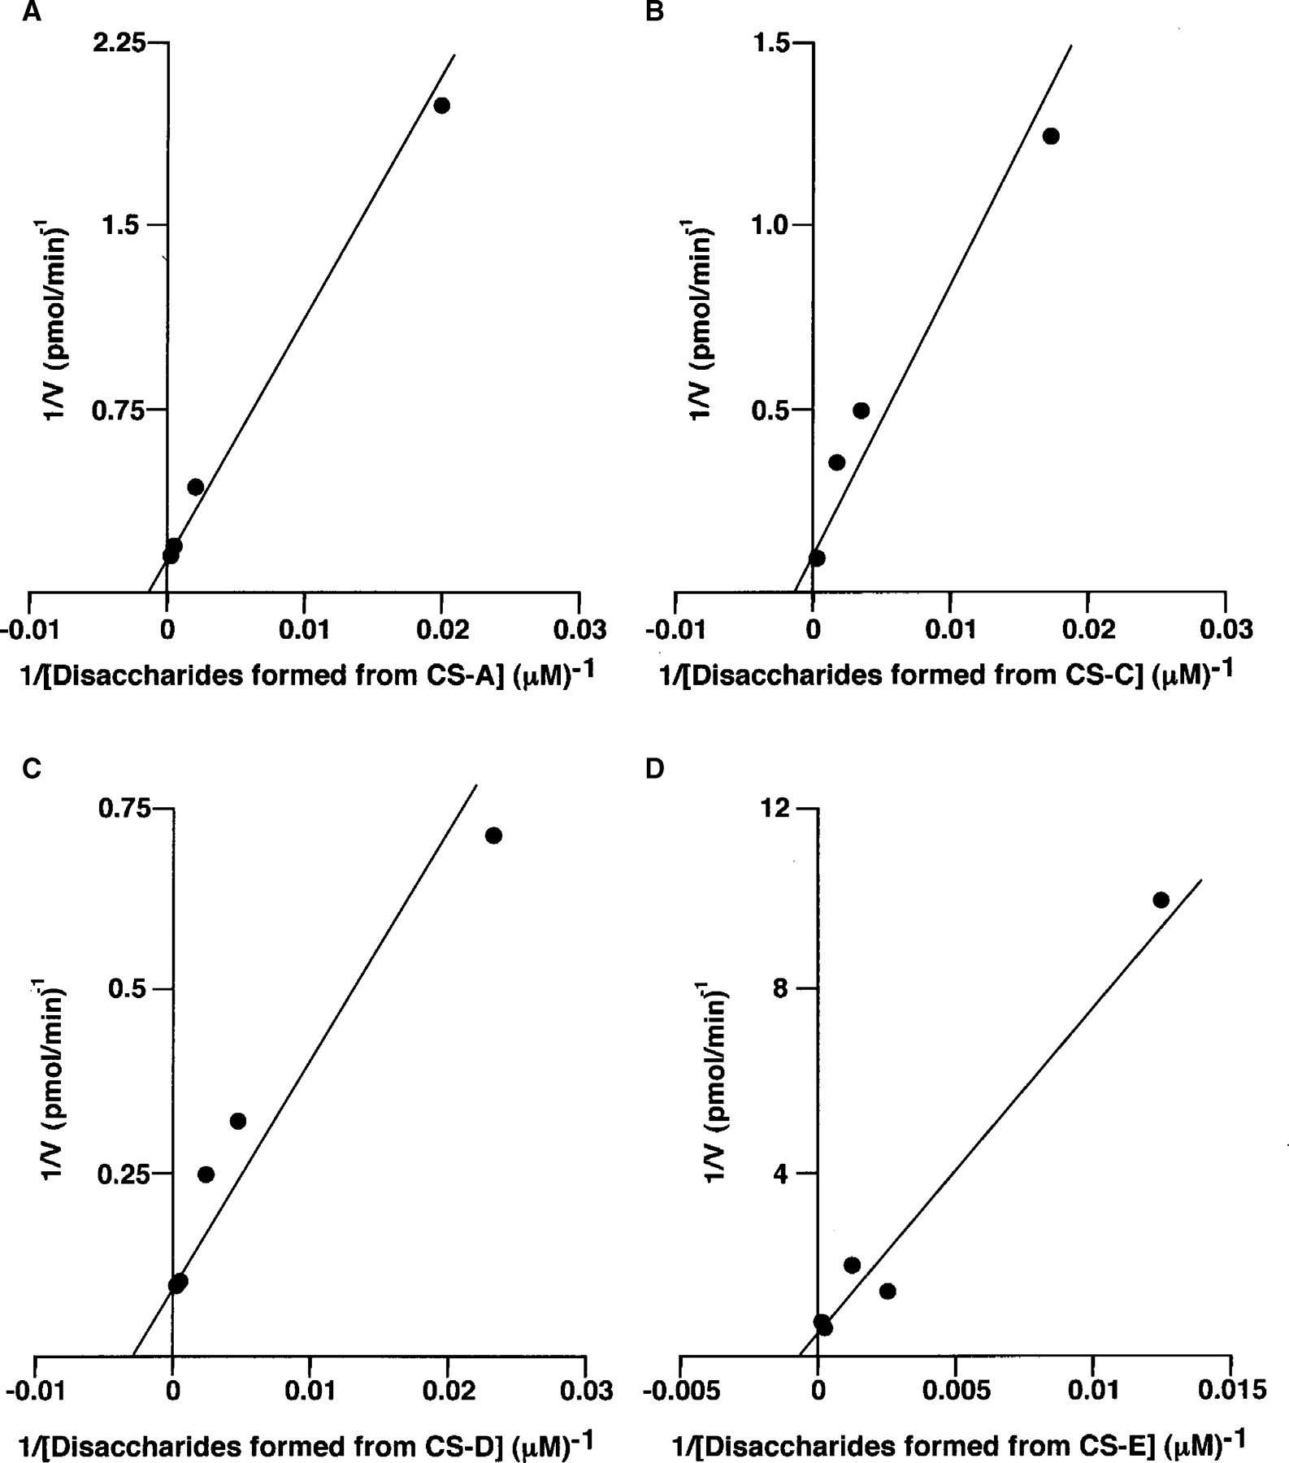
Fig. 4 Lineweaver–Burk plots of the initial velocities obtained by enzymatic hydrolysis of varying concentrations of ...
Notes:
Fig. 4 Lineweaver–Burk plots of the initial velocities obtained by enzymatic hydrolysis of varying concentrations of CS isoforms by CSHY. CSHY was incubated with different concentrations of CS-A (A), CS-C (B), CS-D (C), or CS-E (D). After incubation, degradation products were labeled with 2AB and digested with CSase AC-II. The resultant oligosaccharides were quantified by HPLC as described in Material and methods. The plots showed linearity and the reaction velocities were used for a kinetic analysis to determine apparent Km and Vmax values for CSHY.
Unless provided in the caption above, the following copyright applies to the content of this slide: © Oxford University Press 2009

Slide 5
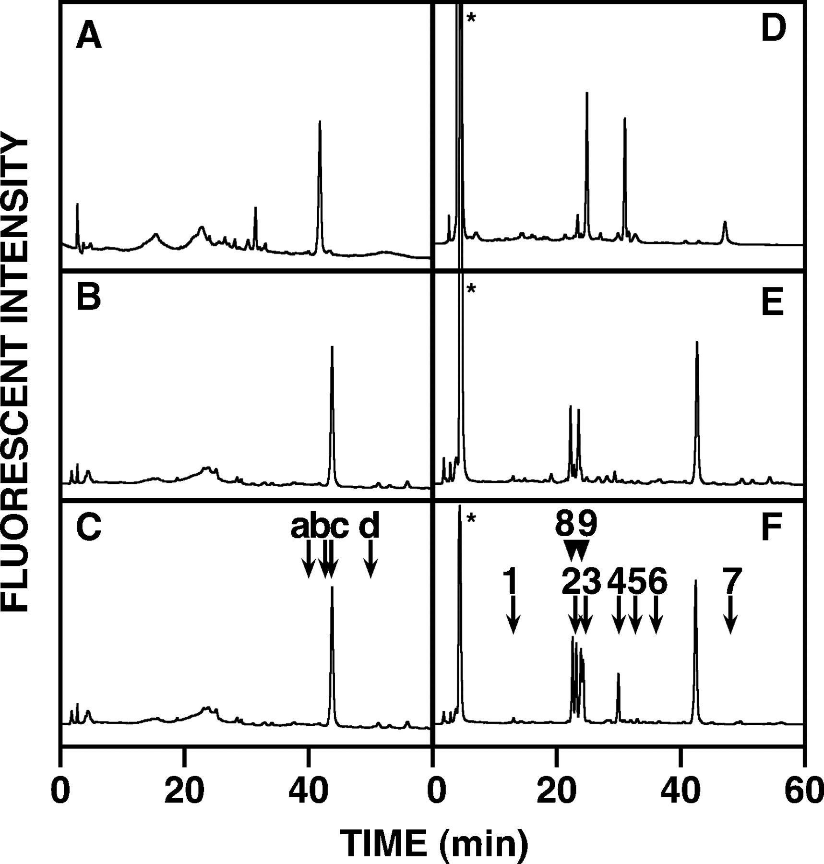
Fig. 5 Identification of the degradation products of CS-D by anion-exchange HPLC. Fractions D-1 (A), D-2 (B, E), and ...
Notes:
Fig. 5 Identification of the degradation products of CS-D by anion-exchange HPLC. Fractions D-1 (A), D-2 (B, E), and D-3 (C, F), isolated from the CSHY digest of CS-D (Figure 2), were analyzed by anion-exchange HPLC after digestion with CSase AC-II (A-C). Fraction D-1′ was digested with CSase ABC, and the digest was labeled with 2AB and analyzed by anion-exchange HPLC (D). Fractions D-2 and D-3 were also digested with CSase ABC, and the digests were labeled with 2AB and analyzed individually (E and F). The elution positions of the 2AB-derivatives of the authentic unsaturated tetrasaccharides (Sugahara et al. 1994a; Deepa et al. 2007) are indicated by arrows marked by letters in panel C: (a) ΔHexUA(2S)-GalNAc(6S)-GlcUA- GalNAc(6S); (b) ΔHexUA(2S)-GalNAc(6S)-GlcUA-GalNAc(4S); (c) ΔHexUA-GalNAc(4S)-GlcUA(2S)-GalNAc(6S); (d) ΔHexUA- GalNAc(6S)-GlcUA(2S)-GalNAc(6S). The peaks marked by asterisks at around 5 min in panels D–F were derived from the 2AB reagents. The numbered arrows and arrowheads in panel F indicate the elution positions of the 2AB-derivatives of authentic unsaturated and saturated disaccharides (Kinoshita and Sugahara 1999): (1) ΔHexUA-GalNAc; (2) ΔHexUA- GalNAc(6S); (3) ΔHexUA-GalNAc(4S); (4) ΔHexUA(2S)-GalNAc(6S); (5) ΔHexUA(2S)-GalNAc(4S); (6) ΔHexUA-GalNAc(4S,6S); (7) ΔHexUA(2S)-GalNAc(4S,6S); (8) GlcUA-GalNAc(6S); (9) GlcUA- GalNAc(4S).
Unless provided in the caption above, the following copyright applies to the content of this slide: © Oxford University Press 2009

Slide 6
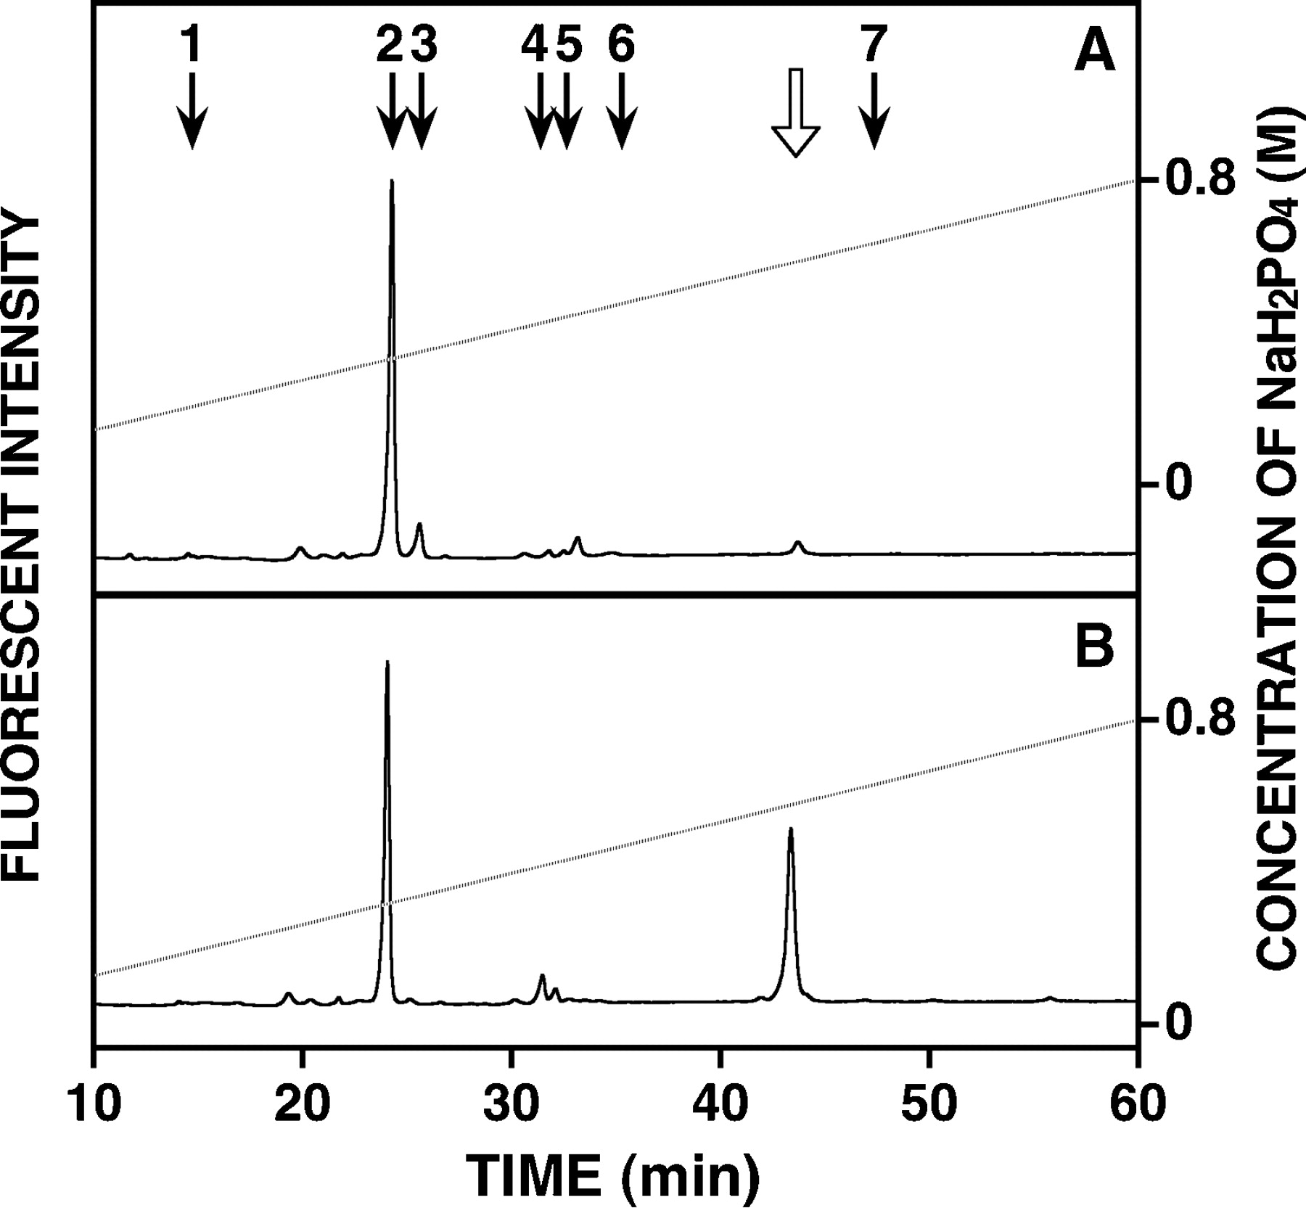
Fig. 6 Analysis of the reducing terminal structure in the degradation products of CS-A and CS-C. CS-A (A) and CS-C ...
Notes:
Fig. 6 Analysis of the reducing terminal structure in the degradation products of CS-A and CS-C. CS-A (A) and CS-C (B) were digested individually with CSHY. Each digest was derivatized with 2AB and analyzed after digestion with CSase AC-II by anion-exchange HPLC using an NaH2PO4 gradient (indicated by the dashed lines). The numbered arrows in panels A indicate the elution positions of the 2AB-derivatives of authentic disaccharides (see the legend to Figure 5). The open arrow in panel A indicates the elution position of the 2AB-derivative of the unsaturated tetrasaccharide, ΔHexUA-GalNAc(4S)-GlcUA(2S)-GalNAc(6S) (Deepa et al. 2007).
Unless provided in the caption above, the following copyright applies to the content of this slide: © Oxford University Press 2009

Slide 7
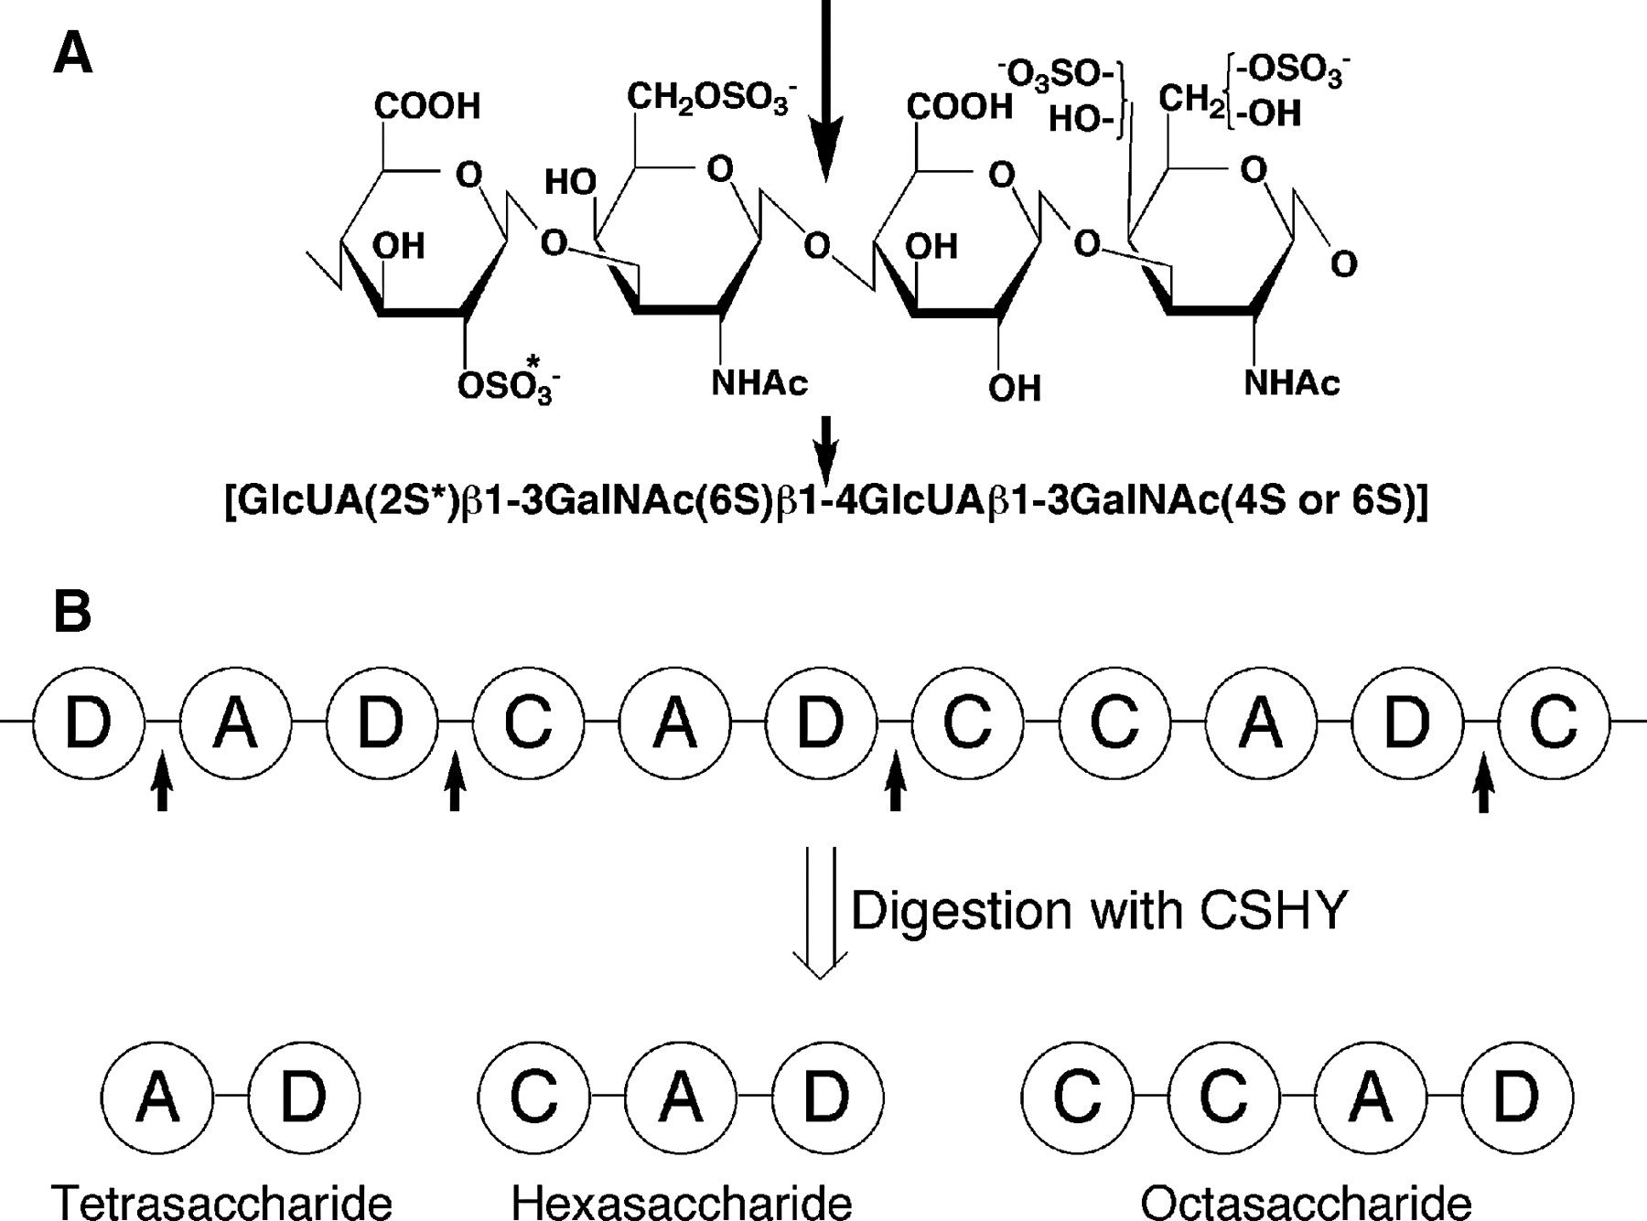
Fig. 7 Structure of the site of cleavage by CSHY in CS. (A) The arrow indicates the galactosaminidic linkage cleaved ...
Notes:
Fig. 7 Structure of the site of cleavage by CSHY in CS. (A) The arrow indicates the galactosaminidic linkage cleaved by CSHY. A sulfated structure appears to be critical for the hydrolytic action of the enzyme. The 6-O-sulfate group on the GalNAc residue on the nonreducing side of the cleavage site is essential, and 4-O- or 6-O-sulfation on the GalNAc residue on the reducing side of the cleavage site is important for recognition by the enzyme. The 2-O-sulfate group on the GlcUA residue on the nonreducing side indicated by an asterisk appears to have a promoting effect on the hydrolytic action of CSHY. (B) A representative saccharide sequence in CS-D is shown. Disaccharide units are depicted as circles. A, C, and D in the circles stand for A unit, C unit, and D unit, respectively. The glycosidic bonds on the reducing side of D units are preferentially hydrolyzed by CSHY as indicated by black arrows, giving tetra-, hexa-, and octasaccharides as major degradation products.
Unless provided in the caption above, the following copyright applies to the content of this slide: © Oxford University Press 2009

Slide 8
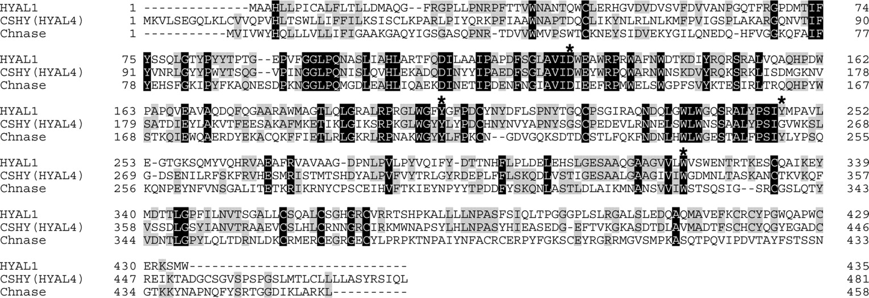
Fig. 8 Comparison of CSHY with HYAL1 and C. elegans Chn hydrolase. Multiple sequence alignment of CSHY (HYAL4) with ...
Notes:
Fig. 8 Comparison of CSHY with HYAL1 and C. elegans Chn hydrolase. Multiple sequence alignment of CSHY (HYAL4) with HYAL1 and C. elegans Chn hydrolase (Chnase) is shown using the ClustalW multiple sequence alignment program (version 1.83) (http://align.genome.jp/clustalw/). Introduced gaps are shown by hyphens, and aligned identical residues are boxed (black for all sequences and dark gray for two sequences). Asterisks indicate the amino acid residues, which are conserved strictly among the human hyaluronidases and supposed to be responsible for their hydrolytic activity (Stern and Jedrzejas 2006). Note that Cys263 in HYAL4 reported by Csóka et al. (1999) (accession number: AF009010) was replaced here by Gly263 in the sequence of the HYAL4 gene cloned by us (accession number: AB470346) and Mammalian Gene Collection Program Team (accession numbers: BC104788 and BC104790) as well as in the human genomic DNA (accession number: NT_007933).
Unless provided in the caption above, the following copyright applies to the content of this slide: © Oxford University Press 2009

