Slide 1
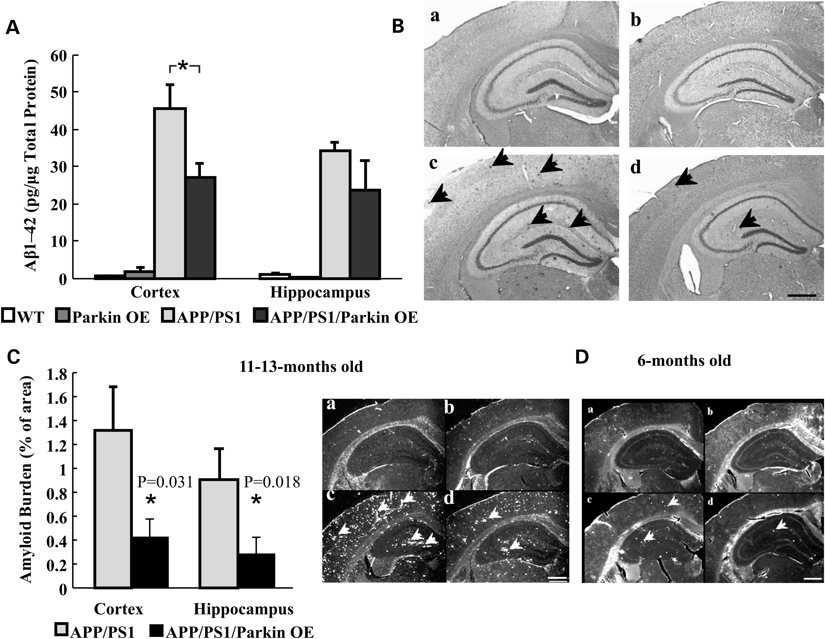
Figure 4. β-Amyloid and amyloid plaques in the cortex and the hippocampus of transgenic and WT mice. (A) Parkin ...
Notes:
Figure 4. β-Amyloid and amyloid plaques in the cortex and the hippocampus of transgenic and WT mice. (A) Parkin overexpression reduces β-amyloid levels in 6-month-old triple transgenic mice. Levels of total β-amyloid levels in the cortex and the hippocampus are expressed as pg/µg protein (n = 3–7 per group). (B) The appearance of β-amyloid plaques was evaluated using Congo-Red staining. Brightfield images show typical Congo-Red staining of the cortex and the hippocampus of 11–13-month-old mice as well amyloid plaques (black arrows). The number of dark spots was markedly reduced in sections of (D) APP/PS1/Parkin OE mice. (C) Plaques burden was determined by thioflavin-S staining. The area of amyloid plaques was determined and normalized to the total area. Fluorescence images indicate the distribution of amyloid plaques (white arrows) in the cortical and hippocampal area of 11–13-month-old mice. (D) Representative fluorescence image of thioflavin-S staining of sections from 6-month-old mice. Representative fluorescent images in (B, C and D) indicate sections from (a) WT, (b) Parkin OE, (c) APP/PS1 and (d) APP/PS1/Parkin OE mice (n = 4–13 per group). Scale bars: 500 µm. Data are expressed as means ± SEM (*/**P < 0.05).
Unless provided in the caption above, the following copyright applies to the content of this slide: © The Author 2013. Published by Oxford University Press. All rights reserved. For Permissions, please email: journals.permissions@oup.com

Slide 2
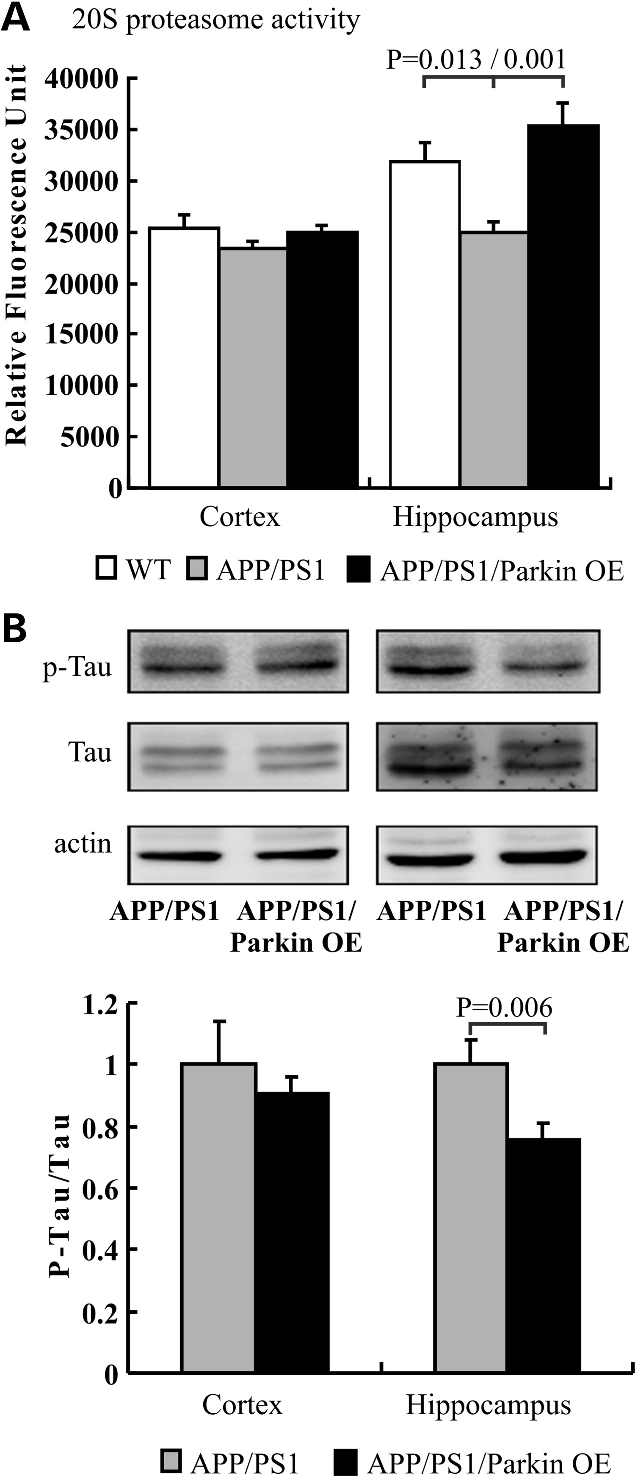
Figure 3. Overexpression of Parkin alters proteasome activity and p-Tau/Tau ratio. (A) The hippocampal 20S proteasome ...
Notes:
Figure 3. Overexpression of Parkin alters proteasome activity and p-Tau/Tau ratio. (A) The hippocampal 20S proteasome activity was significantly reduced in APP/PS1 mice in comparison with WT mice and was found to be recovered to WT levels in APP/PS1/Parkin OE. (B) Western blotting of p-Tau and Tau revealed a significant difference of the p-Tau/Tau ratio in the hippocampus of APP/PS1 and APP/PS1/Parkin OE mice. Values from WT and Parkin OE mice served as a negative control. Data are expressed as means ± SEM and the significance of group differences is indicated with brackets and calculated P-values.
Unless provided in the caption above, the following copyright applies to the content of this slide: © The Author 2013. Published by Oxford University Press. All rights reserved. For Permissions, please email: journals.permissions@oup.com

Slide 3
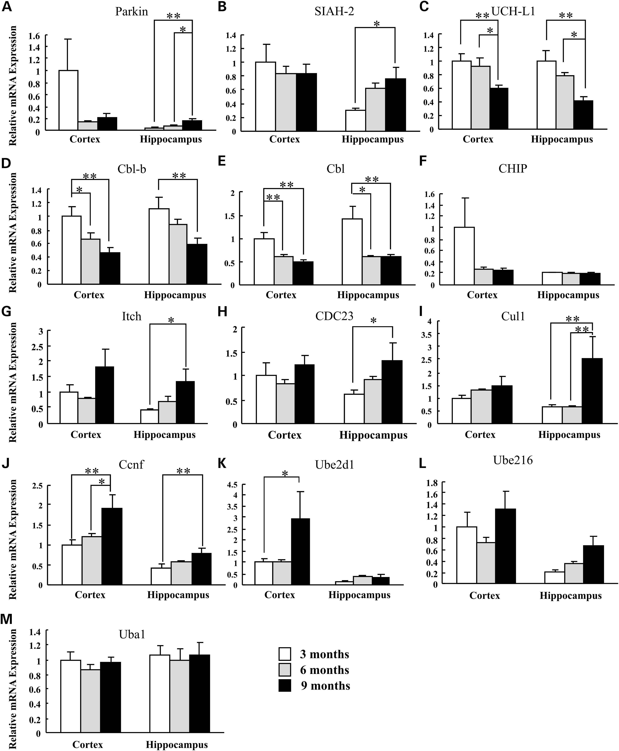
Figure 1. Age dependency of the transcript level of UPS-related genes in the cortex and hippocampus of C57BL/6J mice. ...
Notes:
Figure 1. Age dependency of the transcript level of UPS-related genes in the cortex and hippocampus of C57BL/6J mice. Mice were 3-month- (white column), 6-month- (black column) and 9-month-old (gray column). (A–J) Bar diagrams summarize the relative expression levels of E3 ligases Parkin, SIAH-2, UCH-L1, Cbl-b, Cbl, CHIP, Itch, CDC23, Cul1 and Ccnf. (K–M) Relative expression levels of E2 conjugation enzymes Ube2d1, Ube2l6 and E1 activation enzyme Uba1 are shown. mRNA expression levels were normalized to the amount of β-actin mRNA. Data are presented as means ± SEM (*P < 0.05 or **P < 0.01, n = 8–12).
Unless provided in the caption above, the following copyright applies to the content of this slide: © The Author 2013. Published by Oxford University Press. All rights reserved. For Permissions, please email: journals.permissions@oup.com

Slide 4
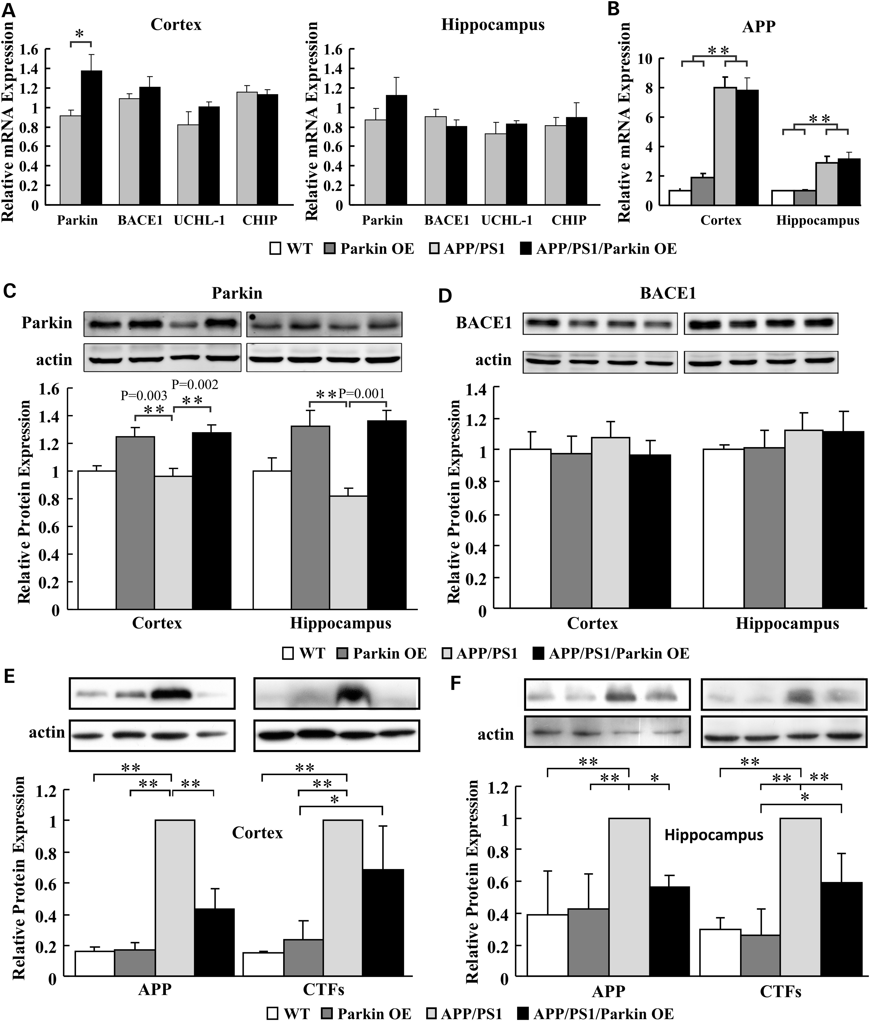
Figure 2. Transcript and post-translational levels of Parkin, BACE1, APP and CTFs in the cortex and the hippocampus of ...
Notes:
Figure 2. Transcript and post-translational levels of Parkin, BACE1, APP and CTFs in the cortex and the hippocampus of 11–13-month-old mice. (A) Transcript levels of Parkin, BACE1, UCHL-1 and CHIP are presented for APP/PS1 and APP/PS1/Parkin OE mice. (B) mRNA levels of APP in the cortex and the hippocampus of four different mouse strains are shown. Relative protein expression levels for Parkin (C) and BACE1 (D) in the cortex and the hippocampus of different mouse strains are indicated. Expression levels of APP and CTFs in the cortex and the hippocampus are summarized in diagram (E) and (F), respectively. White, dark gray, light gray and black colored bars correspond to values from WT, Parkin OE, APP/PS1 and APP/PS1/Parkin OE mice, respectively. Positions of lanes of western blot inserts correspond with bar location. Data are normalized to corresponding β-actin levels and expressed as means ± SEM (brackets with *P < 0.05, **P < 0.01, n = 3–4).
Unless provided in the caption above, the following copyright applies to the content of this slide: © The Author 2013. Published by Oxford University Press. All rights reserved. For Permissions, please email: journals.permissions@oup.com

Slide 5
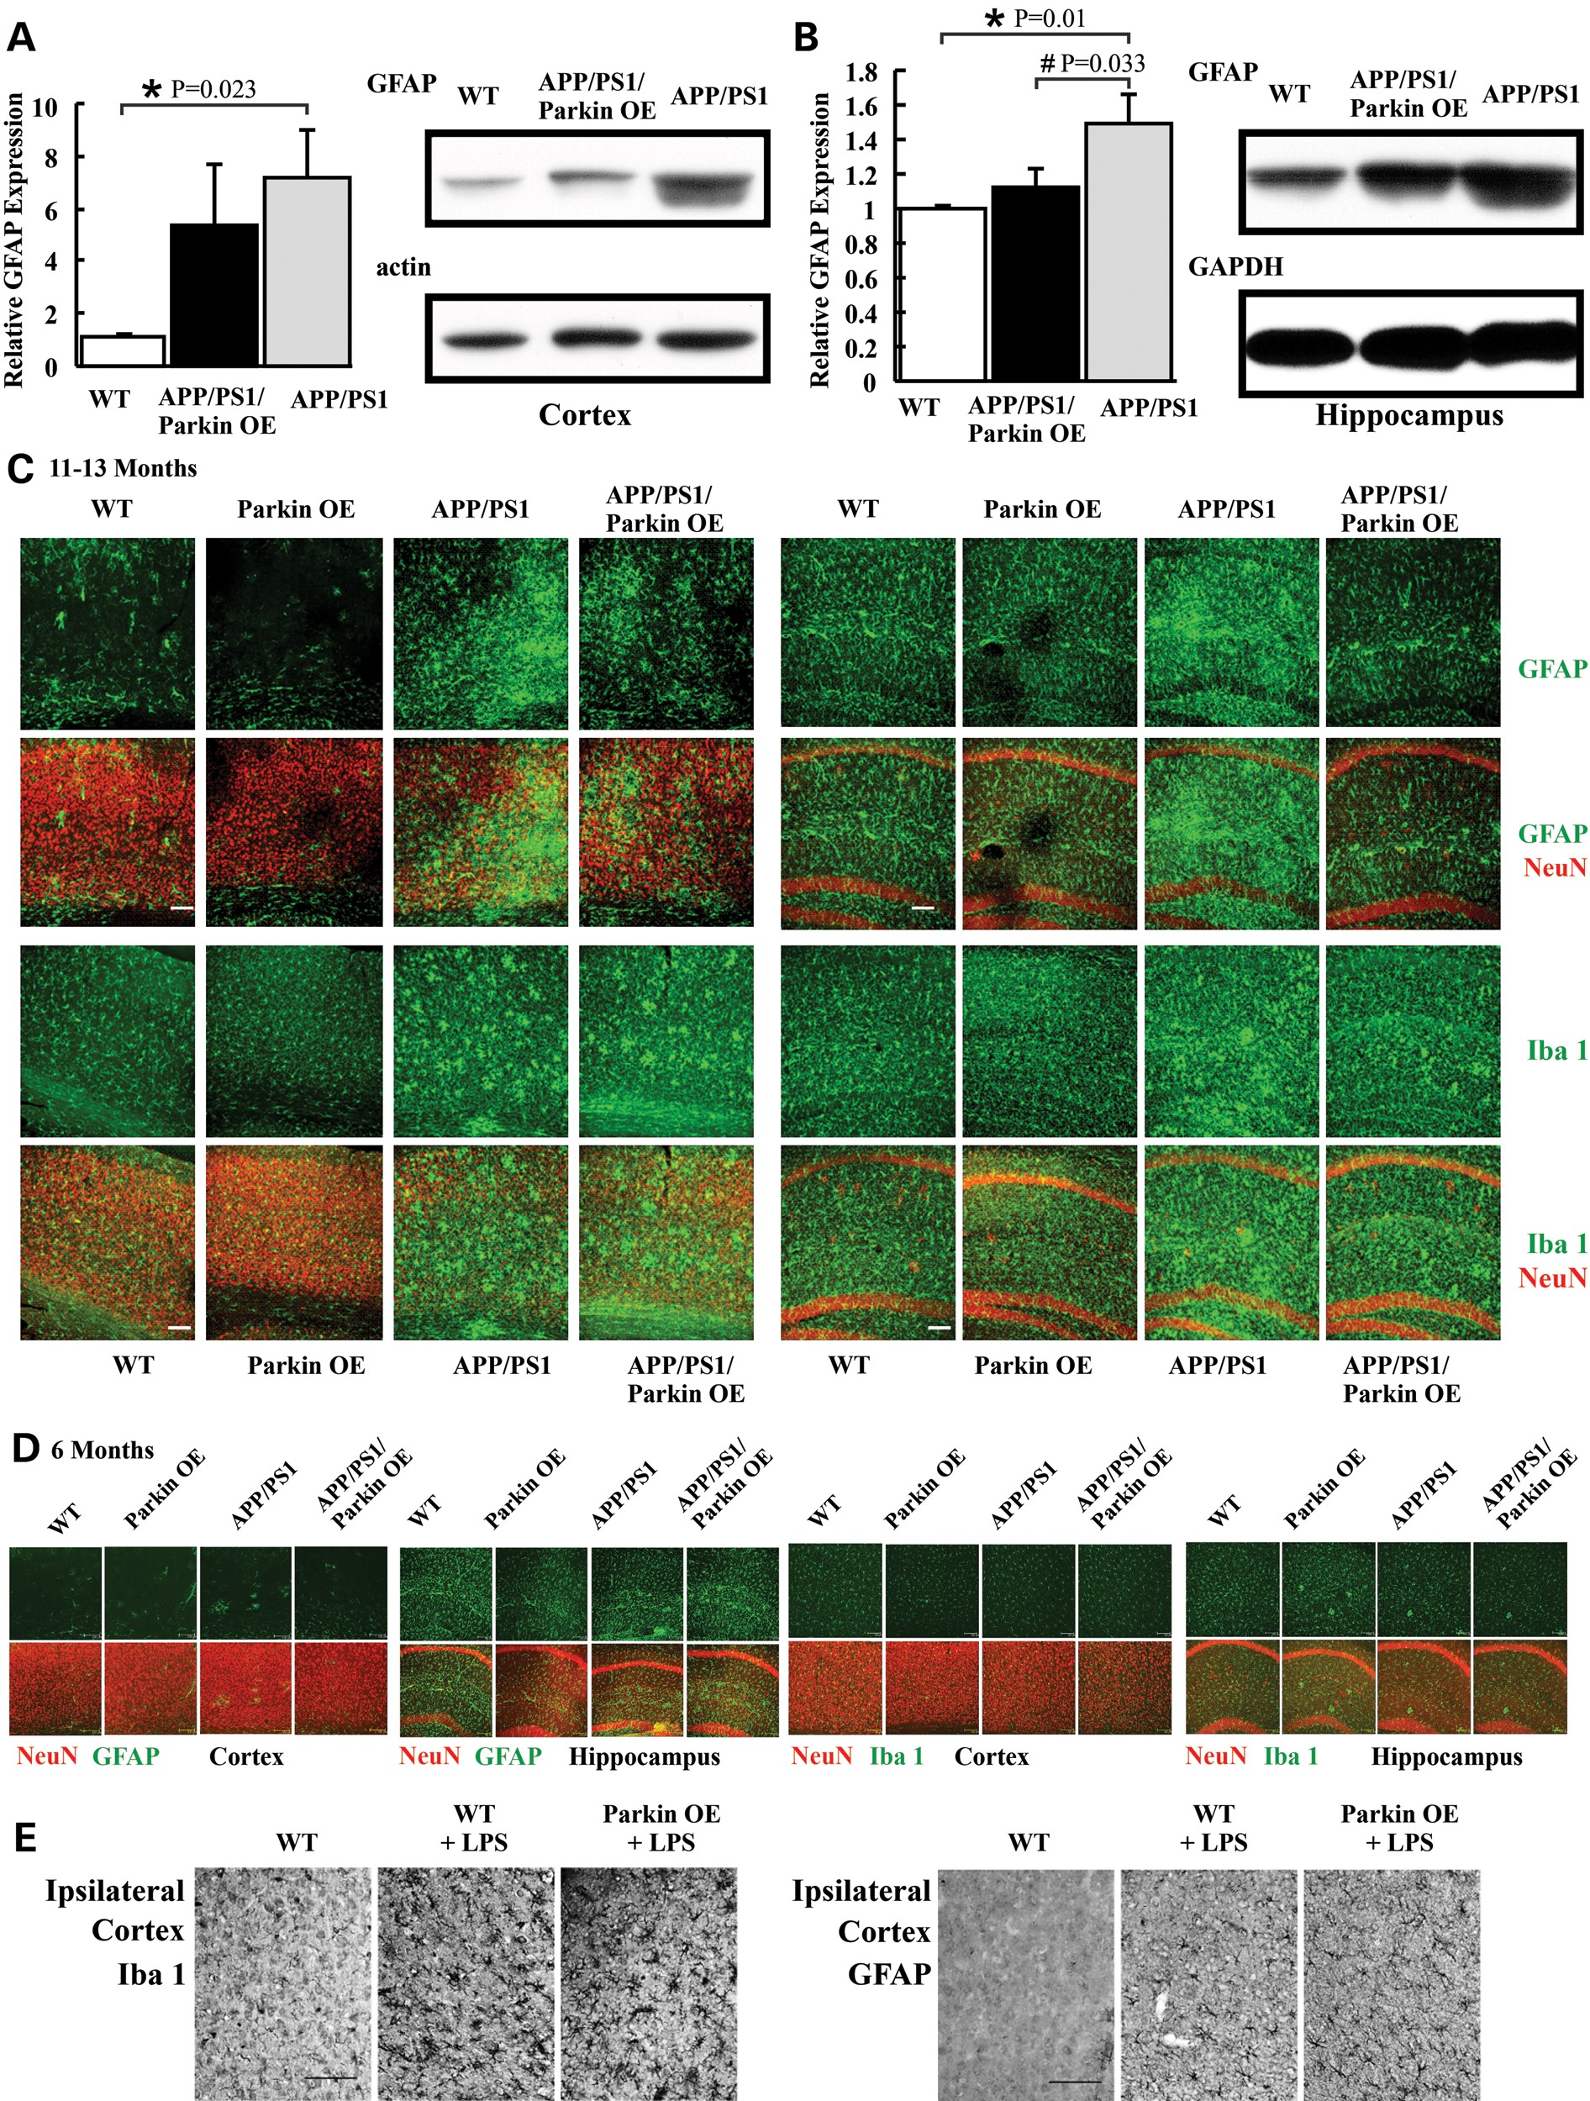
Figure 5. Activation of astrocytes but not microglia is ameliorated in 11–13-month-old APP/PS1/Parkin OE mice. (A) ...
Notes:
Figure 5. Activation of astrocytes but not microglia is ameliorated in 11–13-month-old APP/PS1/Parkin OE mice. (A) Representative western blots (right) and the diagram show the GFAP expression level in the cortex for WT, APP/PS1/Parkin OE and APP/PS1 mice. (B) Blots and data are presented for the GFAP expression level in the hippocampus. Parkin overexpression reduced the GFAP level in comparison with APP/PS1 mice in the cortex and the hippocampus. Data are expressed as means ± SEM (*P < 0.05; #P < 0.01, n = 3). (C) Representative fluorescence images of GFAP (green) and merged with NeuN (red) for cortex (left) and hippocampus (right) of the indicated mouse strains are depicted. The immunosignal for GFAP was increased in APP/PS1 mice and reduced in APP/PS1/Parkin OE mice. Immunofluorescence images for the microglia marker Iba 1 (green) and merged with NeuN (red) are presented. (D) No difference in GFAP staining was seen in sections from the different strains of 6-month-old mice. (E) LPS injection into striatum-induced expression of Iba 1 and GFAP in 12-month-old WT, WT + LPS and Pakin OE + LPS. Scale bar: 100 µm.
Unless provided in the caption above, the following copyright applies to the content of this slide: © The Author 2013. Published by Oxford University Press. All rights reserved. For Permissions, please email: journals.permissions@oup.com

Slide 6
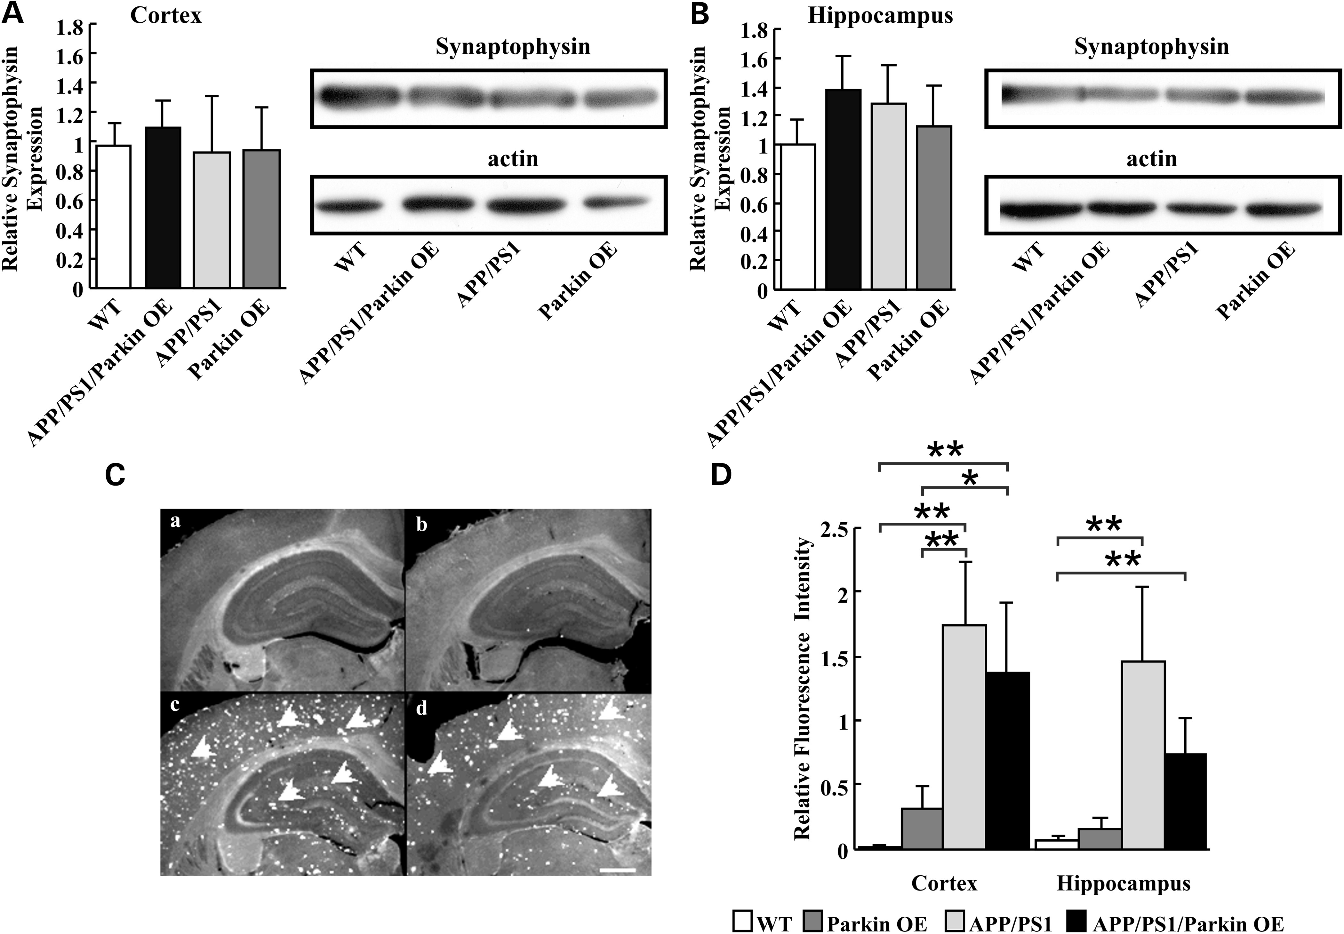
Figure 6. Synaptophysin expression and neurodegeneration in the cortex and the hippocampus of transgenic and WT mice. ...
Notes:
Figure 6. Synaptophysin expression and neurodegeneration in the cortex and the hippocampus of transgenic and WT mice. (A) The depicted western blot indicates the expression level of synaptophysin in the cortex of 11–13-month-old mouse strains with different genotypes. The relative expression level of synaptohpysin is summarized in the bar diagram. (B) Data are presented for synaptohpysin expression in the hippocampus. No changes in the expression level were detectable in the cortex or the hippocampus for the different mouse strains (n = 3 each group). β-Actin served as the internal control. (C) The level of neurodegeneration in the cortex and the hippocampus was evaluated using Fluoro-Jade B staining. White arrows indicate typical spots of degenerating neurons in the fluorescence images of the cortex and the hippocampus from (a) WT; (b) Parkin OE; (c) APP/PS1 and (d) APP/PS1/Parkin OE mice. Parkin overexpression reduced the amount of degenerating neurons only partially. Scale bars: 500 µm. All data are expressed as means ± SEM, *P < 0.05, **P < 0.01, n = 7–17.
Unless provided in the caption above, the following copyright applies to the content of this slide: © The Author 2013. Published by Oxford University Press. All rights reserved. For Permissions, please email: journals.permissions@oup.com

Slide 7
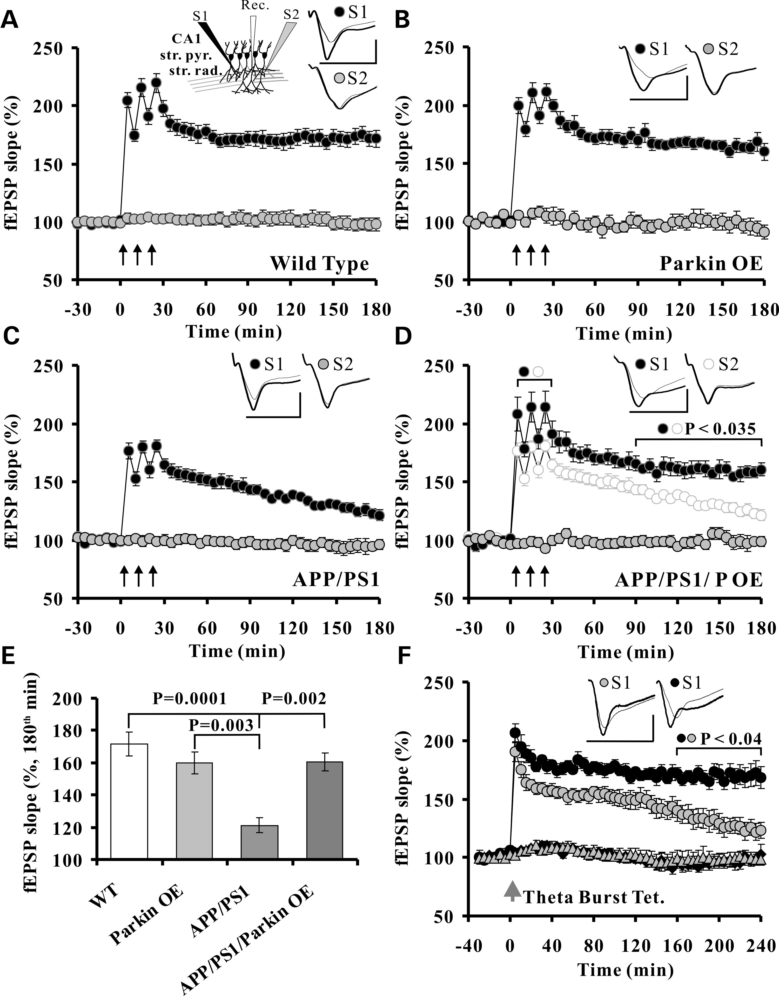
Figure 7. Parkin overexpression restores hippocampal long-term potentiation in APP/PS1 mice. (A) The insert represents ...
Notes:
Figure 7. Parkin overexpression restores hippocampal long-term potentiation in APP/PS1 mice. (A) The insert represents relative positions of electrodes within hippocampal slice. Activity-dependent synaptic plasticity was induced in input S1 by 1-s 100 Hz stimuli [3× high-frequency stimulation (HFS)]. Baseline stability was monitored at input S2. LTP in the acute slices of WT mice was stable for at least 180 min; (B) Parkin overexpression did not alter LTP; (C) fEPSP-slope potentiation in the slices from APP/PS1 transgenic mice declined significantly in comparison with the control and Parkin group; (D) Parkin overexpression prevented APP/PS1-related decay of fEPSP potentiation. fEPSPs of the non-tetanized input S2 remained stable in all groups. Inserts indicate fEPSP traces before tetanization and 180 min after. Scale bars: horizontal: 10 ms; vertical: 1 mV. (E) Bar diagram summarizes averaged group values at the 180th min for different mouse strains. Mice were 6–8-month-old, n = 5–10 per group. (F) Theta-burst stimulation (2 × 5 bursts with 10 stimuli at 100 Hz every 30 s) evoked a transient LTP in APP/PS1 mice (gray, n = 8), which was rescued by Parkin overexpression (black, n = 5). Brackets indicate a significant difference between groups.
Unless provided in the caption above, the following copyright applies to the content of this slide: © The Author 2013. Published by Oxford University Press. All rights reserved. For Permissions, please email: journals.permissions@oup.com

Slide 8
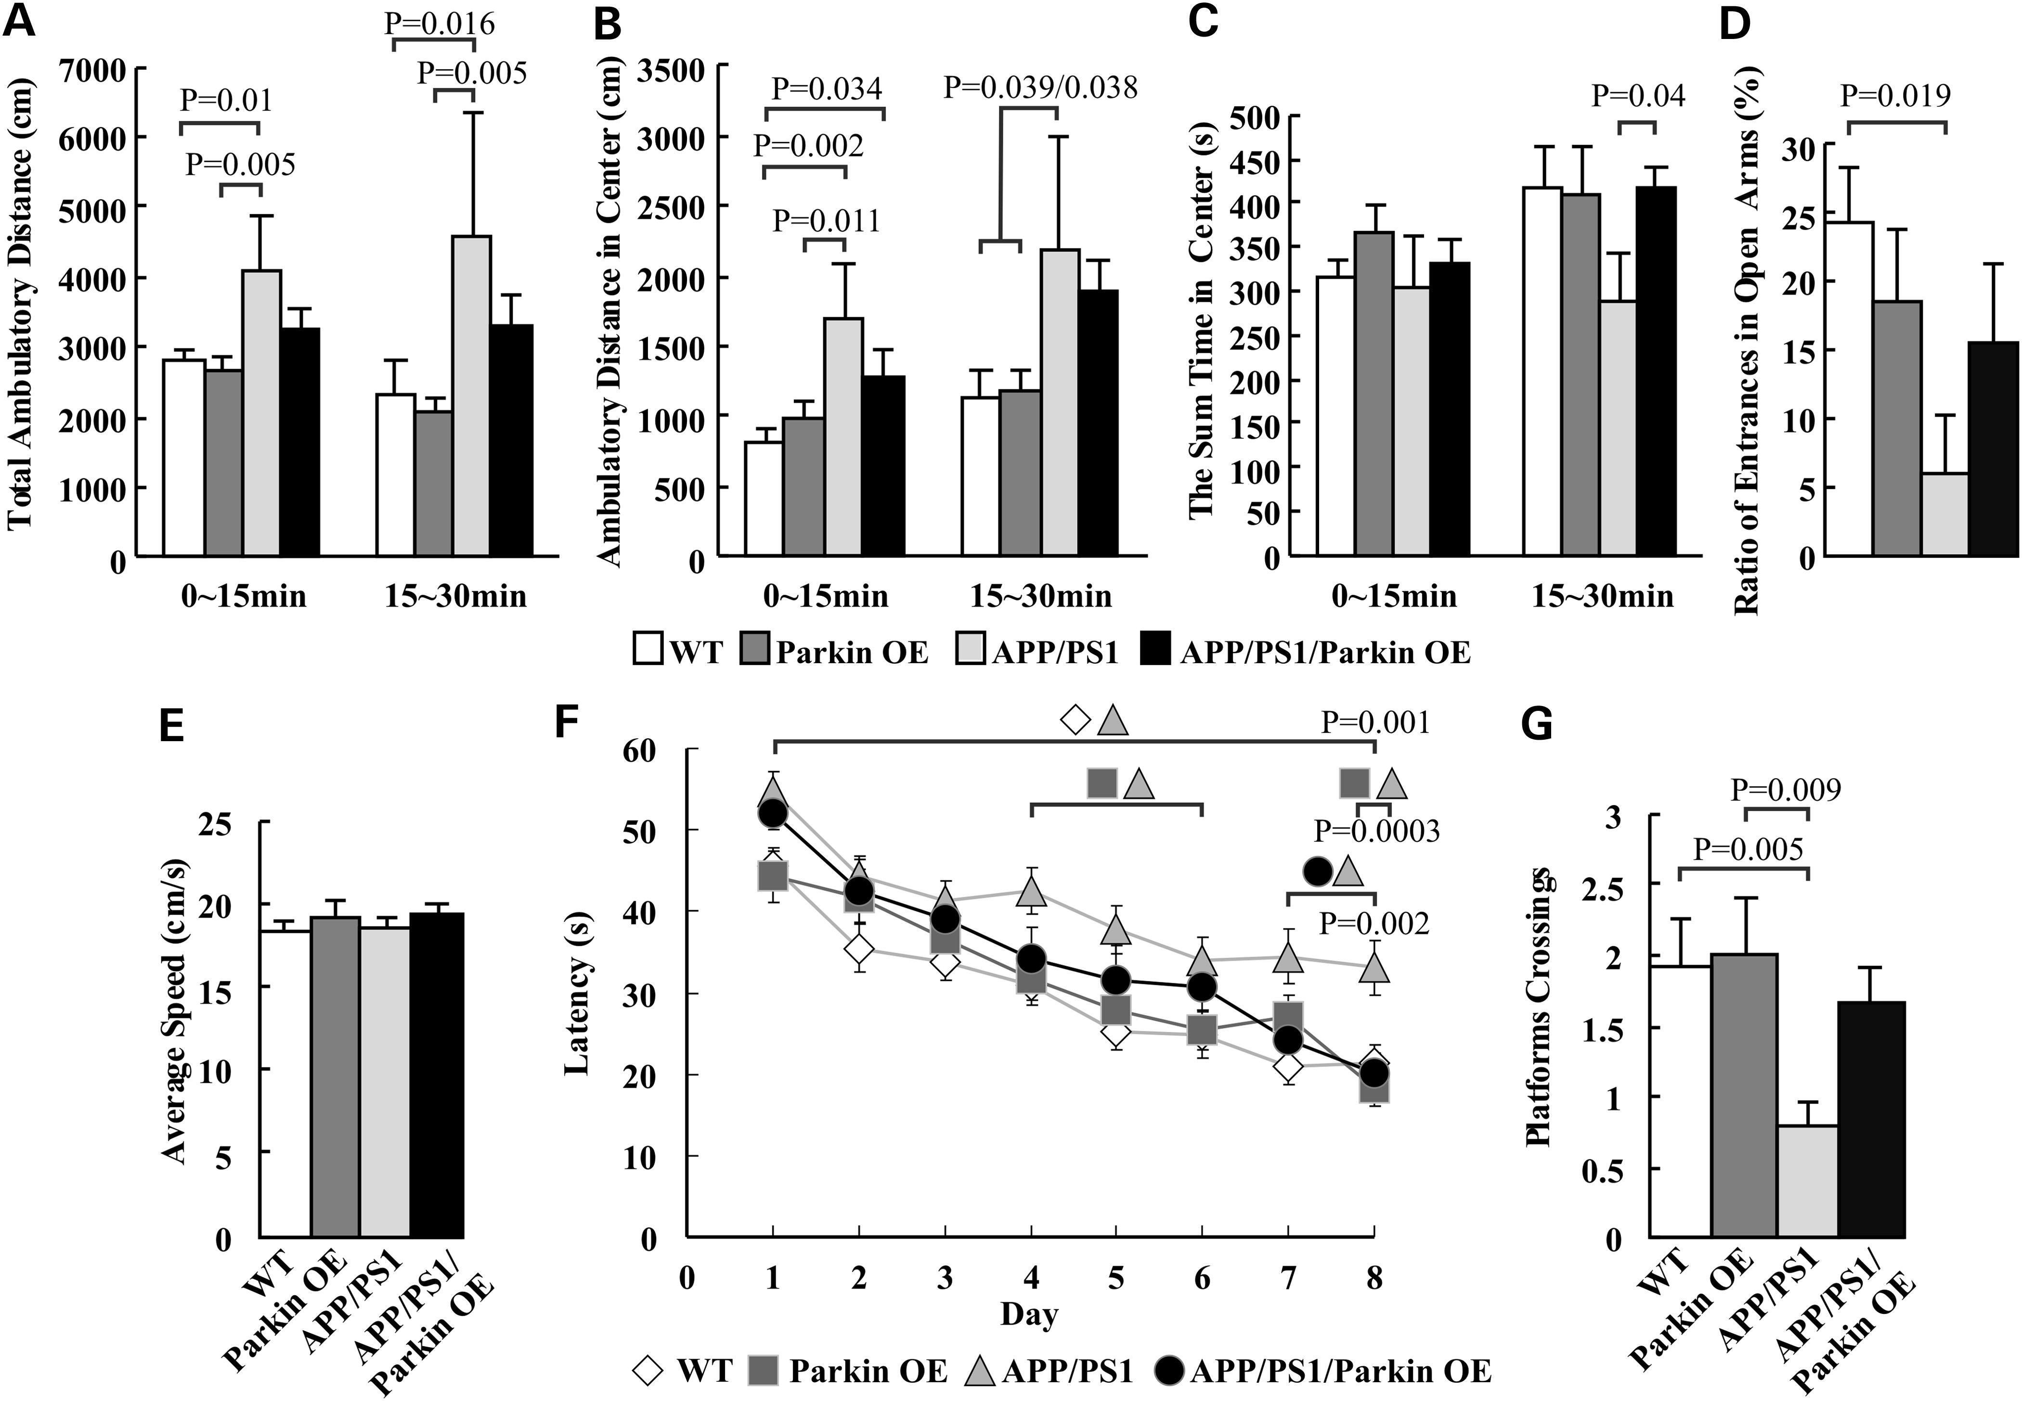
Figure 8. Parkin restores behavioral deficits of APP/PS1 mice in open-field test (A–C), elevated plus-maze test (D) and ...
Notes:
Figure 8. Parkin restores behavioral deficits of APP/PS1 mice in open-field test (A–C), elevated plus-maze test (D) and Morris water maze (E–G). The diagram (A) summarizes the total ambulatory distance (cm) for each of the four different mouse strains (6-month-old, n = 8–20 per group) in the open-field test for the first and second 15 min of observation. APP/PS1 mice showed a significant increase in travel distance, which was reduced by Parkin. (B) Similar results were obtained for their ambulatory distance in centre. (C) The time spent in the centre was only different for the second observation interval indicating a faster movement of the APP/PS1 mice. Data for the elevated plus-maze test are summarized in the diagram (D), presenting the ratio of open arm entries to total entries (9–10-month-old, n = 7–17 per group). Spatial learning and memory performance was tested using Morris water maze and data summarized in diagram (E) to (G) (n = 14–25). The bar diagram (E) represents the average swimming speed for different groups. (F) The average escape latency (four trails per day) for eight consecutive days and (G) crossing times over the former platform location in the probe test are presented. The escape latency was significant different (P < 0.05) at Day 8 between APP/PS1/Parkin OE versus APP/PS1, APP/PS1 versus Parkin OE and APP/PS1 versus WT. In diagram (F) calculated P-values are indicated for Day 8. Data are expressed as means ± SEM. Significance level for between certain groups are indicated with brackets (P < 0.05 or calculate P-values) and corresponding symbols.
Unless provided in the caption above, the following copyright applies to the content of this slide: © The Author 2013. Published by Oxford University Press. All rights reserved. For Permissions, please email: journals.permissions@oup.com

