Slide 1
FIGURE 1. Case 1. A, angiogram after deployment of the first Pipeline embolization device (PED; lateral view). B, ...
Notes:
FIGURE 1. Case 1. A, angiogram after deployment of the first Pipeline embolization device (PED; lateral view). B, angiogram after deployment of the third PED showing excellent parent vessel reconstruction (lateral view). C, postoperative noncontrast cranial computed tomographic scan 6 days later showing a Fisher grade 4 subarachnoid hemorrhage.
Unless provided in the caption above, the following copyright applies to the content of this slide: © 2008 by the Congress of Neurological Surgeons

Slide 2
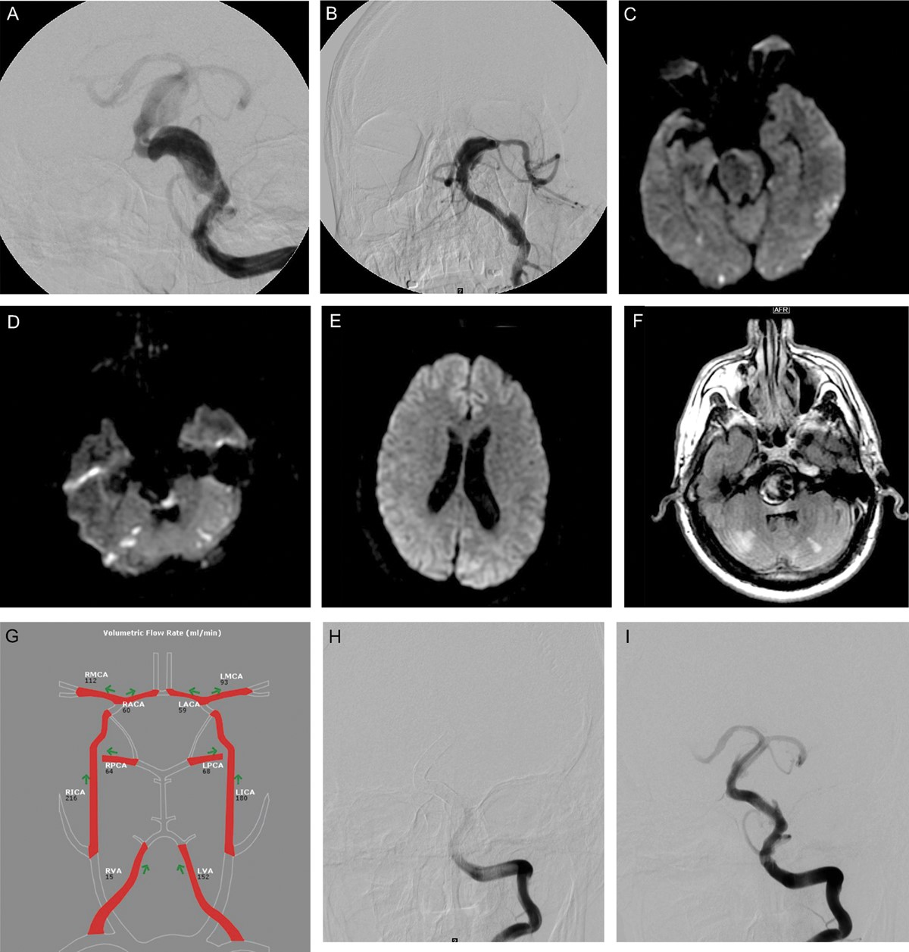
FIGURE 2. Case 2. A, anteroposterior (AP) view of left vertebral artery injection demonstrating large vertebrobasilar ...
Notes:
FIGURE 2. Case 2. A, anteroposterior (AP) view of left vertebral artery injection demonstrating large vertebrobasilar fusiform aneurysm. B, posttreatment AP angiogram. Clockwise from top left: (C) magnetic resonance (MR) imaging demonstrating numerous areas of positive diffusion-weighted imaging changes in the bilateral occipital lobes, (D) bilateral cerebellum, (E) large thrombosed aneurysm compressing the brainstem, and (F) medial left occipital mild diffusion positivity. G, quantitative MR angiography demonstrating nearly symmetric cerebral blood flow in both posterior cerebral arteries despite the absence of flow detection in the basilar artery, presumably caused by artifact. H, final AP angiographic view (early filling) of the left vertebral artery injection. I, final AP angiographic view (later arterial filling) of the left vertebral artery injection. Reproduced from Siddiqui et al8 with permission from the publisher. © 2012 American Association of Neurological Surgeons.
Unless provided in the caption above, the following copyright applies to the content of this slide: © 2008 by the Congress of Neurological Surgeons

Slide 3
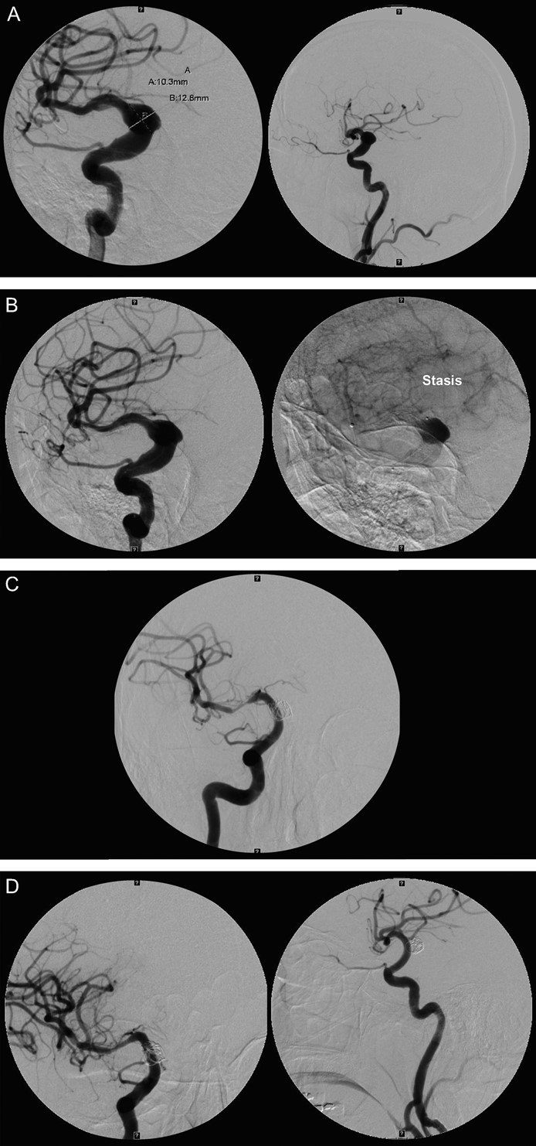
FIGURE 3. Case 3. A, initial angiogram injection showing a large fusiform aneurysm of the right supraclinoid carotid ...
Notes:
FIGURE 3. Case 3. A, initial angiogram injection showing a large fusiform aneurysm of the right supraclinoid carotid artery (left, anteroposterior [AP] view; right, lateral view). B, final angiographic runs showing significant stasis in the aneurysm (left, AP view; right, lateral view). C, 3-month follow-up angiogram showing significant distal in-stent stenosis (AP view). D, excellent results with balloon angioplasty (left, AP view; right, lateral view).
Unless provided in the caption above, the following copyright applies to the content of this slide: © 2008 by the Congress of Neurological Surgeons

