Slide 1
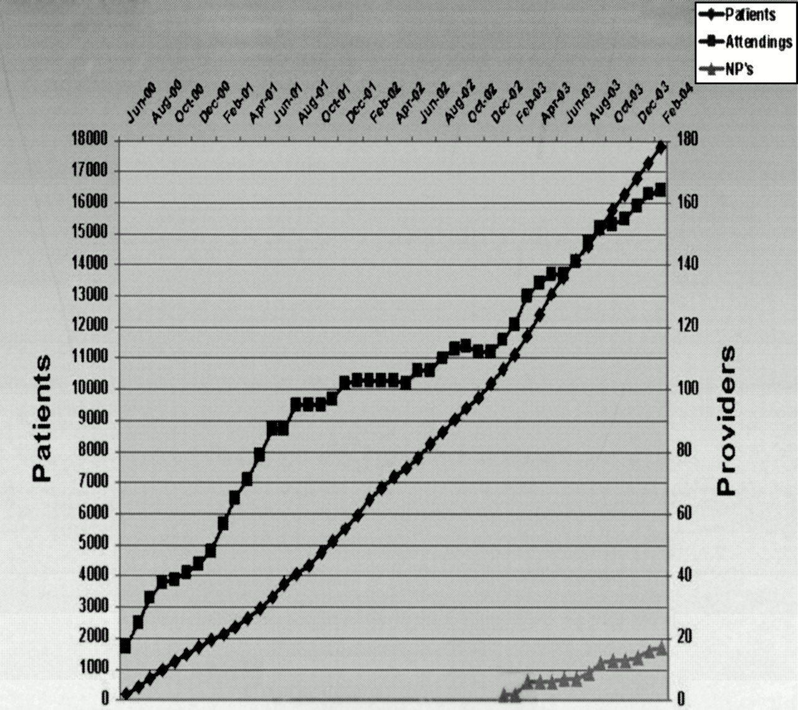
Figure 1 PatientSite active users.
Notes:
Figure 1 PatientSite active users.
Unless provided in the caption above, the following copyright applies to the content of this slide: American Medical Informatics Association

