Slide 1
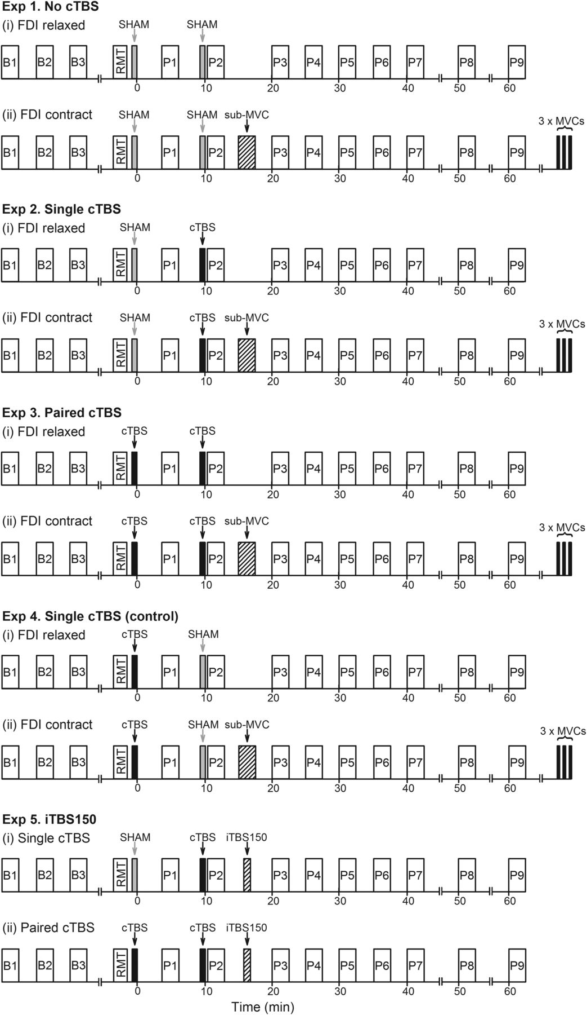
Figure 1. Schematic overview of experimental design. Open rectangles designate blocks of 15 MEP trials measured with ...
Notes:
Figure 1. Schematic overview of experimental design. Open rectangles designate blocks of 15 MEP trials measured with single-pulse TMS at baseline (B1–3) and postintervention (P1–9). All experiments were conducted with the FDI at rest. “FDI contract” as a condition only refers to the 2-min sub-MVC performed after the stimulation protocols and not during MEP measurement. Three maximal voluntary contractions (MVCs) were performed at the end of each FDI contract session for each subject.
Unless provided in the caption above, the following copyright applies to the content of this slide: © The Author 2014. Published by Oxford University Press. All rights reserved. For Permissions, please e-mail: journals.permissions@oup.com

Slide 2
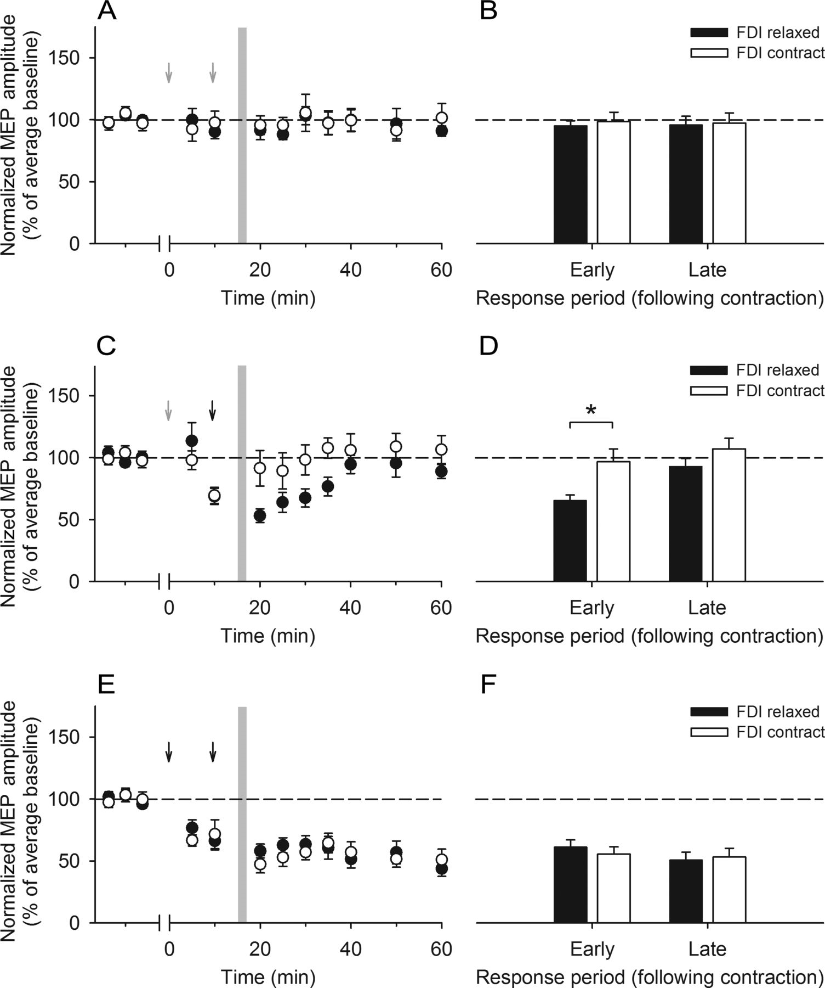
Figure 2. The influence of a sub-MVC (gray column) on MEP responses (expressed as a percentage of the average baseline) ...
Notes:
Figure 2. The influence of a sub-MVC (gray column) on MEP responses (expressed as a percentage of the average baseline) to no cTBS (Experiment 1; A and B), single cTBS (Experiment 2; C and D), and paired cTBS (Experiment 3; E and F). Gray arrows indicate delivery of sham cTBS, while the black arrows indicate delivery of real cTBS. The early and late response time periods used for the pooling MEP data were based on the duration of MEP depression observed for the single cTBS, FDI relaxed condition. (A) There was no change in MEP amplitudes from baseline levels following paired sham protocols for both the FDI relaxed (filled circles) and FDI contract (open circles) conditions. (B) Likewise, postcontraction MEPs pooled into early and late response periods did not differ between the conditions. (C) MEP amplitudes were depressed following single cTBS for the FDI relaxed condition; however, no MEP depression was observed following the contraction for the FDI contract condition. (D) A significant de-depression of MEP amplitudes was observed for MEPs pooled into the early response period following the contraction. (E) There was pronounced depression of MEP amplitudes from baseline levels following paired cTBS protocols for both the FDI relaxed and FDI contract conditions. (F) Postcontraction MEPs pooled into early and late response periods did not differ between the conditions. *P ≤ 0.05, when FDI relaxed and FDI contract conditions are compared. Data are shown as group means ± standard errors of the mean.
Unless provided in the caption above, the following copyright applies to the content of this slide: © The Author 2014. Published by Oxford University Press. All rights reserved. For Permissions, please e-mail: journals.permissions@oup.com

Slide 3
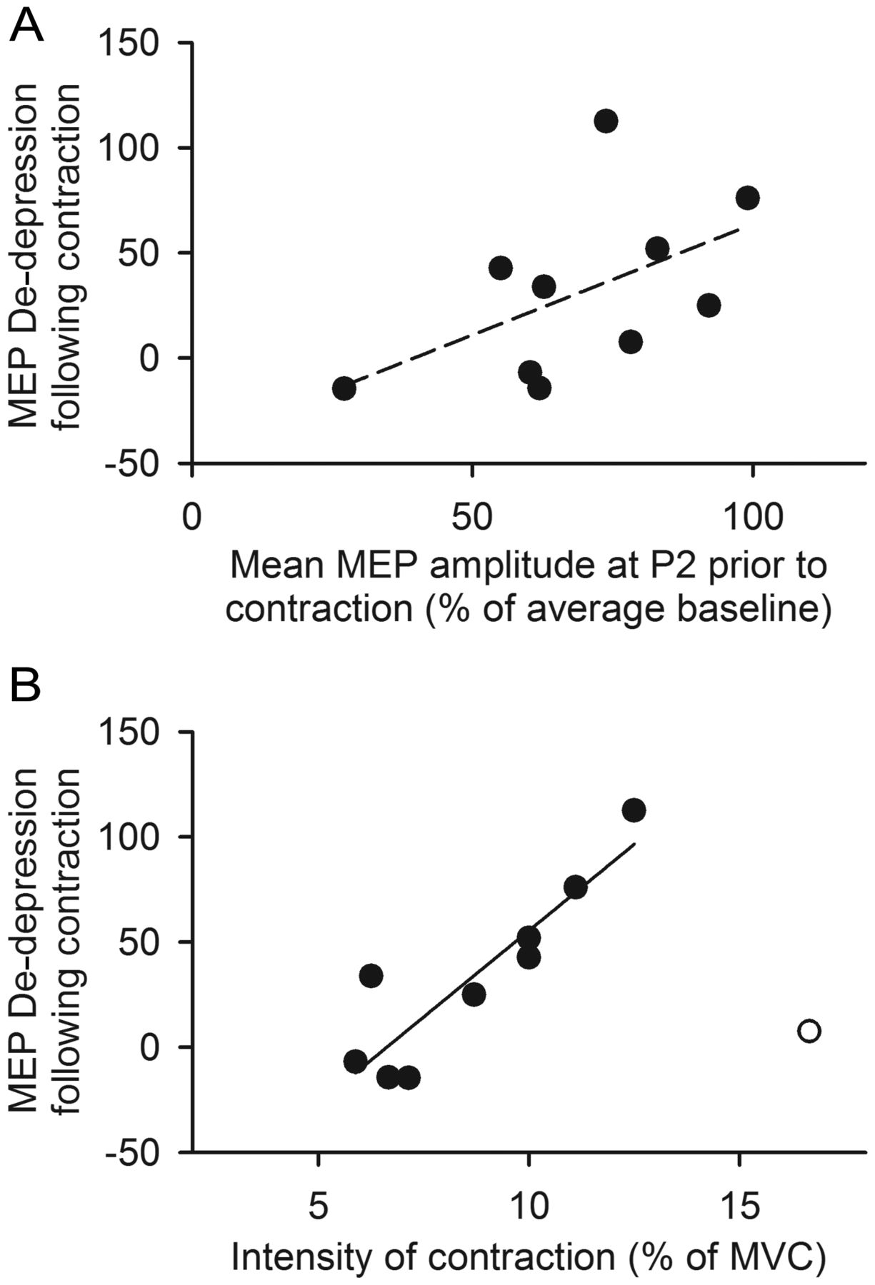
Figure 3. Factors affecting the de-depression of single cTBS-induced MEP depression by a voluntary contraction ...
Notes:
Figure 3. Factors affecting the de-depression of single cTBS-induced MEP depression by a voluntary contraction (Experiment 2). Each data point represents results from an individual subject. MEP de-depression was calculated by subtracting the pooled MEP data (expressed as a percentage of the average baseline) recorded during the early response period following the contraction for the FDI relaxed condition from that recorded during the same period for the FDI contract condition (i.e., values >0 indicate MEP de-depression). (A) There tended to be less MEP de-depression in subjects that responded to single cTBS with greater MEP depression (shown as a smaller mean MEP amplitude recorded prior to the contraction at P2, expressed as a percentage of the average baseline). However, this relationship did not reach statistical significance (r = 0.53, P = 0.12). (B) Subjects that performed a higher intensity contraction (expressed as a percentage of their MVC) showed a greater MEP de-depression [r = 0.90, P = 0.001, excluding an outlier (open circle)].
Unless provided in the caption above, the following copyright applies to the content of this slide: © The Author 2014. Published by Oxford University Press. All rights reserved. For Permissions, please e-mail: journals.permissions@oup.com

Slide 4
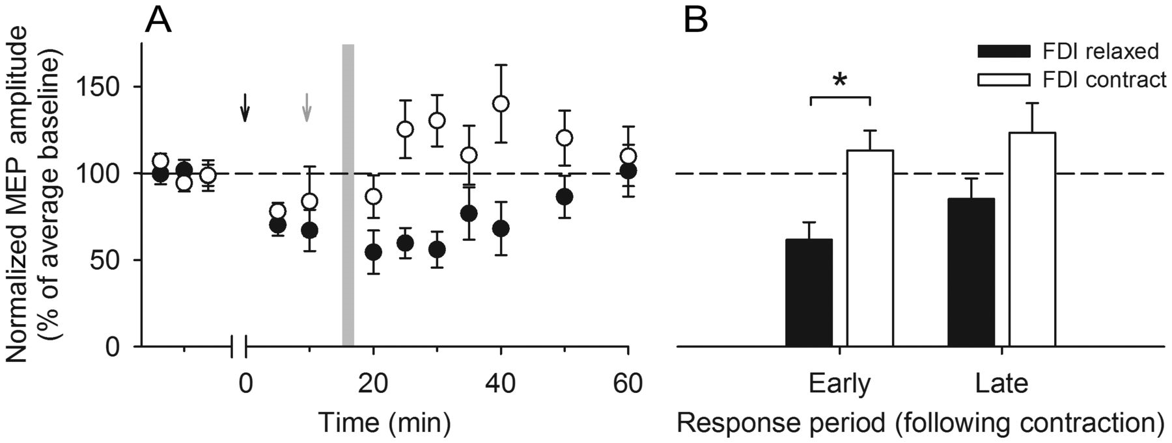
Figure 4. The effect of the time interval separating single cTBS and the voluntary contraction on MEP de-depression ...
Notes:
Figure 4. The effect of the time interval separating single cTBS and the voluntary contraction on MEP de-depression (Experiment 4). The gray arrow indicates delivery of sham cTBS, while the black arrow indicates delivery of real cTBS. (A) As with Experiment 2, MEP amplitudes were depressed following single cTBS for the FDI relaxed condition (filled circles). Despite using a 15-min (instead of 5 min) interval between cTBS and the contraction, there was still MEP reversal back to baseline following the contraction for the FDI contract condition (open circles). (B) Analysis of pooled MEP data showed a significant de-depression of MEP amplitudes pooled into the early response period following the contraction. *P ≤ 0.05, when FDI relaxed and FDI contract conditions are compared. Data are shown as group means ± standard errors of the mean.
Unless provided in the caption above, the following copyright applies to the content of this slide: © The Author 2014. Published by Oxford University Press. All rights reserved. For Permissions, please e-mail: journals.permissions@oup.com

Slide 5
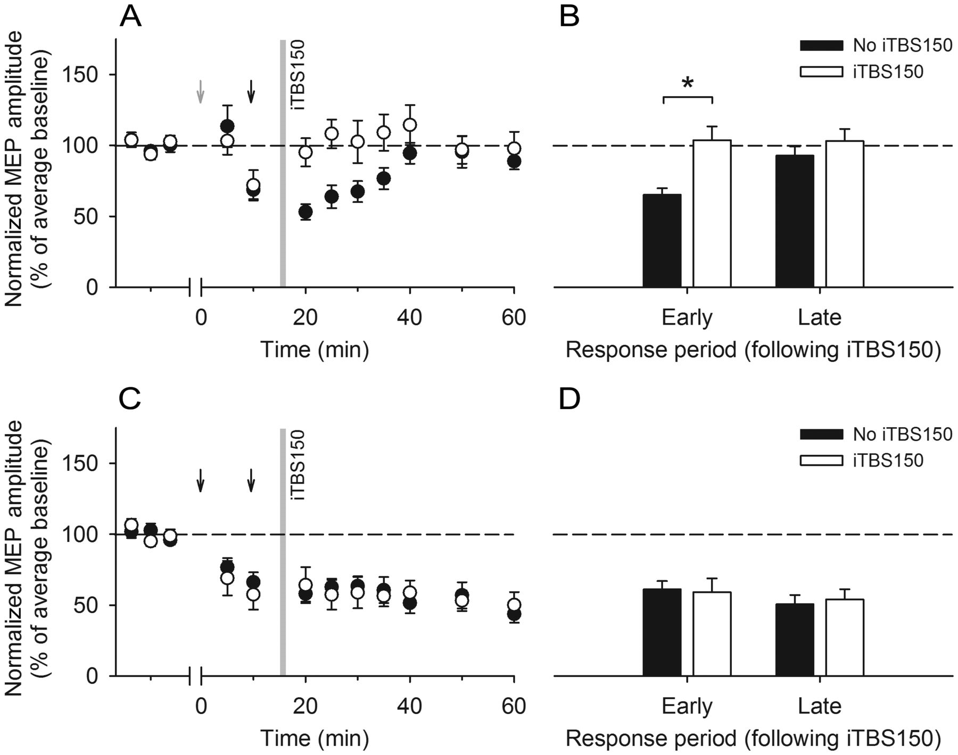
Figure 5. The influence of iTBS150 (gray column) on MEP responses (expressed as a percentage of the average baseline) ...
Notes:
Figure 5. The influence of iTBS150 (gray column) on MEP responses (expressed as a percentage of the average baseline) to single cTBS (A and B) and paired cTBS (C and D) (Experiment 5). The gray arrow indicates delivery of sham cTBS, while the black arrows indicate delivery of real cTBS. (A) Compared with the MEP depression observed for the FDI relaxed condition of Experiment 2 (i.e., no iTBS; filled circles), there was no change in MEP amplitudes from baseline levels following single cTBS for the iTBS150 condition (open circles). (B) Analysis of pooled MEP data showed that this was due to reduced MEP depression during the early response period following iTBS150 application. (C) As with the FDI relaxed condition of Experiment 3 (i.e., no iTBS; filled circles), there was a pronounced depression of MEP amplitudes from baseline levels following paired cTBS for the iTBS150 condition (open circles). (D) Post-iTBS150 MEPs pooled into early and late response periods did not differ between the conditions. *P ≤ 0.05, when the iTBS150 condition is compared with the FDI relaxed condition of Experiment 2 (i.e., no iTBS). Data are shown as group means ± standard errors of the mean.
Unless provided in the caption above, the following copyright applies to the content of this slide: © The Author 2014. Published by Oxford University Press. All rights reserved. For Permissions, please e-mail: journals.permissions@oup.com

