Slide 1
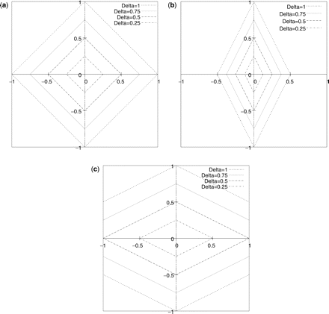
Fig. 1 Graphs showing the structure of the distance measure implied by Burrows's Delta in two dimensions (). Each ...
Notes:
Fig. 1 Graphs showing the structure of the distance measure implied by Burrows's Delta in two dimensions (). Each graph shows a space assuming two words are used for computing the measure, where the coordinates of each point in the space correspond to the frequencies of these words in a possible text. The diamonds show the ‘iso-Delta’ lines, such that all points on each diamond have the same value for Delta. (a) The standard deviation is 1 for the frequencies of both words. (b) The standard deviation for the word on the x axis is 2, while the other is 1. (c) The standard deviation for the word on the x axis is , while the other is 1
Unless provided in the caption above, the following copyright applies to the content of this slide: © The Author 2008. Published by Oxford University Press on behalf of ALLC and ACH. All rights reserved. For Permissions, please email: journals.permissions@oxfordjournals.org

Slide 2
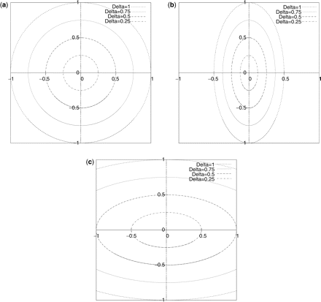
Fig. 2 Graphs showing the structure of the distance measure implied by axis-parallel quadratic Delta in two ...
Notes:
Fig. 2 Graphs showing the structure of the distance measure implied by axis-parallel quadratic Delta in two dimensions (). Each graph shows a space assuming two words are used for computing the measure, where the coordinates of each point in the space correspond to the frequencies of these words in a possible text. The ellipses show the ‘iso-Delta’ lines, such that all points on each ellipse have the same value for Delta. (a) The standard deviation is 1 for the frequencies of both words. (b) The standard deviation for the word on the x axis is 2, while the other is 1. (c) The standard deviation for the word on the x axis is , while the other is 1
Unless provided in the caption above, the following copyright applies to the content of this slide: © The Author 2008. Published by Oxford University Press on behalf of ALLC and ACH. All rights reserved. For Permissions, please email: journals.permissions@oxfordjournals.org

Slide 3
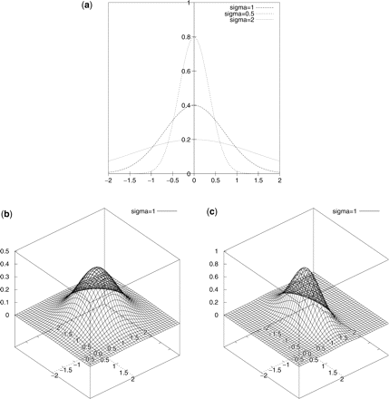
Fig. 3 Gaussian probability distributions. (a) 1-dimensional Gaussian distributions for several values of standard ...
Notes:
Fig. 3 Gaussian probability distributions. (a) 1-dimensional Gaussian distributions for several values of standard deviation σ. (b) 2-dimensional Gaussian distribution (probability shown along the vertical axis) where both standard deviations are 1. Note that horizontal cross-sections are circles. (c) 2-dimensional Gaussian distribution where one standard deviation is 1 and the other is 2. Note that horizontal cross-sections are ellipses
Unless provided in the caption above, the following copyright applies to the content of this slide: © The Author 2008. Published by Oxford University Press on behalf of ALLC and ACH. All rights reserved. For Permissions, please email: journals.permissions@oxfordjournals.org

Slide 4
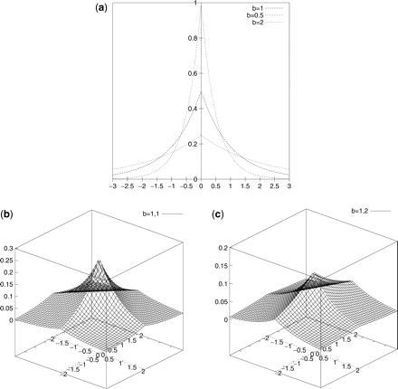
Fig. 4 Laplace probability distributions. (a) 1-dimensional Laplace distributions for several values of standard ...
Notes:
Fig. 4 Laplace probability distributions. (a) 1-dimensional Laplace distributions for several values of standard deviation σ. (b) 2-dimensional Laplace distribution (probability shown along the vertical axis) where both standard deviations are 1. Note that horizontal cross-sections are diamonds. (c) 2-dimensional Laplace distribution where one standard deviation is 1 and the other is . Note that horizontal cross-sections are elongated diamonds
Unless provided in the caption above, the following copyright applies to the content of this slide: © The Author 2008. Published by Oxford University Press on behalf of ALLC and ACH. All rights reserved. For Permissions, please email: journals.permissions@oxfordjournals.org

Slide 5
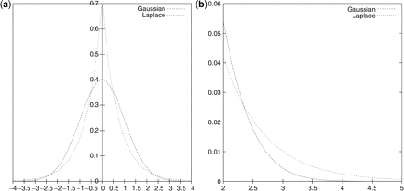
Fig. 5 Comparison of Gaussian and Laplace probability distributions, showing a Gaussian density function with μ = 0 ...
Notes:
Fig. 5 Comparison of Gaussian and Laplace probability distributions, showing a Gaussian density function with μ = 0 and σ = 1 and a Laplace density function with a = 0 and (such that its standard deviation is also 1. (a) From x = −4 to x = 4. (b) Detail view of the range x = 2 to x = 5, showing the heavier tail of the Laplace distribution
Unless provided in the caption above, the following copyright applies to the content of this slide: © The Author 2008. Published by Oxford University Press on behalf of ALLC and ACH. All rights reserved. For Permissions, please email: journals.permissions@oxfordjournals.org

Slide 6
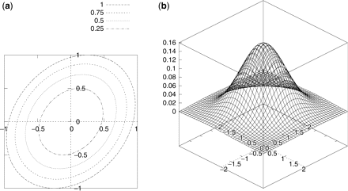
Fig. 6 Two-dimensional quadratic ranking functions with dependent variables; standard deviations σ₁ = 1 ...
Notes:
Fig. 6 Two-dimensional quadratic ranking functions with dependent variables; standard deviations σ1 = 1 and σ2 = 2 and covariance . (a) Iso-Delta curves; note that the ellipses are rotated 45° due to the covariance. (b) The Gaussian probability distribution
Unless provided in the caption above, the following copyright applies to the content of this slide: © The Author 2008. Published by Oxford University Press on behalf of ALLC and ACH. All rights reserved. For Permissions, please email: journals.permissions@oxfordjournals.org

Slide 7
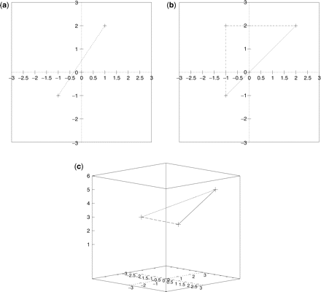
Fig. 7 Illustrations of subspaces spanned by small numbers of points (i.e. comparison texts). (a) Two points in a ...
Notes:
Fig. 7 Illustrations of subspaces spanned by small numbers of points (i.e. comparison texts). (a) Two points in a two dimensional space can give variation along both axes, but span a ‘natural’ space (the line segment connecting them) with no ‘thickness’, regardless of how the points are placed. Hence two points can only span a 1-dimensional subspace. (b) Three non collinear points in a 2-dimensional space give a triangle, which has ‘thickness’ in all directions, and so span a 2-dimensional subspace. (c) Even if embedded in three dimensions, such that the points have different locations on all three axes, they still only form a two-dimensional triangle regardless of where they are located, and so three points can only span a 2-dimensional space
Unless provided in the caption above, the following copyright applies to the content of this slide: © The Author 2008. Published by Oxford University Press on behalf of ALLC and ACH. All rights reserved. For Permissions, please email: journals.permissions@oxfordjournals.org

