Slide 1
Figure 1. Behavioral data from pilot testing (different sample; left) and from the postscanning test (scanned ...
Notes:
Figure 1. Behavioral data from pilot testing (different sample; left) and from the postscanning test (scanned participant sample; right). Note that the locus of the effect is clearly at 4-band noise-vocoded speech in both studies. Interaction of signal degradation (x axis) and context (cloze probability; white—low, black—high) is significant in both data sets. See text for details.
Unless provided in the caption above, the following copyright applies to the content of this slide: © The Author 2009. Published by Oxford University Press. All rights reserved. For permissions, please e-mail: journals.permissions@oxfordjournals.org

Slide 2
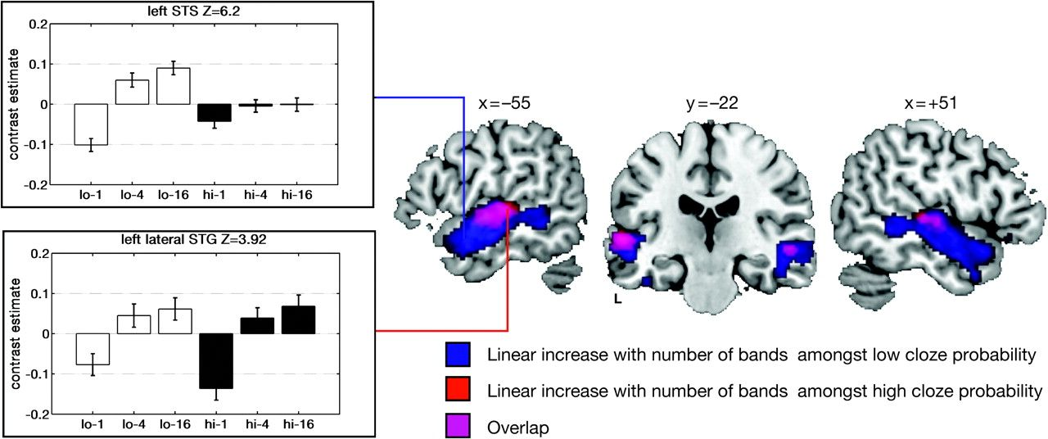
Figure 2. Effects of signal degradation on temporal lobe activation separately for low- and high-cloze probability ...
Notes:
Figure 2. Effects of signal degradation on temporal lobe activation separately for low- and high-cloze probability sentences, thresholded at P 87 voxels; identical with Table 1), plotted onto left and right sagittal and coronal slices of a T1-weighted template brain image. The monotonic increase of activation is strongest in bilateral anterolateral STG/STS, extending also in posterior STS regions. It appears almost exclusively driven by low-cloze sentences (blue), whereas intelligibility modulation among high-cloze sentences (red, overlap in purple) yields activation confined to mid-STG and STS regions. This is reflected in the contrast estimate bar graphs from peak voxels in the left anterior STS (top left panel) and the mid- to posterior STG (left bottom panel; white bars—low cloze, black bars—high cloze).
Unless provided in the caption above, the following copyright applies to the content of this slide: © The Author 2009. Published by Oxford University Press. All rights reserved. For permissions, please e-mail: journals.permissions@oxfordjournals.org

Slide 3
Figure 3. Regions exhibiting an effect of low- > high-cloze probability, thresholded at P < 0.001 (cluster extent k > ...
Notes:
Figure 3. Regions exhibiting an effect of low- > high-cloze probability, thresholded at P 87 voxels; identical with Table 1), plotted onto left and right sagittal (top middle panels) and axial slices (bottom middle panels) of a T1-weighted template brain image. Left IFG (most likely located in BA 44; site a) and bilateral posterior STS (site b) exhibit enhanced activation under low-cloze conditions. Notably, however, patterns of activation across conditions differ, and left IFG (a, bottom left panel) shows the most language-specific pattern: With better signal quality, the expected signature of semantic computation (low > high cloze) becomes evident.
Unless provided in the caption above, the following copyright applies to the content of this slide: © The Author 2009. Published by Oxford University Press. All rights reserved. For permissions, please e-mail: journals.permissions@oxfordjournals.org

Slide 4
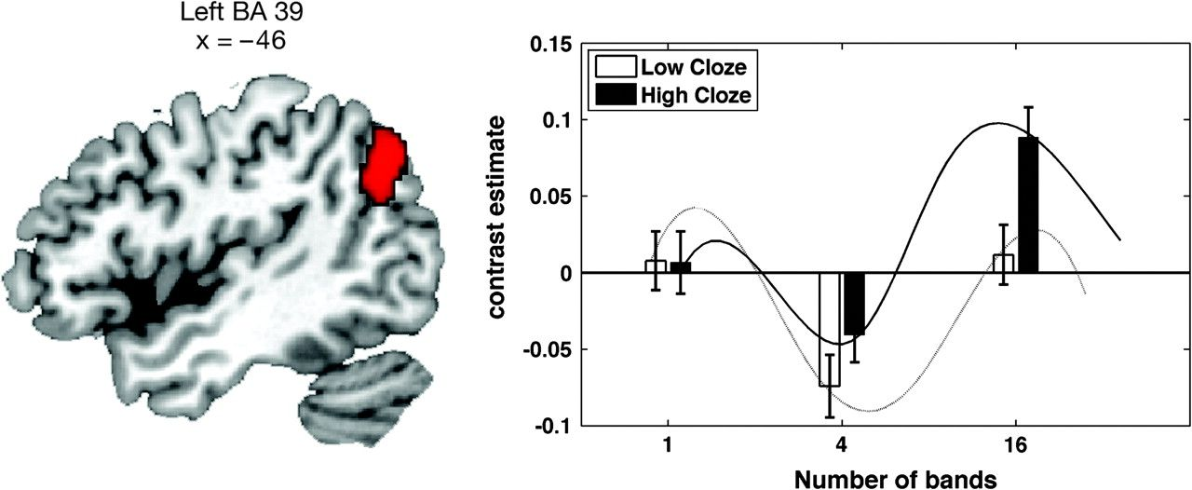
Figure 4. Activation pattern of the left IPC (angular gyrus, BA 39). Contrast estimates (right panel) for all ...
Notes:
Figure 4. Activation pattern of the left IPC (angular gyrus, BA 39). Contrast estimates (right panel) for all conditions in left BA 39 (thresholded at P 87 voxels; identical with Table 1) are shown. The spline interpolations (based on the current data as well as 2-, 8-, and 32-band speech as reported in Obleser et al. 2007) demonstrate the inverted u-shaped response behavior of the inferior parietal gyrus with changing speech degradation levels. This is more pronounced for sentences that allow for a high semantic expectancy (high cloze; black bars and solid line).
Unless provided in the caption above, the following copyright applies to the content of this slide: © The Author 2009. Published by Oxford University Press. All rights reserved. For permissions, please e-mail: journals.permissions@oxfordjournals.org

