Slide 1
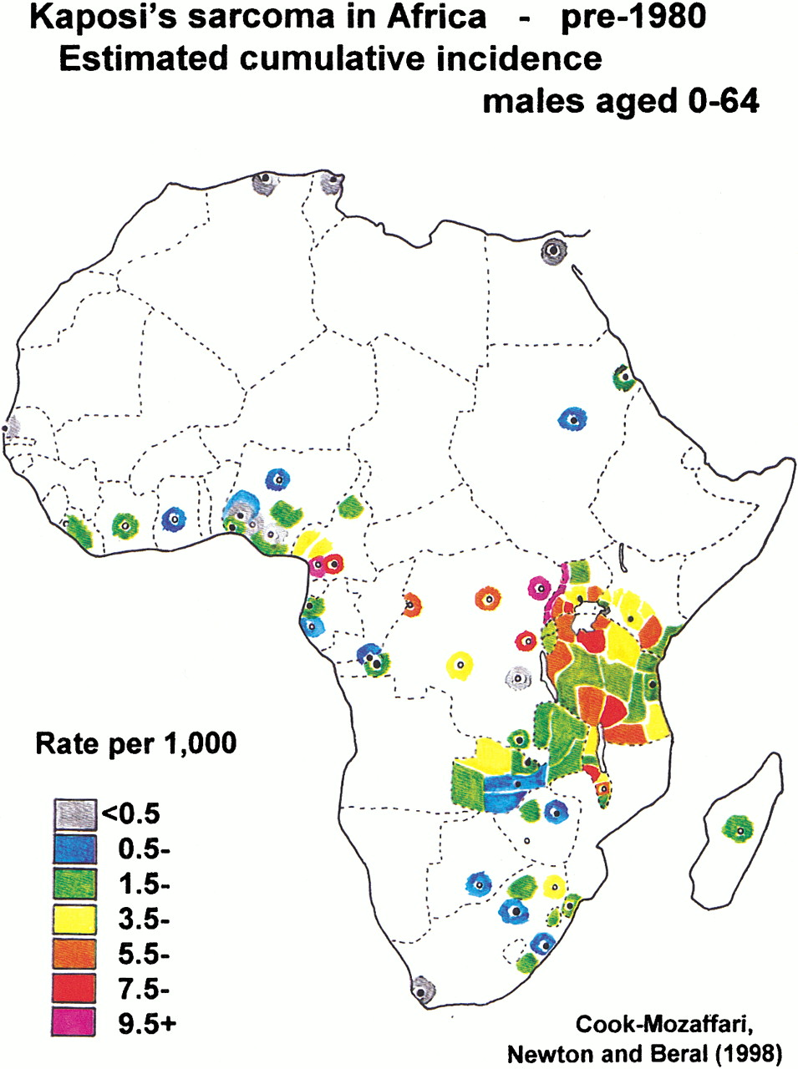
Fig. 1. Estimated cumulative incidence of Kaposi's sarcoma in males aged 0–64 years in Africa, before 1980. Adapted ...
Notes:
Fig. 1. Estimated cumulative incidence of Kaposi's sarcoma in males aged 0–64 years in Africa, before 1980. Adapted from (5).
Unless provided in the caption above, the following copyright applies to the content of this slide: © Oxford University Press

