Slide 1
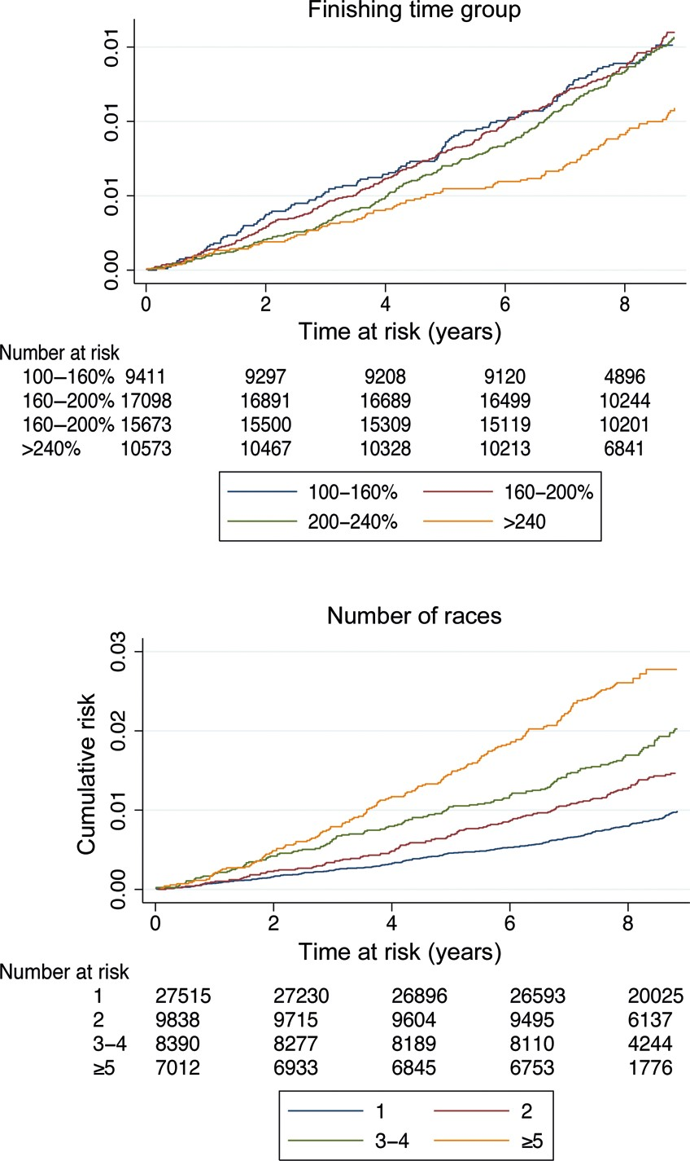
Figure 1 Cumulative incidence of any arrhythmia by finishing time group in per cent of winning time and number of ...
Notes:
Figure 1 Cumulative incidence of any arrhythmia by finishing time group in per cent of winning time and number of completed races during the period 1989–98.
Unless provided in the caption above, the following copyright applies to the content of this slide: Published on behalf of the European Society of Cardiology. All rights reserved. © The Author 2013. For permissions please email: journals.permissions@oup.com

Slide 2
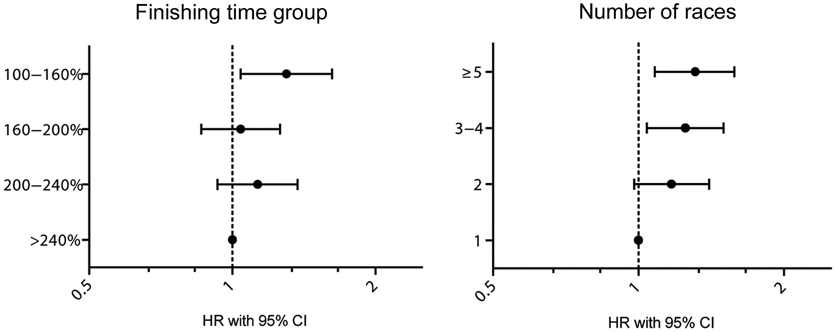
Figure 2 Hazard ratios of any arrhythmia with 95% confidence intervals (log scale) by finishing time group in per cent ...
Notes:
Figure 2 Hazard ratios of any arrhythmia with 95% confidence intervals (log scale) by finishing time group in per cent of winning time and number of previous races. Model adjusted for age, occupation, and education level.
Unless provided in the caption above, the following copyright applies to the content of this slide: Published on behalf of the European Society of Cardiology. All rights reserved. © The Author 2013. For permissions please email: journals.permissions@oup.com

