Slide 1
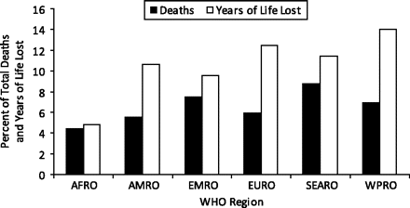
Figure 1. Percent of total deaths and years of life lost attributable to unintentional injuries by year 2004 World ...
Notes:
Figure 1. Percent of total deaths and years of life lost attributable to unintentional injuries by year 2004 World Health Organization region estimates. AFRO, African region; AMRO, American region; EMRO, Eastern Mediterranean region; EURO, European region; SEARO, Southeast Asian region; WHO, World Health Organization; WPRO, Western Pacific region.
Unless provided in the caption above, the following copyright applies to the content of this slide: Epidemiologic Reviews © The Author 2010. Published by Oxford University Press on behalf of the Johns Hopkins Bloomberg School of Public Health. All rights reserved. For permissions, please e-mail: journals.permissions@oxfordjournals.org.

Slide 2
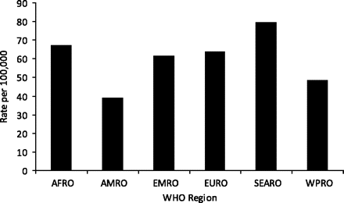
Figure 2. Unintentional injury death rate per 100,000 population by year 2004 World Health Organization region ...
Notes:
Figure 2. Unintentional injury death rate per 100,000 population by year 2004 World Health Organization region estimates. AFRO, African region; AMRO, American region; EMRO, Eastern Mediterranean region; EURO, European region; SEARO, Southeast Asian region; WHO, World Health Organization; WPRO, Western Pacific region.
Unless provided in the caption above, the following copyright applies to the content of this slide: Epidemiologic Reviews © The Author 2010. Published by Oxford University Press on behalf of the Johns Hopkins Bloomberg School of Public Health. All rights reserved. For permissions, please e-mail: journals.permissions@oxfordjournals.org.

Slide 3
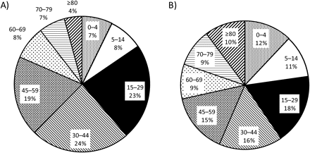
Figure 7. Proportion of unintentional injury deaths, by age group, in males (A) and females (B), by year 2004 World ...
Notes:
Figure 7. Proportion of unintentional injury deaths, by age group, in males (A) and females (B), by year 2004 World Health Organization region estimates.
Unless provided in the caption above, the following copyright applies to the content of this slide: Epidemiologic Reviews © The Author 2010. Published by Oxford University Press on behalf of the Johns Hopkins Bloomberg School of Public Health. All rights reserved. For permissions, please e-mail: journals.permissions@oxfordjournals.org.

Slide 4
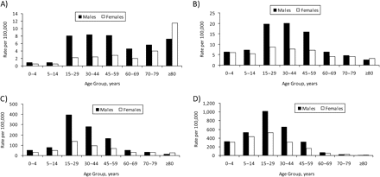
Figure 8. By age group and gender, global unintentional injury deaths in high-income countries (A), deaths in low- and ...
Notes:
Figure 8. By age group and gender, global unintentional injury deaths in high-income countries (A), deaths in low- and middle-income countries (B), disability-adjusted life-years in high-income countries (C), and disability-adjusted life-years in low- and middle-income countries (D), by year 2004 World Health Organization region estimates.
Unless provided in the caption above, the following copyright applies to the content of this slide: Epidemiologic Reviews © The Author 2010. Published by Oxford University Press on behalf of the Johns Hopkins Bloomberg School of Public Health. All rights reserved. For permissions, please e-mail: journals.permissions@oxfordjournals.org.

Slide 5
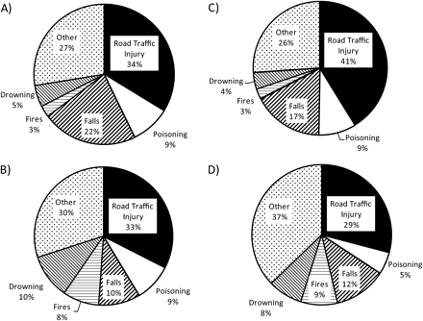
Figure 6. Distribution by cause of unintentional injury deaths in high-income countries (A), deaths in low- and ...
Notes:
Figure 6. Distribution by cause of unintentional injury deaths in high-income countries (A), deaths in low- and middle-income countries (B), disability-adjusted life-years in high-income countries (C), and disability-adjusted life-years in low- and middle-income countries (D) by year 2004 World Health Organization region estimates. “Other” combines other unintentional injury deaths (e.g., animal bites), as well as unspecified unintentional injury deaths, per the International Classification of Diseases.
Unless provided in the caption above, the following copyright applies to the content of this slide: Epidemiologic Reviews © The Author 2010. Published by Oxford University Press on behalf of the Johns Hopkins Bloomberg School of Public Health. All rights reserved. For permissions, please e-mail: journals.permissions@oxfordjournals.org.

Slide 6
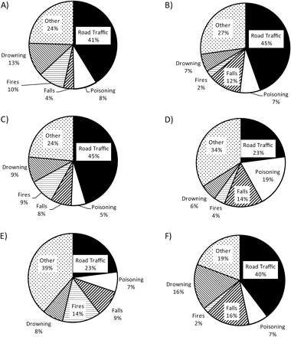
Figure 3. Proportion of unintentional injury deaths, by cause, by year 2004 World Health Organization region estimates: ...
Notes:
Figure 3. Proportion of unintentional injury deaths, by cause, by year 2004 World Health Organization region estimates: American region (A), African region (B), European region (C), Eastern Mediterranean region (D), Southeast Asian region (E), and Western Pacific region (F). “Other” combines other unintentional injury deaths (e.g., animal bites), as well as unspecified unintentional injury deaths, per the International Classification of Diseases.
Unless provided in the caption above, the following copyright applies to the content of this slide: Epidemiologic Reviews © The Author 2010. Published by Oxford University Press on behalf of the Johns Hopkins Bloomberg School of Public Health. All rights reserved. For permissions, please e-mail: journals.permissions@oxfordjournals.org.

Slide 7
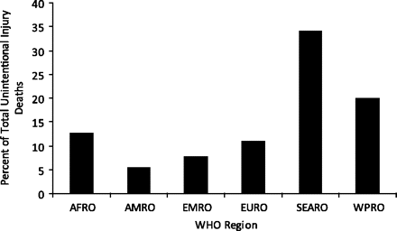
Figure 5. Percent of total unintentional injury deaths in low- and middle-income countries by year 2004 World Health ...
Notes:
Figure 5. Percent of total unintentional injury deaths in low- and middle-income countries by year 2004 World Health Organization region estimates. AFRO, African region; AMRO, American region; EMRO, Eastern Mediterranean region; EURO, European region; SEARO, Southeast Asian region; WHO, World Health Organization; WPRO, Western Pacific region.
Unless provided in the caption above, the following copyright applies to the content of this slide: Epidemiologic Reviews © The Author 2010. Published by Oxford University Press on behalf of the Johns Hopkins Bloomberg School of Public Health. All rights reserved. For permissions, please e-mail: journals.permissions@oxfordjournals.org.

Slide 8
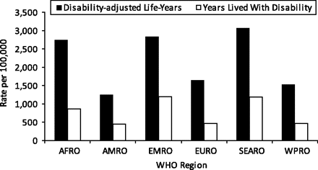
Figure 4. Rate per 100,000 population of disability-adjusted life-years and years lived with disability due to ...
Notes:
Figure 4. Rate per 100,000 population of disability-adjusted life-years and years lived with disability due to unintentional injuries by year 2004 World Health Organization region estimates. AFRO, African region; AMRO, American region; EMRO, Eastern Mediterranean region; EURO, European region; SEARO, Southeast Asian region; WHO, World Health Organization; WPRO, Western Pacific region.
Unless provided in the caption above, the following copyright applies to the content of this slide: Epidemiologic Reviews © The Author 2010. Published by Oxford University Press on behalf of the Johns Hopkins Bloomberg School of Public Health. All rights reserved. For permissions, please e-mail: journals.permissions@oxfordjournals.org.

