Slide 1
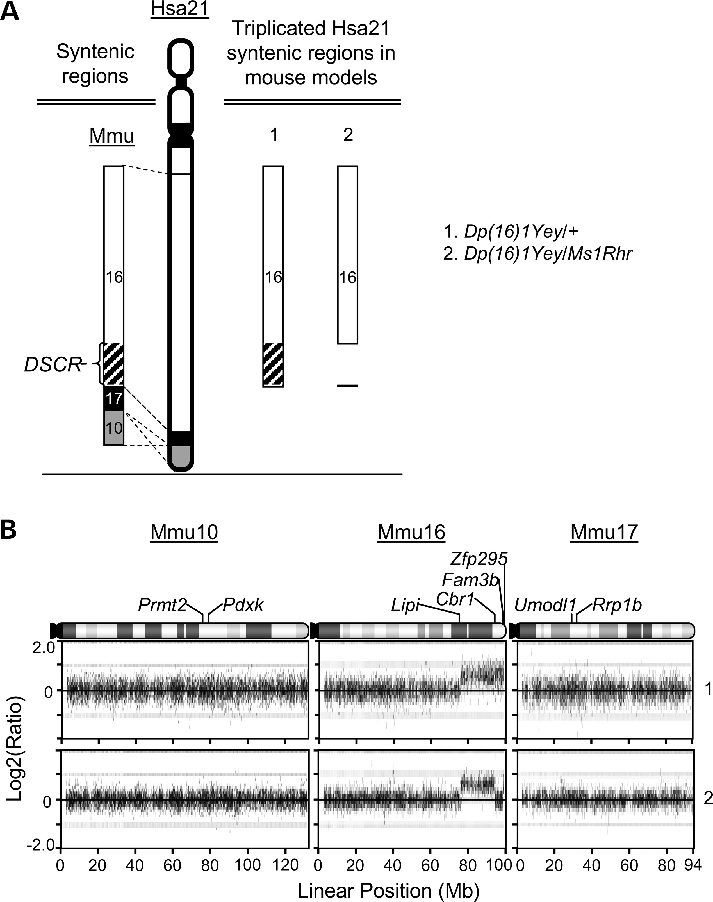
Figure 1. The mouse models of DS carrying three copies in the different Hsa21 orthologous regions on Mmu16. (A) ...
Notes:
Figure 1. The mouse models of DS carrying three copies in the different Hsa21 orthologous regions on Mmu16. (A) Schematic representation of Hsa21 and the triplicated Hsa21 syntenic regions in the mouse models. (B) Agilent microarray CGH profiles show the duplication [Dp(16)1Yey] and the deletion [Ms1Rhr] in the Hsa21 orthologous region on Mmu16. CGH profiles 1 and 2 were generated using the DNA samples isolated from mouse models 1 and 2, respectively (A). No genomic alterations were detected on Mmu10 and Mmu17. Plotted are log2-transformed hybridization ratios of the DNA from mutants versus wild-type mouse DNA. The endpoint genes of the Hsa21 orthologous regions and the Ms1Rhr region are shown.
Unless provided in the caption above, the following copyright applies to the content of this slide: © The Author 2013. Published by Oxford University Press. All rights reserved. For Permissions, please email: journals.permissions@oup.com

Slide 2
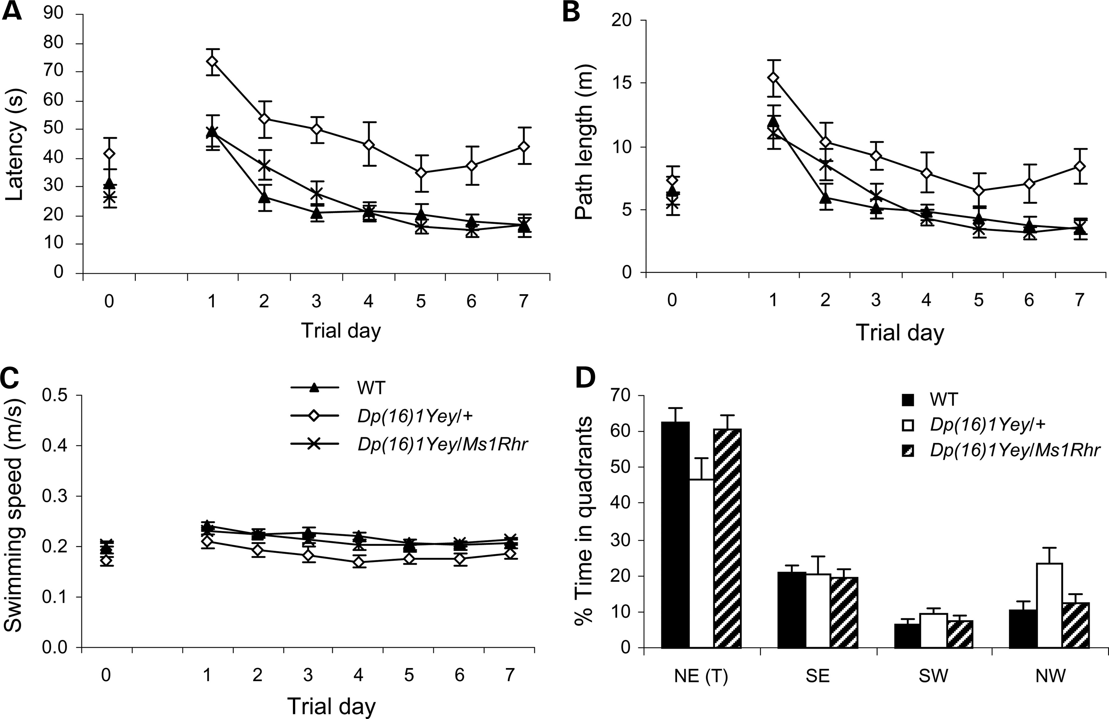
Figure 2. Analysis of the contribution of the Cbr1-Fam3b region to the Mmu16-associated performance in the Morris water ...
Notes:
Figure 2. Analysis of the contribution of the Cbr1-Fam3b region to the Mmu16-associated performance in the Morris water maze test by the mouse models of DS. The Dp(16)1Yey/+ (n = 11), Dp(16)1Yey/Ms1Rhr (n = 10) and the wild-type control mice (n = 11) were examined in the Morris water maze. (A) Latency to locate the platform (s). (B) Path-length to locate the platform (m). (C) Swimming speed (m/s). (D) The relative amount of time spent in different quadrants during the probe test 1 day after the end of the training trials.
Unless provided in the caption above, the following copyright applies to the content of this slide: © The Author 2013. Published by Oxford University Press. All rights reserved. For Permissions, please email: journals.permissions@oup.com

Slide 3
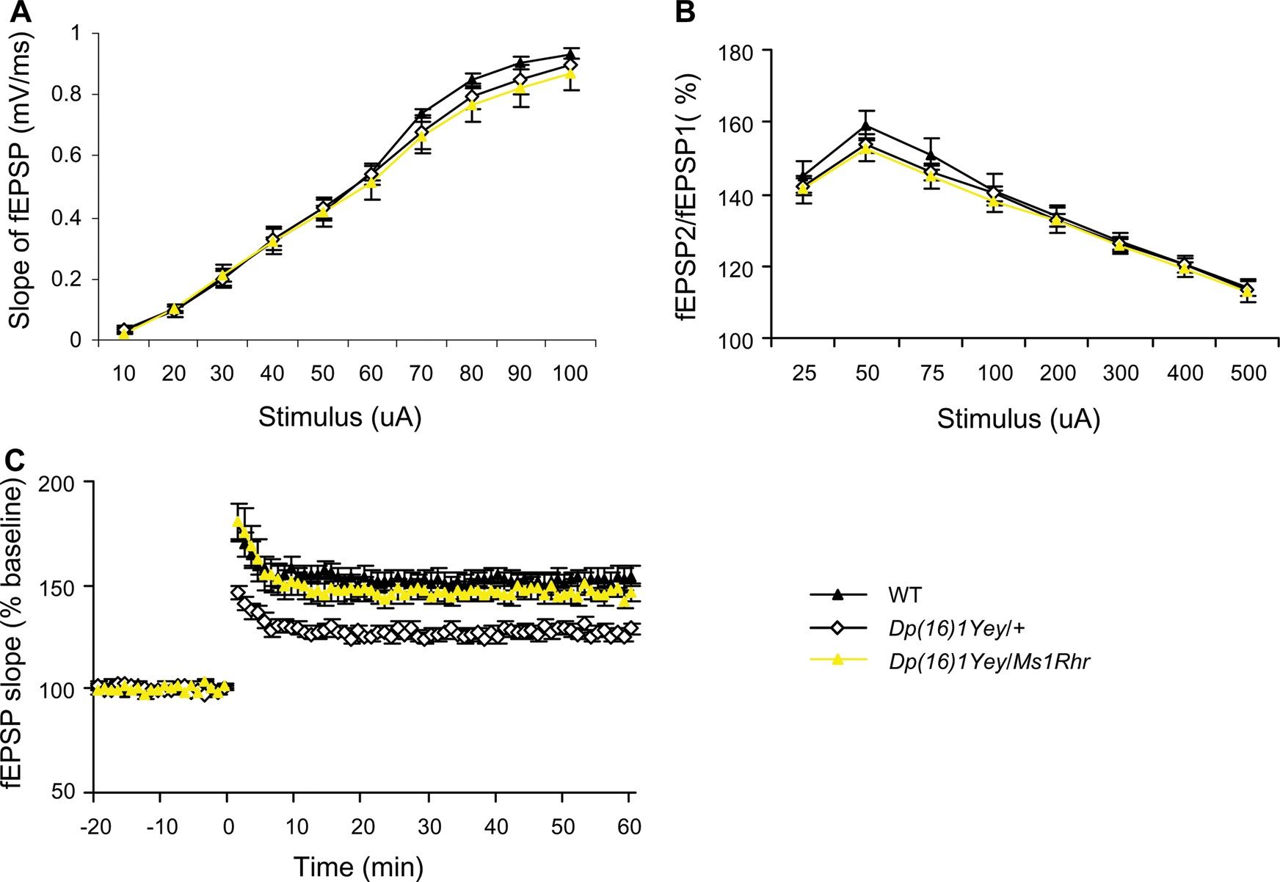
Figure 3. Analysis of the contribution of the Cbr1-Fam3b region to the Mmu16-associated electrophysiological phenotype ...
Notes:
Figure 3. Analysis of the contribution of the Cbr1-Fam3b region to the Mmu16-associated electrophysiological phenotype in the mouse models of DS. In vitro characterizations of hippocampal synaptic transmission and plasticity were carried out by utilizing electrophysiological recordings in the CA1 region of the hippocampus in the brain slices of the Dp(16)1Yey/+ mice (n = 12), Dp(16)1Yey/Ms1Rhr mice (n = 10) and the wild-type control mice (n = 10). (A) Input–output curves were generated by applying stimuli of increasing intensity and measuring the initial slopes of the fEPSPs. (B) Paired-pulse facilitation was measured by applying two closely spaced stimuli and was expressed as the ratio of synaptic responses (fEPSP2/fEPSP1) as a function of interstimulus interval. (C) For measuring hippocampal LTP, the fEPSPs were induced by TBS. Recordings were carried out before and after TBS inductions for the DS mouse models and the wild-type control mice. Evoked potentials were normalized to the fEPSP recorded prior to TBS induction (baseline = 100%). The data are presented as the percentage of fEPSP as a function of time.
Unless provided in the caption above, the following copyright applies to the content of this slide: © The Author 2013. Published by Oxford University Press. All rights reserved. For Permissions, please email: journals.permissions@oup.com

Slide 4
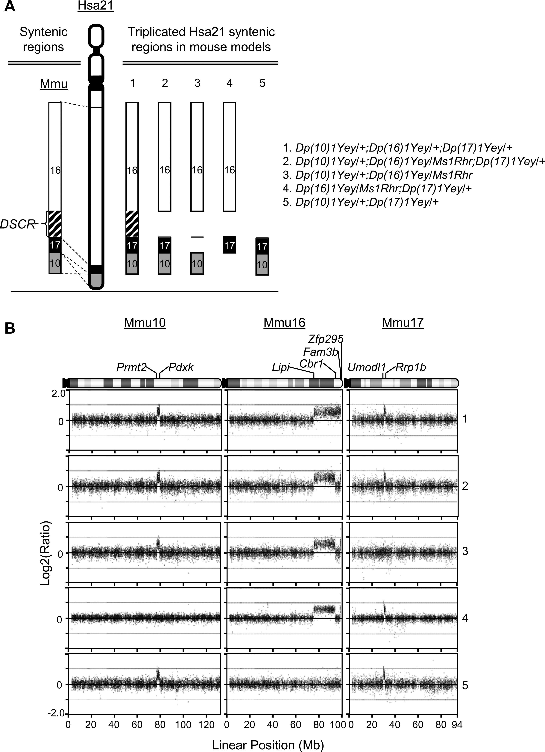
Figure 4. The mouse models of DS carrying three copies in the different Hsa21 orthologous regions on Mmu10, Mmu16 and ...
Notes:
Figure 4. The mouse models of DS carrying three copies in the different Hsa21 orthologous regions on Mmu10, Mmu16 and Mmu17. (A) Schematic representation of Hsa21 and the triplicated Hsa21 syntenic regions in the mouse models. (B) Agilent microarray CGH profiles show duplications [Dp(10)1Yey, Dp(16)1Yey and Dp(17)1Yey] and the deletion [Ms1Rhr] in the Hsa21 orthologous region on Mmu10, Mmu16 and Mmu17. CGH profiles 1, 2, 3, 4 and 5 were generated using the DNA samples isolated from mouse models 1, 2, 3, 4 and 5, respectively (A). Plotted are log2-transformed hybridization ratios of the DNA from mutants versus wild-type mouse DNA. The endpoint genes of the Hsa21 orthologous regions and the Ms1Rhr region are shown.
Unless provided in the caption above, the following copyright applies to the content of this slide: © The Author 2013. Published by Oxford University Press. All rights reserved. For Permissions, please email: journals.permissions@oup.com

Slide 5
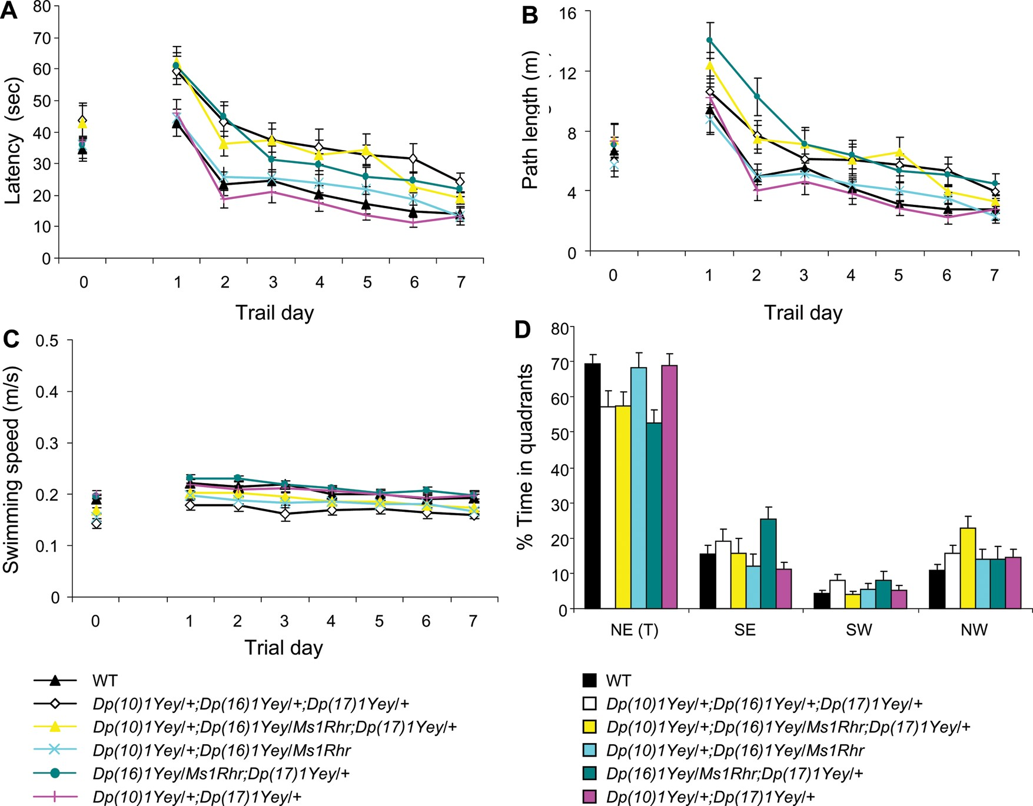
Figure 5. Analysis of the contributions of the Cbr1-Fam3b region and the Hsa21 orthologous region on Mmu17 to the ...
Notes:
Figure 5. Analysis of the contributions of the Cbr1-Fam3b region and the Hsa21 orthologous region on Mmu17 to the performance in the Morris water maze test by the mouse models of DS. The Dp(10)1Yey/+;Dp(16)1Yey/+;Dp(17)1Yey/+ (n = 12), Dp(10)1Yey/+;Dp(16)1Yey/Ms1Rhr;Dp(17)1Yey/+ (n = 14), Dp(10)1Yey/+;Dp(16)1Yey/Ms1Rhr (n = 13), Dp(16)1Yey/Ms1Rhr;Dp(17)1Yey/+ (n = 14), Dp(10)1Yey/+;Dp(17)1Yey/+ (n = 13) and the wild-type control mice (n = 13) were examined in the Morris water maze. (A) Latency to locate the platform (s). (B) Path-length to locate the platform (m). (C) Swimming speed (m/s). (D) The relative amount of time spent in different quadrants during the probe test 1 day after the end of the training trials.
Unless provided in the caption above, the following copyright applies to the content of this slide: © The Author 2013. Published by Oxford University Press. All rights reserved. For Permissions, please email: journals.permissions@oup.com

Slide 6
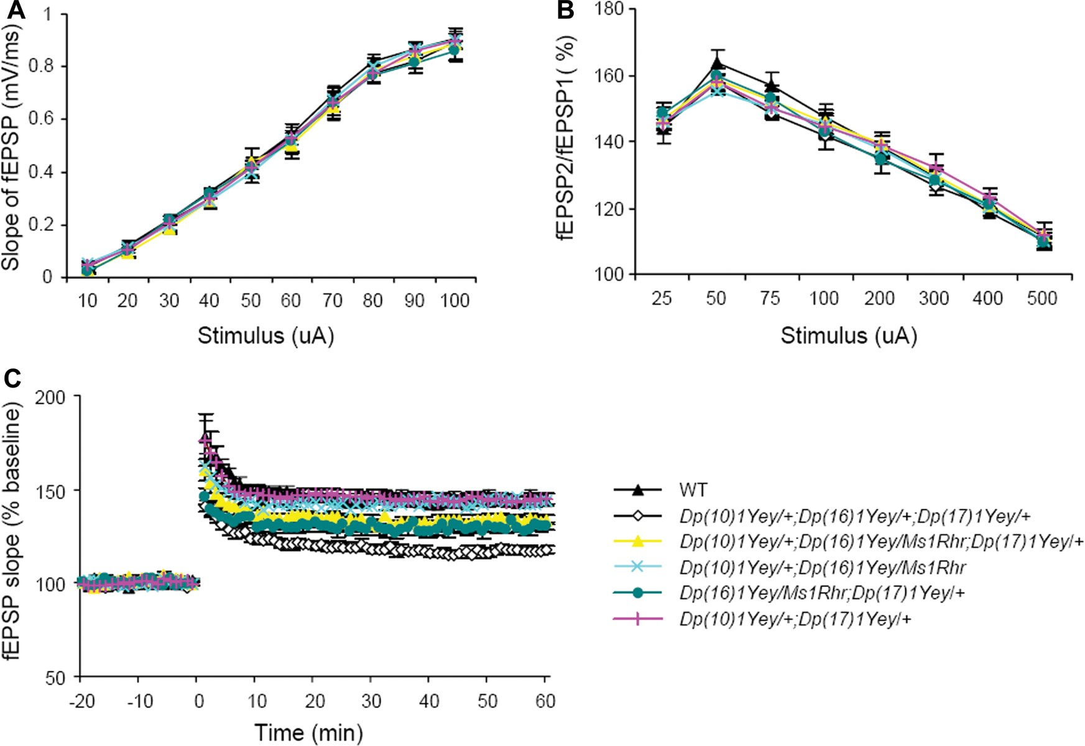
Figure 6. Analysis of the contributions of the Cbr1-Fam3b region and the Hsa21 orthologous region on Mmu17 to the ...
Notes:
Figure 6. Analysis of the contributions of the Cbr1-Fam3b region and the Hsa21 orthologous region on Mmu17 to the electrophysiological phenotype in the mouse models of DS. In vitro characterizations of hippocampal synaptic transmission and plasticity were carried out by utilizing electrophysiological recordings in the CA1 region of the hippocampus in the brain slices of the Dp(10)1Yey/+;Dp(16)1Yey/+;Dp(17)1Yey/+ (n = 12), Dp(10)1Yey/+;Dp(16)1Yey/Ms1Rhr;Dp(17)1Yey/+ (n = 11), Dp(10)1Yey/+;Dp(16)1Yey/Ms1Rhr (n = 10), Dp(16)1Yey/Ms1Rhr;Dp(17)1Yey/+ (n = 10), Dp(10)1Yey/+;Dp(17)1Yey/+ (n = 10) and the wild-type control mice (n = 12). (A) Input–output curves were generated by applying stimuli of increasing intensity and measuring the initial slopes of the fEPSPs. (B) Paired-pulse facilitation was measured by applying two closely spaced stimuli and was expressed as the ratio of synaptic responses (fEPSP2/fEPSP1) as a function of the interstimulus interval. (C) For measuring hippocampal LTP, the fEPSPs were induced by TBS. Recordings were carried out before and after TBS inductions for the DS mouse models and the wild-type control mice. Evoked potentials were normalized to the fEPSP recorded prior to TBS induction (baseline = 100%). The data are presented as the percentage of fEPSP as a function of time.
Unless provided in the caption above, the following copyright applies to the content of this slide: © The Author 2013. Published by Oxford University Press. All rights reserved. For Permissions, please email: journals.permissions@oup.com

