Slide 1
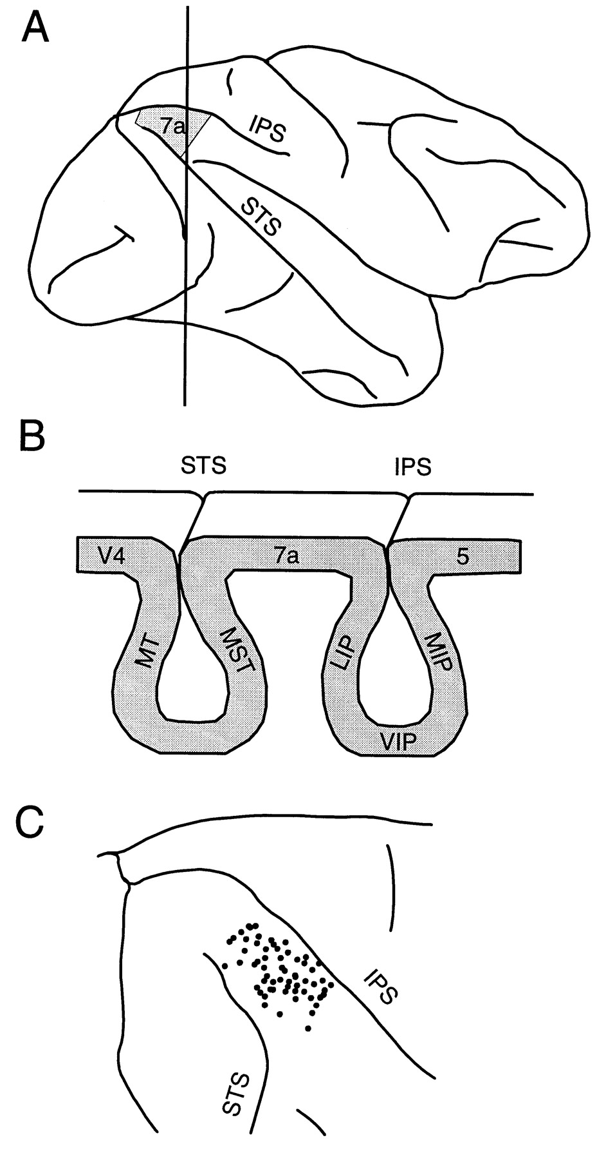
Figure 1. Recordings were made in area 7a of the posterior parietal cortex, bounded by the intraparietal and superior ...
Notes:
Figure 1. Recordings were made in area 7a of the posterior parietal cortex, bounded by the intraparietal and superior temporal sulci. (A) Lateral view of the macaque brain. (B) Cross-section through the posterior parietal cortex at the level indicated by the vertical line in (A). (C) Anatomical reconstruction of recording sites where we encountered task-responsive units. Posterior parietal cortex is shown in dorsal view. IPS, intraparietal sulcus; LIP, lateral intraparietal area; MIP, medial intraparietal area; MST, medial superior temporal area; MT, medial temporal area; STS, superior temporal sulcus; VIP, ventral intraparietal area.
Unless provided in the caption above, the following copyright applies to the content of this slide: © Oxford University Press

Slide 2
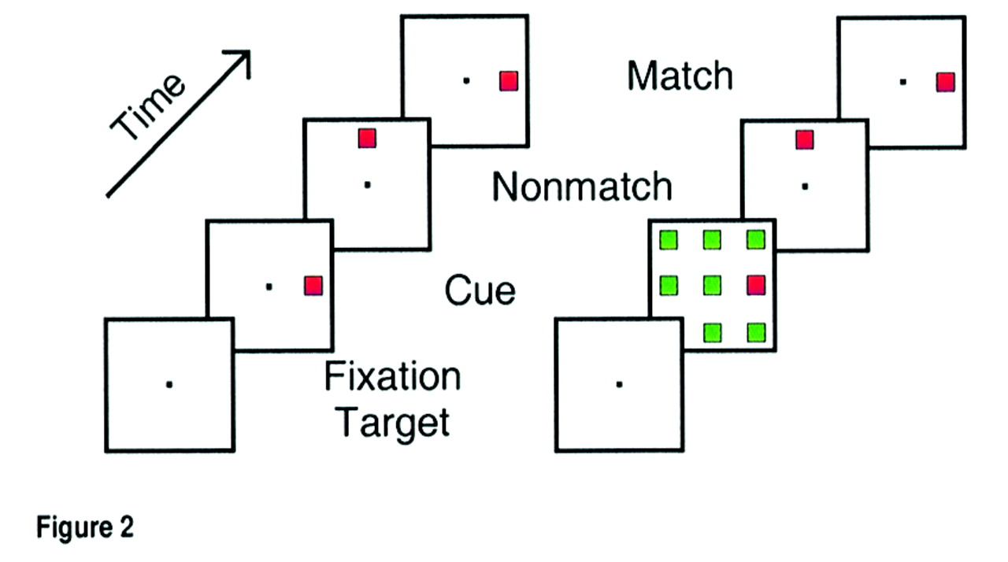
Figure 2. Behavioral task. Trials consisted of a series of visual presentations separated by delay periods with only ...
Notes:
Figure 2. Behavioral task. Trials consisted of a series of visual presentations separated by delay periods with only the fixation target present. Successive time frames represent the sequence of stimulus presentations (delay periods are not shown). The duration of stimulus and delay periods was typically 500ms. Trials in which the match immediately followed the cue were randomly interleaved with those in which the cue and match were separated in time by one or two presentations of a stimulus at an uncued location (non-match). Cue presentations consisted of red or green squares either alone (left) or in a field of distractors of the opposite color (right). Arrays were centered on the fixation point with elements spaced 25° apart. Trials with presentations using single or multiple stimuli of either color were randomly interleaved so that the monkey could not predict the color or location of the salient stimulus.
Unless provided in the caption above, the following copyright applies to the content of this slide: © Oxford University Press

Slide 3
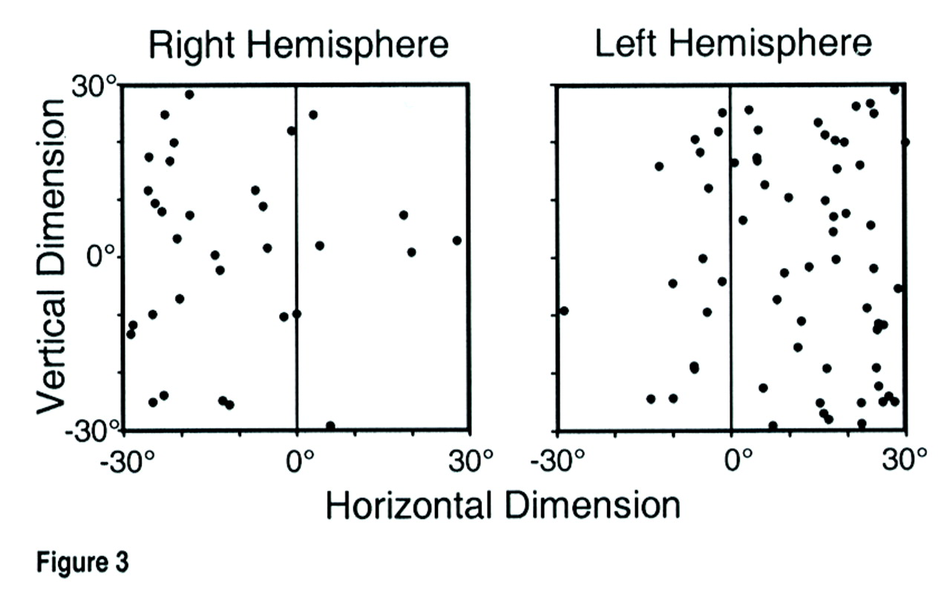
Figure 3. Points represent the preferred locations of neurons recorded in the left and right hemispheres. Preferred ...
Notes:
Figure 3. Points represent the preferred locations of neurons recorded in the left and right hemispheres. Preferred locations were determined by fitting a two-dimensional Gaussian to neuronal responses for single stimuli at each of the nine locations.
Unless provided in the caption above, the following copyright applies to the content of this slide: © Oxford University Press

Slide 4
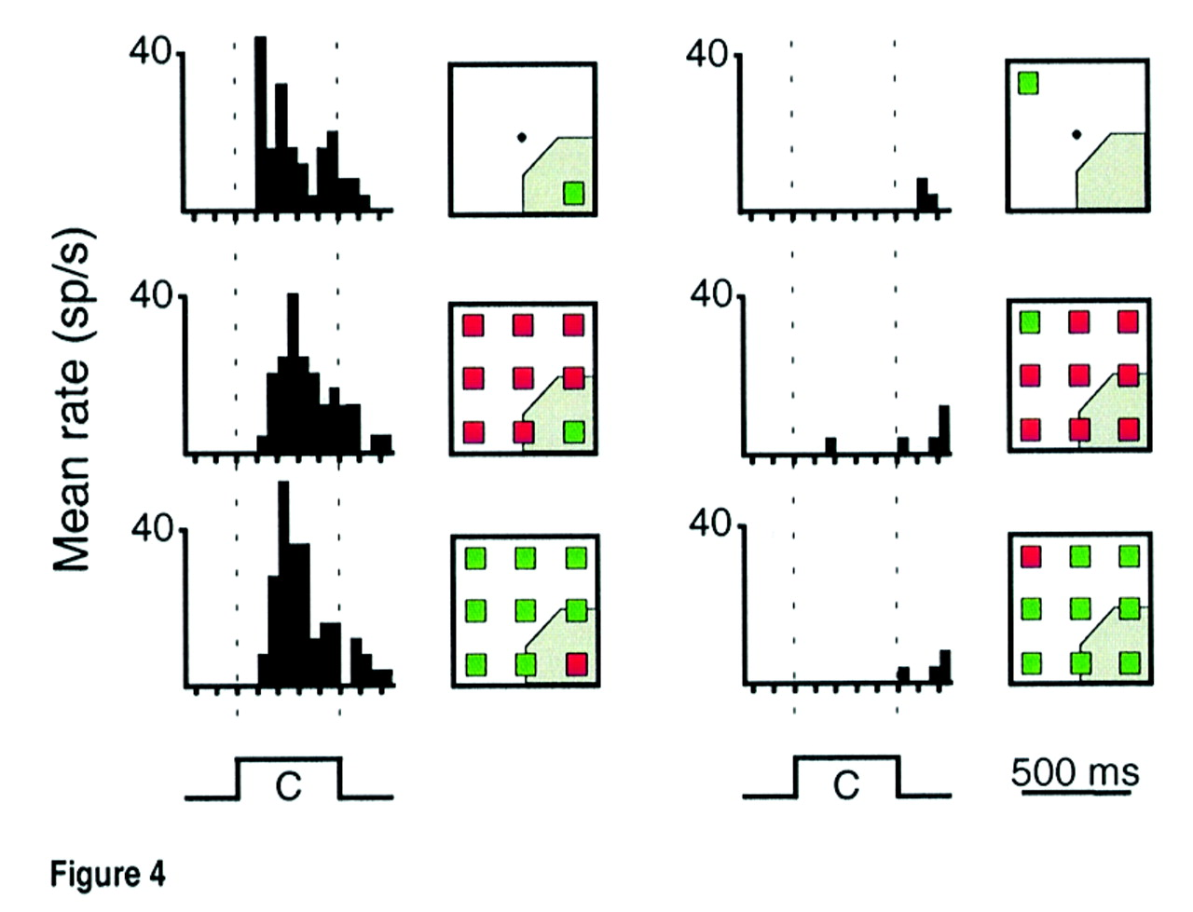
Figure 4. PST histograms depict responses of one area 7a neuron for each of the six cue presentations shown in the ...
Notes:
Figure 4. PST histograms depict responses of one area 7a neuron for each of the six cue presentations shown in the frames to the right of each group (ordinate values in impulses/s; bin size = 50 ms). The shaded area represents the neuron's approximate receptive field. Strong responses were observed to salient stimuli presented inside of the receptive field either alone (top left) or with distractors (middle and bottom left). Weak responses were observed when the salient stimuli appeared outside the receptive field (right panels), even when distractors appeared inside the receptive field (middle and bottom right).
Unless provided in the caption above, the following copyright applies to the content of this slide: © Oxford University Press

Slide 5
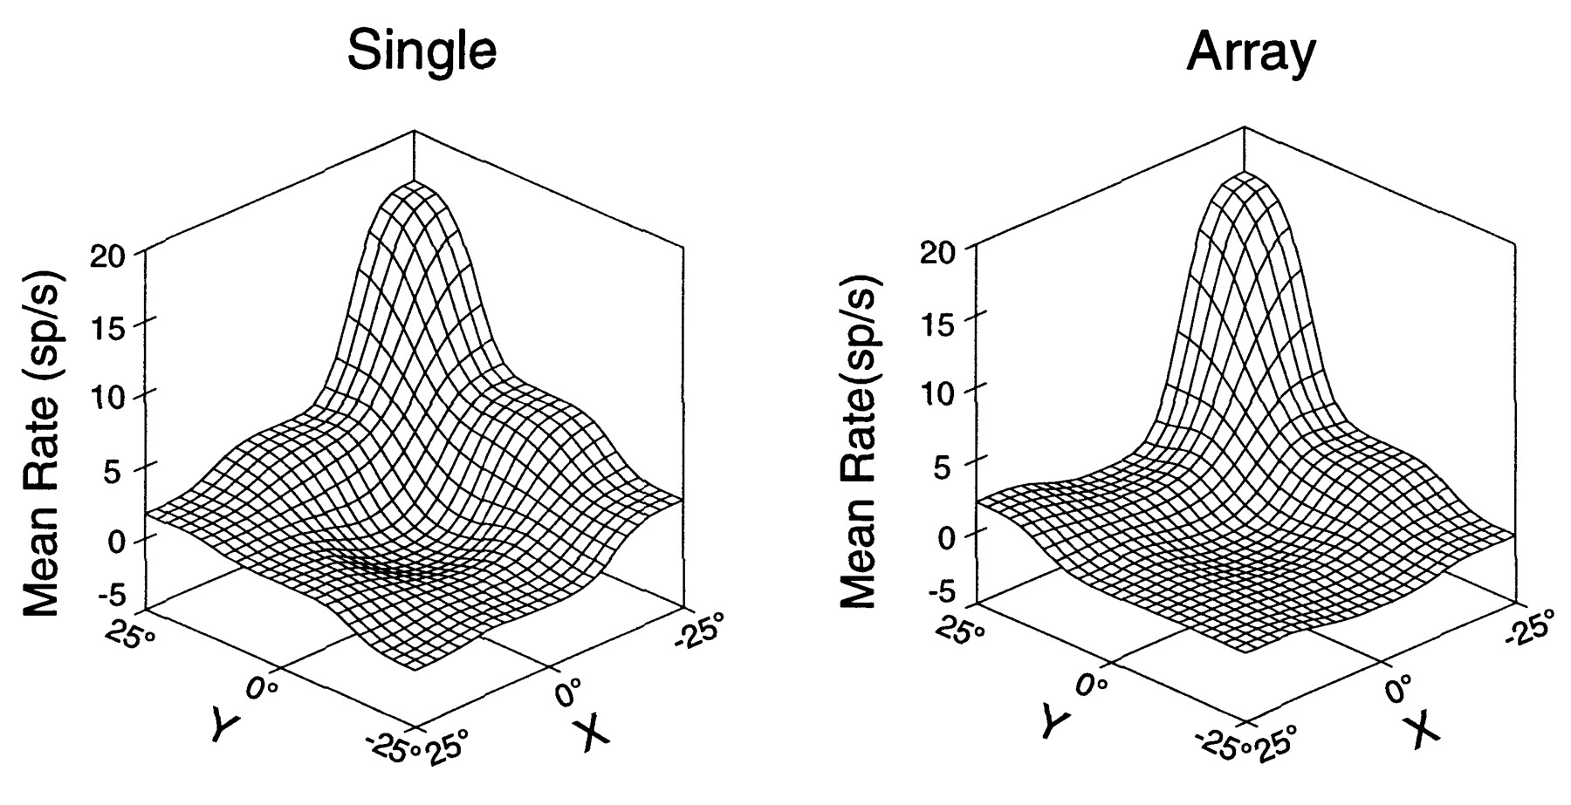
Figure 5. Surface plots represent the mean firing rate of the neuron shown in Figure 3 during the cue presentation ...
Notes:
Figure 5. Surface plots represent the mean firing rate of the neuron shown in Figure 3 during the cue presentation period as a function of the coordinates of a salient stimulus presented alone (left) or in a multiple-stimulus array (right). Nine locations were tested; intermediate points were interpolated using an inverse power function.
Unless provided in the caption above, the following copyright applies to the content of this slide: © Oxford University Press

Slide 6
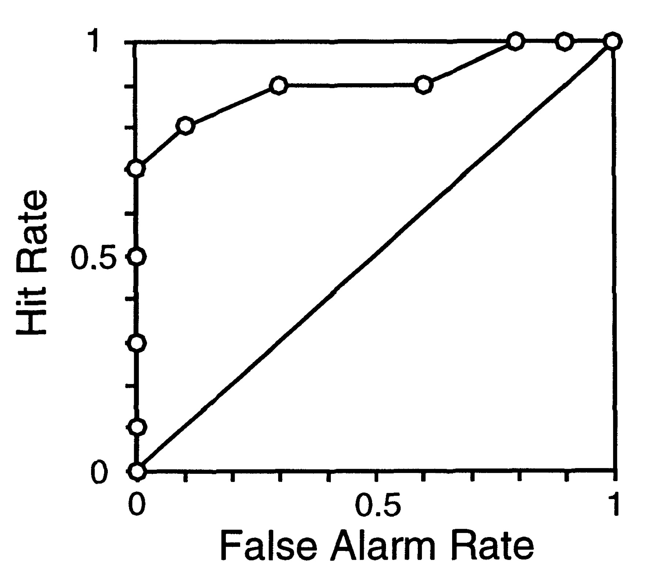
Figure 6. ROC curve based on the responses to the salient stimulus and distractors is shown for one area 7a neuron. ...
Notes:
Figure 6. ROC curve based on the responses to the salient stimulus and distractors is shown for one area 7a neuron. The area under the ROC curve was 0.9 for this example.
Unless provided in the caption above, the following copyright applies to the content of this slide: © Oxford University Press

Slide 7
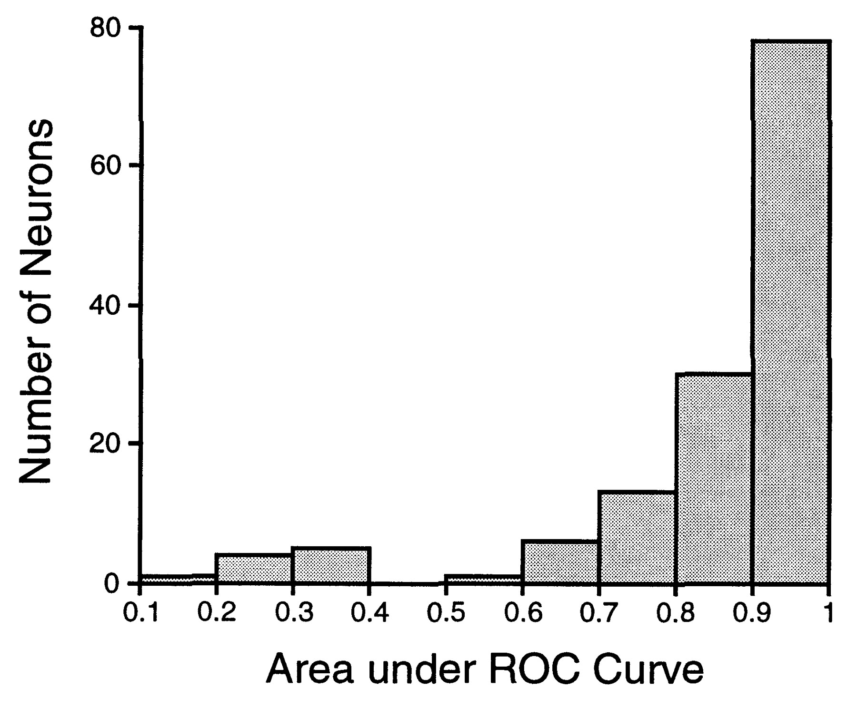
Figure 7. The distribution of the area under the ROC curve is shown for the population of area 7a neurons studied. ROC ...
Notes:
Figure 7. The distribution of the area under the ROC curve is shown for the population of area 7a neurons studied. ROC analysis was performed to compare the responses to salient stimuli and to distractors appearing inside the receptive field.
Unless provided in the caption above, the following copyright applies to the content of this slide: © Oxford University Press

Slide 8
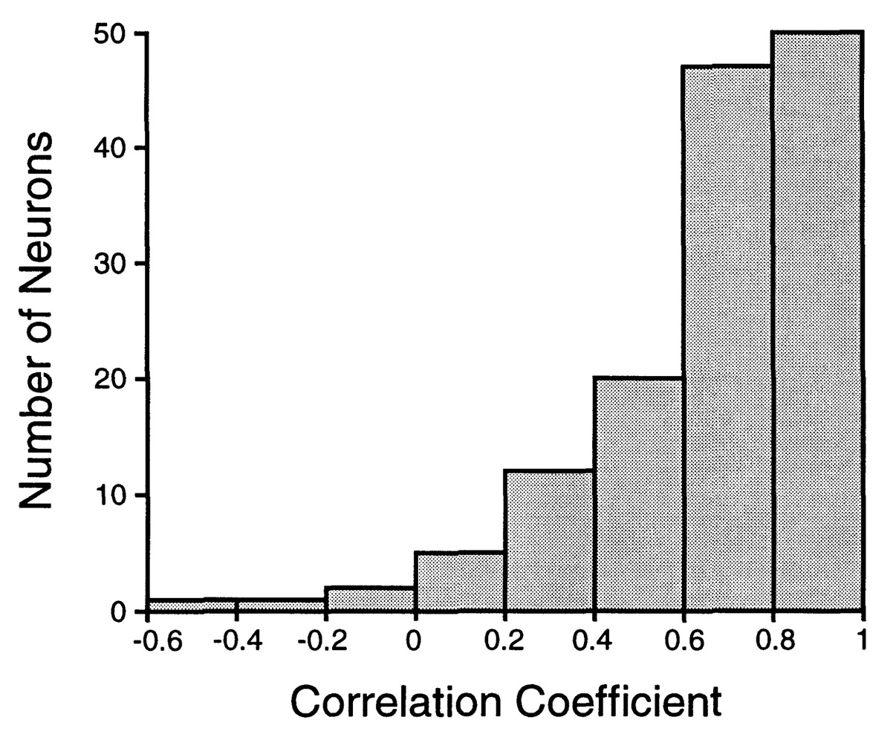
Figure 8. Coefficients of correlation between the responses to single and multiple stimuli presented with the salient ...
Notes:
Figure 8. Coefficients of correlation between the responses to single and multiple stimuli presented with the salient stimulus at each of the nine grid locations.
Unless provided in the caption above, the following copyright applies to the content of this slide: © Oxford University Press

Slide 9
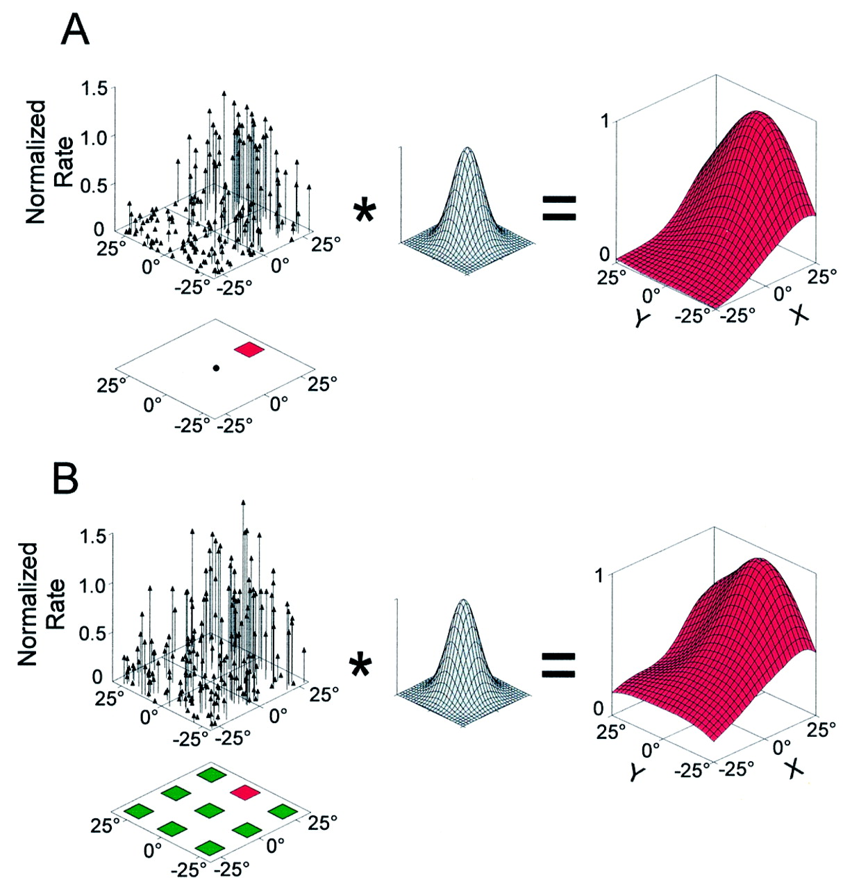
Figure 9. Population model of responses to single stimuli and multiple-stimulus arrays. Each vector represents the ...
Notes:
Figure 9. Population model of responses to single stimuli and multiple-stimulus arrays. Each vector represents the response of one neuron to the stimulus appearing to the right of fixation. The location of the vector represents the neuron's preferred stimulus location. The height of the vector is proportional to the neuron's normalized response to the stimulus. The population of vectors was convolved with a two-dimensional Gaussian with a standard deviation of 10° to produce the continuous population response function to the right. (A) Population responses to a single stimulus. (B) Responses to a multiple-stimulus array with the salient stimulus appearing to the right of fixation. Stimulus size (4°) not drawn to scale.
Unless provided in the caption above, the following copyright applies to the content of this slide: © Oxford University Press

Slide 10
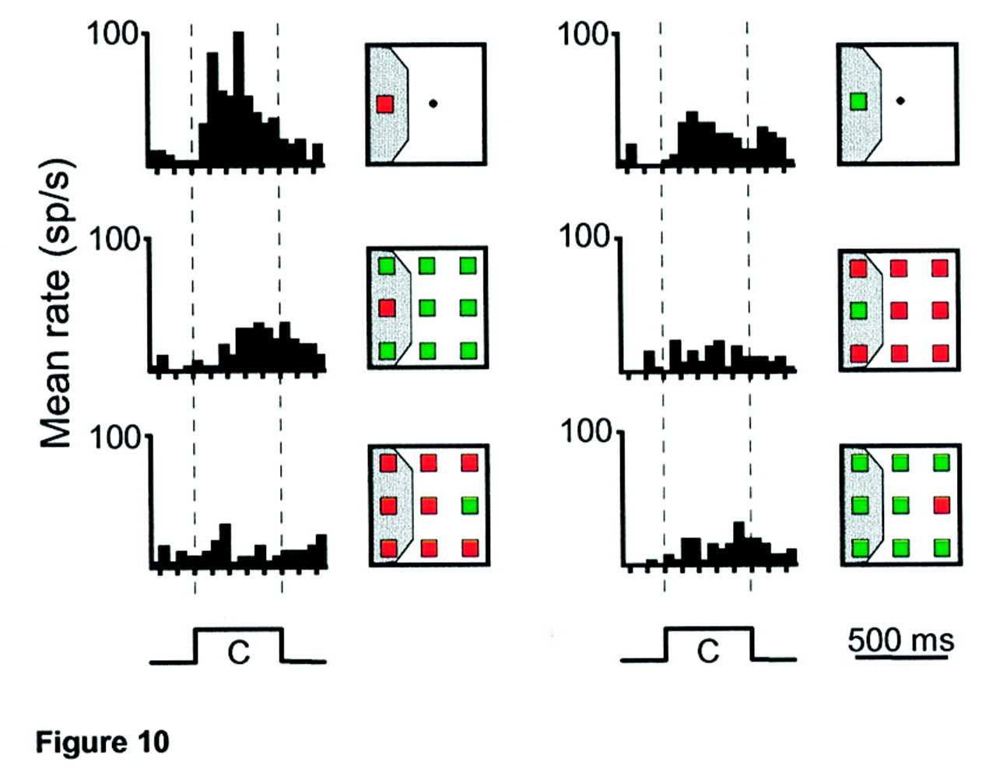
Figure 10. Response histograms show one of the rare examples of neurons displaying color selectivity. Conventions are ...
Notes:
Figure 10. Response histograms show one of the rare examples of neurons displaying color selectivity. Conventions are the same as in Figure 4. The neuron responded best to a red single stimulus in the receptive field (top left). The neuron responded to a lesser degree to a salient red stimulus (middle left), but not to red distractors in the receptive field. The response to salient stimuli of either color (top and middle rows) was ordinarily significantly greater than the response to distractors (bottom row).
Unless provided in the caption above, the following copyright applies to the content of this slide: © Oxford University Press

Slide 11
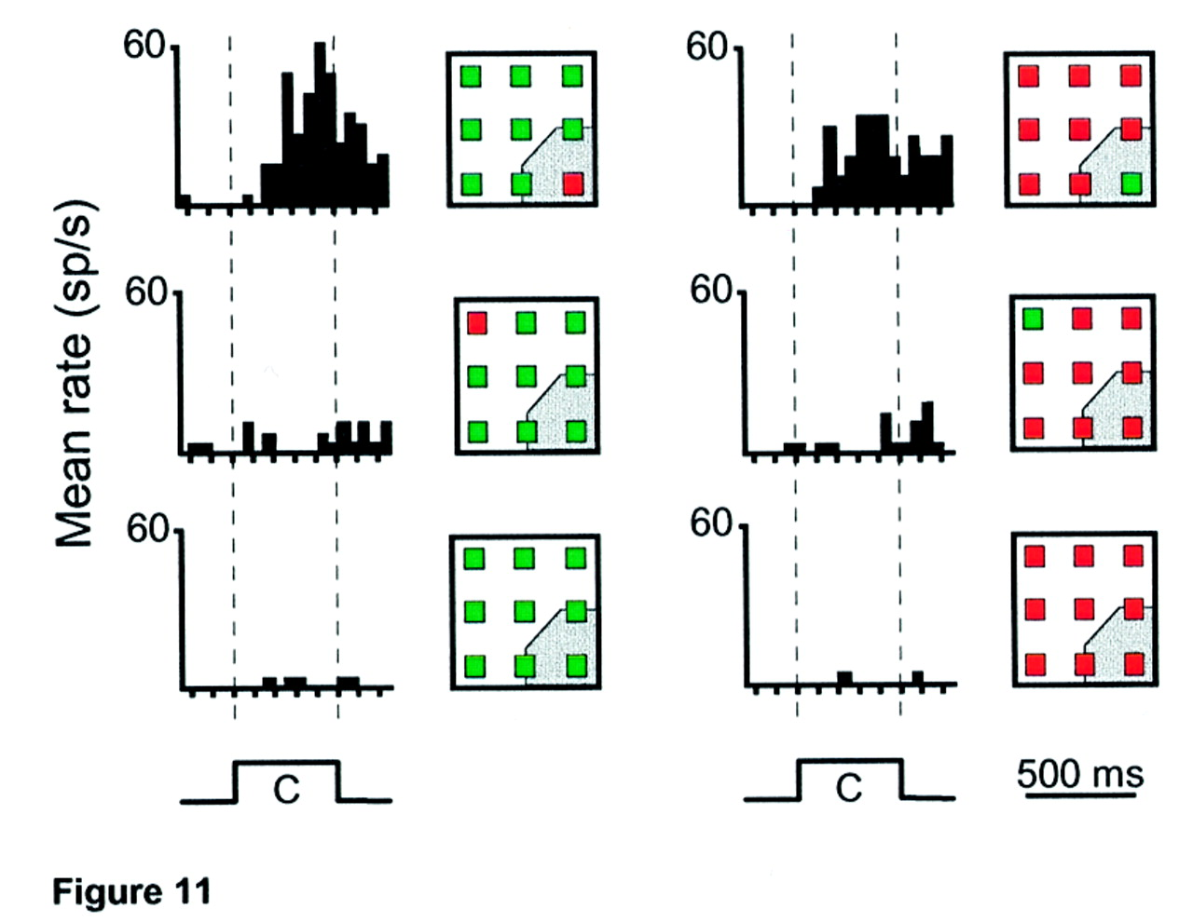
Figure 11. Response histogram shows responses of one area 7a neuron to displays with identical stimuli. Conventions are ...
Notes:
Figure 11. Response histogram shows responses of one area 7a neuron to displays with identical stimuli. Conventions are the same as in Figure 4. The neuron responded to salient stimuli of either color (top), but not to distractors (middle) appearing inside the receptive field. No response was elicited when the neuron was tested with arrays having nine identical stimuli (bottom row).
Unless provided in the caption above, the following copyright applies to the content of this slide: © Oxford University Press

Slide 12
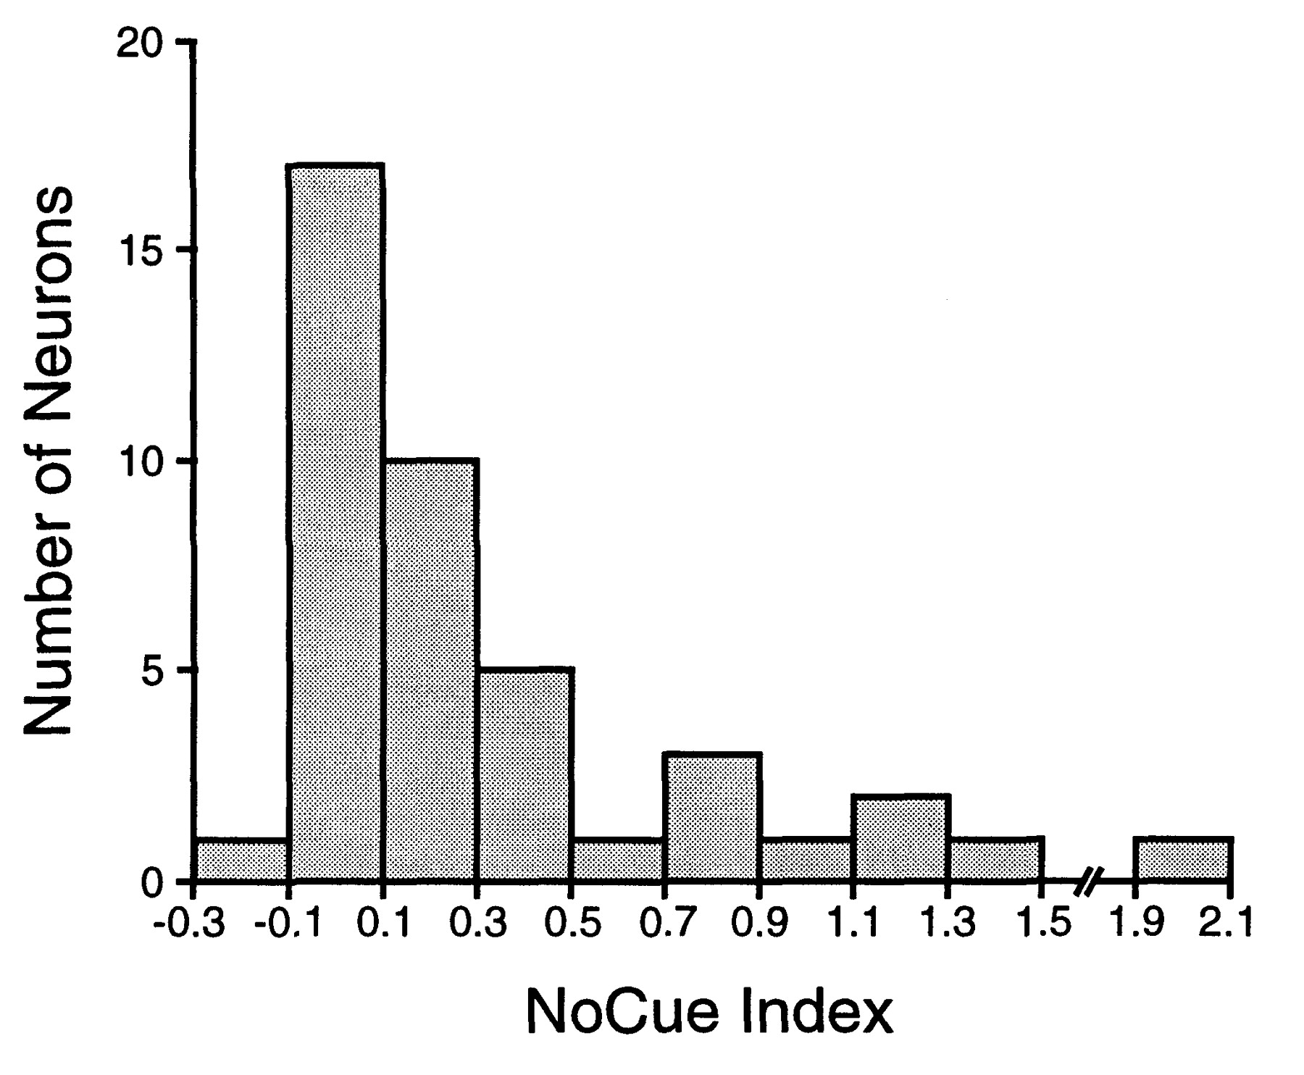
Figure 12. Histogram shows the distribution of the No-Cue index (see text for details) in the population of neurons ...
Notes:
Figure 12. Histogram shows the distribution of the No-Cue index (see text for details) in the population of neurons tested with arrays of nine identical stimuli. The majority of neurons have values close to zero, indicating that the response to a display with no salient stimulus was approximately equal to that when the salient stimulus was outside of the receptive field.
Unless provided in the caption above, the following copyright applies to the content of this slide: © Oxford University Press

Slide 13
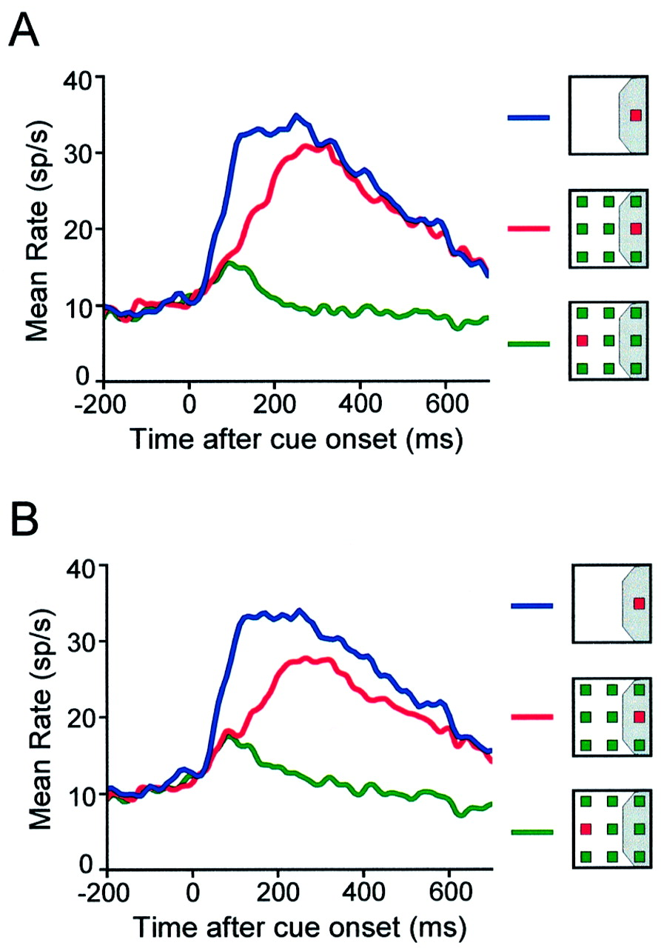
Figure 13. Population PST histograms display single and array stimulus responses. Responses are shown for single ...
Notes:
Figure 13. Population PST histograms display single and array stimulus responses. Responses are shown for single stimuli presented at the most responsive location for each neuron (blue line), for stimulus arrays with the salient stimuli at that location (red line), and for stimulus arrays with a distractor at the most responsive and the salient stimulus at the least responsive location (green line). The stimulus positions shown are examples; the actual location of the stimulus differed for each neuron. (A) Responses of the 138 neurons selective for the location of the salient stimulus. (B) Responses of all 202 neurons in our sample.
Unless provided in the caption above, the following copyright applies to the content of this slide: © Oxford University Press

Slide 14
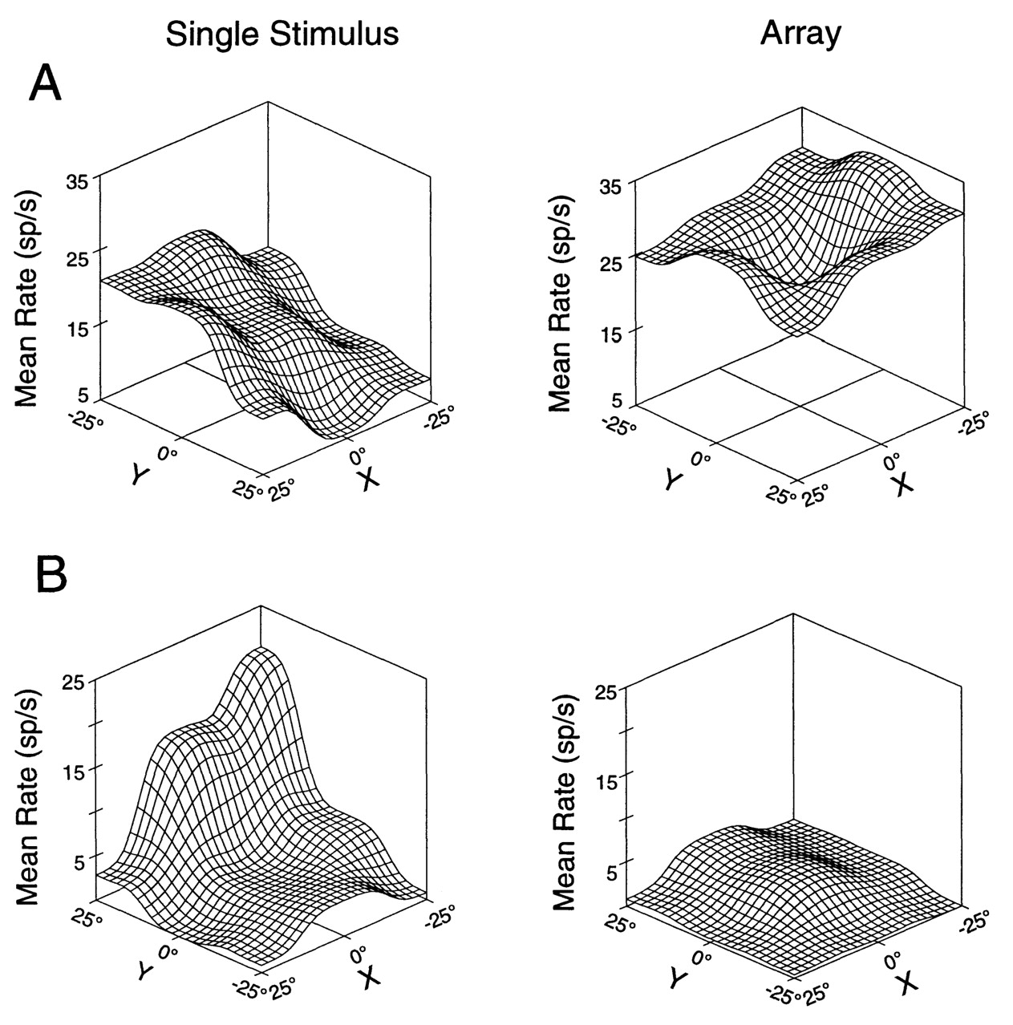
Figure 14. Surface plots showing receptive field profiles of two different neurons that did not discriminate between ...
Notes:
Figure 14. Surface plots showing receptive field profiles of two different neurons that did not discriminate between salient stimuli and distractors in multiple-stimulus arrays. Conventions are the same as in Figure 5. (A) An example of a neuron that showed similar responses to the presentation of a multiple-stimulus array regardless of the position of the salient stimulus. (B) An example of a neuron with responses that were suppressed by the presentation of the multi-stimulus array.
Unless provided in the caption above, the following copyright applies to the content of this slide: © Oxford University Press

