Slide 1
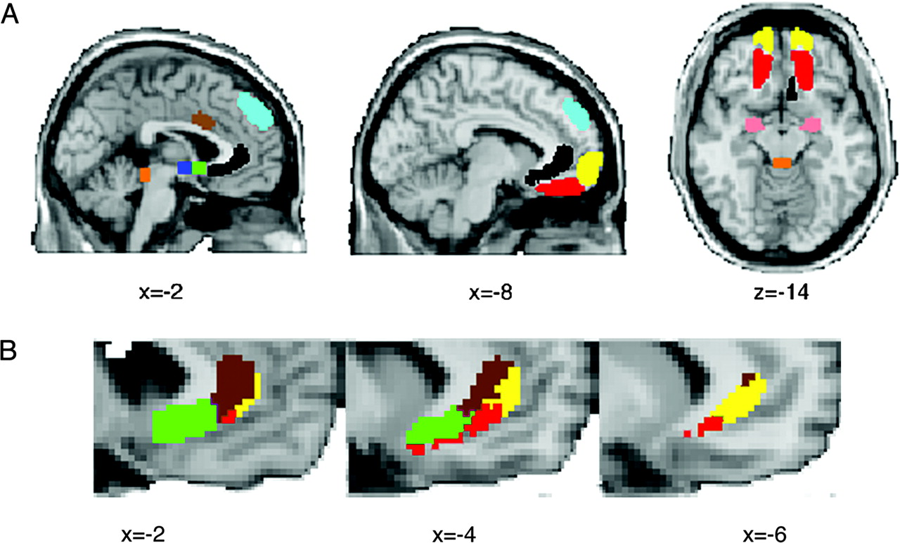
Figure 1. Distribution of connections involving ACC. (A) Locations of target ROIs defined based on change in regional ...
Notes:
Figure 1. Distribution of connections involving ACC. (A) Locations of target ROIs defined based on change in regional cerebral blood flow in a previous PET study of chronic subgenual DBS. Pink = amygdala (AMYG); brown = anterior mid cingulate (AMCC); blue = hypothalamus (HTH); green = nucleus accumbens (NAC); light blue = dorsal medial frontal (DMF); red = orbitofrontal (OFC); yellow = frontal pole (FP); orange = periaqueductal gray (PAG); also shown in black is the perigenual seed mask. (B) Dominant connections from ACC to areas showing significant functional changes following DBS. ACC voxels from within the seed ROI are color coded according to the target region with highest probability of connection only. Colors match those used for ROIs in (A): brown = AMCC; yellow = FP; green = NAC; red = OFC. Note that this representation shows only the most probable connection for each ACC seed voxel. Many voxels show connections to more than 1 target ROI (see Fig. 2).
Unless provided in the caption above, the following copyright applies to the content of this slide: © 2007 The AuthorsThis is an Open Access article distributed under the terms of the Creative Commons Attribution Non-Commercial License (http://creativecommons.org/licenses/by-nc/2.0/uk/) which permits unrestricted non-commercial use, distribution, and reproduction in any medium, provided the original work is properly cited.

Slide 2
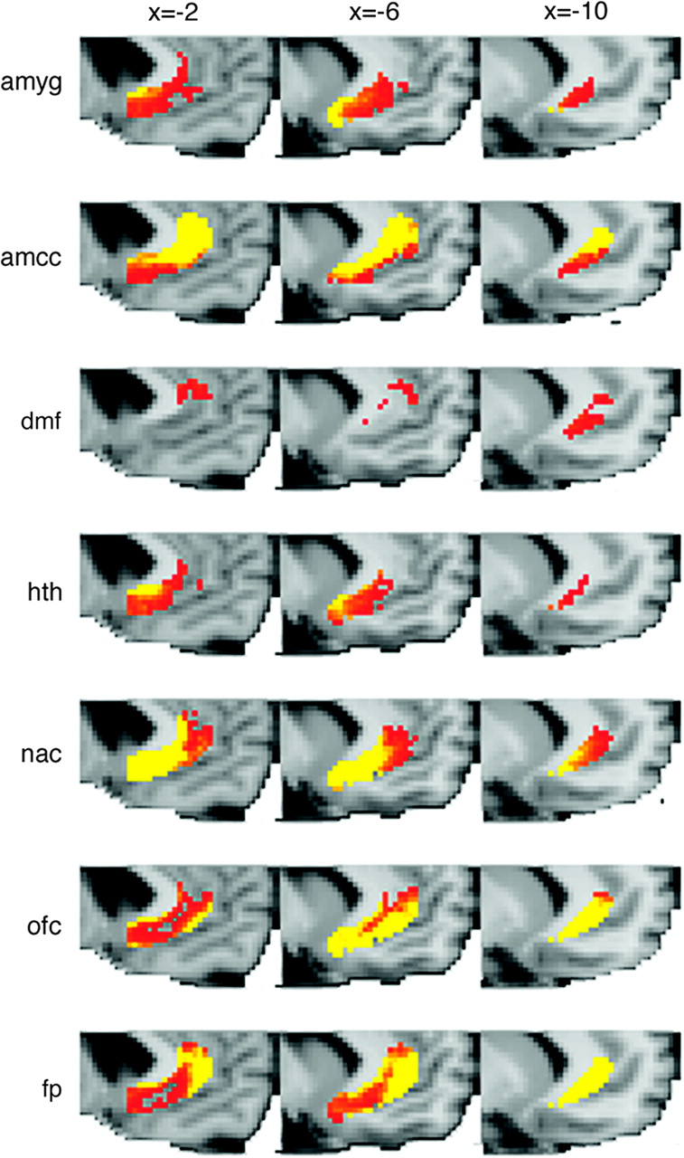
Figure 2. Distribution of connections from the perigenual cingulate seed ROI to target ROIs showing significant ...
Notes:
Figure 2. Distribution of connections from the perigenual cingulate seed ROI to target ROIs showing significant functional changes following DBS. Group average results showing voxels within the ACC seed ROI, which connected to each target ROI. The color scale indicates probability of connection from low (red, >50/5000 paths from seed voxel reach target ROI) to high (yellow, >500/5000 paths from seed voxel reach target ROI) (no voxels connecting to periaqueductal gray were found). Abbreviations for each target mask are defined in Figure 1.
Unless provided in the caption above, the following copyright applies to the content of this slide: © 2007 The AuthorsThis is an Open Access article distributed under the terms of the Creative Commons Attribution Non-Commercial License (http://creativecommons.org/licenses/by-nc/2.0/uk/) which permits unrestricted non-commercial use, distribution, and reproduction in any medium, provided the original work is properly cited.

Slide 3
Figure 3. Connectivity-based parcellation of ACC and location of electrode contacts. (A, B) Population probability maps ...
Notes:
Figure 3. Connectivity-based parcellation of ACC and location of electrode contacts. (A, B) Population probability maps of connectivity-defined sACC and pACC. Color scales represent the population probability of a voxel belonging to sACC (from 50% [dark blue] to 80% [light blue] probability) or pACC (from 50% [red] to 80% [yellow] probability). Also shown are the locations of effective electrode contacts from 9 patients overlaid in black. Effective electrode locations are mainly localized within the sACC subregion. A is located at X=−6 and B at X=−8.
Unless provided in the caption above, the following copyright applies to the content of this slide: © 2007 The AuthorsThis is an Open Access article distributed under the terms of the Creative Commons Attribution Non-Commercial License (http://creativecommons.org/licenses/by-nc/2.0/uk/) which permits unrestricted non-commercial use, distribution, and reproduction in any medium, provided the original work is properly cited.

Slide 4
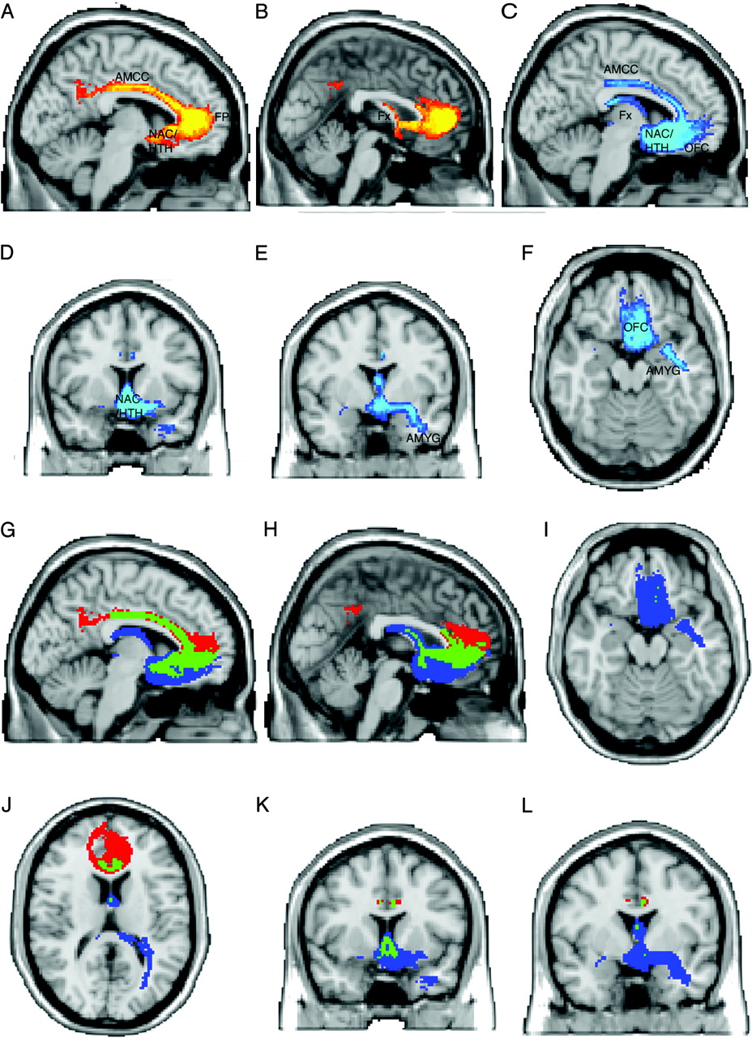
Figure 4. Tracts from sACC and pACC regions. (A–F) Population maps of results of probabilistic tractography from the ...
Notes:
Figure 4. Tracts from sACC and pACC regions. (A–F) Population maps of results of probabilistic tractography from the pACC and sACC subregions. Color scales represent the population probability of a voxel belonging to a pathway from pACC (A, B, red to yellow) or sACC (C–F, dark blue to light blue). Abbreviated labels indicate gray matter regions that are connected with sACC or pACC via these pathways. (Note that the labels identify the pathways, rather than the gray matter structures themselves, which may not be visible in all views). (A, B) Pathways from pACC connect with the AMCC (A), FP (A), NAC (A), hypothalamus (A), and fornix (B). Color scale represents population probability of a pathway being present from 50% (red) to 80% (yellow). (C, D, E, F) Pathways from the sACC connect with the OFC (C, F), NAC (C, D), hypothalamus (C, D), AMCC (C), fornix (C), and amygdala (E, F). Color scale represents population probability of a pathway being present from 50% (dark blue) to 80% (light blue). Panels G–L overlay paths from pACC (red) and sACC (blue) and indicate areas of overlapping paths (green). Note that these representations depend somewhat on the degree of thresholding applied to the pathways. Here, we show paths present in at least 50% of subjects. Using a lower threshold would give greater overlap between sACC and pACC paths, whereas a higher threshold would give less overlap.
Unless provided in the caption above, the following copyright applies to the content of this slide: © 2007 The AuthorsThis is an Open Access article distributed under the terms of the Creative Commons Attribution Non-Commercial License (http://creativecommons.org/licenses/by-nc/2.0/uk/) which permits unrestricted non-commercial use, distribution, and reproduction in any medium, provided the original work is properly cited.

