Slide 1
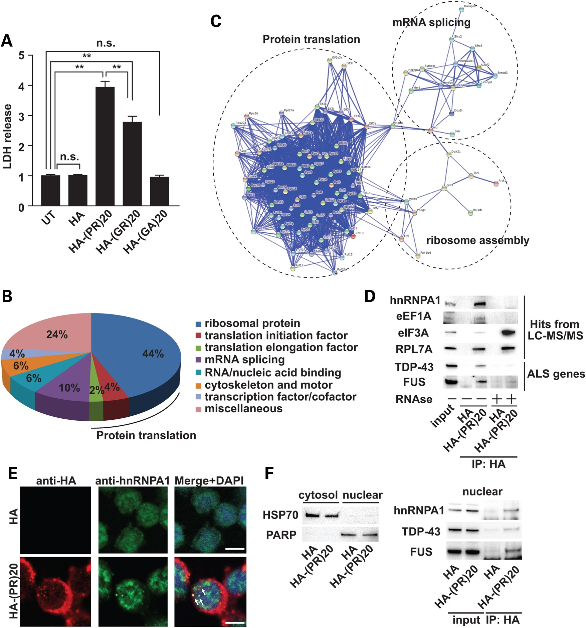
Figure 1. Poly-PR peptide interacts with RNA-binding proteins. (A) Cytotoxicity of C9orf72-derived dipeptides (10 μm) ...
Notes:
Figure 1. Poly-PR peptide interacts with RNA-binding proteins. (A) Cytotoxicity of C9orf72-derived dipeptides (10 μm) was monitored by release of LDH. N = 5 biological replicates. Statistical analysis was determined by one-way ANOVA followed by Dunnett's test. **P < 0.01 and *P < 0.05. n.s., not significant. (B) PANTHER classification of poly-PR peptide-interacting proteins identified by LC-MS/MS. (C) Functional protein association network of poly-(PR)20 peptide-binding proteins by STRING classification with high confidence (score = 0.700). (D) Co-immunoprecipitation of hnRNPA1, eEF1A, eIF3A, RPL7A (identified by LC-MS/MS), TDP-43 and FUS (familial ALS-causative RNA-binding proteins) with HA-poly-(PR)20 peptide with or without RNAse treatment. (E) Immunocytochemical analysis of NSC34 cells treated with HA peptide (5 μm) or HA-poly-(PR)20 peptide (5 μm) for overnight. The white bar shows 10 μm. (F) Left panel: Fractionated samples from NSC34 cells treated with HA peptide (5 μm) or HA-poly-(PR)20 peptide (5 μm) for overnight. HSP70 was used as a cytosolic marker and PARP was used as a nuclear marker. Right panel: co-immunoprecipitation of hnRNPA1, TDP-43 and FUS with HA-poly-(PR)20 peptide in the nuclear fraction.
Unless provided in the caption above, the following copyright applies to the content of this slide: © The Author 2016. Published by Oxford University Press. All rights reserved. For Permissions, please email: journals.permissions@oup.com

Slide 2
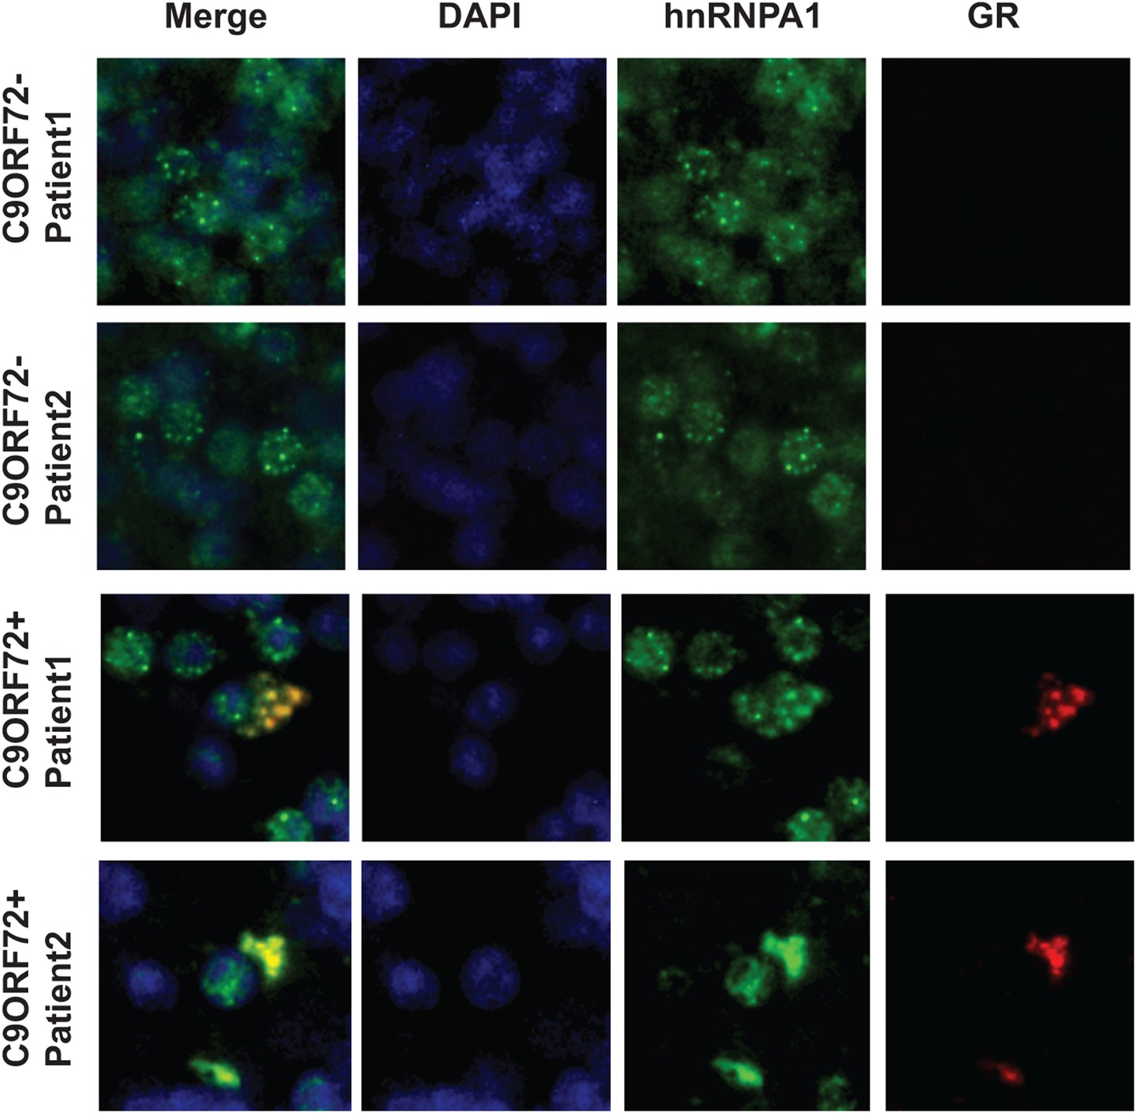
Figure 2. GR-aggregates colocalize with hnRNPA1. Immunohistochemistry in the cerebellar granular layer of two C9orf72 ...
Notes:
Figure 2. GR-aggregates colocalize with hnRNPA1. Immunohistochemistry in the cerebellar granular layer of two C9orf72 ALS cases and two non-C9orf72 cases reveals coaggregation of poly-GR with hnRNPA1.
Unless provided in the caption above, the following copyright applies to the content of this slide: © The Author 2016. Published by Oxford University Press. All rights reserved. For Permissions, please email: journals.permissions@oup.com

Slide 3
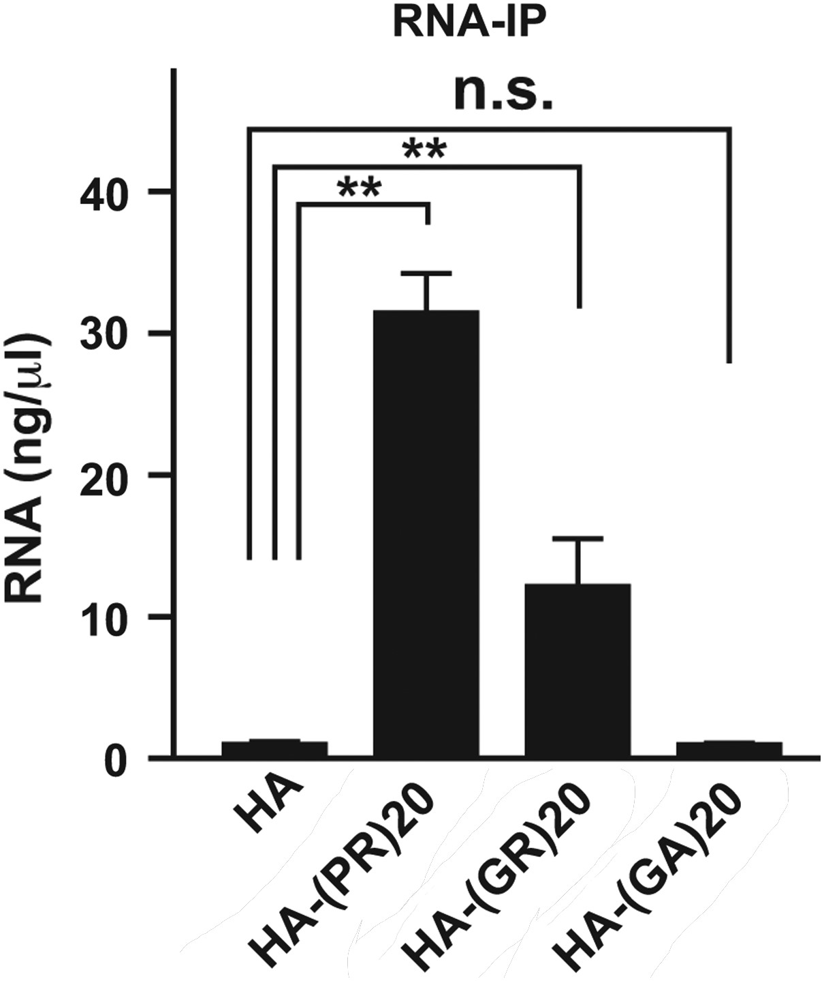
Figure 7. Interaction between C9orf72 dipeptides and ribonucleotides in vivo. The concentration of RNA extracted from ...
Notes:
Figure 7. Interaction between C9orf72 dipeptides and ribonucleotides in vivo. The concentration of RNA extracted from immunoprecipitated samples from NSC34 cells cultured with 10 μm of HA peptide, HA-poly-(PR)20, HA-poly-(GR)20 or HA-poly-(GA)20 peptides. N = 3 biological replicates. Asterisks indicate a significant difference analyzed by one-way ANOVA followed by Dunnett's test (**P < 0.01 and *P < 0.05).
Unless provided in the caption above, the following copyright applies to the content of this slide: © The Author 2016. Published by Oxford University Press. All rights reserved. For Permissions, please email: journals.permissions@oup.com

Slide 4
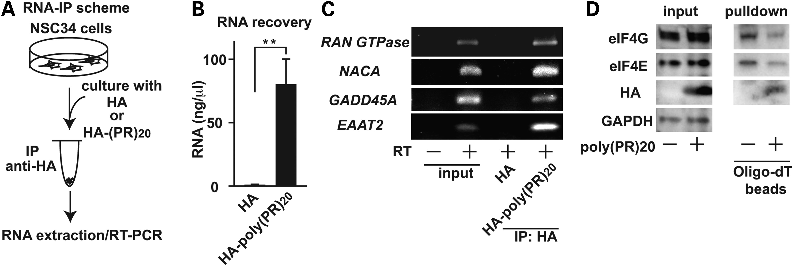
Figure 6. Poly-(PR)₂₀-mRNA complexes inhibits protein translation. (A) A scheme of RNA immunoprecipitation ...
Notes:
Figure 6. Poly-(PR)20-mRNA complexes inhibits protein translation. (A) A scheme of RNA immunoprecipitation followed by RT-PCR. NSC34 cells cultured with 10 μm of HA peptide or HA-poly-(PR)20 peptide was harvested, followed by RNA immunoprecipitated with anti-HA antibody. After extraction of RNA, RT-PCR was performed. (B) The concentration of RNA extracted from immunoprecipitated samples. N = 3 biological replicates. (C) RT-PCR of Ran GTPase, NACA, GADD45A and EAAT2 from immunoprecipitated samples. (D) mRNA–protein complex in NSC34 cells treated with or without 10 μm of HA-poly-(PR)20 peptide, fixed with formaldeyde, were isolated with oligo-dT beads, followed by immunoblot analysis with anti-eIF4E and anti-eIF4G antibody. Asterisks indicate a significant difference analyzed by Dunnet's test (**P < 0.01). Each experiment and imaging was repeated a least three times independently. Reperesentative images were shown.
Unless provided in the caption above, the following copyright applies to the content of this slide: © The Author 2016. Published by Oxford University Press. All rights reserved. For Permissions, please email: journals.permissions@oup.com

Slide 5
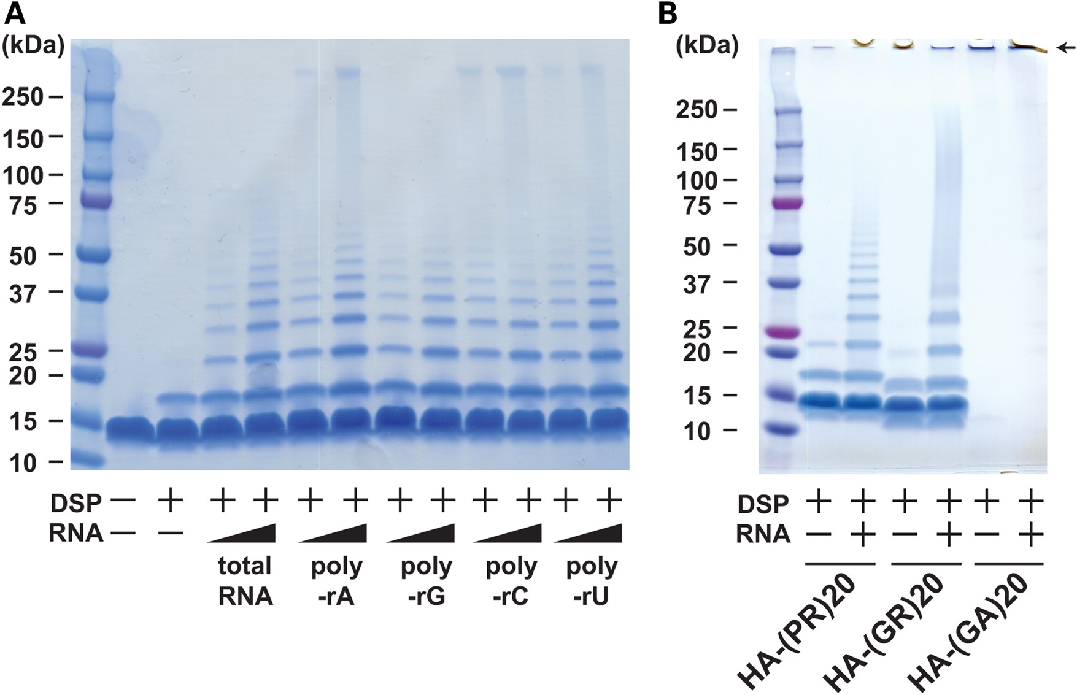
Figure 5. Interaction between C9orf72 dipeptides and ribonucleotides in vitro. (A) Coomassie blue staining of poly-PR ...
Notes:
Figure 5. Interaction between C9orf72 dipeptides and ribonucleotides in vitro. (A) Coomassie blue staining of poly-PR aggregates induced by yeast total RNA or monopolymeric poly-adenilyc acids (poly-rA, poly-rG, poly-rC or poly-rU). Samples were crosslinked with dithiobis (succinimidyl propionate) (DSP, 2 mm) before applied to SDS–PAGE. (B) Coomassie blue staining of poly-PR, poly-GR or poly-GA aggregates induced by yeast total RNA. Samples were crosslinked with dithiobis (succinimidyl propionate) (DSP, 2 mm) before applied to SDS–PAGE. An arrow shows the aggregate of poly-GA accumulated in the stucking gel.
Unless provided in the caption above, the following copyright applies to the content of this slide: © The Author 2016. Published by Oxford University Press. All rights reserved. For Permissions, please email: journals.permissions@oup.com

Slide 6
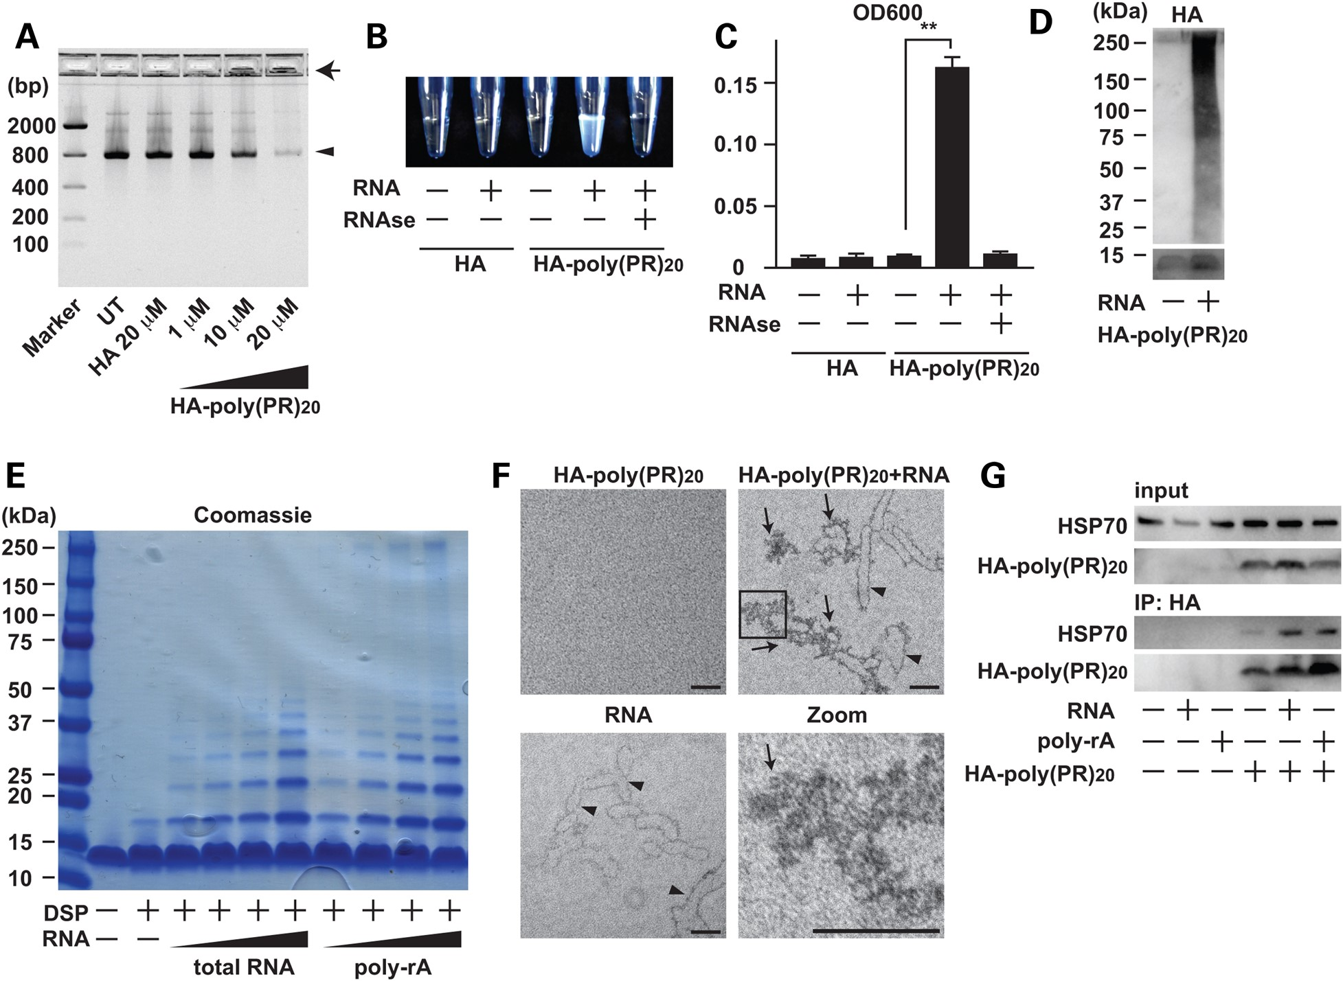
Figure 4. Poly-PR peptide interacts with RNA and forms aggregates. (A) Agarose gel electrophoresis of solutions ...
Notes:
Figure 4. Poly-PR peptide interacts with RNA and forms aggregates. (A) Agarose gel electrophoresis of solutions containing GFP mRNA with HA peptide or HA-poly-(PR)20 peptide at indicated concentrations. An arrowhead shows GFP mRNA and an arrow shows insoluble RNA aggregate. (B and C) The measurement of turbidity using the optical density at 600 nm (OD600) of the solution containing HA peptide or HA-poly-(PR)20 peptides mixed with or without yeast total RNA. The image represents visible formation of poly-PR aggregates that can be reversed by treatment with RNase. N = 3 biological replicates. (D) Immunoblot analysis of HA-poly-(PR)20 peptides mixed with or without yeast total RNA. SDS–PAGE was performed with a 4–20% gradient gel. (E) Coomassie blue staining of poly-PR aggregates induced by yeast total RNA or monopolymeric poly-adenilyc acids (poly-rA). Samples were crosslinked with dithiobis (succinimidyl propionate) (DSP, 2 mm) before applied to SDS–PAGE. (F) Electron microscope images of poly-PR aggregates induced by RNA. The scale bar shows 50 nm. Arrowheads show RNA and arrows show poly-PR aggregate. (G) Co-immunoprecipitation of human recombinant HSP70 with HA-poly-(PR)20 peptides mixed with or without yeast total RNA or poly-rA. Each experiment was repeated at least three times and representative images were shown. Asterisks indicate a significant difference analyzed by one-way ANOVA followed by Dunnett's test (**P < 0.01 and *P < 0.05).
Unless provided in the caption above, the following copyright applies to the content of this slide: © The Author 2016. Published by Oxford University Press. All rights reserved. For Permissions, please email: journals.permissions@oup.com

Slide 7
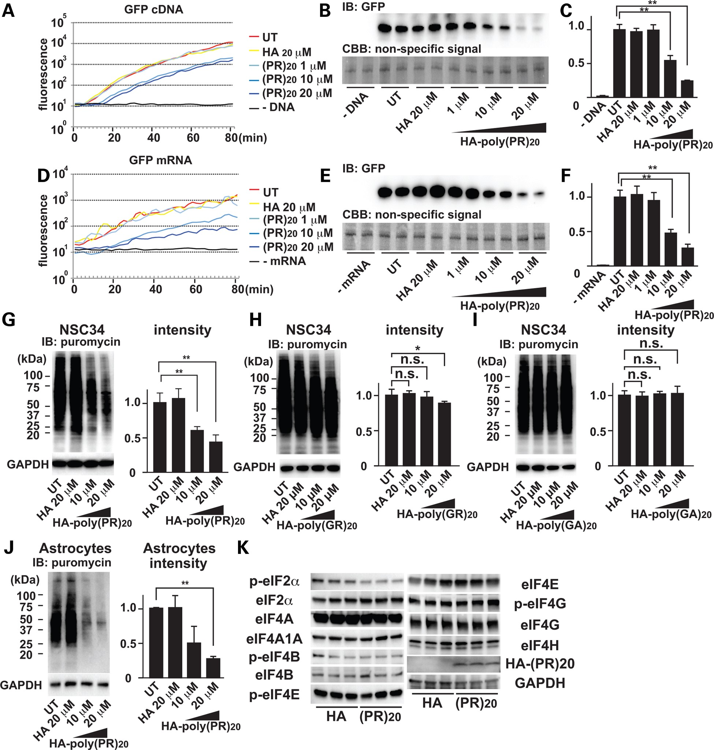
Figure 3. Poly-PR peptide inhibits protein translation. (A) Real-time monitoring of GFP fluorescence translated from ...
Notes:
Figure 3. Poly-PR peptide inhibits protein translation. (A) Real-time monitoring of GFP fluorescence translated from GFP cDNA by IVT. (B) Immunoblot analysis of GFP protein. Coomassie stained non-specific signals were used as loading controls. (C) Quantitation of immunoblot of GFP. N = 3 biological replicates. (D) Real-time monitoring of GFP fluorescence translated from GFP mRNA by IVT. (E) Immunoblot analysis of GFP protein. Coomassie stained non-specific bands were used as loading control. (F) Quantitation of immunoblot of GFP. N = 3 biological replicates. (G) Immunoblot analysis of newly translated proteins in NSC34 cells incubated with HA peptide or HA-poly-(PR)20 peptide. Newly translated proteins were labeled with puromycin and visualized by anti-puromycin antibody. (H) Immunoblot analysis of newly translated proteins in NSC34 cells incubated with HA peptide or HA-poly-(GR)20 peptide. Newly translated proteins were labeled with puromycin and visualized by anti-puromycin antibody. N = 3 biological replicates. (I) Immunoblot analysis of newly translated proteins in NSC34 cells incubated with HA peptide or HA-poly-(GA)20 peptide. Newly translated proteins were labeled with puromycin and visualized by anti-puromycin antibody. N = 3 biological replicates. (J) Immunoblot analysis of newly translated proteins in mouse primary astrocytes incubated with HA peptide or HA-poly-(PR)20 peptide. Newly translated proteins were labeled with puromycin and visualized by anti-puromycin antibody. N = 3 biological replicates. (K) Immunoblot analysis of a series of eIF, phosphorylated forms of eIFs, HA and GAPDH in the cell lysates of NSC34 cells treated with 10 μm of HA control peptide or HA-poly-(PR)20 peptide. N = 3 biological replicates. Each experiment was repeated at least three times independently. Representative images were shown. Asterisks indicate a significant difference analyzed by one-way ANOVA followed by Dunnett's test (**P < 0.01 and *P < 0.05).
Unless provided in the caption above, the following copyright applies to the content of this slide: © The Author 2016. Published by Oxford University Press. All rights reserved. For Permissions, please email: journals.permissions@oup.com

