Slide 1
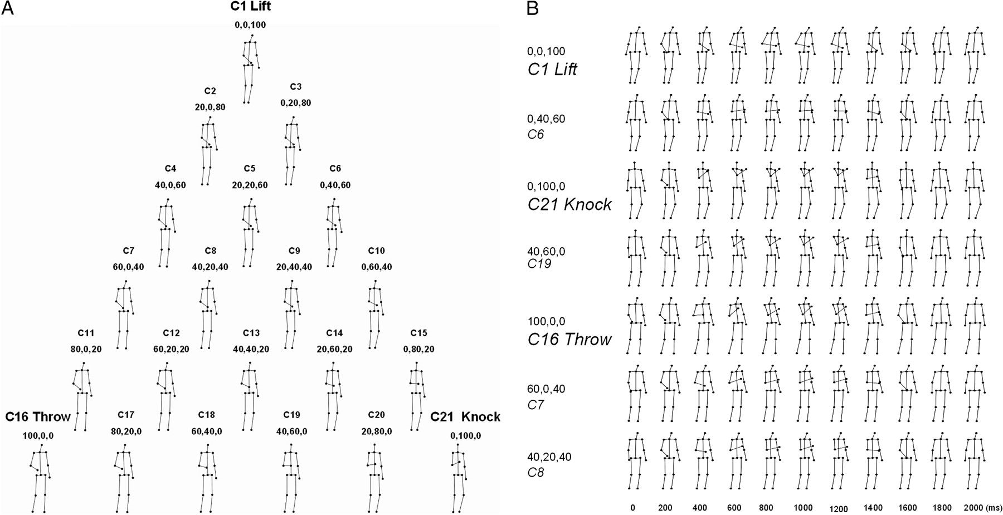
Figure 1. Schematic representation of the parametric action space. (A) Triangular 2D configuration of the parametric ...
Notes:
Figure 1. Schematic representation of the parametric action space. (A) Triangular 2D configuration of the parametric action space displaying the 18th frame (occurring at 300 ms) of each action sequence. Condition labels and blending weights (percentage of throwing, knocking, and lifting, respectively), are given above each frame. (B) Undersampled sequences of snapshots of 7 actions, sampled every 200 ms. The condition labels and weights (expressed in percentage) used in the blending algorithm based on the throwing-, knocking-, and lifting-prototype, respectively, are shown in front of each action sequence.
Unless provided in the caption above, the following copyright applies to the content of this slide: © The Author 2008. Published by Oxford University Press. All rights reserved. For permissions, please e-mail: journals.permissions@oxfordjournals.org

Slide 2
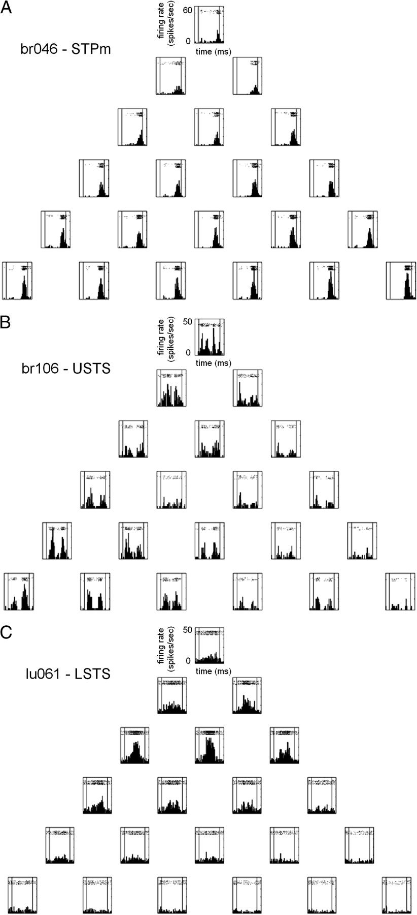
Figure 2. Selectivity for parameterized actions in temporal visual cortex: single neuron examples. Peristimulus time ...
Notes:
Figure 2. Selectivity for parameterized actions in temporal visual cortex: single neuron examples. Peristimulus time histograms (PSTH) with raster plots of 3 example neurons recorded with the parametric action space test. PSTHs are positioned according to the position of the stimulus in the parametric action space (Fig. 1A). (A) Neurons were recorded in the STPm region (A), the upper bank of the STS (USTS) (B) and the lower bank of the STS (LSTS) (C). Bin width was 50 ms. For each neuron, firing rates in spikes/s are indicated on the vertical axis. Vertical lines inside each box mark stimulus onset and offset; stimulus duration was 2000 ms.
Unless provided in the caption above, the following copyright applies to the content of this slide: © The Author 2008. Published by Oxford University Press. All rights reserved. For permissions, please e-mail: journals.permissions@oxfordjournals.org

Slide 3
Figure 3. Neural representation of the parametric action space. (A) Triangular 2D configuration of the stimulus space ...
Notes:
Figure 3. Neural representation of the parametric action space. (A) Triangular 2D configuration of the stimulus space of actions, with the same convention of condition numbers as in Figure 1A. The outer sides of the triangle are marked in red, whereas different colors are used to indicate different weighting of the lifting-prototype (action C1). (B) Neural representations of the stimulus space obtained after applying ISOMAP (nonlinear MDS) to the mean responses averaged using an analysis window ranging from 50 to 2050 ms (N = 198 neurons). (C) Scree plot of the residual variance as a function of the number of dimensions. A 2 dimensional configuration captured the original distances rather well (residual variance = 0.05).
Unless provided in the caption above, the following copyright applies to the content of this slide: © The Author 2008. Published by Oxford University Press. All rights reserved. For permissions, please e-mail: journals.permissions@oxfordjournals.org

Slide 4
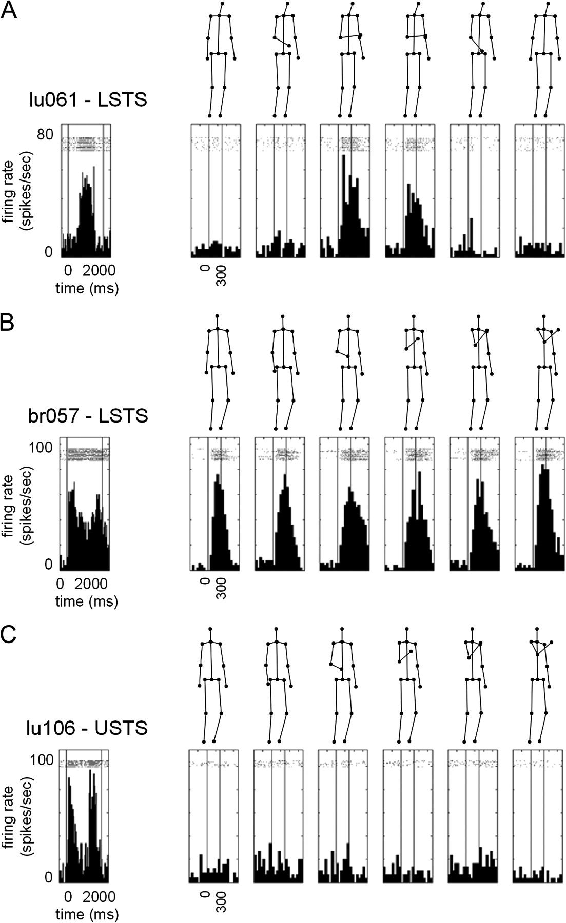
Figure 4. Neural responses to static snapshot presentations and actions compared. Peristimulus time histograms with ...
Notes:
Figure 4. Neural responses to static snapshot presentations and actions compared. Peristimulus time histograms with raster plots of 3 example neurons showing responses in the static snapshot test. (A) Neuron recorded in the lower bank of the STS (LSTS), corresponding to Figure 2C (Action index = −0.01). (B) Neuron recorded in the lower bank of the STS (Action index = −0.13). (C) Neuron recorded in the upper bank of the STS (Action index = 0.64). The left box of each panel contains the neural response to the corresponding full action sequence. Boxes on the right side of each panel contain the neural responses to the different static snapshots. The 6 snapshots are illustrated above the PSTH boxes. Time course (in ms) and response strength (firing rate in spikes/s) are indicated. Vertical lines mark stimulus onset and offset (stimulus duration of action sequence (left boxes): 2000 ms; stimulus duration of static snapshot presentations (right boxes): 300 ms).
Unless provided in the caption above, the following copyright applies to the content of this slide: © The Author 2008. Published by Oxford University Press. All rights reserved. For permissions, please e-mail: journals.permissions@oxfordjournals.org

Slide 5
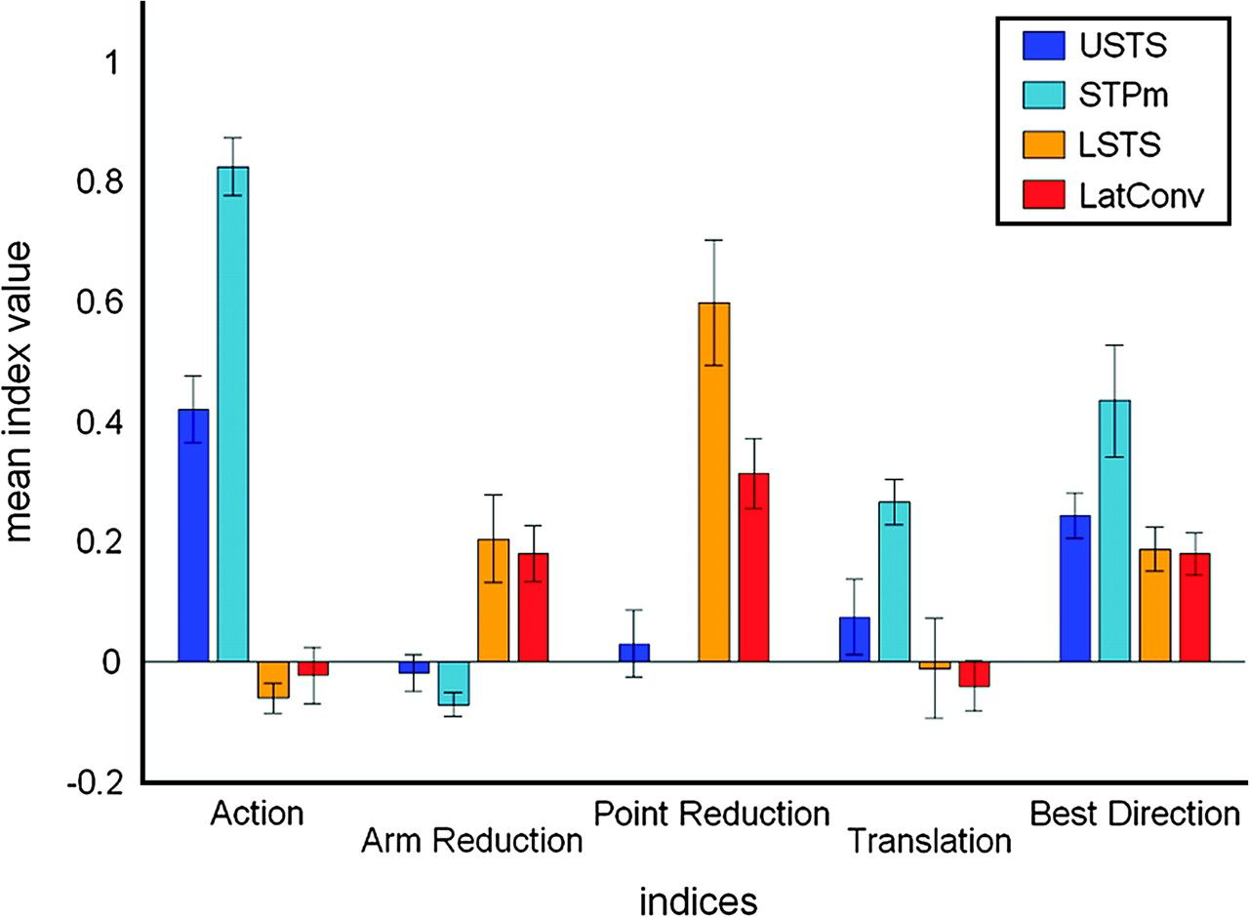
Figure 5. Regional differences in neural response properties in the visual temporal cortex. Mean index values (indices ...
Notes:
Figure 5. Regional differences in neural response properties in the visual temporal cortex. Mean index values (indices = Action, Arm Reduction, Point Reduction, Translation, and Best Direction) for the different anatomical regions (USTS = upper bank and fundus of the STS (blue), STPm (light blue), LSTS = lower bank of the STS (orange), and LatConv = lateral temporal convexity (red). Vertical bars denote standard errors of the mean. An index of 1 for the first 4 indices indicates, respectively, no responses to static snapshots, to reduced-action configurations presenting the arm-only or wristpoint-only, and to translating snapshots. An index of 1 for the Best Direction index indicates maximum direction selectivity among the dominant motion axes of the action.
Unless provided in the caption above, the following copyright applies to the content of this slide: © The Author 2008. Published by Oxford University Press. All rights reserved. For permissions, please e-mail: journals.permissions@oxfordjournals.org

Slide 6
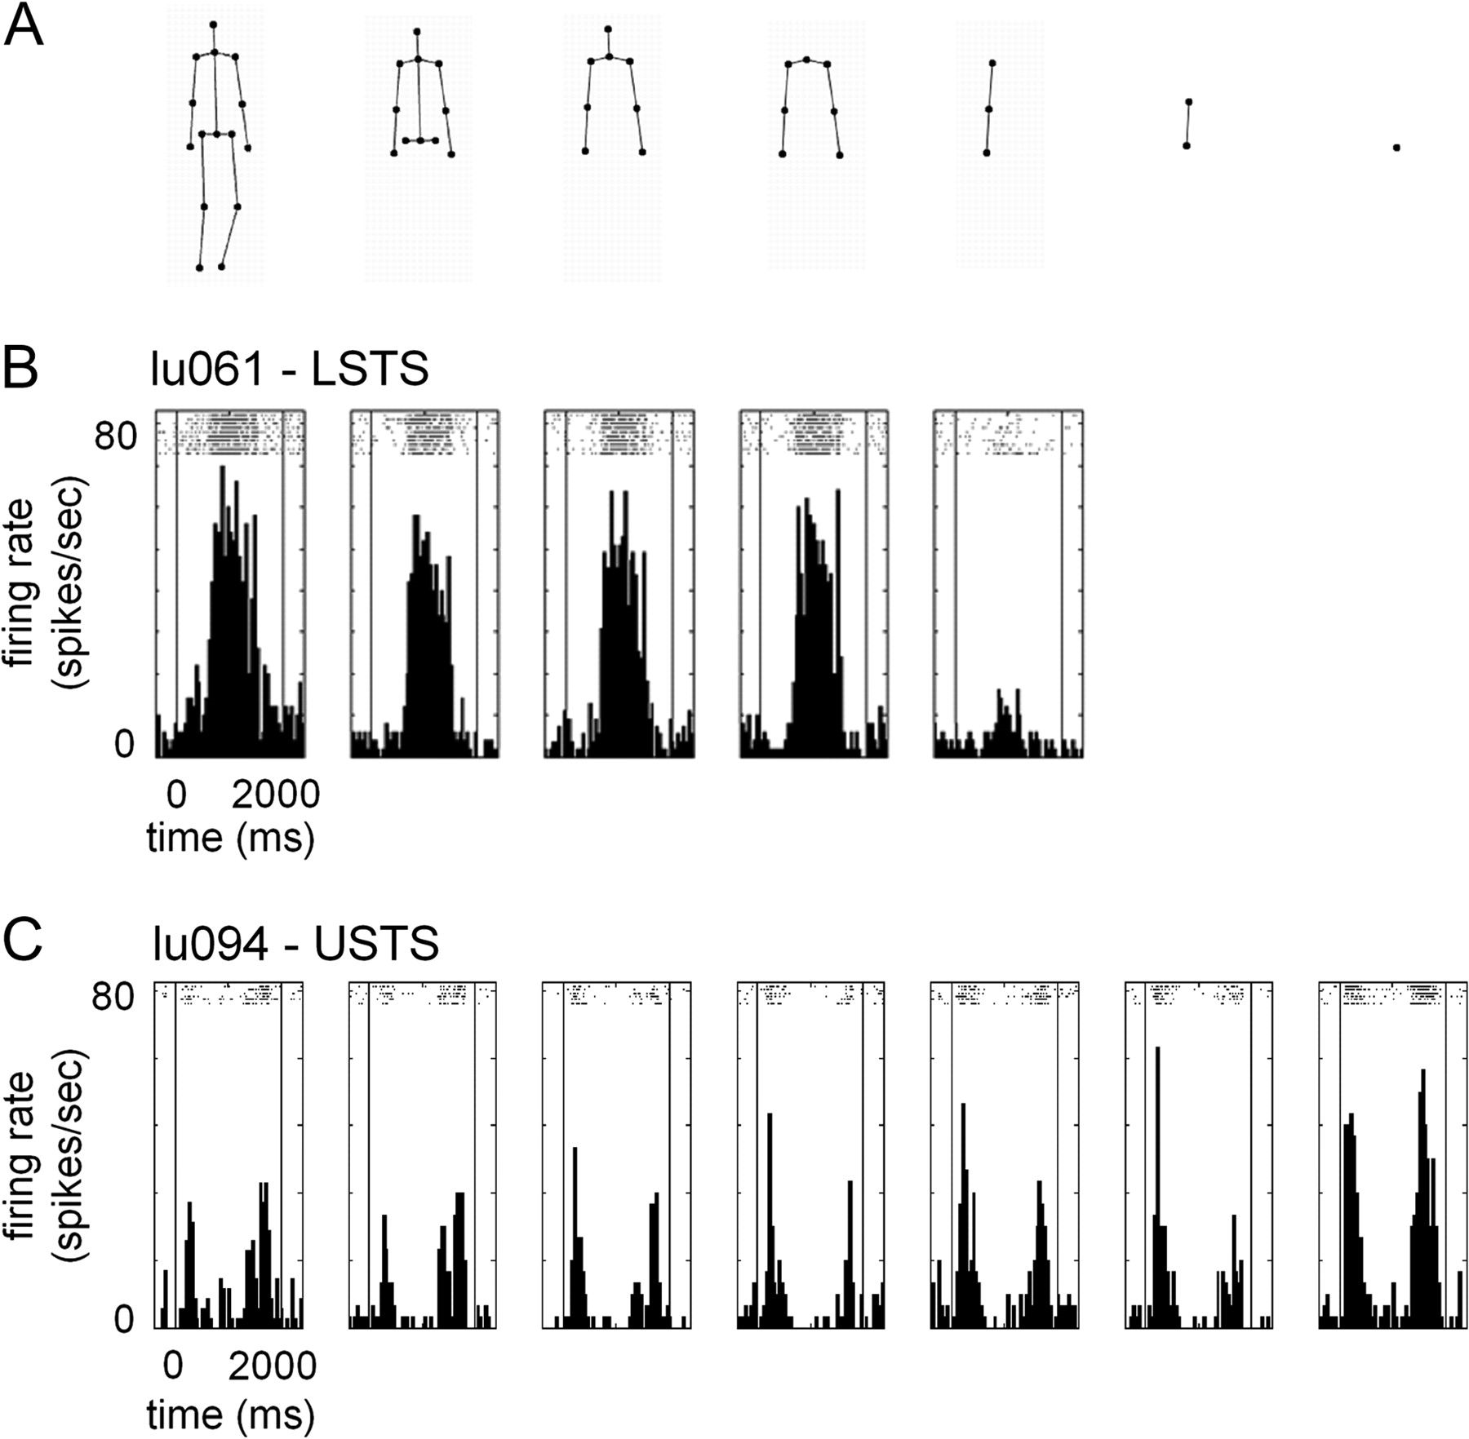
Figure 6. Neural responses to full-body and reduced-action configurations compared. Peristimulus time histograms with ...
Notes:
Figure 6. Neural responses to full-body and reduced-action configurations compared. Peristimulus time histograms with raster plots for 2 example neurons recorded with the reduced-action configuration test. (A) Systematic reductions of the stimulus configuration from the full-body action configuration down to the presentation of the wristpoint-only. Only the first frame of action C1 (lifting-prototype) is shown. Note that the actual test contained dynamic sequences of these reduced configurations. (B) Neuron recorded in the lower bank of the STS, corresponding to Figure 2C, tested with the reduced-action configurations of C5 down to the arm-only presentations. A “Napoleon” posture with the right arm wristpoint covering the left arm elbow point was necessary to drive this neuron. (Arm Reduction index = 0.71). (C) Neuron recorded in the fundus/upper bank of the STS, tested with the reduced-action configurations of C21 down to the presentation of the wristpoint dynamic sequence, which drove the response even more strongly than the full action configuration (Arm Reduction index = −0.19; Point Reduction index = −0.32). Time course (in ms) and response strength (firing rate in spikes/s) are indicated on the action sequence scale. Vertical lines mark stimulus onset and offset. Stimulus durations were 2000 ms.
Unless provided in the caption above, the following copyright applies to the content of this slide: © The Author 2008. Published by Oxford University Press. All rights reserved. For permissions, please e-mail: journals.permissions@oxfordjournals.org

Slide 7
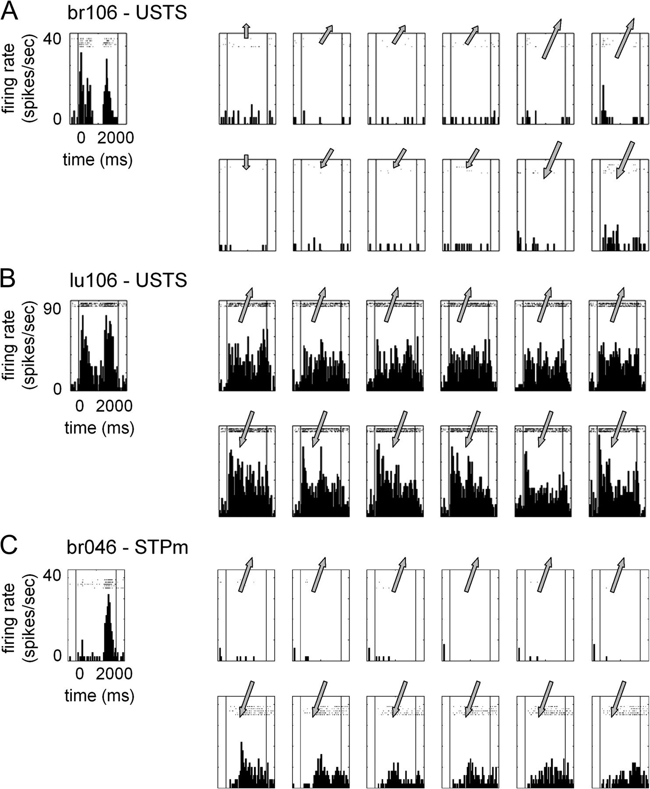
Figure 7. Neural responses to actions and translating snapshots compared. Peristimulus time histograms with raster ...
Notes:
Figure 7. Neural responses to actions and translating snapshots compared. Peristimulus time histograms with raster plots of 3 example neurons recorded with the translating snapshots test. The left boxes of each panel contain the responses to the action sequences. The right boxes of each panel contain the responses to 6 translating snapshots (not shown), in upward (upper part) and in downward directions (lower part). The arrows approximate the velocity (speed = length of arrow, direction = angle of arrow) of translation of each snapshot. (A) Neuron recorded in the upper bank/fundus of the STS. This neuron responded well to nonrigid motion in the action sequence, but failed to respond to rigidly translating snapshots. (Translation index = 0.38; Best Direction index = 0.13) (B) Neuron recorded in the upper bank/fundus of the STS. This neuron showed responses to translating snapshots. (Translation index = −0.02; Best Direction index = 0.25) (C) Neuron recorded in the STPm region. This neuron manifested strong direction selectivity for the translating snapshots. (Translation index = 0.34; Best Direction index = 0.88). Time course (in ms) and response strength (firing rate in spikes/s) are indicated on the action sequence scale. Vertical lines mark stimulus onset and offset. Stimulus durations were 2000 ms.
Unless provided in the caption above, the following copyright applies to the content of this slide: © The Author 2008. Published by Oxford University Press. All rights reserved. For permissions, please e-mail: journals.permissions@oxfordjournals.org

Slide 8
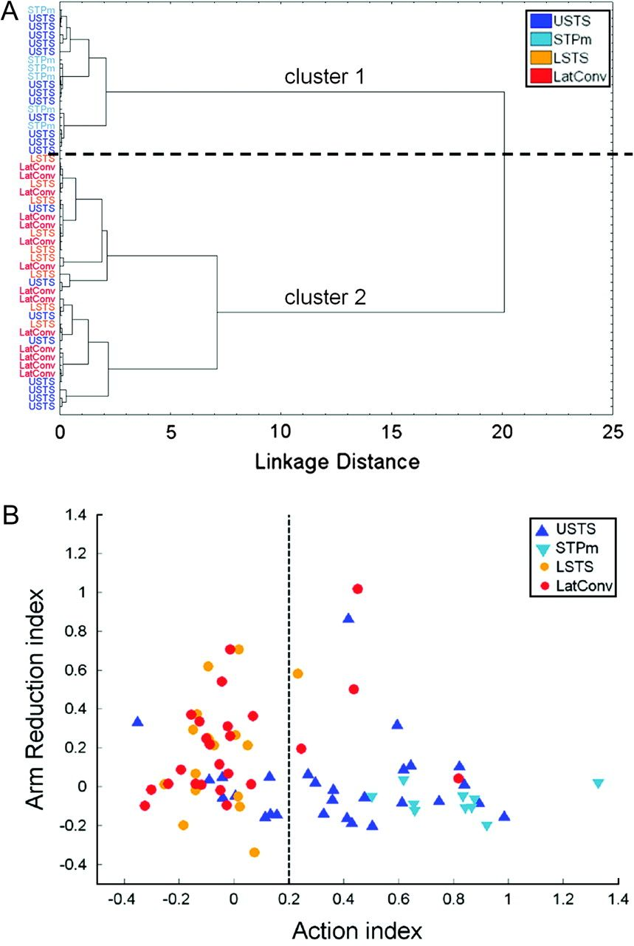
Figure 8. Functional differentiation of temporal cortical regions. (A) Tree diagram of the result of a cluster analysis ...
Notes:
Figure 8. Functional differentiation of temporal cortical regions. (A) Tree diagram of the result of a cluster analysis based on pairwise between-neuron correlations of the Action, Arm Reduction, Translation and Best Direction indices (N = 49 neurons). Neurons are labeled according to their anatomical region. (B) Relationship between Action and Arm Reduction indices. Each dot represents a neuron (N = 79) that was recorded in both the Static Snapshot and Reduced-action configuration tests. The color coding is the same as in (A). The criterion to distinguish between “snapshot” and “motion” neurons was set at 0.20 and is indicated by the striped vertical line.
Unless provided in the caption above, the following copyright applies to the content of this slide: © The Author 2008. Published by Oxford University Press. All rights reserved. For permissions, please e-mail: journals.permissions@oxfordjournals.org

Slide 9
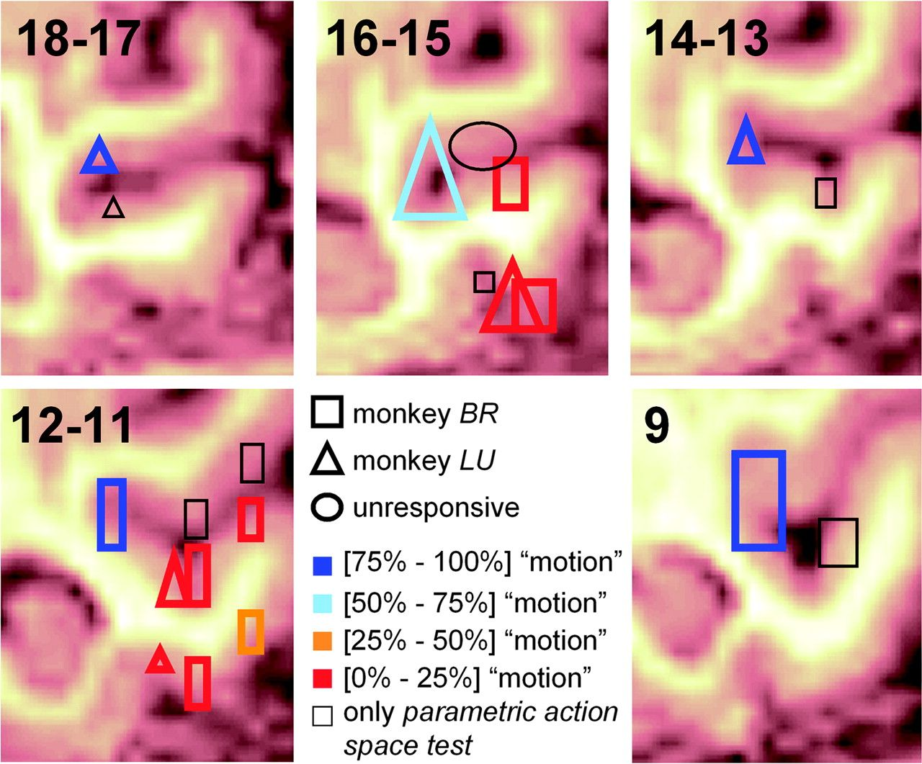
Figure 9. Estimated recording positions. Estimated positions of recorded neurons are based on white and gray matter ...
Notes:
Figure 9. Estimated recording positions. Estimated positions of recorded neurons are based on white and gray matter transitions combined with depth measurements from anatomical MRI scans and guiding tube positions. Five coronal sections of the STS and lateral temporal cortical convexity of monkey BR are shown. The lowest number in the top left corner of each section indicates the anterior/posterior level (in mm anterior to the external auditory meatus). The sections of the 2 animals were aligned by comparing the sulcal patterns. Different shapes indicate different monkeys (monkey BR = quadrangles, monkey LU = triangles, unresponsive area in both animals = ellipse), and different colors indicate the proportion of “motion” neurons (Action index higher than 0.20, see text). Neurons were pooled over 2 mm A/P sections. STPm is the fundus/upper bank region of in the most caudal coronal slice (9 mm anterior). Regions with responsive units but no static snapshot test (see text) are in indicated in black.
Unless provided in the caption above, the following copyright applies to the content of this slide: © The Author 2008. Published by Oxford University Press. All rights reserved. For permissions, please e-mail: journals.permissions@oxfordjournals.org

Slide 10
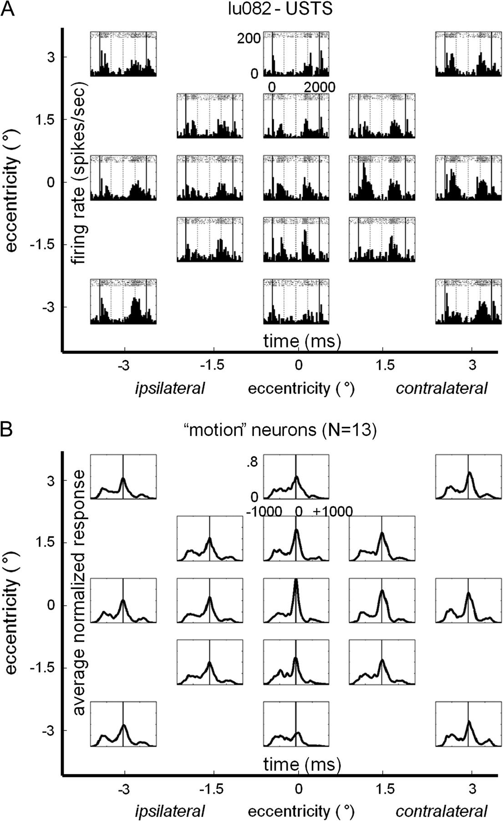
Figure 15. Neural responses at different spatial positions compared. (A) Peristimulus time histograms with raster plots ...
Notes:
Figure 15. Neural responses at different spatial positions compared. (A) Peristimulus time histograms with raster plots of one “motion” neuron (lu082) recorded in the position test. In this position test, in addition to a foveal presentation, there were 8 positions located on a small grid of 1.5° spacing and 8 positions located on a larger grid of 3° spacing. Time course (in ms) and response strength (firing rate in spikes/s) are indicated on the foveal action sequence. Solid vertical lines mark stimulus onset and offset. (B) The within-action response modulation for “motion” neurons cannot be explained by RF inhomogeneities. The smoothed normalized responses of 13 “motion” neurons at different spatial positions were aligned to the time of the peak response at the foveal position (the same grid spacing holds as in A). The solid vertical line marks the time of the foveal peak response, which was set at 0 ms. The peaks at the parafoveal positions generally occur at times similar to the foveal peak.
Unless provided in the caption above, the following copyright applies to the content of this slide: © The Author 2008. Published by Oxford University Press. All rights reserved. For permissions, please e-mail: journals.permissions@oxfordjournals.org

Slide 11
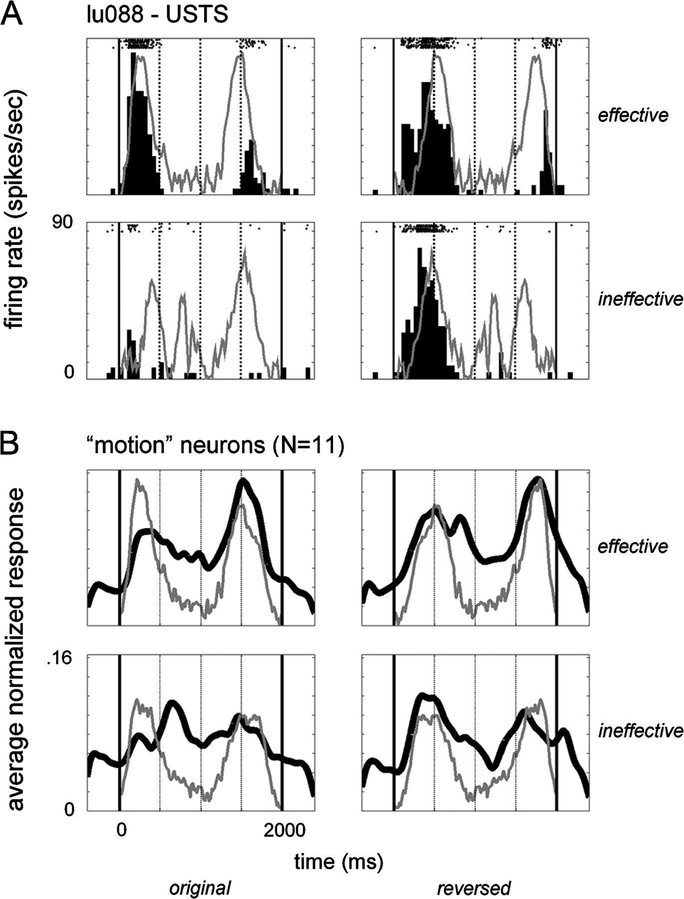
Figure 14. Selectivity of “motion” neurons to temporally reversed action sequences, that is, actions played backwards. ...
Notes:
Figure 14. Selectivity of “motion” neurons to temporally reversed action sequences, that is, actions played backwards. (A) Peristimulus time histograms with raster plots of responses in the reversed temporal order test for one example neuron (lu088) recorded in the upper bank/fundus STS. Gray lines indicate the speed profile of the wristpoint, scaled to the maximum of the response (rows: top = most effective action, bottom = least-effective action; columns: left = original order, right = reversed temporal order). (B) Smoothed averaged normalized responses of the population of “motion” neurons (N = 11) tested in the reversed temporal order test and the averaged speed profiles of the motion sequences involved. Same conventions as in (A).
Unless provided in the caption above, the following copyright applies to the content of this slide: © The Author 2008. Published by Oxford University Press. All rights reserved. For permissions, please e-mail: journals.permissions@oxfordjournals.org

Slide 12
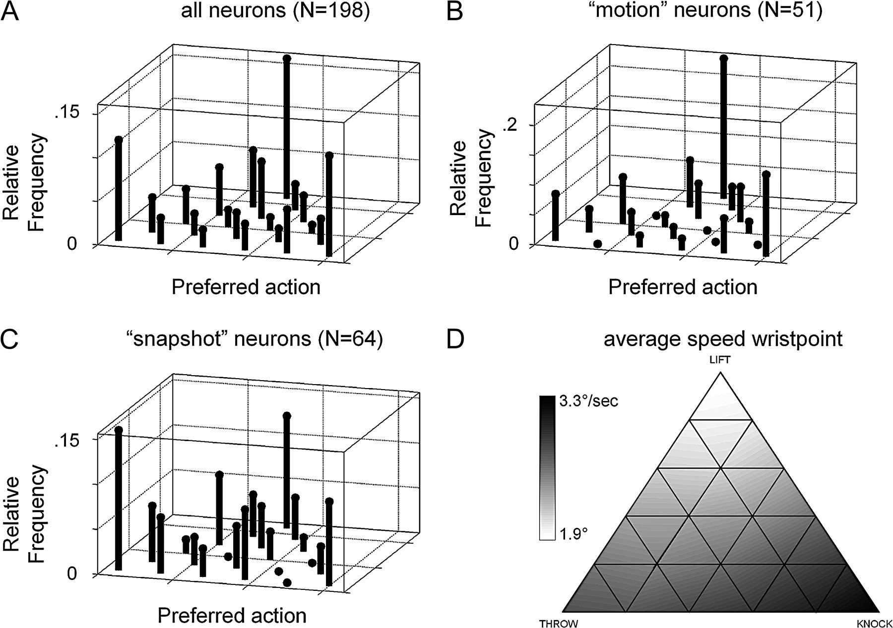
Figure 13. Bias for the extremities of the parametric action space. The distributions of preferred actions for the ...
Notes:
Figure 13. Bias for the extremities of the parametric action space. The distributions of preferred actions for the population of (A) all responsive neurons (N = 198), (B) “motion” neurons (N = 51), and (C) “snapshot” neurons (N = 64) demonstrate the preference for extreme actions in the parametric action space. The incongruence between the distribution of the preferred actions for “motion” neurons (B) and the distribution of the average speed of the wristpoint (D) indicates that “motion” neurons respond to properties other than just speed.
Unless provided in the caption above, the following copyright applies to the content of this slide: © The Author 2008. Published by Oxford University Press. All rights reserved. For permissions, please e-mail: journals.permissions@oxfordjournals.org

Slide 13
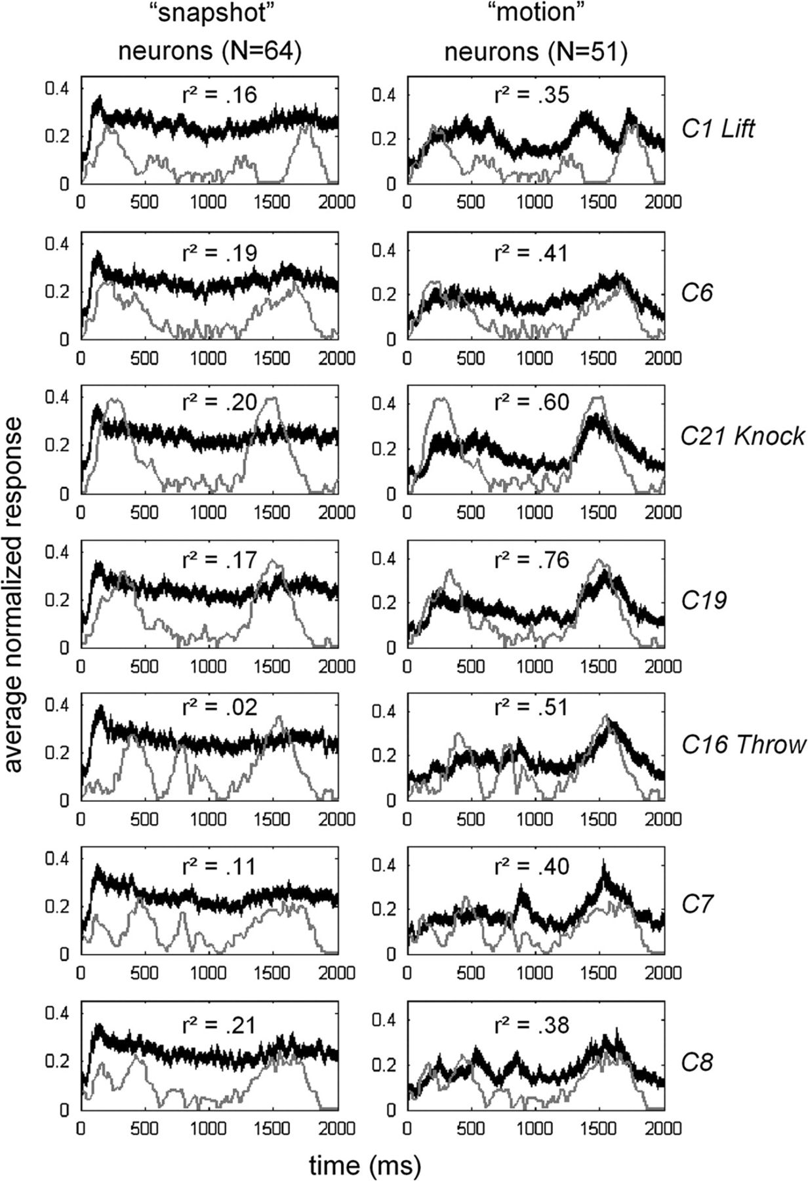
Figure 12. Population responses and speed profiles compared. The mean normalized responses (±SEM) to 7 different actions ...
Notes:
Figure 12. Population responses and speed profiles compared. The mean normalized responses (±SEM) to 7 different actions (same actions as in Fig. 1B) for “snapshot” neurons (N = 64, left panel) and “motion” neurons (N = 51, right panel). The x-axis represents stimulus duration (in ms), whereas the y-axis represents the average normalized neural response. The instantaneous speed of the wristpoint for each action sequence is indicated by gray curves and is scaled to the across-action maximum of the average normalized responses for illustrative purposes. Median correlations (r2) between the instantaneous speed and firing rate are indicated for each action and group of neurons.
Unless provided in the caption above, the following copyright applies to the content of this slide: © The Author 2008. Published by Oxford University Press. All rights reserved. For permissions, please e-mail: journals.permissions@oxfordjournals.org

Slide 14
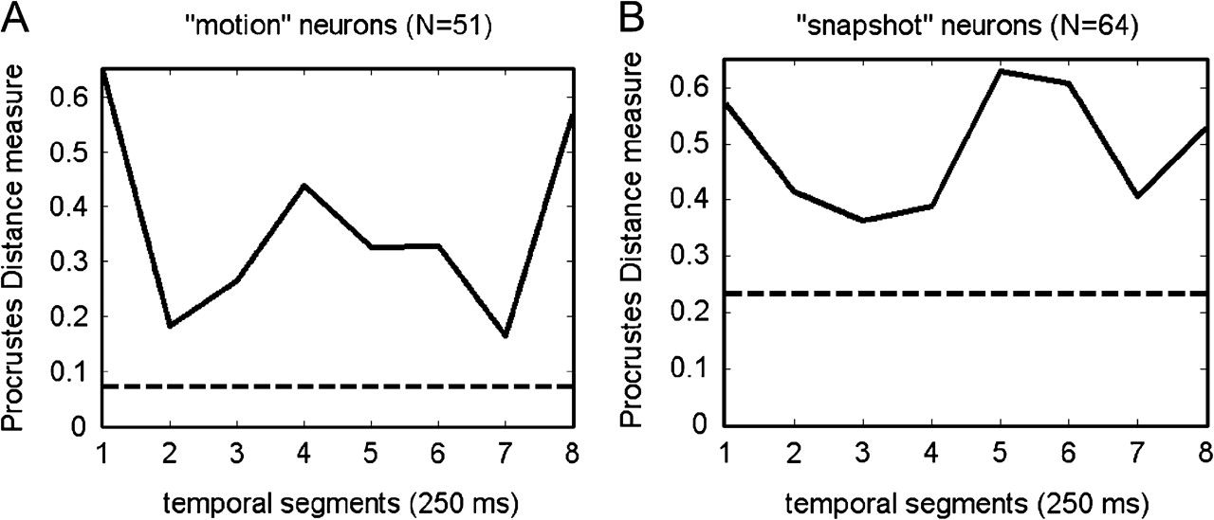
Figure 11. Temporal evolution of the fit of the neural representation of the action space and the physical parametric ...
Notes:
Figure 11. Temporal evolution of the fit of the neural representation of the action space and the physical parametric stimulus configuration. The full line shows the evolution of the Procrustes Distance measure during the course of the action, based on ISOMAP analyses in 8 consecutive 250 ms long segments. The larger the Procrustes Distance measure, the worse the fit. Striped horizontal line indicates the Procrustes Distance based on ISOMAP of the full 2000 ms long action duration. (A)“Motion” neurons; (B) “Snapshot” neurons.
Unless provided in the caption above, the following copyright applies to the content of this slide: © The Author 2008. Published by Oxford University Press. All rights reserved. For permissions, please e-mail: journals.permissions@oxfordjournals.org

Slide 15
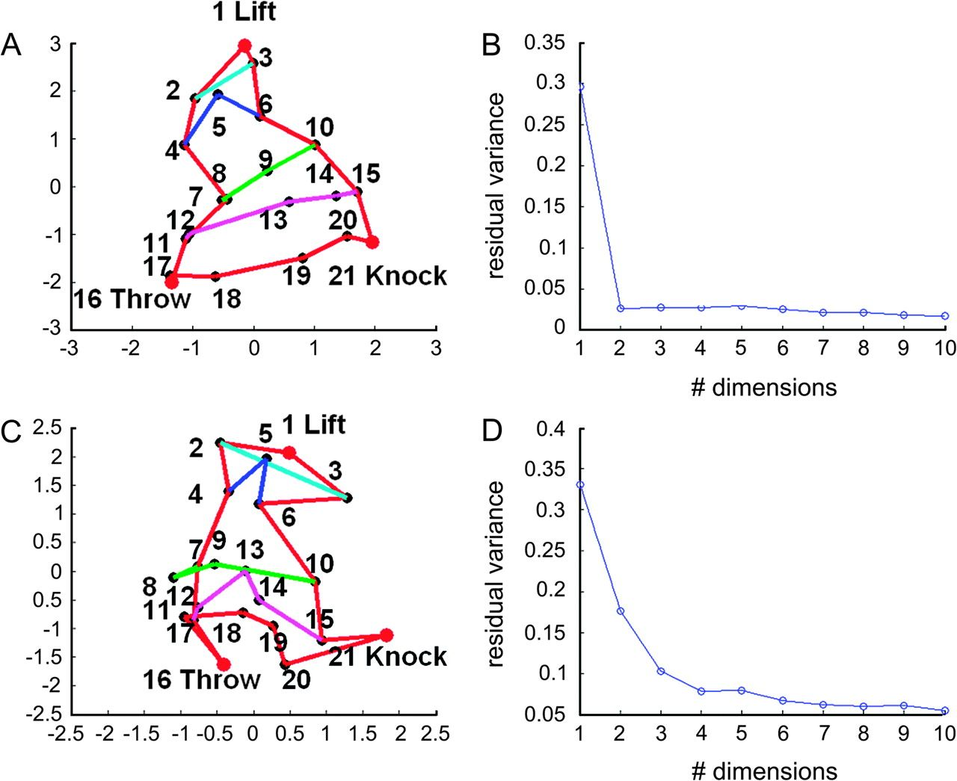
Figure 10. Neural representation of the parametric action space in “motion” and “snapshot” neurons. (A and C) Neural ...
Notes:
Figure 10. Neural representation of the parametric action space in “motion” and “snapshot” neurons. (A and C) Neural representations of the stimulus space obtained after applying ISOMAP (nonlinear MDS) to the mean responses averaged using an analysis window ranging from 50 to 2050 ms: “motion” (A) and “snapshot” (C) neurons. (B and D) Scree plots of the residual variance as a function of the number of dimensions. Same conventions as in Figure 3.
Unless provided in the caption above, the following copyright applies to the content of this slide: © The Author 2008. Published by Oxford University Press. All rights reserved. For permissions, please e-mail: journals.permissions@oxfordjournals.org

Slide 16
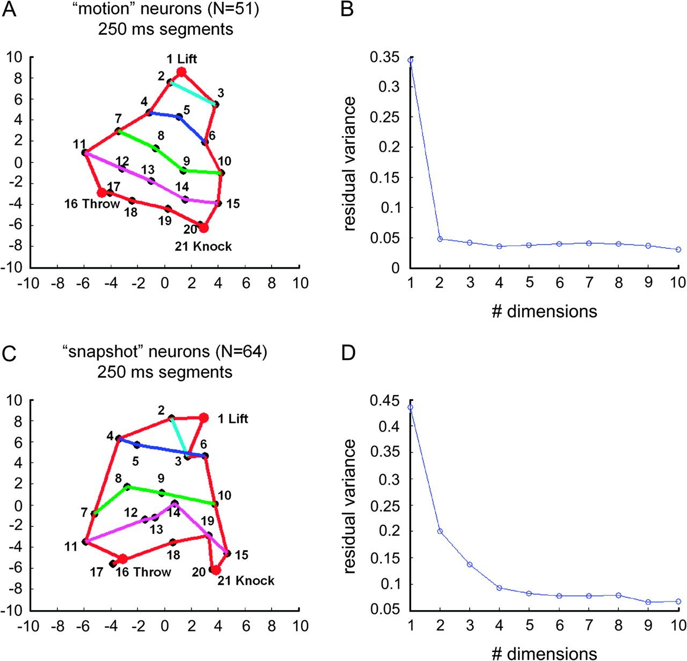
Figure 16. Neural representation of the parametric action space in “motion” and “snapshot” neurons computed using 250-ms ...
Notes:
Figure 16. Neural representation of the parametric action space in “motion” and “snapshot” neurons computed using 250-ms long segments of the actions. (A and C) Neural representations of the stimulus space obtained after applying ISOMAP (nonlinear MDS) to the mean responses averaged in 8 successive 250-ms long analysis windows: “motion” (A) and “snapshot” (C) neurons. (B and D) Scree plots of the residual variance as a function of the number of dimensions. Same conventions as in Figure 3.
Unless provided in the caption above, the following copyright applies to the content of this slide: © The Author 2008. Published by Oxford University Press. All rights reserved. For permissions, please e-mail: journals.permissions@oxfordjournals.org

