Slide 1
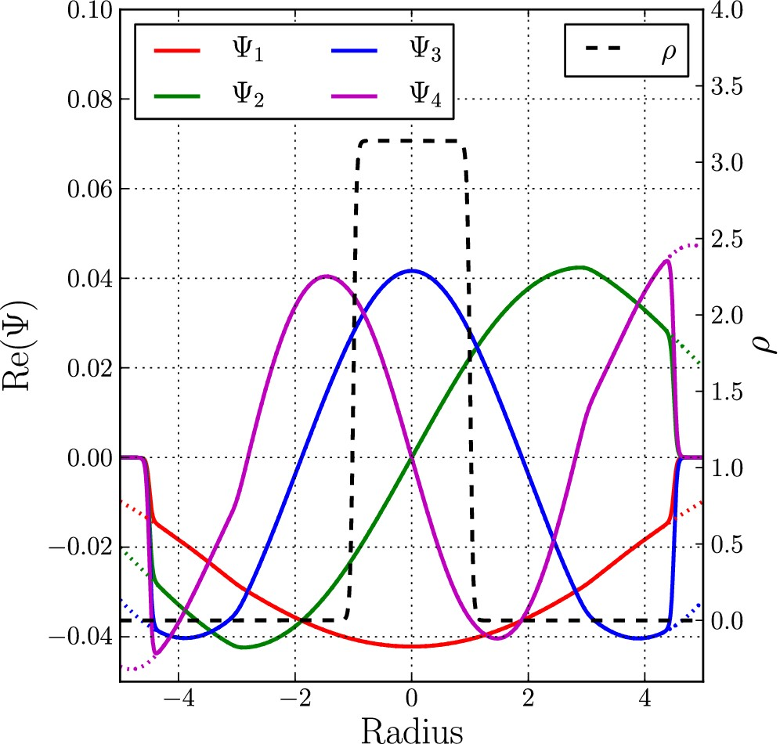
Figure 1. The first four wavefunctions contributing to the WDF of the approximate uniform sphere before (dotted lines) ...
Notes:
Figure 1. The first four wavefunctions contributing to the WDF of the approximate uniform sphere before (dotted lines) and after (superimposed solid lines) having applied the smooth window function to make them vanish at the boundaries of the box. These functions are different from zero almost everywhere but their combination in a WDF corresponds to the density profile (dashed black line, equation 92), which is zero on most of the interval.
Unless provided in the caption above, the following copyright applies to the content of this slide: © 2014 The Authors Published by Oxford University Press on behalf of the Royal Astronomical Society

Slide 2
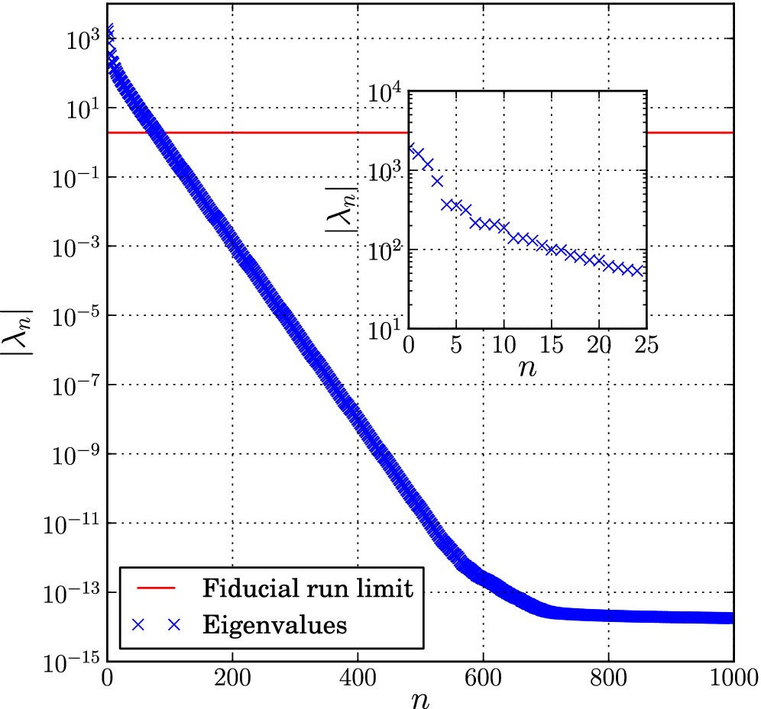
Figure 2. The first 1000 eigenvalues λ_{n} corresponding to the SVD decomposition of the spherical collapse ...
Notes:
Figure 2. The first 1000 eigenvalues λn corresponding to the SVD decomposition of the spherical collapse problem. The values decrease rapidly and become negligible (when compared to the first one) for n > 100. They even reach a minimum close to the machine epsilon for n > 700. Our fiducial run uses all the wavefunctions up to n = 79 which corresponds to $\frac{\lambda _n}{\lambda _0} > 10^{-3}$. This limit is shown as the red solid line in the figure. The small panel presents a zoomed-in region of the eigenvalues with n < 25. The decrease on this small subset is already of more than an order of magnitude.
Unless provided in the caption above, the following copyright applies to the content of this slide: © 2014 The Authors Published by Oxford University Press on behalf of the Royal Astronomical Society

Slide 3
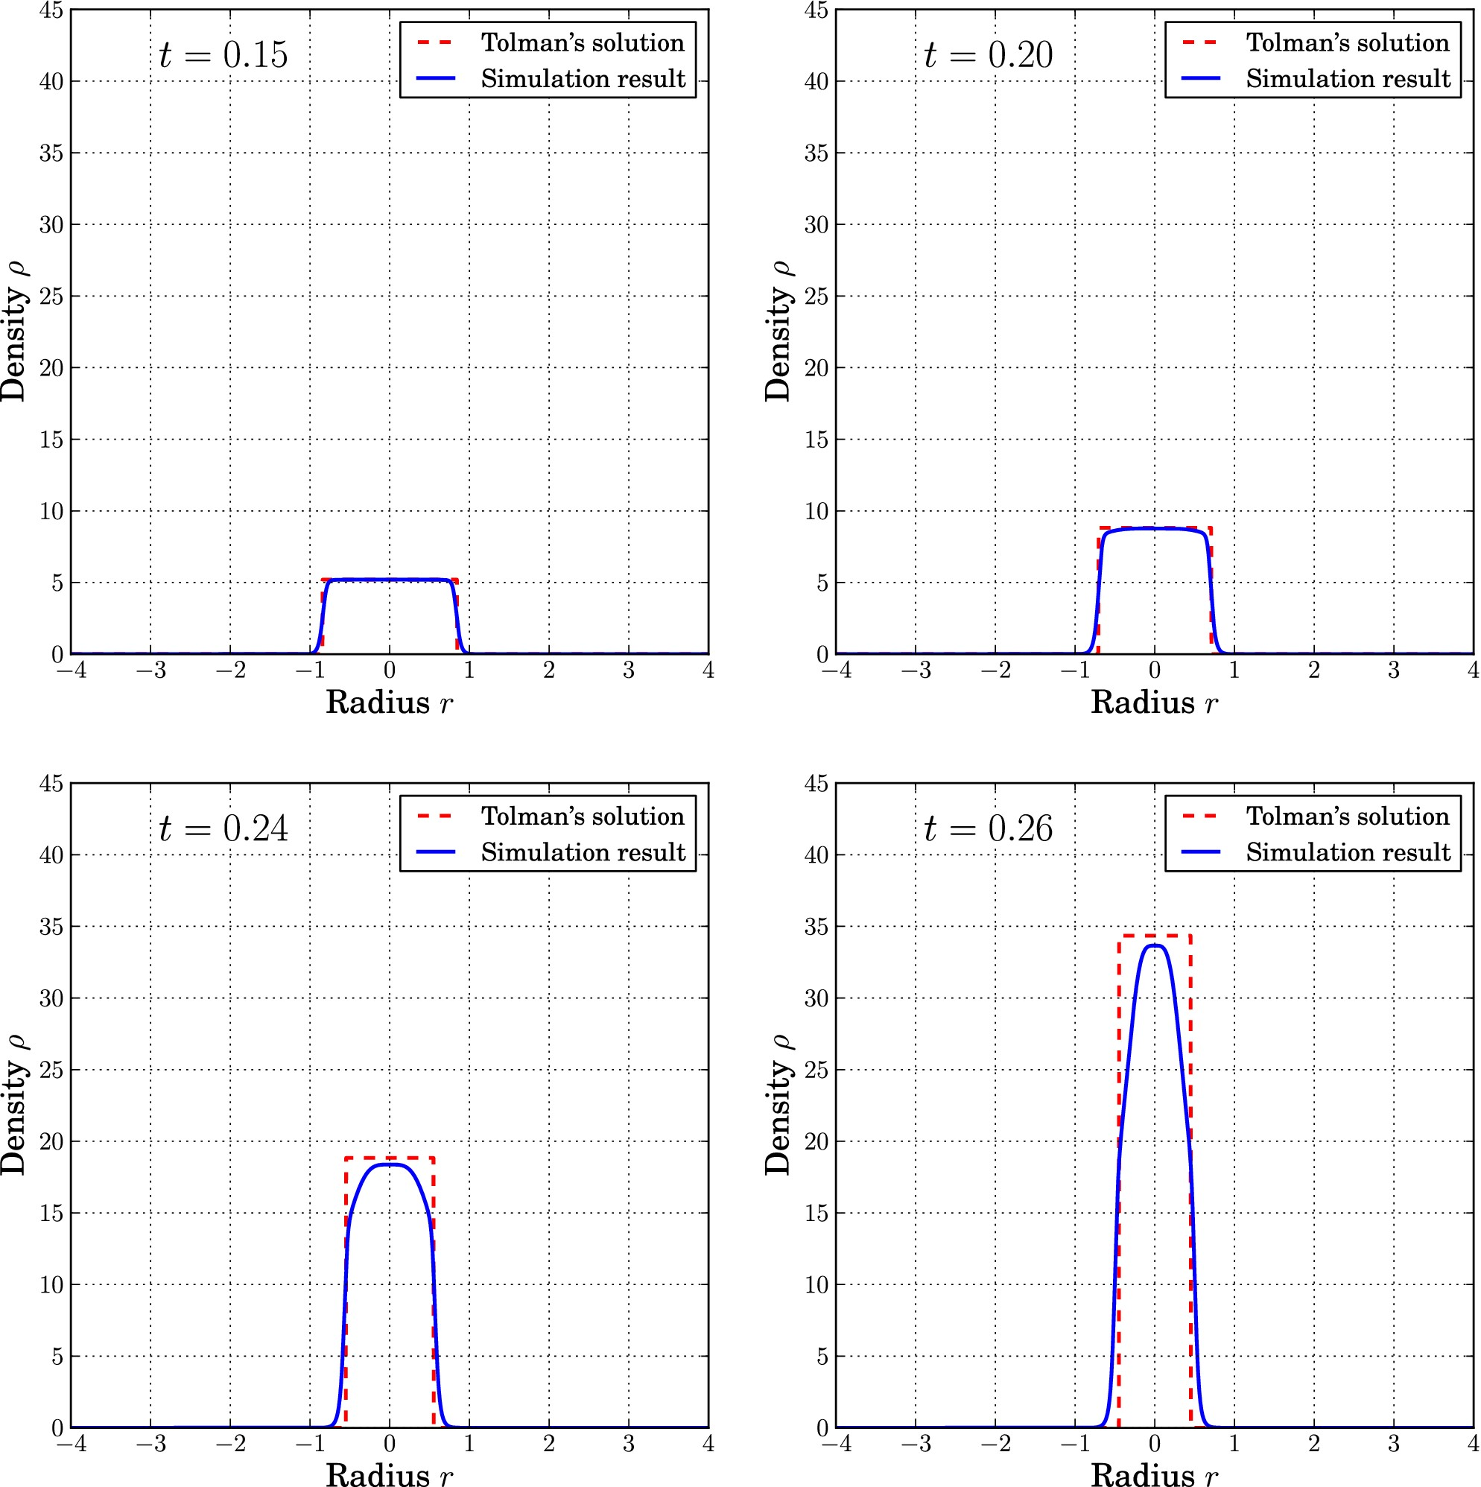
Figure 3. Four different density profiles (blue solid line) of our fiducial run at t = 0.15, 0.20, 0.24 and 0.26 ...
Notes:
Figure 3. Four different density profiles (blue solid line) of our fiducial run at t = 0.15, 0.20, 0.24 and 0.26 together with the analytical solution (red dashed line) at the same time steps. The simulation follows almost perfectly the analytical solution until t ≈ 0.20 and then starts to deviate. For obvious reasons, the situation gets worse at later times and even the centre of the sphere does not follow the exact solution any more. After the collapse time tc ≈ 0.306 the behaviour becomes clearly non-physical due to the unresolved infinities. The very centre of the sphere still follows Tolman's solution closely on the last two panels but the sharp features at the edge of the sphere get increasingly more difficult to represent. This suggests that increasing the spatial resolution of the lattice may help getting better derivative estimate and hence improve the quality of the result.
Unless provided in the caption above, the following copyright applies to the content of this slide: © 2014 The Authors Published by Oxford University Press on behalf of the Royal Astronomical Society

Slide 4
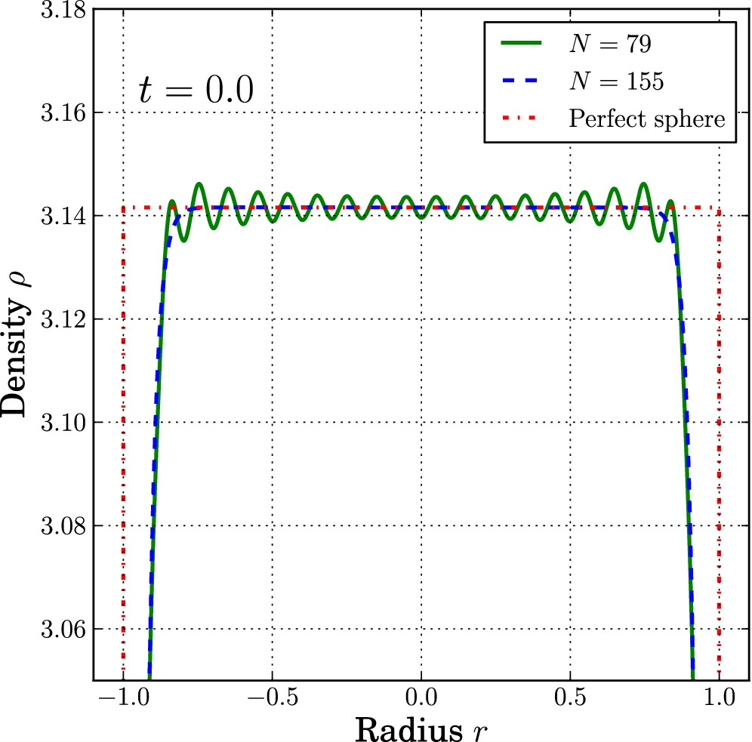
Figure 4. Comparison of the density profiles at the initial time for N = 79 (green solid line) and N = 155 (blue dashed ...
Notes:
Figure 4. Comparison of the density profiles at the initial time for N = 79 (green solid line) and N = 155 (blue dashed line) wavefunctions. The figure zooms in the central regions where the difference can be spotted. The N = 79 line presents a lot of oscillations that are suppressed if more wavefunctions are used. The N = 155 line almost perfectly matches the density profile given by equation (92). Notice, however, that this differs from the perfect sphere profile (red dash–dotted line), which cannot be represented by a finite set of continuous functions.
Unless provided in the caption above, the following copyright applies to the content of this slide: © 2014 The Authors Published by Oxford University Press on behalf of the Royal Astronomical Society

Slide 5
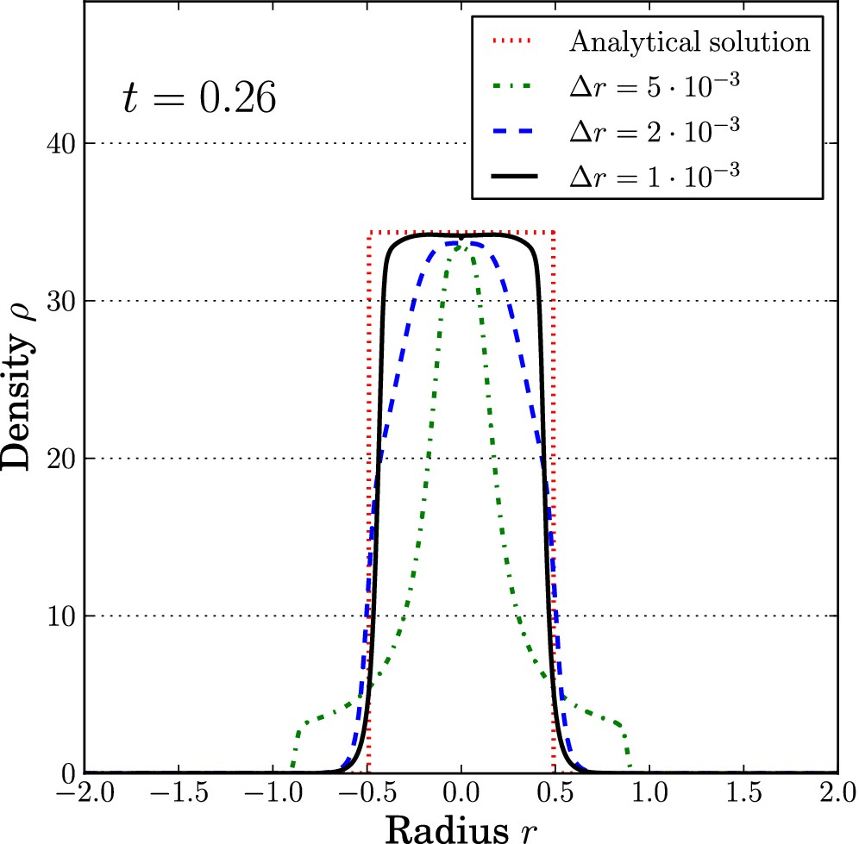
Figure 5. The output at t = 0.26 for different lattice resolution using N = 79 wavefunctions. The green dash–dotted ...
Notes:
Figure 5. The output at t = 0.26 for different lattice resolution using N = 79 wavefunctions. The green dash–dotted line corresponds to a low-resolution run with Δr = 5 · 10−3, the blue dashed line corresponds to our fiducial run at Δr = 2 · 10−3 and the black solid line is the output of a high-resolution run using Δr = 10−3. The quality of the output is clearly improved by using a higher resolution lattice. This can be directly related to the problem of estimating sharp derivatives on a grid, where the only solution is to increase the resolution.
Unless provided in the caption above, the following copyright applies to the content of this slide: © 2014 The Authors Published by Oxford University Press on behalf of the Royal Astronomical Society

Slide 6
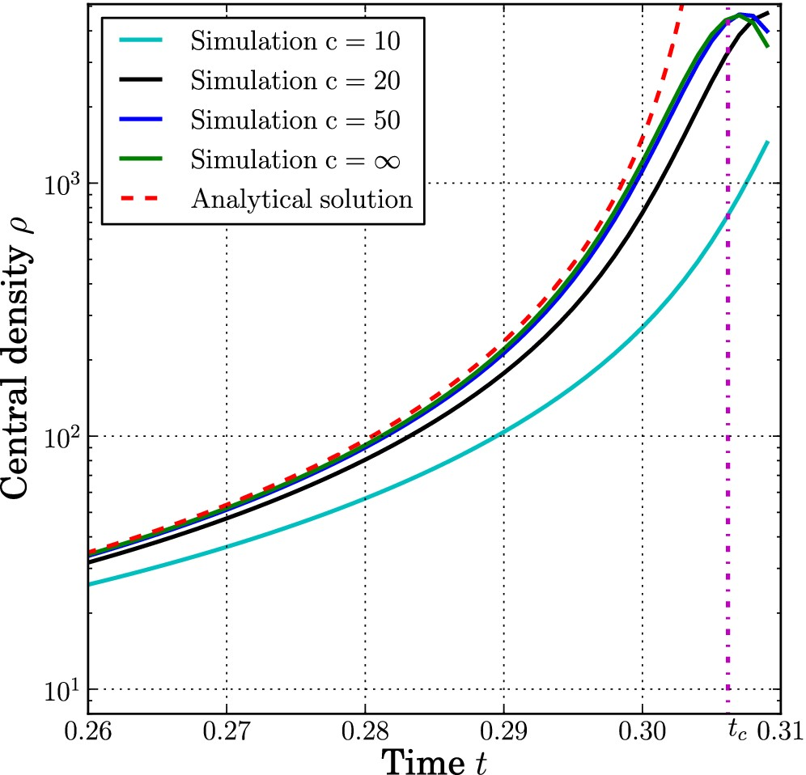
Figure 6. Evolution of the density at the centre of the sphere (r = 0) for different values of the numerical speed of ...
Notes:
Figure 6. Evolution of the density at the centre of the sphere (r = 0) for different values of the numerical speed of light c. The red dashed line corresponds to the analytical solution (91), the vertical dash–dotted line represents the final collapse time and the different solid lines correspond to the different values of c. The higher the value of c, the closer the line lies to the exact solution. The line with c = ∞ has been obtained by solving Poisson's equation on the grid instead of evolving gravity using Klein–Gordon's equation. The quality of the simulation outcome clearly depends on the value of c but if the value is high enough (compared to the velocity of the matter), the difference with the c = ∞ becomes very small. Once the density peak has been reached, the value of ρ(r = 0) decreases as is expected after the different matter shells have crossed. The simulations have not been carried on much beyond this point as the departure from the analytical solution is already significant. Moreover, the peak cannot be represented accurately by any numerical mean and any subsequent event would be erroneous.
Unless provided in the caption above, the following copyright applies to the content of this slide: © 2014 The Authors Published by Oxford University Press on behalf of the Royal Astronomical Society

Slide 7
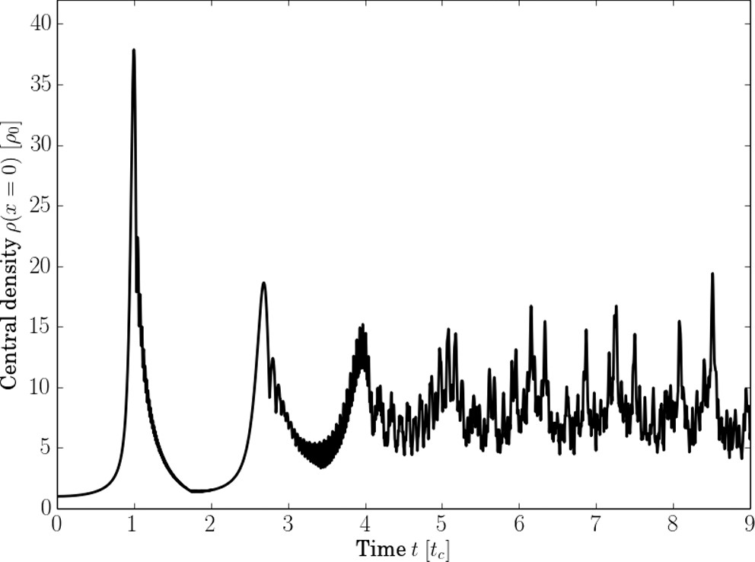
Figure 7. Evolution of the density at the centre of the domain (x = 0) beyond the first collapse (t > t_{c}). ...
Notes:
Figure 7. Evolution of the density at the centre of the domain (x = 0) beyond the first collapse (t > tc). The multiple collapses and re-expansions of the matter distribution can be tracked by the framework. The appearance of multiple matter streams during the evolution of the collapse can be resolved by the simulation even with one single wavefunction.
Unless provided in the caption above, the following copyright applies to the content of this slide: © 2014 The Authors Published by Oxford University Press on behalf of the Royal Astronomical Society

Slide 8
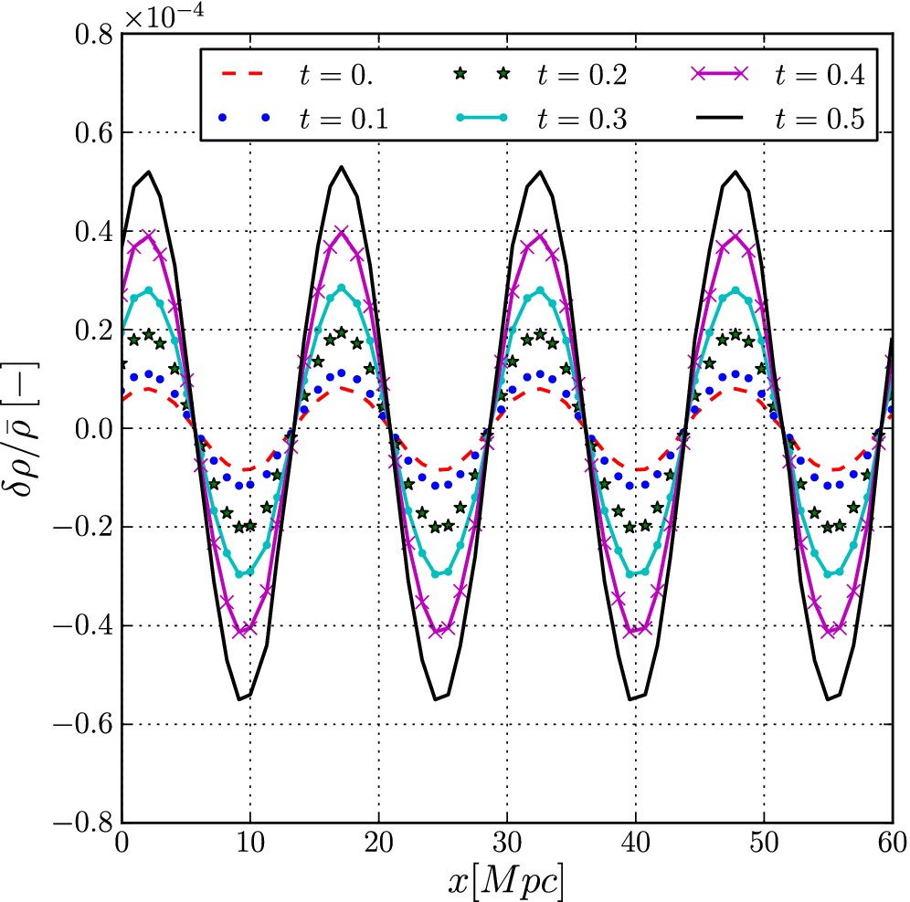
Figure 8. Time evolution of the density field in an expanding universe. The different lines correspond to various time ...
Notes:
Figure 8. Time evolution of the density field in an expanding universe. The different lines correspond to various time steps in normalized units. The values are taken along one line parallel to the x-axis in the box but all lines yield the same results. The initial amplitude of the harmonic density increases with time, without distortion of the shape, as expected from structure formation in the linear regime.
Unless provided in the caption above, the following copyright applies to the content of this slide: © 2014 The Authors Published by Oxford University Press on behalf of the Royal Astronomical Society

Slide 9
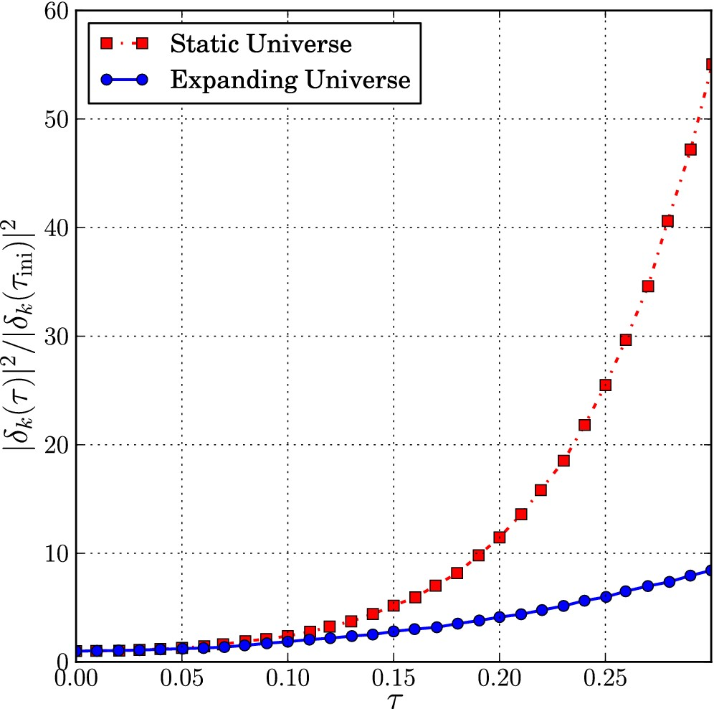
Figure 9. Comparison of the growth of the perturbation ...
Notes:
Figure 9. Comparison of the growth of the perturbation |δk(τ)|2/|δk(τini)|2 in a non-expanding universe (red squares, upper line) and in a matter-dominated, expanding universe (blue circles, lower line) as a function of the conformal time τ. As expected, the growth is clearly suppressed in the presence of expansion.
Unless provided in the caption above, the following copyright applies to the content of this slide: © 2014 The Authors Published by Oxford University Press on behalf of the Royal Astronomical Society

