Slide 1
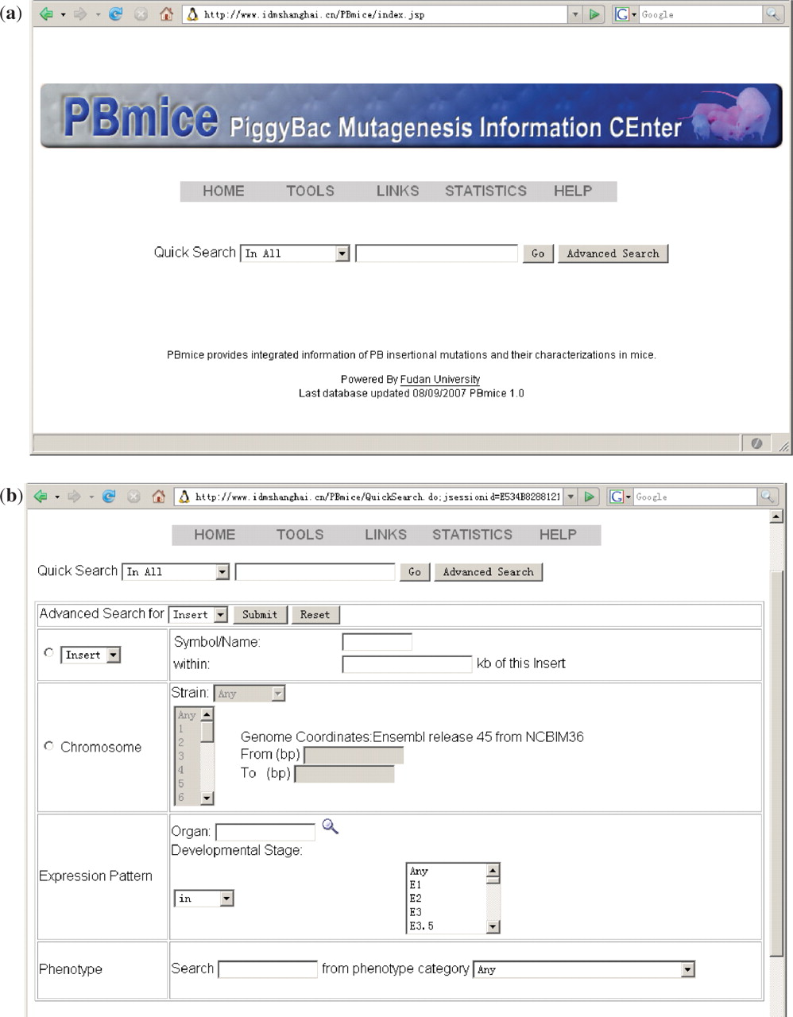
Figure 1. Search interfaces. ( a ) The Quick Search interface. This is also the homepage of PBmice. ( b ) The Advanced ...
Notes:
Figure 1. Search interfaces. ( a ) The Quick Search interface. This is also the homepage of PBmice. ( b ) The Advanced Search interface.
Unless provided in the caption above, the following copyright applies to the content of this slide: © 2007 The Author(s)This is an Open Access article distributed under the terms of the Creative Commons Attribution Non-Commercial License (http://creativecommons.org/licenses/by-nc/2.0/uk/) which permits unrestricted non-commercial use, distribution, and reproduction in any medium, provided the original work is properly cited.

Slide 2
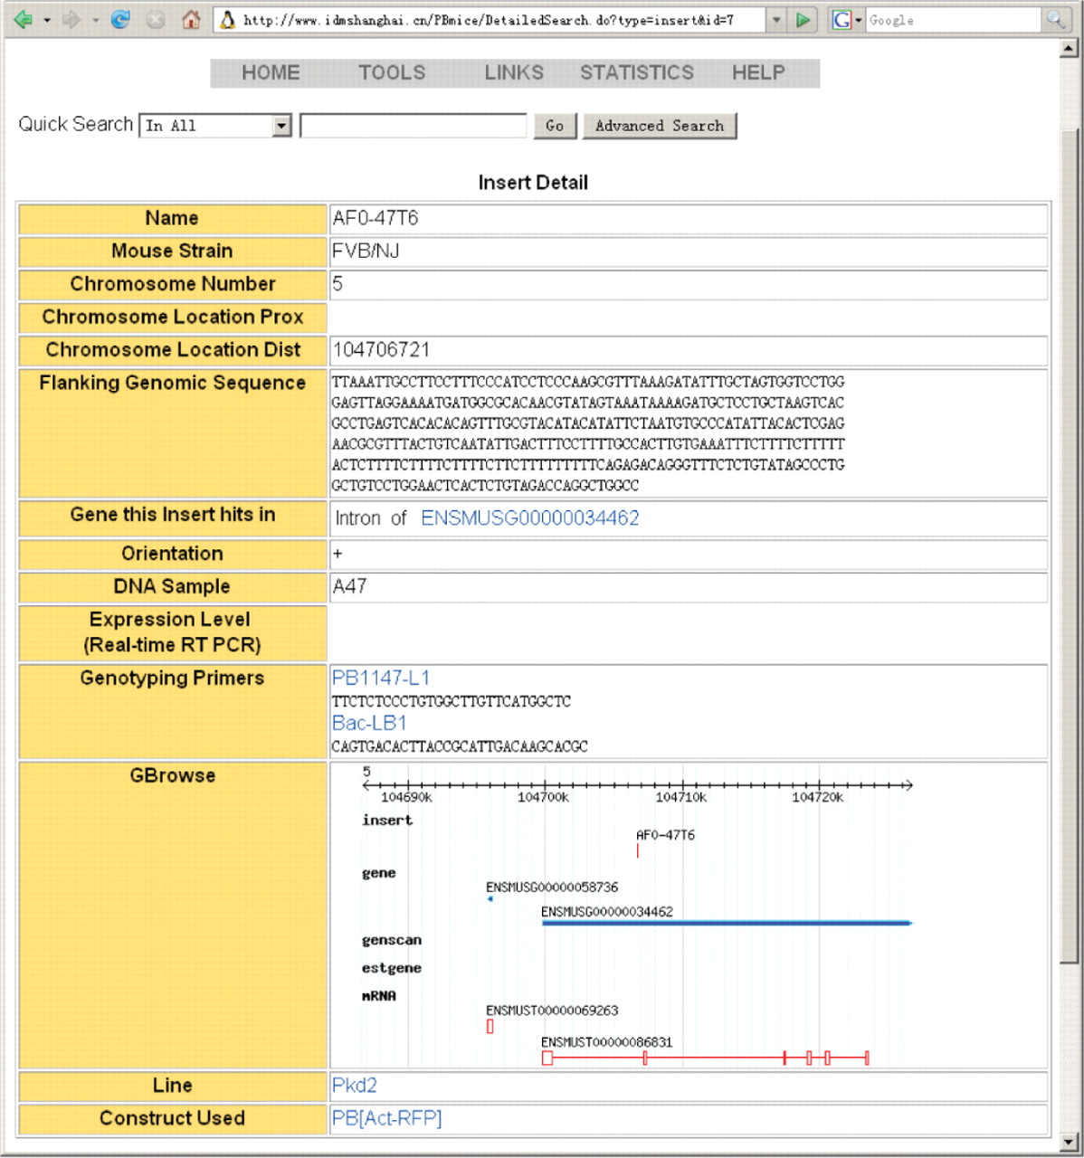
Figure 2. An example of the INSERT Detail interface. Information is based on INSERT AF0-47T6 in PBmice.
Notes:
Figure 2. An example of the INSERT Detail interface. Information is based on INSERT AF0-47T6 in PBmice.
Unless provided in the caption above, the following copyright applies to the content of this slide: © 2007 The Author(s)This is an Open Access article distributed under the terms of the Creative Commons Attribution Non-Commercial License (http://creativecommons.org/licenses/by-nc/2.0/uk/) which permits unrestricted non-commercial use, distribution, and reproduction in any medium, provided the original work is properly cited.

Slide 3
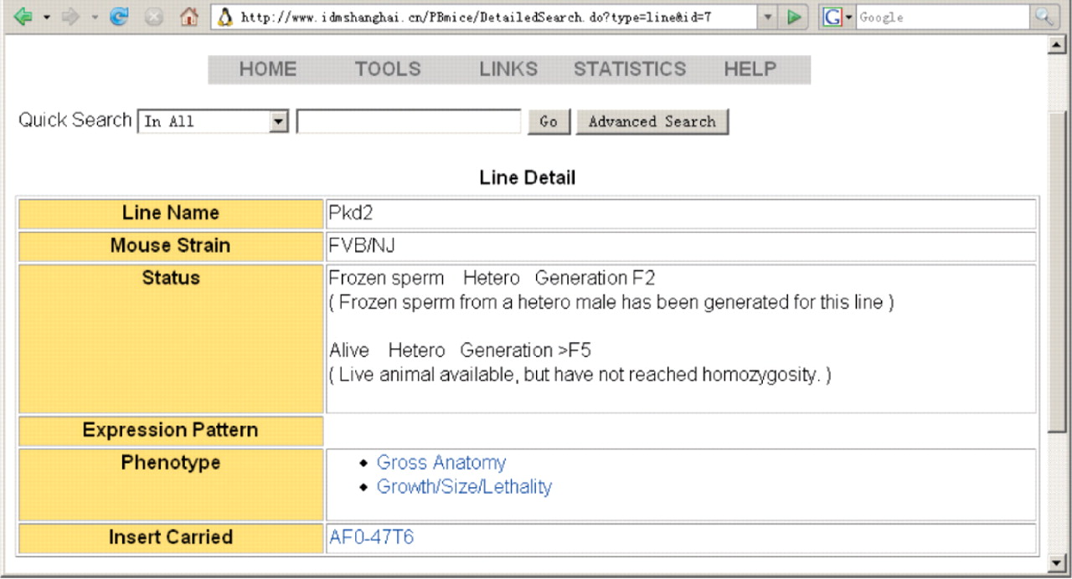
Figure 3. An example of the LINE interface. Information is based on LINE Pkd2.
Notes:
Figure 3. An example of the LINE interface. Information is based on LINE Pkd2.
Unless provided in the caption above, the following copyright applies to the content of this slide: © 2007 The Author(s)This is an Open Access article distributed under the terms of the Creative Commons Attribution Non-Commercial License (http://creativecommons.org/licenses/by-nc/2.0/uk/) which permits unrestricted non-commercial use, distribution, and reproduction in any medium, provided the original work is properly cited.

Slide 4
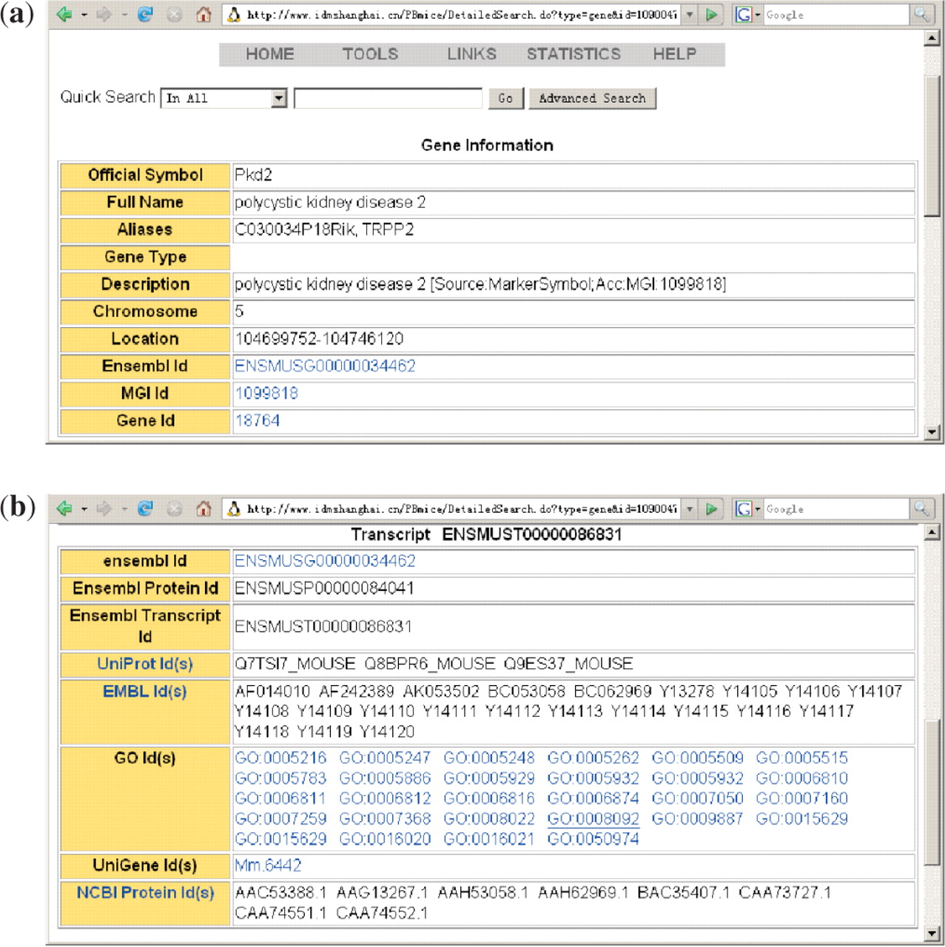
Figure 4. Examples of the Gene Information interface and Transcript interface. Data displayed is based on the Pkd2 ...
Notes:
Figure 4. Examples of the Gene Information interface and Transcript interface. Data displayed is based on the Pkd2 gene.
Unless provided in the caption above, the following copyright applies to the content of this slide: © 2007 The Author(s)This is an Open Access article distributed under the terms of the Creative Commons Attribution Non-Commercial License (http://creativecommons.org/licenses/by-nc/2.0/uk/) which permits unrestricted non-commercial use, distribution, and reproduction in any medium, provided the original work is properly cited.

Slide 5
Figure 5. An example of the Search Result interface, using search term Pkd2.
Notes:
Figure 5. An example of the Search Result interface, using search term Pkd2.
Unless provided in the caption above, the following copyright applies to the content of this slide: © 2007 The Author(s)This is an Open Access article distributed under the terms of the Creative Commons Attribution Non-Commercial License (http://creativecommons.org/licenses/by-nc/2.0/uk/) which permits unrestricted non-commercial use, distribution, and reproduction in any medium, provided the original work is properly cited.

