Slide 1
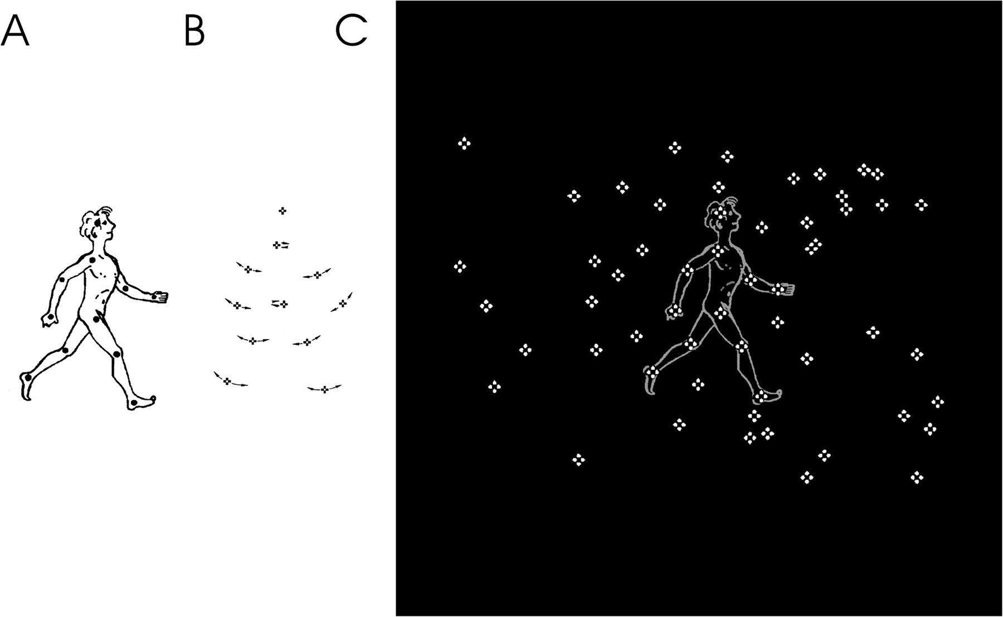
Figure 1. Static representation of point-light BM. (A) The locations of dots on the main joints of a walking figure. ...
Notes:
Figure 1. Static representation of point-light BM. (A) The locations of dots on the main joints of a walking figure. For illustrative purposes, an outline of the walking figure is presented. (B) A frame taken from a walking cycle of a noncamouflaged point-light walker. Vectors illustrate motion of each dot. (C) The point-light walking figure simultaneously camouflaged by a moving scrambled walker mask. The motion of each dot of the mask is identical to the motion of one of the dots defining the point-light figure. The type, size, luminance, and phase relations of the dots also remain unchanged. Participants are presented only with a set of bright dots against a black background (adapted from Pavlova et al. 2007 with permission).
Unless provided in the caption above, the following copyright applies to the content of this slide: © The Author 2011. Published by Oxford University Press. All rights reserved. For permissions, please e-mail: journals.permissions@oup.com

Slide 2
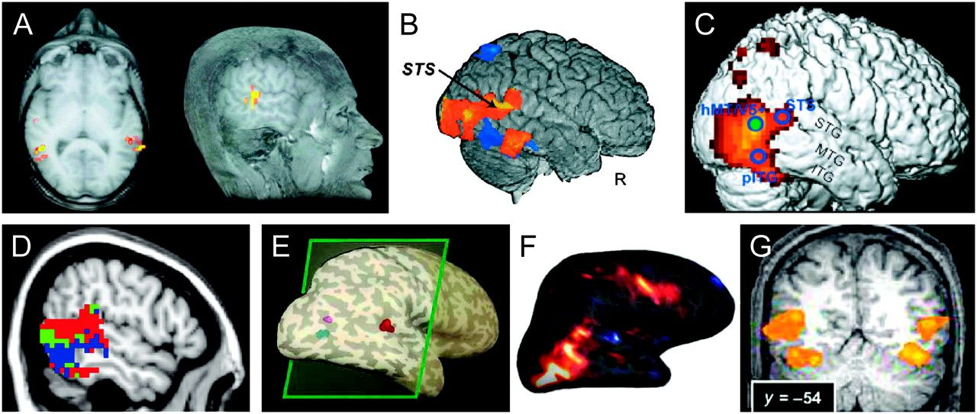
Figure 2. fMRI robustly points to the key role of the right pSTS for visual processing of BM. (A) Axial and sagittal ...
Notes:
Figure 2. fMRI robustly points to the key role of the right pSTS for visual processing of BM. (A) Axial and sagittal views of the point-light BM responsive area in the pSTS as compared with scrambled displays (from Grossman and Blake 2001 with permission). (B) The right pSTS is active during processing of point-light and full-light BM as compared with tools (from Beauchamp et al. 2003 with permission); (C) The brain regions in the right hemisphere, including the right STS, active during passive viewing of point-light BM as compared with scrambled motion (from Peuskens et al. 2005 with permission); (D) Responses to full-light motion of eyes (red), mouth (blue), and hand (green) in an individual subject (from Pelphrey, Morris, Michelich, et al. 2005 with permission); (E) The right pSTS (red) is responsive to point-light BM (actions) as compared with scrambled motion (from Grossman and Blake 2002 with permission); (F) Right hemispheric activity in response to point-light BM as compared with scrambled motion (from Saygin et al. 2004 with permission); (G) The STS and fusiform face area are more active in the right hemisphere (the right side of the brain is on the left side of the image according to radiological convention) in response to point-light BM as compared with random motion (from Gobbini et al. 2007 with permission). Similar activation is observed in response to Heider-and-Simmel-like displays as compared with random motion of geometric shapes.
Unless provided in the caption above, the following copyright applies to the content of this slide: © The Author 2011. Published by Oxford University Press. All rights reserved. For permissions, please e-mail: journals.permissions@oup.com

Slide 3
Figure 3. Oscillatory cortical MEG activity in response to point-light BM. The response occurs consecutively at ...
Notes:
Figure 3. Oscillatory cortical MEG activity in response to point-light BM. The response occurs consecutively at latencies of (A) 100 ms over the left occipital cortex, (B) 130 ms over the bilateral parietal cortices, and (C) 170 ms over the right temporal cortex (adapted from Pavlova et al. 2004 with permission).
Unless provided in the caption above, the following copyright applies to the content of this slide: © The Author 2011. Published by Oxford University Press. All rights reserved. For permissions, please e-mail: journals.permissions@oup.com

Slide 4
Figure 4. Regions of mutual lesion involvement for patients with left lateral cerebellar lesions who are impaired on BM ...
Notes:
Figure 4. Regions of mutual lesion involvement for patients with left lateral cerebellar lesions who are impaired on BM processing. These regions are represented as density plots at a T1-weighted MRI template in Montreal Neurological Institute space: (A) the transversal slices corresponding to the maximal axial extent of the density plots (z = −55); (B) the maximal coronal extent (y = −70); (C) the maximal sagittal extent (x = −40). These areas (marked by red) are affected in all patients with tumors in the left lateral cerebellum (adapted from Sokolov, Gharabaghi, et al. 2010 with permission).
Unless provided in the caption above, the following copyright applies to the content of this slide: © The Author 2011. Published by Oxford University Press. All rights reserved. For permissions, please e-mail: journals.permissions@oup.com

Slide 5
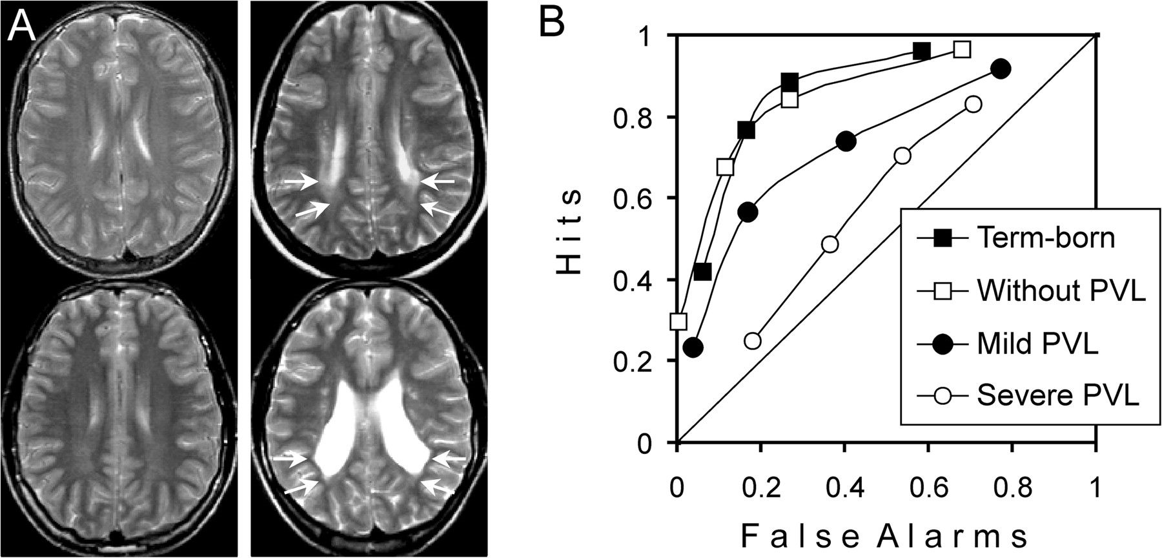
Figure 5. Visual sensitivity to biological motion in adolescents aged 11–17 years. (A) Structural MR images (axial ...
Notes:
Figure 5. Visual sensitivity to biological motion in adolescents aged 11–17 years. (A) Structural MR images (axial T2 weighted, z = 22 mm above the bicommissural plane, from top to bottom) for the representative participants (left column) DHE (healthy term-born adolescent), KRO (adolescent who was born preterm, without PVL), (right column) TSA (former preterm with mild PVL), and SSA (former preterm with severe PVL); light arrows point to the parieto-occipital PVL; (B) Psychophysical receiver operating characteristic curves obtained for upright-oriented point-light human locomotion. Diagonal represents chance level. Data for term-born controls are represented by closed and for preterms without PVL by open squares, for preterms with mild and severe PVL by closed and open circles, respectively. Visual sensitivity to body motion in patients with severe PVL was at chance level. In patients with mild PVL, it was significantly lower than in both control groups (adapted from Pavlova, Sokolov, et al. 2006 with permission).
Unless provided in the caption above, the following copyright applies to the content of this slide: © The Author 2011. Published by Oxford University Press. All rights reserved. For permissions, please e-mail: journals.permissions@oup.com

Slide 6
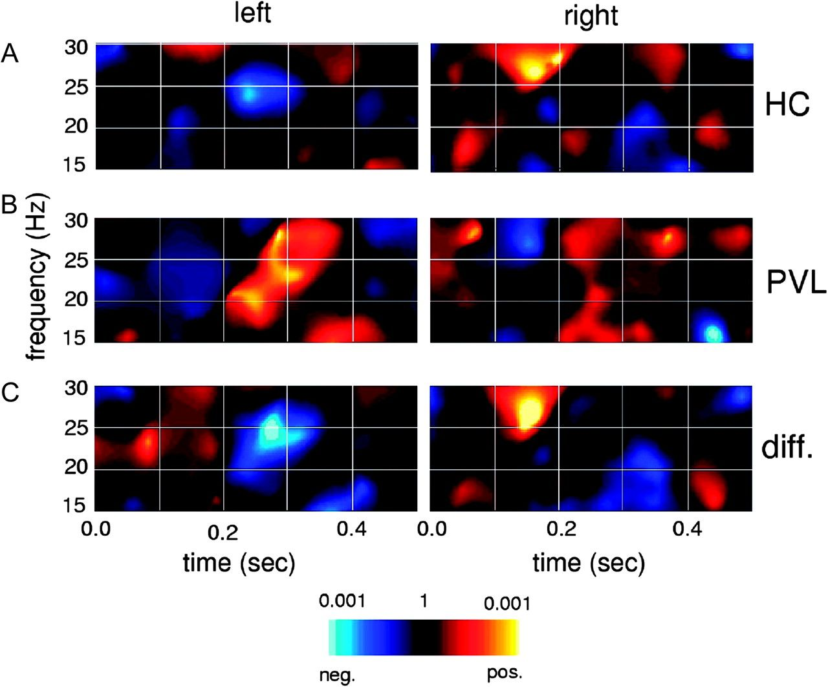
Figure 6. Grand average time–frequency (TF) representations of the difference in the MEG oscillatory response to body ...
Notes:
Figure 6. Grand average time–frequency (TF) representations of the difference in the MEG oscillatory response to body motion. Separate plots are given for the left hemispheric response (left column), the right hemispheric response (right column), and (A) healthy controls (HC); (B) PVL patients (PVL); (C) difference between PVL patients and controls (diff.). In healthy controls, the peak in TF amplitude of the oscillatory response was observed at a latency of 170 ms over the right parietotemporal cortex. In PVL patients, the significant peak occurred later, at a latency of 290 ms over the left temporal cortex (adapted from Pavlova et al. 2007 with permission).
Unless provided in the caption above, the following copyright applies to the content of this slide: © The Author 2011. Published by Oxford University Press. All rights reserved. For permissions, please e-mail: journals.permissions@oup.com

