Slide 1
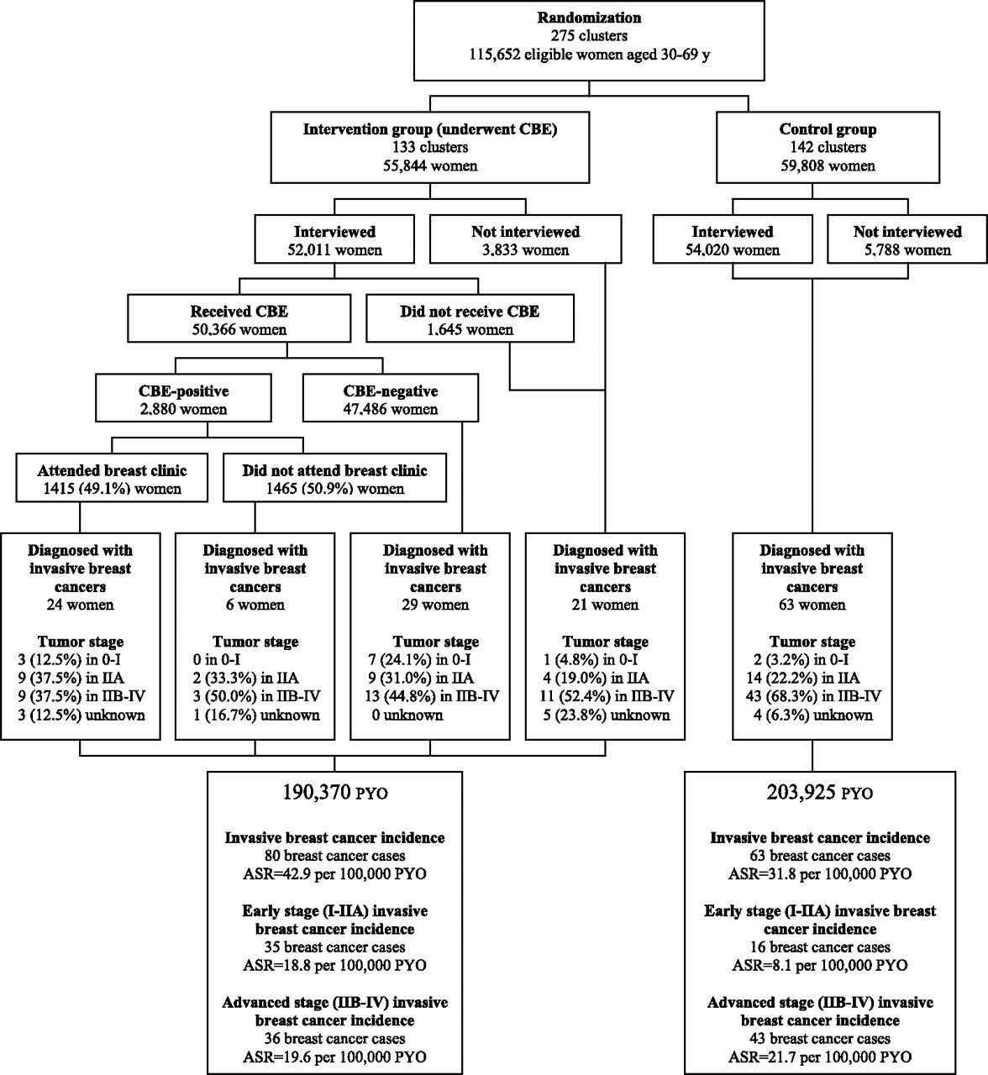
Figure 1 Enrollment of participants in the trial and outcomes. Eligible women were apparently healthy women aged ...
Notes:
Figure 1 Enrollment of participants in the trial and outcomes. Eligible women were apparently healthy women aged 30–69 years, with intact breasts and no history of breast cancer. Women were interviewed for sociodemographic and reproductive history. Some of the eligible women were not interviewed or did not undergo clinical breast examination (CBE) (in intervention group) either because they were not present at the time when the female health workers visited their homes or did not attend a nearby health center or a makeshift clinic in the locality. Tumor staging was done based on Union for International Cancer Control TNM stage groupings ( 15 ). Age-standardized incidence rates per 100 000 person-years were calculated using the direct standardization method with the world standard population as a reference population ( 2 , 3 ). ASR = age-standardized rate; PYO = person-years of observation.
Unless provided in the caption above, the following copyright applies to the content of this slide: © The Author 2011. Published by Oxford University Press.

