Slide 1
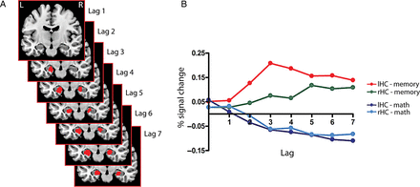
Figure 1. Temporal characteristics of hippocampal activation during AM retrieval. (A) Hippocampal activation (slice ...
Notes:
Figure 1. Temporal characteristics of hippocampal activation during AM retrieval. (A) Hippocampal activation (slice number: y = −10) in red across 7 lags (=14 s) that showed a greater bootstrap ratio (BSR) than 3.0 and a cluster size of >10 contiguous voxels. Activation is displayed on a T1-weighted MRI. (B) Percent signal change for the left (lHC, MNI: −20 −10 −22; peak in lag 2) and right (rHC, MNI: 26 −16 −18; peak in lag 3) hippocampus during AM retrieval (memory) and the control task (math).
Unless provided in the caption above, the following copyright applies to the content of this slide: © The Author 2013. Published by Oxford University Press. All rights reserved. For Permissions, please e-mail: journals.permissions@oup.com

Slide 2
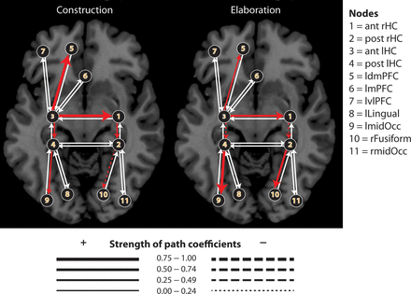
Figure 4. Effective hippocampal–neocortical networks during AM retrieval. Red arrows represent positive (solid) or ...
Notes:
Figure 4. Effective hippocampal–neocortical networks during AM retrieval. Red arrows represent positive (solid) or negative (dashed) effective connections that differed between construction and elaboration, white arrows represent anatomical connections that were included in the model but did not differ between both AM retrieval processes. The thickness of the arrows indicates the strength of the influence from one region to the other (path coefficient).
Unless provided in the caption above, the following copyright applies to the content of this slide: © The Author 2013. Published by Oxford University Press. All rights reserved. For Permissions, please e-mail: journals.permissions@oup.com

Slide 3
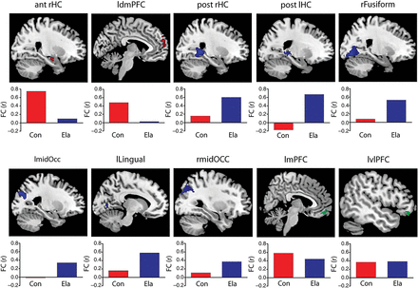
Figure 3. Location of SEM nodes and correlation to the seed. In addition to the seed voxel in the ant lHC, 10 regions ...
Notes:
Figure 3. Location of SEM nodes and correlation to the seed. In addition to the seed voxel in the ant lHC, 10 regions were included in the following SEM analysis. For clarity, individual clusters are displayed separately on a T1-weighted MRI. The functional connectivity (correlation coefficient, r) between the seed and the peak voxel of the cluster during construction (Con; lag 2) and elaboration (Ela; lag 6) is shown underneath each region.
Unless provided in the caption above, the following copyright applies to the content of this slide: © The Author 2013. Published by Oxford University Press. All rights reserved. For Permissions, please e-mail: journals.permissions@oup.com

Slide 4
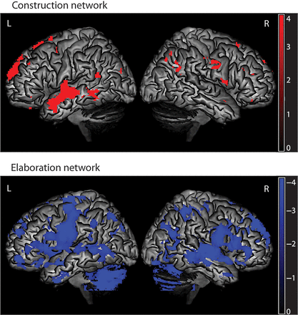
Figure 2. Functional hippocampal–neocortical networks during AM retrieval. Functional connectivity between the ...
Notes:
Figure 2. Functional hippocampal–neocortical networks during AM retrieval. Functional connectivity between the hippocampal seed (lHC, MNI: −20 −10 −22) and other brain regions during construction (= lag 2) and elaboration (= lag 6) displayed on a rendered T1-weigthed MRI. BSR > 2.0 and clusters of more than 5 contiguous voxels were considered significant.
Unless provided in the caption above, the following copyright applies to the content of this slide: © The Author 2013. Published by Oxford University Press. All rights reserved. For Permissions, please e-mail: journals.permissions@oup.com

