Slide 1
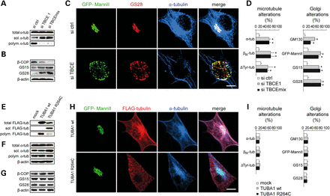
Figure 6. Tubulin polymerization, Golgi structure and vesicle markers after TBCE depletion or mutant α-tubulin ...
Notes:
Figure 6. Tubulin polymerization, Golgi structure and vesicle markers after TBCE depletion or mutant α-tubulin expression. (A) Western blot showing that TBCE-depletion does not affect the total levels of α-tubulin but leads to a drastic decrease in the levels of polymerized α-tubulin and a significant increase in the levels of soluble α-tubulin (siTBCE 1: 1.6 ± 0.3-fold, siTBCE mix: 1.9 ± 0.1-fold, mean ± SD, Mann–Whitney test, paired). Soluble α-tubulin levels were quantified by densitometric analysis of six blots from three independent transfections. β-actin loading control is shown in panel B. (B) Decreased levels of β-COP in TBCE-depleted cells in comparison to control cells. Levels of GS15 and GS28 are increased in comparison to control by 7.4 ± 0.6 and 6.2 ± 0.3-fold (mean ± SD) respectively, as quantified by densitometric analysis of four independent experiments. (C) Confocal imaging showing that the α-tubulin-labeled microtubule alterations in TBCE-depleted cells are associated with Golgi alterations labeled with GFP-MannII and GS28, as compared with control. (D) Increased percentage of microtubule alterations labeled with α-, βIII- or ΔTyr-tubulin and Golgi alterations labeled with GM130, GFP-MannII, GS15, and GS28 in TBCE-depleted cells, as compared with control cells, mean ± SD, n ≥ 100 cells per condition. Asterisks indicate statistical significance, P < 0.05 as measured by Student's t-test, unpaired, unequal variance. (E) Western blot analysis with anti-FLAG antibodies showing that expression of FLAG-tagged mutant α-tubulin (TUBA1 R264C) leads to increased levels of soluble mutant α-tubulin and decreased levels of polymerized mutant α-tubulin, in comparison to expression of FLAG-tagged wild-type α-tubulin (TUB1A wt). (F) Western blot with anti-α-tubulin antibodies showing a 1.6 ± 0.2-fold increase (mean ± SD) in the levels of soluble α-tubulin after TUBA1 R264C expression, as quantified by densitometric analysis of six independent blots; P < 0.026, Mann–Whitney test, paired, unequal variance. (G) Unaltered expression of β-COP, GS15 and GS28 in mutant TUBA1 R264C expressing cells. (H) Confocal imaging demonstrating that FLAG-tagged α-tubulin mutant TUBA1 R264C does not affect Golgi or microtubule structure. (I) Absence of microtubule or Golgi alterations in cells expressing mutant TUBA1 R264C α-tubulin, mean ± SD, n ≥ 100 cells per condition. Scale bars 5 µm.
Unless provided in the caption above, the following copyright applies to the content of this slide: © The Author 2014. Published by Oxford University Press. All rights reserved. For Permissions, please email: journals.permissions@oup.com

Slide 2
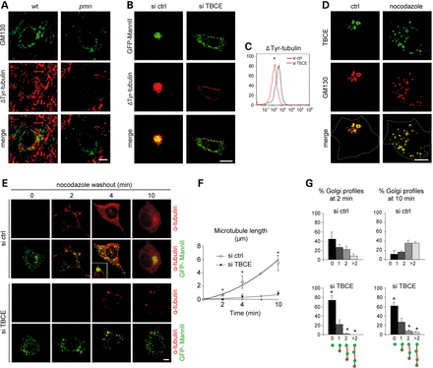
Figure 5. Defective polymerization of Golgi-derived microtubules in pmn and TBCE-depleted motor neurons. (A) ...
Notes:
Figure 5. Defective polymerization of Golgi-derived microtubules in pmn and TBCE-depleted motor neurons. (A) Immunofluorescence showing that fragmentation of the GM130-labeled Golgi apparatus in motor neurons of 25-day-old pmn mice is associated with loss of Golgi-associated microtubules labeled for ΔTyr-tubulin, as compared with wild-type. (B) Loss of ΔTyr-tubulin-labeled microtubules in TBCE-depleted NSC34 motor neurons co-labeled with GFP-MannII, as compared with control. (C) Flow cytometry showing reduced levels of ΔTyr-tubulin-labeled microtubules after TBCE-depletion. (D) Immunofluroescence showing that TBCE remains associated with GM130-labeled Golgi profiles in nocodazole-treated NSC34 cells. (E) Immunofluroescence showing regrowth of microtubules from GFP-MannII-labeled Golgi profiles in control and TBCE-depleted NSC34 motor neurons after nocodazole treatment and washout. (F) Reduced growth rate of Golgi-derived microtubules in TBCE-depleted cells. Each point (means of mean ± SD) represents n = 10 cells per condition/time point and 10 randomly chosen microtubules per cell, *P < 0.05 by Student's t-test. (G) Increased percentage of Golgi elements unlinked to microtubules in TBCE-depleted cells as compared with control cells after nocodazole washout. Golgi elements are classified into four categories. Mean ± SD, n≈ 500 profiles analyzed per time point and condition, *P < 0.05 by Student's t-test.
Unless provided in the caption above, the following copyright applies to the content of this slide: © The Author 2014. Published by Oxford University Press. All rights reserved. For Permissions, please email: journals.permissions@oup.com

Slide 3
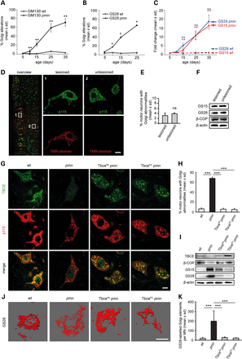
Figure 4. Kinetics, specificity and TBCE-mediated rescue of Golgi vesiculation in pmn motor neurons. (A–B) Kinetics of ...
Notes:
Figure 4. Kinetics, specificity and TBCE-mediated rescue of Golgi vesiculation in pmn motor neurons. (A–B) Kinetics of Golgi alterations labeled by immunofluorescence for GM130 (A) or GS28 (B) in pmn and wild-type motor neurons, n > 200 motor neurons from at least two mice per genotype and time-point, **P < 0.01 by Student's t-test. (C) Kinetics of GS15 and GS28 levels in pmn and wild-type spinal cord extracts analyzed by western blot. Fold changes are expressed relative to levels at Day 5. Each time point represents n = 3 spinal cords per genotype analyzed each by two independent densitometric scans. * P < 0.05 by Student's t-test., **P < 0.01 by Student's t-test. (D) Confocal imaging showing the absence of Golgi alterations after axotomy. Sciatic nerves of 35-day-old normal mice were unilaterally transected, motor neurons retrogradely labeled with Tetramethylrhodamin (TMR)–dextran and lumbar spinal cord sections immunolabeled for p115. The overview in the frontal plane shows motor neurons on the lesioned and unlesioned side. The zooms demonstrate absence of Golgi pathology in lesioned motor neurons, as compared with unlesioned motor neurons. (E) No significant Golgi alterations in lesioned motor neurons. P = 0.34 (ns, non-significant by Student's t-test), n = 251 (lesioned), n = 275 (unlesioned) motor neurons from a total of three animals. (F) Western blots showing similar levels of β-COP, GS15 and GS28 in lumbar spinal cord hemisegments from the lesioned and unlesioned side. (G) Confocal imaging showing rescue of Golgi alterations in pmn mice by transgenic complementation with wild-type TBCE. Lumbar spinal cord cross sections from 35-day-old wild-type, pmn, transgenic TbcePApmn and TbcePCpmn mice were immunolabeled for TBCE and p115. Loss of TBCE expression in pmn motor neurons is associated with reduced p115 immunolabeling at Golgi membranes. Transgenic TBCE expression in motor neurons of TbcePApmn and TbcePCpmn mice restores normal p115 immunolabeling. (H) Rescue of p115-labeled Golgi alterations in motor neurons of transgenic TbcePApmn and TbcePCpmn mice. Number of motor neurons and mice analyzed per genotype: wt n = 390 (four mice), pmn 397 (four mice), TbcePApmn n = 275 (3 mice), TbcePCpmn n = 321 (three mice). Statistical significance ***P < 0.001 by one-way ANOVA and Tukey's post hoc test: significant for pmn versus wt, TbcePApmn versus pmn, and TbcePCpmn versus pmn, TbcePApmn versus wt, not significant for TbcePCpmn versus wt, TbcePApmn versus pmn and TbcePCpmn versus TbcePApmn. (I) Transgenic rescue of pathological β-COP, GS15 and GS28 expression analyzed by western blot in lumbar spinal cord of TbcePApmn and TbcePCpmn mice as compared with wild-type and pmn mice. Data are representative of three independent tissue samples per genotype. Two independent experiments gave similar results. (J) Rescue of Golgi vesiculation by transgenic TBCE complementation. 3D modelings show GS28-labeled Golgi elements in lumbar motor neurons of the indicated genotypes. (K) Rescue of the number (mean ± SD) of GS28-labeled Golgi elements determined by 3D-modeling. Number of motor neurons counted by an observer blinded to the genotypes: wt n = 12, pmn n = 12, TbcePApmn n = 13, TbcePCpmn n = 12, each from two mice per genotype. Statistical significance P < 0.0001 between groups by Kruskal–Wallis test and Dunn's post hoc test for pmn versus wt, TbcePApmn versus pmn and TbcePCpmn versus pmn; not significant for TbcePApmn versus wt, TbcePCpmn versus wt, and TbcePApmn versus TbcePCpmn. Scale bars 10 μm.
Unless provided in the caption above, the following copyright applies to the content of this slide: © The Author 2014. Published by Oxford University Press. All rights reserved. For Permissions, please email: journals.permissions@oup.com

Slide 4
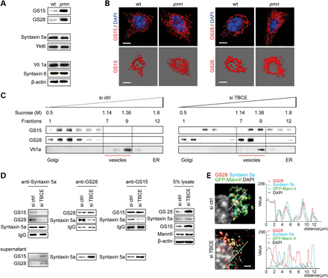
Figure 3. TBCE-linked Golgi vesiculation is associated with defective SNARE pairing and recycling. (A) Western blots ...
Notes:
Figure 3. TBCE-linked Golgi vesiculation is associated with defective SNARE pairing and recycling. (A) Western blots showing a drastic increase in Golgi v-SNAREs GS15 and GS28 in pmn spinal cord but normal expression of the corresponding t-SNAREs Syntaxin 5a and Ykt6 as compared with wild-type siblings. Expression of endosomal SNARE pairs Vti1a/Syntaxin 6 and also of MannII and GalT is unaltered in pmn. (B) Confocal imaging (upper rows) and 3D modeling (lower rows) reveal accumulation of GS15 and GS28 in small vesicle-like puncta of pmn motor neurons. (C) Sucrose gradient fractionation showing a shift of GS15 and GS28 to vesicle fractions in TBCE-depleted cells. The control protein Vt1a is not shifted. Data are representative of ≥2 independent experiments. (D) Immunoprecipitation analysis of v-/t-SNARE complexes. Reduced levels of GS15/Syntaxin 5a and GS28/Syntaxin 5a complexes (upper panels) but increased amounts of unpaired SNAREs (lower panels) in TBCE-depleted cells as compared with control cells. Controls: MannII and β-actin in cell lysates, IgG in immunoprecipitates. Two independent experiments gave similar results. (E) High resolution confocal imaging and fluorescent line profiles showing dissociated GS28/Syntaxin 5a signals in TBCE-depleted cells as compared with overlapping signals in control cells, n = 20 cells analyzed per condition. Scale bars 10 μm (B), 5 µm (E).
Unless provided in the caption above, the following copyright applies to the content of this slide: © The Author 2014. Published by Oxford University Press. All rights reserved. For Permissions, please email: journals.permissions@oup.com

Slide 5
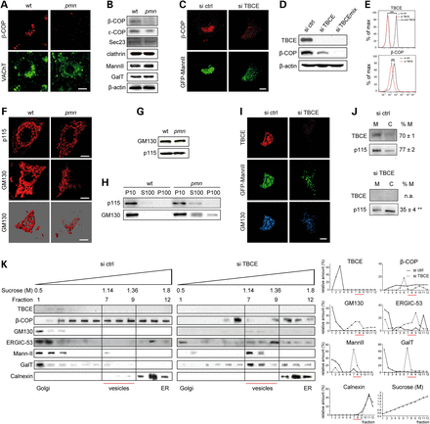
Figure 2. Defective COPI vesicle formation and tethering in mutant pmn and TBCE-depleted NSC34 motor neurons. (A) ...
Notes:
Figure 2. Defective COPI vesicle formation and tethering in mutant pmn and TBCE-depleted NSC34 motor neurons. (A) Confocal microscopy showing decreased β-COP immunoreactivity in a pmn motor neuron identified by vesicular acetylcholine transporter (VAchT) expression, as compared with a wild-type motor neuron at age 25 days. At least 100 motor neurons were analyzed from each lumbar spinal cord (n = 3 mice per genotype). (B) Western blot analysis of pmn lumbar spinal cords at age 25 days showing reduced levels of β-COP and ε-COP but normal levels of Sec23 and clathrin as compared with wild-type. Levels of MannII and GalT are also similar between pmn and wild-type. Western blots were performed using samples from three pairs of pmn and wt litter mice. Repeating the experiment twice gave similar results. (C) Confocal microscopy demonstrating decreased β-COP immunoreactivity in a TBCE-depleted NSC34 motor neuron with GFP-MannII-labeled Golgi fragmentation, as compared with a control neuron at 4 days in vitro (DIV) after transfection. (D) Western blot analysis of NSC34 motor neuron cultures showing decreased levels of β-COP after efficient TBCE depletion with si TBCE or si TBCE mix as compared with control. (E) Flow cytometry showing complete TBCE depletion in NSC34 motor neurons (upper panel), as compared with control cells incubated without primary antibody, and significant reduction of cellular β-COP levels (lower panel). T(x) > 4, **P < 0.01 by χ2 test. (F) Decreased p115 and GM130 immunoreactivity at Golgi membranes of pmn motor neurons as compared with wild-type siblings (upper rows). 3D-modeling of GM130 membranes (lower rows) confirms Golgi fragmentation in pmn. (G) Western blots demonstrating similar total levels of GM130 and p115 in pmn and wild-type spinal cords. (H) Subcellular fractionation showing pathological redistribution of GM130 and p115 from P10 fraction (membranes) to S100 (cytosol) and for GM130 also to P100 (membrane fragments, vesicles) in pmn spinal cord extracts, n = 3 independent experiments. (I) Confocal microscopy showing decreased GM130 immunoreactivity at fragmented Golgi (GFP-MannII) in TBCE-depleted NSC34 cell as compared with control cell. (J) Cell fractionation showing lower p115 recruitment to membranes in TBCE-depleted cells, as compared with controls. Protein expression in membrane (M) and cytosol (C) is quantified relative to total, %M = M/(M + C), mean ± SD, **P < 0.001 by Student's t-test. na, not applicable, n = 3 independent experiments. (K) Sucrose density fractionation. In control cells, Golgi membranes are identified in fractions 1–4 by TBCE, MannII and GM130, vesicles in fractions 7–9 according to their sucrose density of 1.14–1.36 m (21) and ER membranes in fractions 10–12 by Calnexin. In TBCE-depleted cells, GM130 is completely lost from Golgi membranes, β-COP is specifically lost from vesicle fractions and ERGIC-53, MannII as well as GalT peak in vesicle fractions. Plots showing relative protein content per fraction (right panels) are representative of ≥2 independent experiments. Sucrose concentration in each fraction was measured by enzymatic assay. Scale bars 10 μm.
Unless provided in the caption above, the following copyright applies to the content of this slide: © The Author 2014. Published by Oxford University Press. All rights reserved. For Permissions, please email: journals.permissions@oup.com

Slide 6
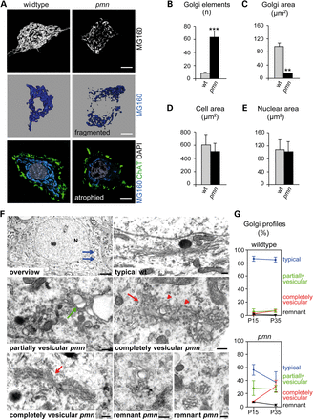
Figure 1. Golgi pathology in motor neurons of pmn mice. (A) Golgi architecture assessed by immunofluorescence using ...
Notes:
Figure 1. Golgi pathology in motor neurons of pmn mice. (A) Golgi architecture assessed by immunofluorescence using MG160 in wild-type and pmn motor neurons. The middle row shows a 3D surface modeling illustrating Golgi fragmentation and the lower row demonstrates the strong reduction in Golgi area (atrophy) in pmn motor neurons. (B) Increased number of Golgi elements labeled with MG160 in pmn motor neurons after 3D modeling (mean ± SD, n = 12 motor neurons per genotype, ***P < 0.0001 by Student's t-test). (C) Reduced cross-sectional area of MG160-labeled Golgi elements in pmn motor neurons as assessed by immunofluorescence (mean ± SD, n = 50 motor neurons per genotype, **P < 0.001 by Student's t-test, unpaired, unequal variance). (D–E). Sizes of cell area and nuclear area measured, respectively, by VAChT immunofluorescence and DAPI staining are not statistically different between wt and pmn. (F) Electron microscopy showing an overview of a wild-type motor neuron (Day 35) with nucleus (N), nucleolus (No) and numerous Golgi profiles (arrows). Typical Golgi profiles in wild-type can be distinguished from partially vesicular, completely vesicular and remnant Golgi profiles in pmn motor neurons. (G) Quantification of Golgi profiles from the indicated categories in wild-type and pmn motor neurons at Day 15 and Day 35. Golgi profiles analyzed per time point: n = 287 (Day 15), n = 372 (Day 35). For each category and time point the difference between wt and pmn was statistically different, P < 0.05, Student's t-test, unpaired. Scale bar 10 µm (A), 200 nm (C).
Unless provided in the caption above, the following copyright applies to the content of this slide: © The Author 2014. Published by Oxford University Press. All rights reserved. For Permissions, please email: journals.permissions@oup.com

Slide 7
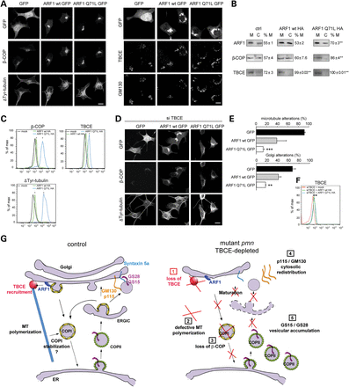
Figure 7. Role of an ARF1/TBCE-mediated cross-talk in Golgi maintenance. (A) Confocal imaging showing that expression ...
Notes:
Figure 7. Role of an ARF1/TBCE-mediated cross-talk in Golgi maintenance. (A) Confocal imaging showing that expression of GFP-tagged ARF1 wt or ARF1 Q71L in NSC34 cells triggers a stronger β-COP signal and polymerization of more ΔTyr-tubulin-containing microtubules around the Golgi apparatus than GFP expression (left panels). GFP-tagged ARF1 wt and GFP-tagged ARF1 Q71L recruit TBCE to Golgi membranes labeled with GM130 (arrow, right panels). (B) Cellular fractionation. Expression of HA-tagged ARF1 wt or ARF1 Q71L stimulates recruitment of β-COP and TBCE from cytosolic (C) to membrane fractions (M). Relative protein expression is indicated as %M: M/(M + C), mean ± SD, n = 3 experiments, **P 4, P 28, P < 0.01, by χ2 test. (D) Confocal imaging reveals rescue of the pathologically decreased β-COP expression in siTBCE transfected cells by expression of GFP-tagged ARF1 wt or ARF1 Q71L, as compared with expression of GFP (upper and middle rows). Note also enhanced polymerization of ΔTyr-tubulin by expression of GFP-tagged ARF1 wt or GFP-tagged ARF1 Q71L (lower rows). (E) Rescue of microtubule or GM130-labeled Golgi alterations by ARF1 Q71L GFP in siTBCE-transfected cells (mean ± SD). Each experiment was done in triplicate conditions with n > 50 cells per condition. Statistical significance: ***P < 0.0002 (microtubule alterations) and **P 26, P 26, P < 0.01, by χ2 test. (G) Model showing the ARF1/TBCE cross-talk which coordinates polymerization of Golgi-derived microtubules and COPI vesicle formation and the consequences of its disruption in mutant pmn and TBCE-depleted motor neurons. Scale bars 10 μm.
Unless provided in the caption above, the following copyright applies to the content of this slide: © The Author 2014. Published by Oxford University Press. All rights reserved. For Permissions, please email: journals.permissions@oup.com

