Slide 1
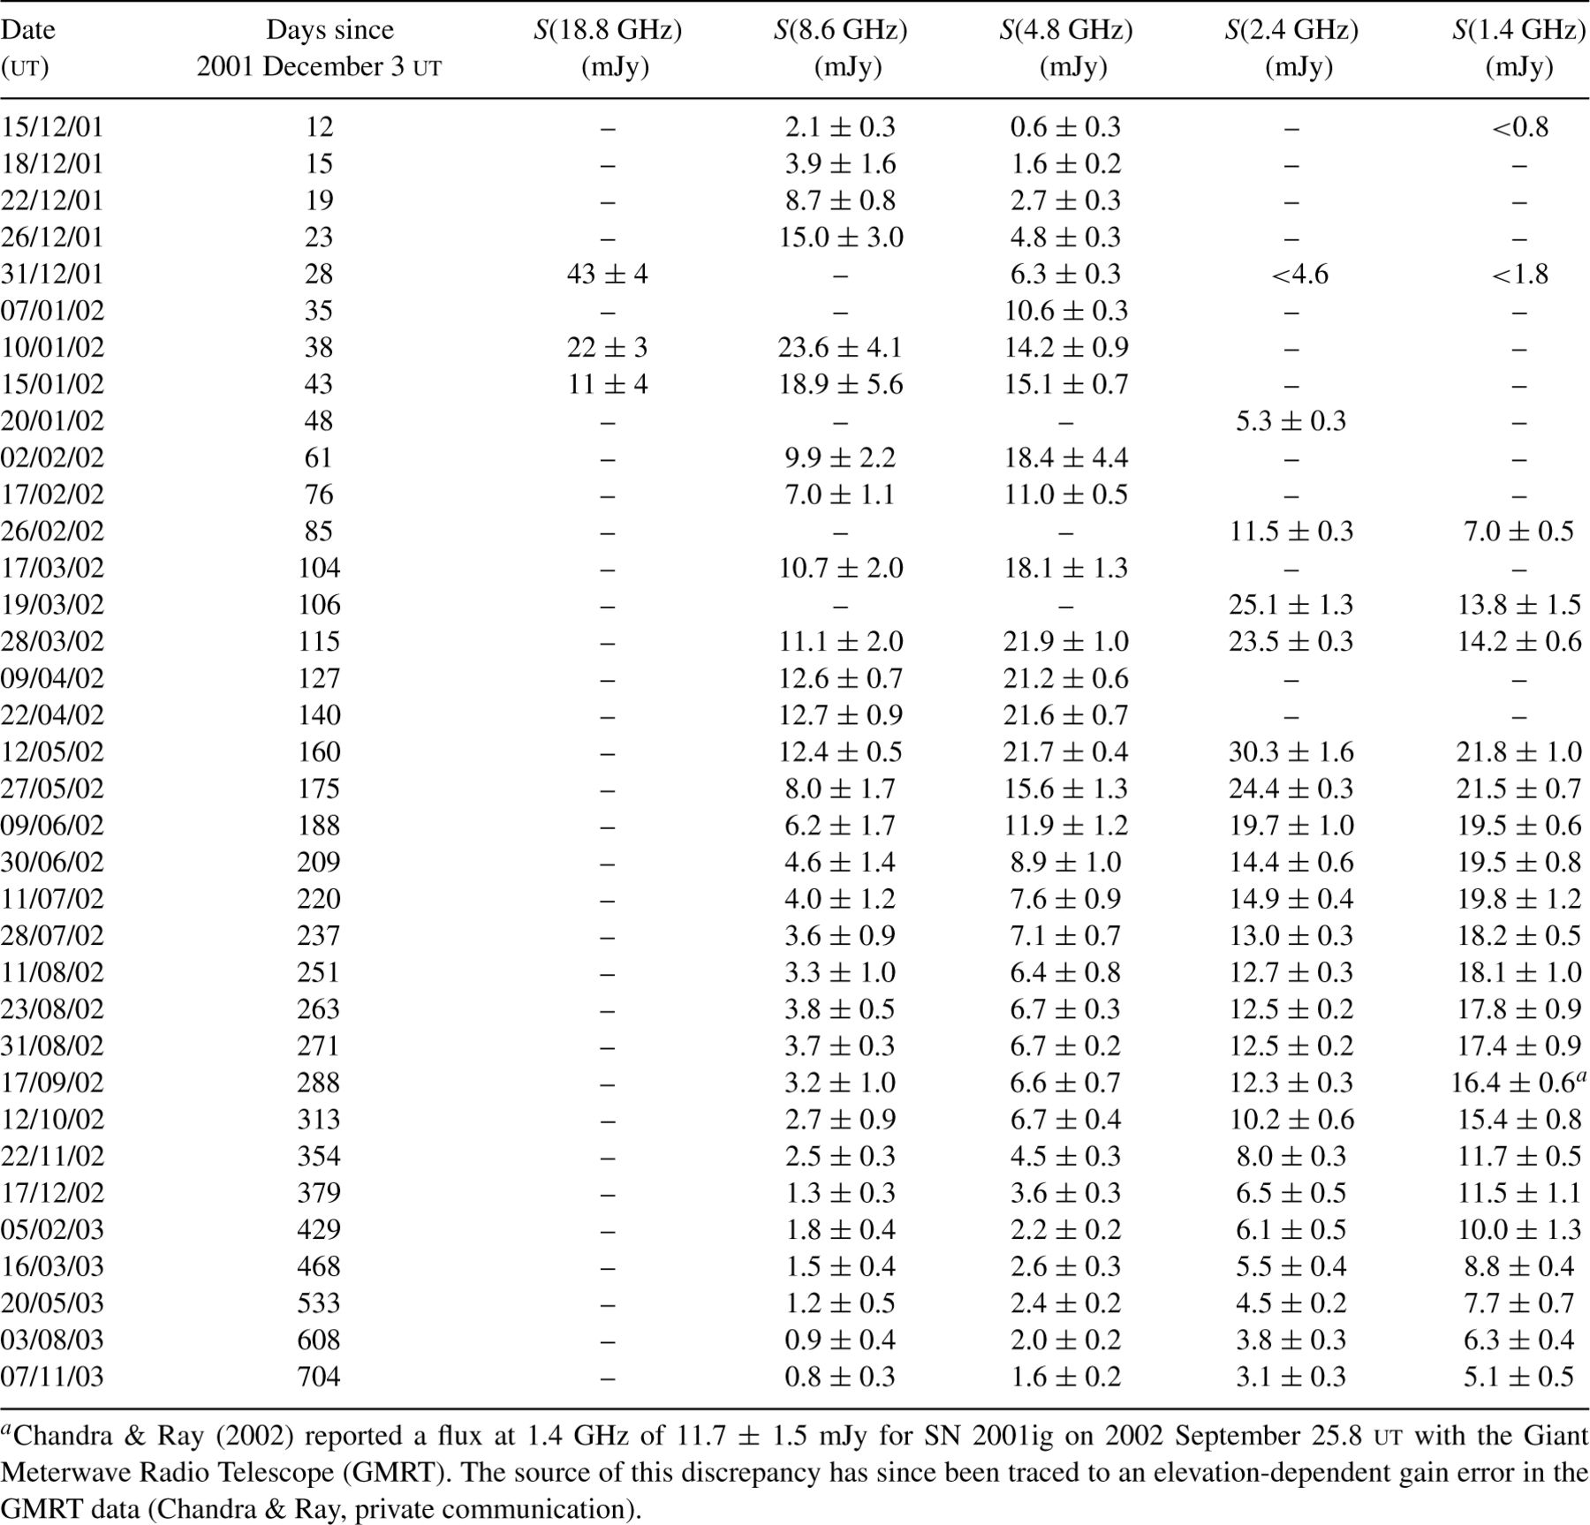
1 SN 2001ig radio flux measurements with the ATCA.
Notes:
1 SN 2001ig radio flux measurements with the ATCA.
Unless provided in the caption above, the following copyright applies to the content of this slide: © 2004 RAS

Slide 2
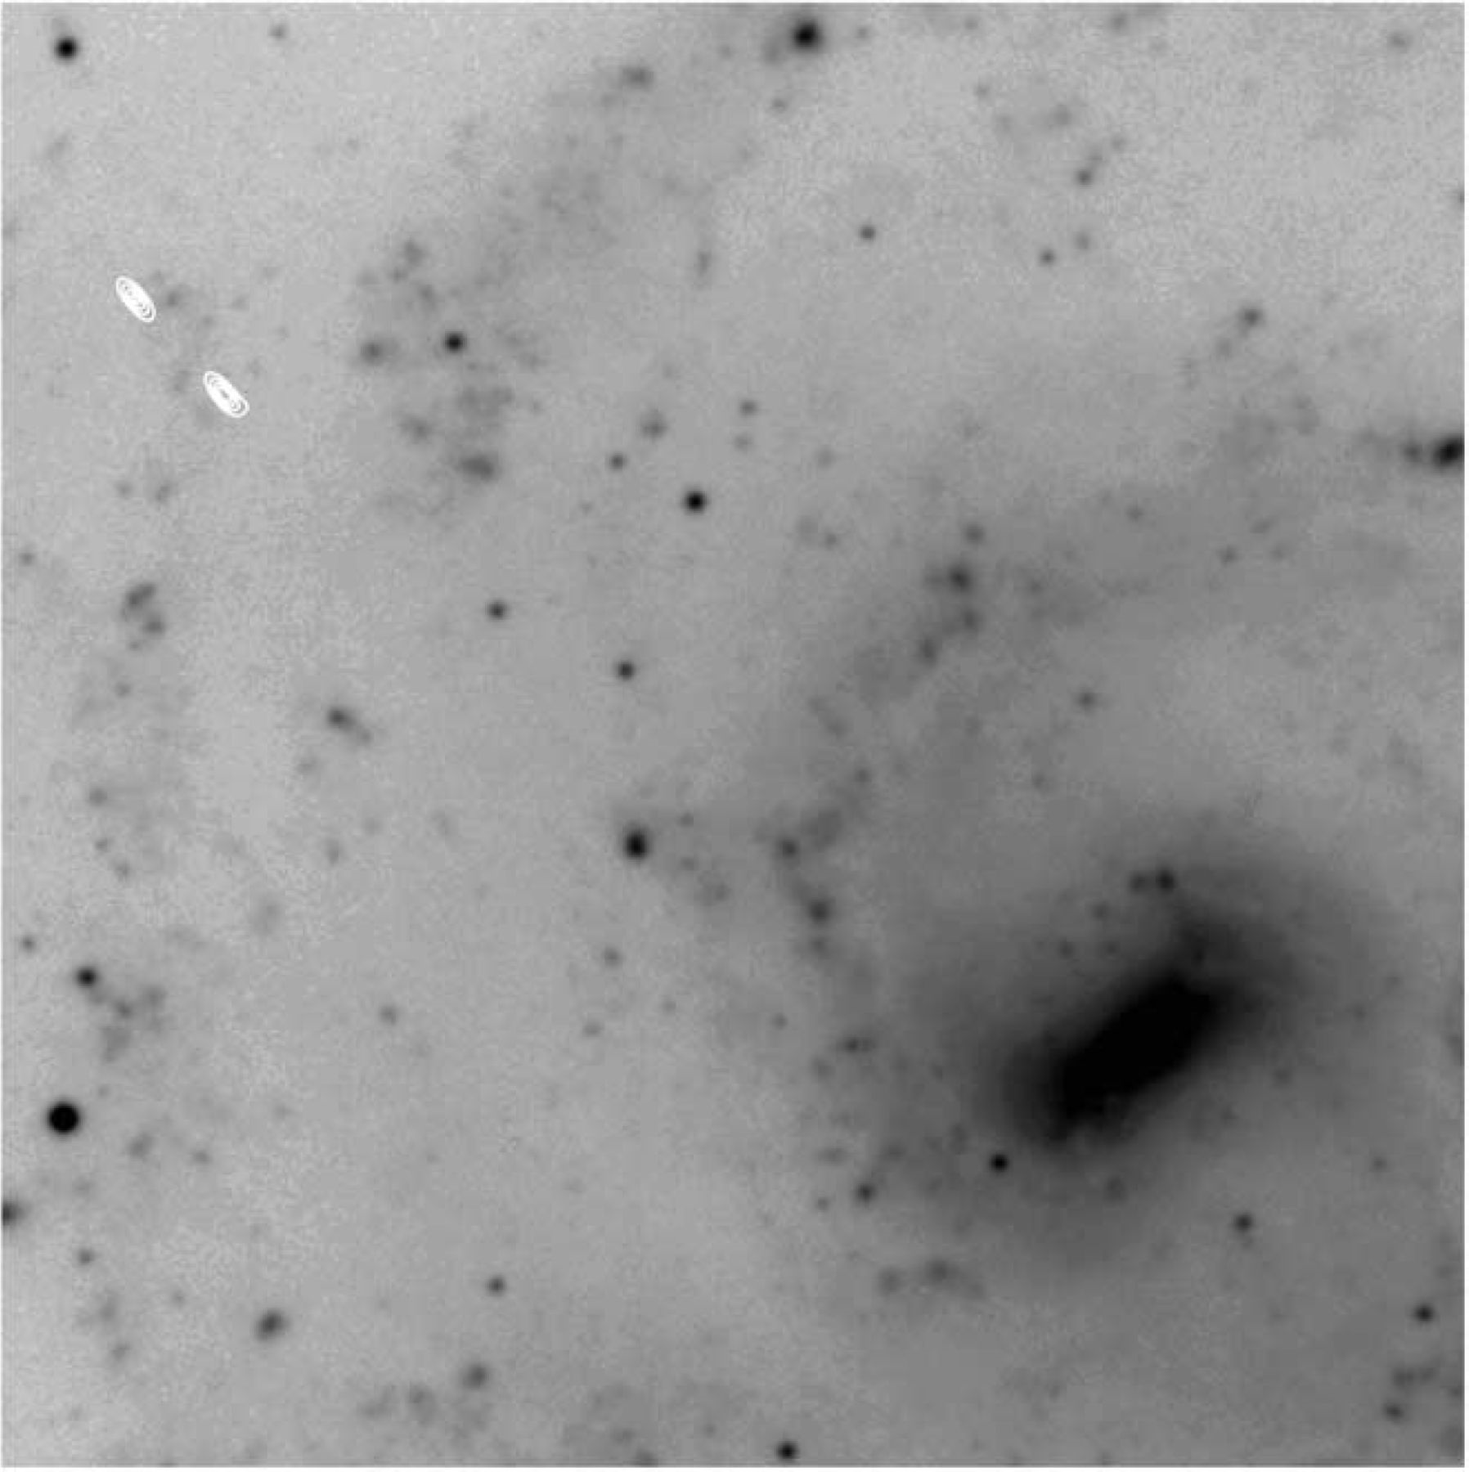
1 Contours of 4.790-GHz radio emission, on a V-band image of NGC 7424. The radio observations were made with ...
Notes:
1 Contours of 4.790-GHz radio emission, on a V-band image of NGC 7424. The radio observations were made with the ATCA on 2002 February 17 ut, and have a synthesized beamwidth of 3.8 arcsec × 1.5 arcsec. SN 2001ig is the upper-left of the two (unresolved) sources. The optical image is 3.5 arcmin on a side, obtained with the DFOSC instrument on the Danish 1.54-m telescope on La Silla (Larsen & Richtler 1999), and made available through the NASA/IPAC Extragalactic Database.
Unless provided in the caption above, the following copyright applies to the content of this slide: © 2004 RAS

Slide 3
2 SN 2001ig radio flux measurements with the VLA.
Notes:
2 SN 2001ig radio flux measurements with the VLA.
Unless provided in the caption above, the following copyright applies to the content of this slide: © 2004 RAS

Slide 4
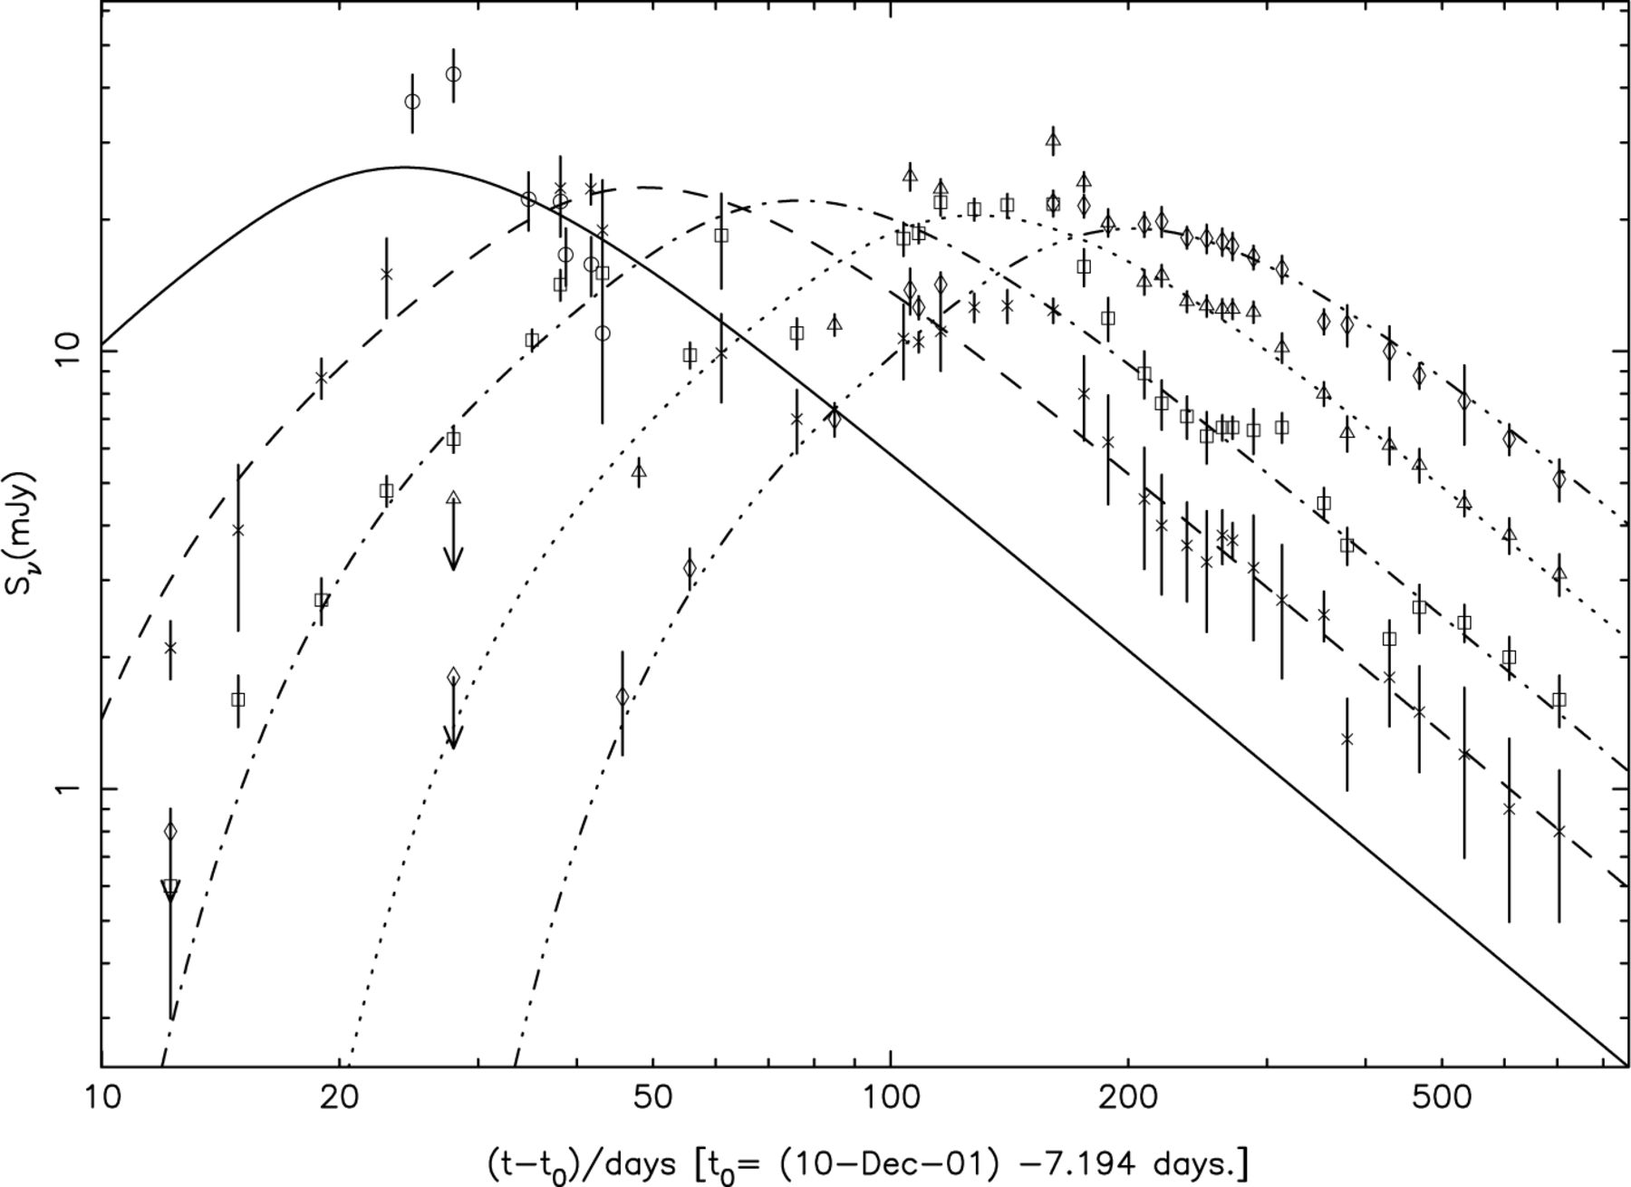
2 SN 2001ig at radio frequencies of 22.5/18.8 GHz (circles, thick solid line), 8.6/8.5 GHz (crosses, dashed ...
Notes:
2 SN 2001ig at radio frequencies of 22.5/18.8 GHz (circles, thick solid line), 8.6/8.5 GHz (crosses, dashed line), 4.9/4.8 GHz (squares, dash-dotted line), 2.4 GHz (triangles, dotted line), and 1.4 GHz (diamonds, dash-triple dotted line). The curves are a model fitting to the data, as described in the text.
Unless provided in the caption above, the following copyright applies to the content of this slide: © 2004 RAS

Slide 5
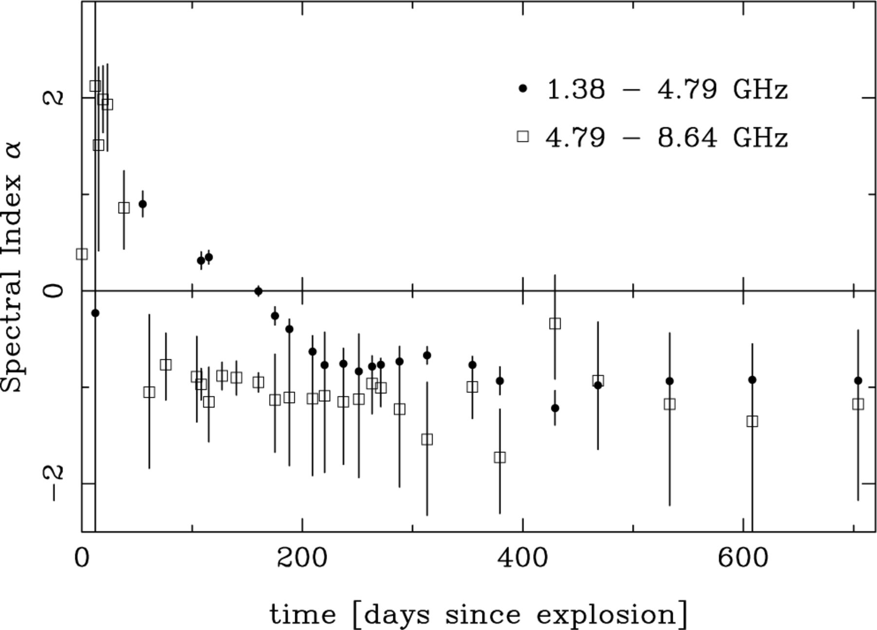
3 Evolution of the spectral index, α, for SN 2001ig, plotted linearly as a function of time between 1.38 and ...
Notes:
3 Evolution of the spectral index, α, for SN 2001ig, plotted linearly as a function of time between 1.38 and 4.8/4.9 GHz (solid circles) and between 4.8/4.9 and 8.64 GHz (open squares).
Unless provided in the caption above, the following copyright applies to the content of this slide: © 2004 RAS

Slide 6
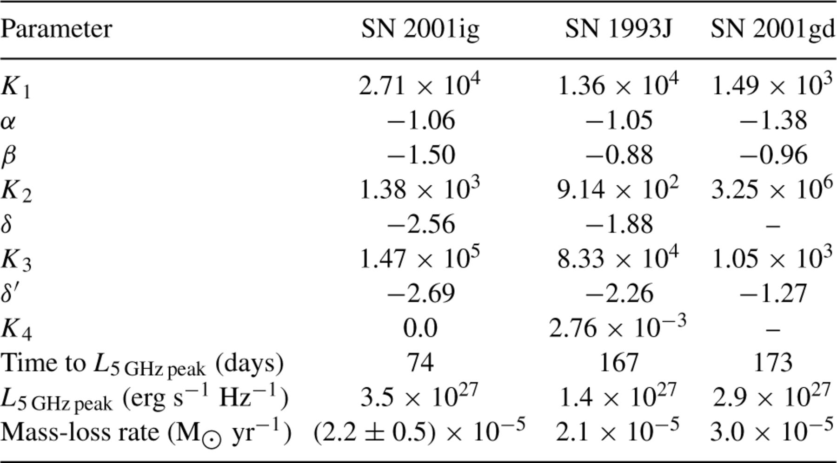
3 Comparison of the radio light-curve model parameters.
Notes:
3 Comparison of the radio light-curve model parameters.
Unless provided in the caption above, the following copyright applies to the content of this slide: © 2004 RAS

Slide 7
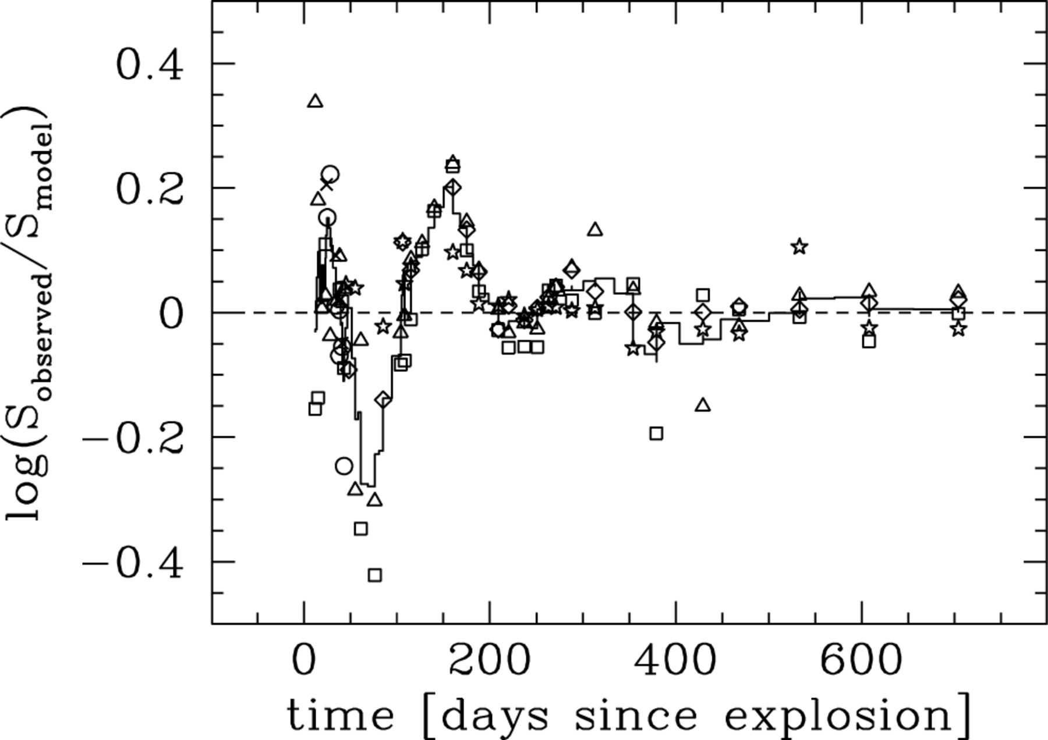
4 Deviations of the observed flux (on a log scale) about the best-fitting model, plotted linearly as a function ...
Notes:
4 Deviations of the observed flux (on a log scale) about the best-fitting model, plotted linearly as a function of time. The symbols represent frequencies of 22.5/18.8 GHz (circles), 15.0 GHz (crosses), 8.6/8.5 GHz (squares), 4.9/4.8 GHz (triangles), 2.4 GHz (diamonds) and 1.4 GHz (stars), while the solid line is a smoothed interpolation, as described in the text.
Unless provided in the caption above, the following copyright applies to the content of this slide: © 2004 RAS

