Slide 1
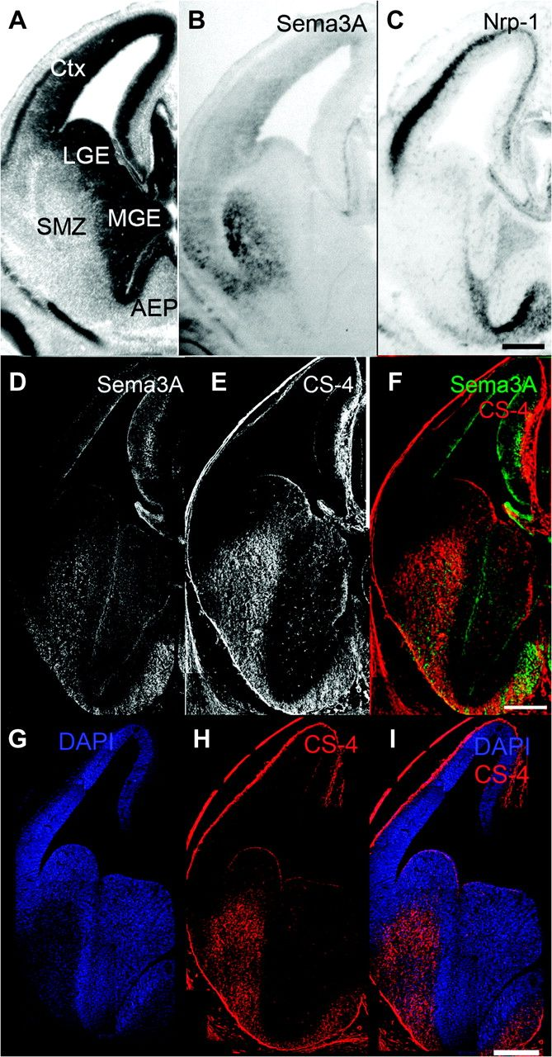
Figure 1. Sema 3A is coexpressed with CS in the striatum during the period of tangential migration of cortical ...
Notes:
Figure 1. Sema 3A is coexpressed with CS in the striatum during the period of tangential migration of cortical interneurons. In situ hybridization on E14 coronal brain sections against Sema 3A and Nrp-1 is shown in (B and C), respectively. (A) The relevant subdivisions of the telencephalon at this age are marked in a Nissl-stained section adjacent to (B). Immunostaining for Sema 3A (D) and CS-4 (E) is shown in E14 adjacent coronal brain sections. The overlay (F, color coded) demonstrates coexpression of the 2 molecules in the mantle zone of the striatum. DAPI staining in (G) allows the morphological identification of the SMZ as the area within LGE with lowest cell density. SMZ is positive for Sema 3A (D) and CS-4 (E, H), as demonstrated with the overlay for CS-4 and DAPI (I). Ctx, cortex; scale bars: 200 μm.
Unless provided in the caption above, the following copyright applies to the content of this slide: © The Author 2010. Published by Oxford University Press. All rights reserved. For permissions, please e-mail: journals.permissions@oxfordjournals.org

Slide 2
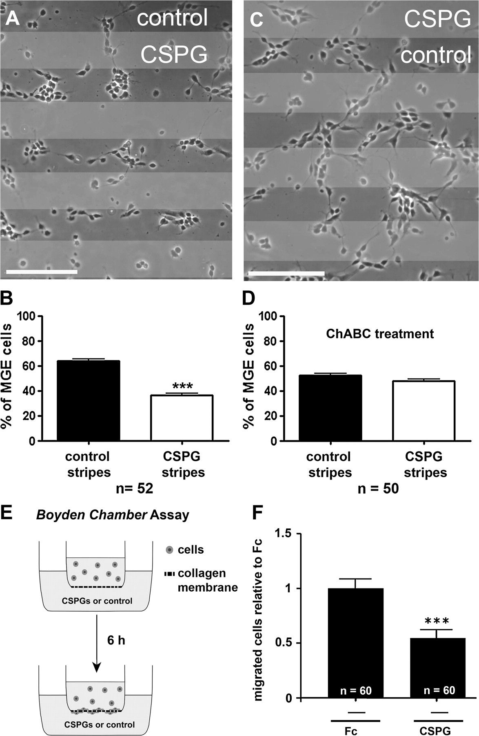
Figure 2. CSPGs have a repulsive effect on cortical interneurons in vitro. Dissociated MGE cells were plated on ...
Notes:
Figure 2. CSPGs have a repulsive effect on cortical interneurons in vitro. Dissociated MGE cells were plated on alternating stripes containing either CSPG or control protein (A) or CSPG and control previously treated with ChABC (C). Quantification of the distribution of MGE cells on the stripes after 24 h in vitro is shown in (B and D). (E) Schematic drawing of the setup of the transwell chemotactic assay (Boyden chamber assay). (F) Quantification of the number of cells migrated through the membrane in the lower compartment after application of CSPGs relative to Fc. Scale bars: 100 μm; n = number of analyzed frames (including 4 independent experiments in B, 3 independent experiments in D, and 3 independent experiments in F; ***, P < 0.001; mean ± SEM).
Unless provided in the caption above, the following copyright applies to the content of this slide: © The Author 2010. Published by Oxford University Press. All rights reserved. For permissions, please e-mail: journals.permissions@oxfordjournals.org

Slide 3
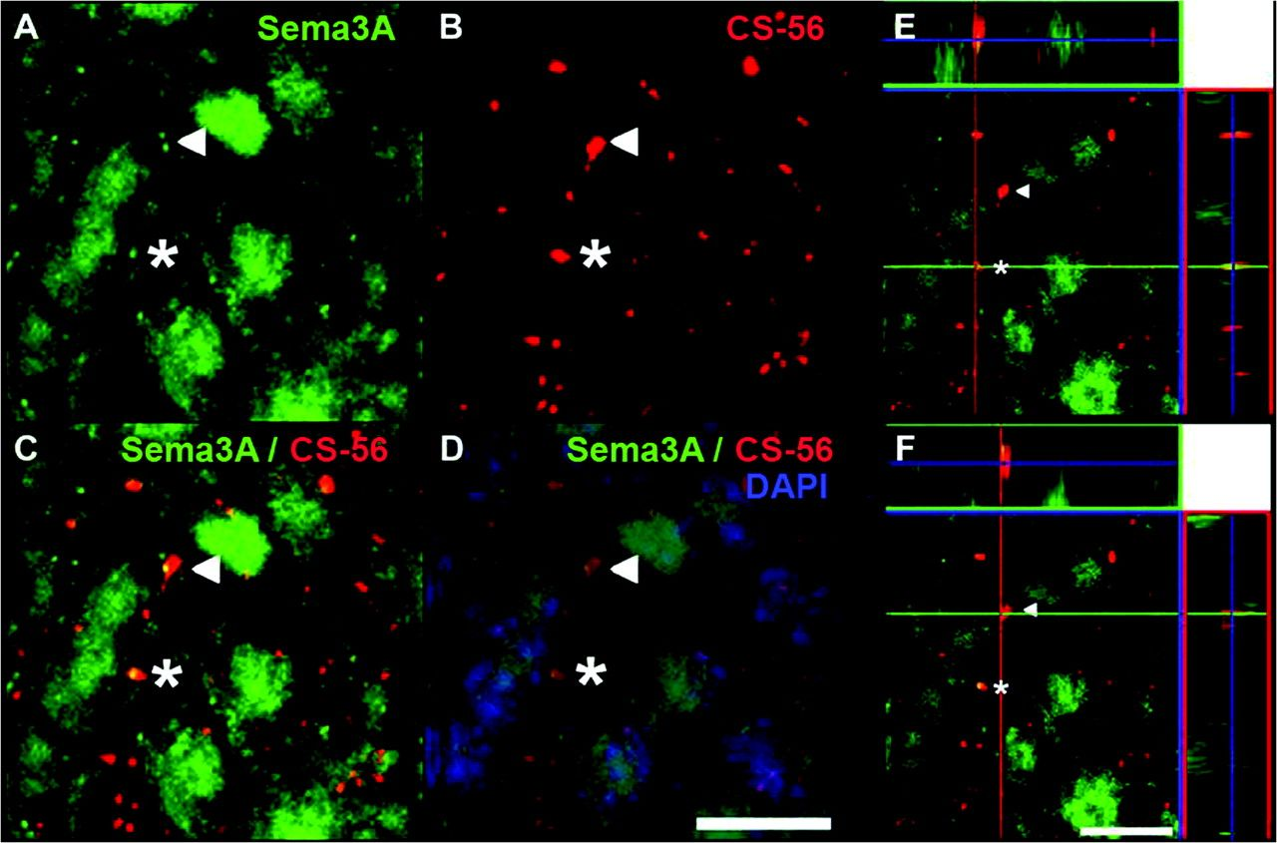
Figure 3. Extracellular Sema 3A in the striatum is colocalized with CS. Double immunostaining was performed using a ...
Notes:
Figure 3. Extracellular Sema 3A in the striatum is colocalized with CS. Double immunostaining was performed using a Sema 3A (A) and CS-56 (B) antibody. The indicated Sema 3A signals in (A) (asterisk and arrowhead) could also be observed using the CS-56 antibody in (B). The overlay in (C and D) (includes DAPI staining) suggests a colocalization of Sema 3A and CS. (E and F) Illustrates X and Y line scans through a single optical plane for the colocalized Sema 3A (green) and CS (red) signals marked with the asterisk (E) and the arrowhead (F). Scale bar: 20 μm.
Unless provided in the caption above, the following copyright applies to the content of this slide: © The Author 2010. Published by Oxford University Press. All rights reserved. For permissions, please e-mail: journals.permissions@oxfordjournals.org

Slide 4
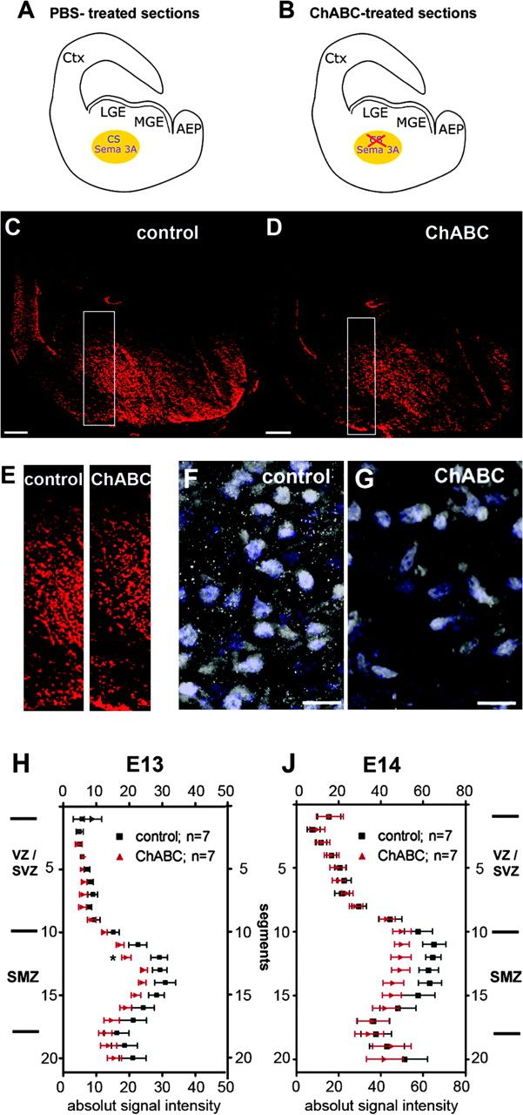
Figure 4. Extracellular Sema 3A in the striatum is reduced after CS cleavage. Immunohistochemistry for Sema 3A on E14 ...
Notes:
Figure 4. Extracellular Sema 3A in the striatum is reduced after CS cleavage. Immunohistochemistry for Sema 3A on E14 frozen brain sections was performed without (A, C) and with ChABC pretreatment (B, D). (A and B) Schematically illustrate the slices and applied conditions. For quantification, we measured absolute fluorescence intensities of the rectangular area in (C and D), magnified in (E). The analysis was performed on E13 and E14 brain sections and is shown in (H and J), respectively. An overlay of Sema 3A and DAPI staining of magnified sections of the striatum after pretreatment with PBS and ChABC is presented in (F and G), respectively, to illustrate the reduced punctate Sema 3A staining after CS cleavage. Ctx, cortex; scale bar: 200 μm in (C and D), 20 μm in (F and G), 50 μm in (K).
Unless provided in the caption above, the following copyright applies to the content of this slide: © The Author 2010. Published by Oxford University Press. All rights reserved. For permissions, please e-mail: journals.permissions@oxfordjournals.org

Slide 5
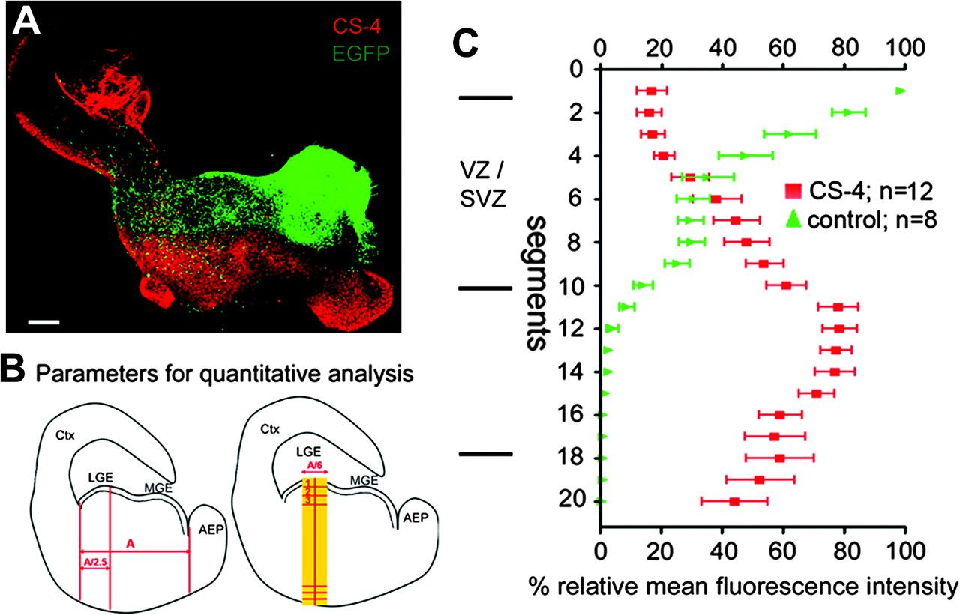
Figure 5. Grafted MGE-EGFP neurons avoid entering the striatum in slices where CS-4 is expressed. Grafting experiments ...
Notes:
Figure 5. Grafted MGE-EGFP neurons avoid entering the striatum in slices where CS-4 is expressed. Grafting experiments were used as an approach to study the tangential migration of cortical interneurons in vitro. (A) Grafted EGFP-MGE cells (green) migrate into the cortex after 2 d.i.v., avoiding the mantle zone of the striatum, that is characterized by a high expression of CS-4 (red), as revealed by immunostaining. (B) Schematic views of coronal brain slices as used for the grafting experiments. The left drawing illustrates how the size of each slice was measured to determine the dimensions of the analyzed area (shown in yellow on the right). The area was horizontally divided into 20 segments, starting with segment 1 in the VZ. The segment with the highest fluorescence in each slice was set to 100% and the lowest to 0%. The relative intensities of the remaining segments were calculated in relation to these 2 reference values (see Materials and methods for details). In (C), the distribution of the EGFP-MGE cells (green dots) in the analyzed area of the LGE is plotted against the CS-4 signal (red dots). Abbreviations as in previous figures. Scale bar: 200 μm; n = number of analyzed slices (mean ± SEM).
Unless provided in the caption above, the following copyright applies to the content of this slide: © The Author 2010. Published by Oxford University Press. All rights reserved. For permissions, please e-mail: journals.permissions@oxfordjournals.org

Slide 6
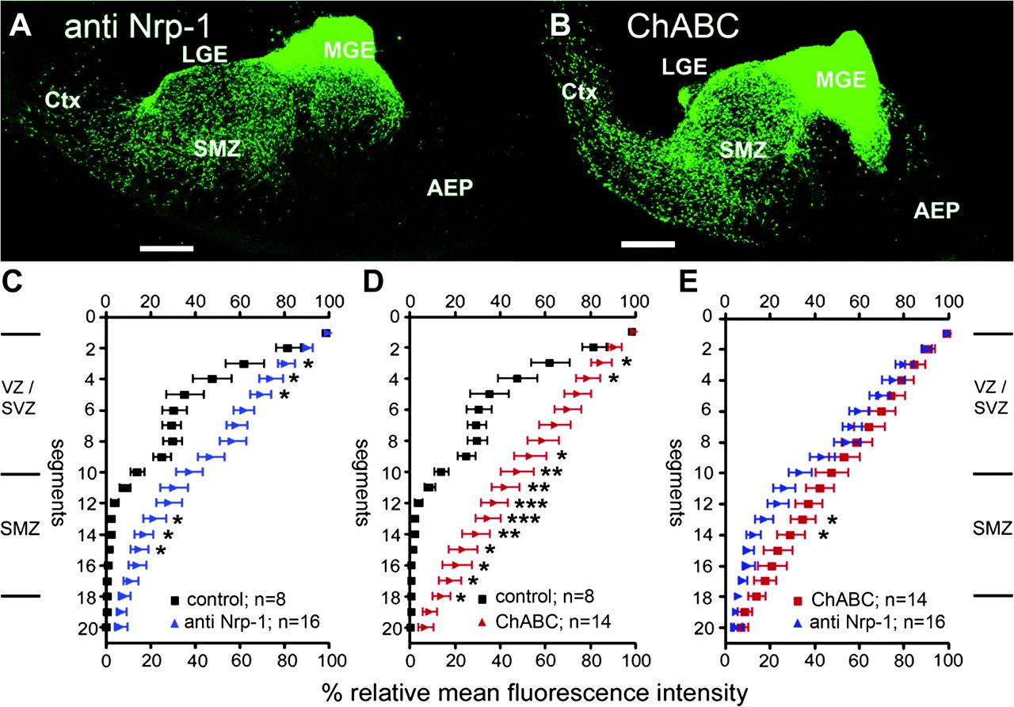
Figure 6. Manipulation of the tangential migration in grafting experiments. The tangential migration of EGFP-MGE ...
Notes:
Figure 6. Manipulation of the tangential migration in grafting experiments. The tangential migration of EGFP-MGE neurons in WT slices was investigated after blockage of Nrp-1 function (A) and enzymatic cleavage of CS side chains (B). Quantification of the relative fluorescence intensities after blocking Nrp-1 receptors is presented in (C) and after ChABC treatment in (D). (E) Represents the direct comparison of fluorescence intensities obtained after CS cleavage and blocking of Nrp-1. Student’s t-test was used for statistical comparison (*, P < 0.05; **, P < 0.01; ***, P < 0.001). Abbreviations as in previous figures. Scale bar: 200 μm; n = number of analyzed slices (mean ± SEM).
Unless provided in the caption above, the following copyright applies to the content of this slide: © The Author 2010. Published by Oxford University Press. All rights reserved. For permissions, please e-mail: journals.permissions@oxfordjournals.org

Slide 7
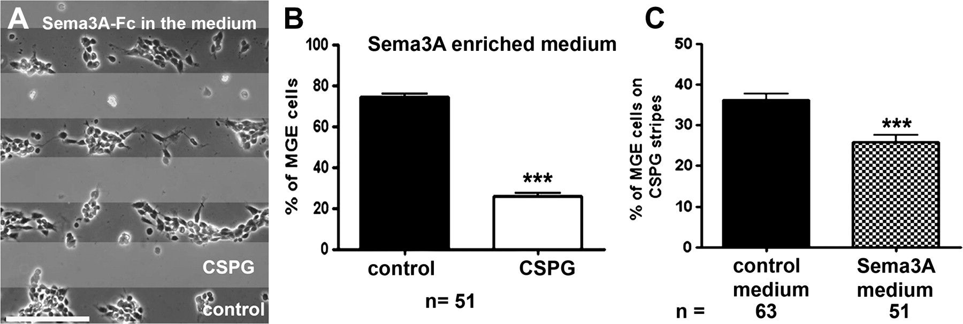
Figure 7. CS-induced repulsion in the stripe assay is increased in Sema 3A-Fc–enriched medium. Dissociated MGE cells ...
Notes:
Figure 7. CS-induced repulsion in the stripe assay is increased in Sema 3A-Fc–enriched medium. Dissociated MGE cells were plated on alternating stripes of CSPGs and control protein, and 5 μg/ml Sema 3A–Fc was added to the medium (A). The distribution of MGE cells was analyzed after 24 h in vitro (B; ***, P < 0.001; mean ± SEM). As illustrated in (C), the number of MGE cells growing on CSPG stripes in Sema 3A-Fc–enriched medium was significantly reduced, as compared with the number of MGE cells in CSPG stripes with control medium (without Sema 3A–Fc). Scale bar: 50 μm; n = number of analyzed frames (***, P < 0.001; mean ± SEM).
Unless provided in the caption above, the following copyright applies to the content of this slide: © The Author 2010. Published by Oxford University Press. All rights reserved. For permissions, please e-mail: journals.permissions@oxfordjournals.org

