Slide 1
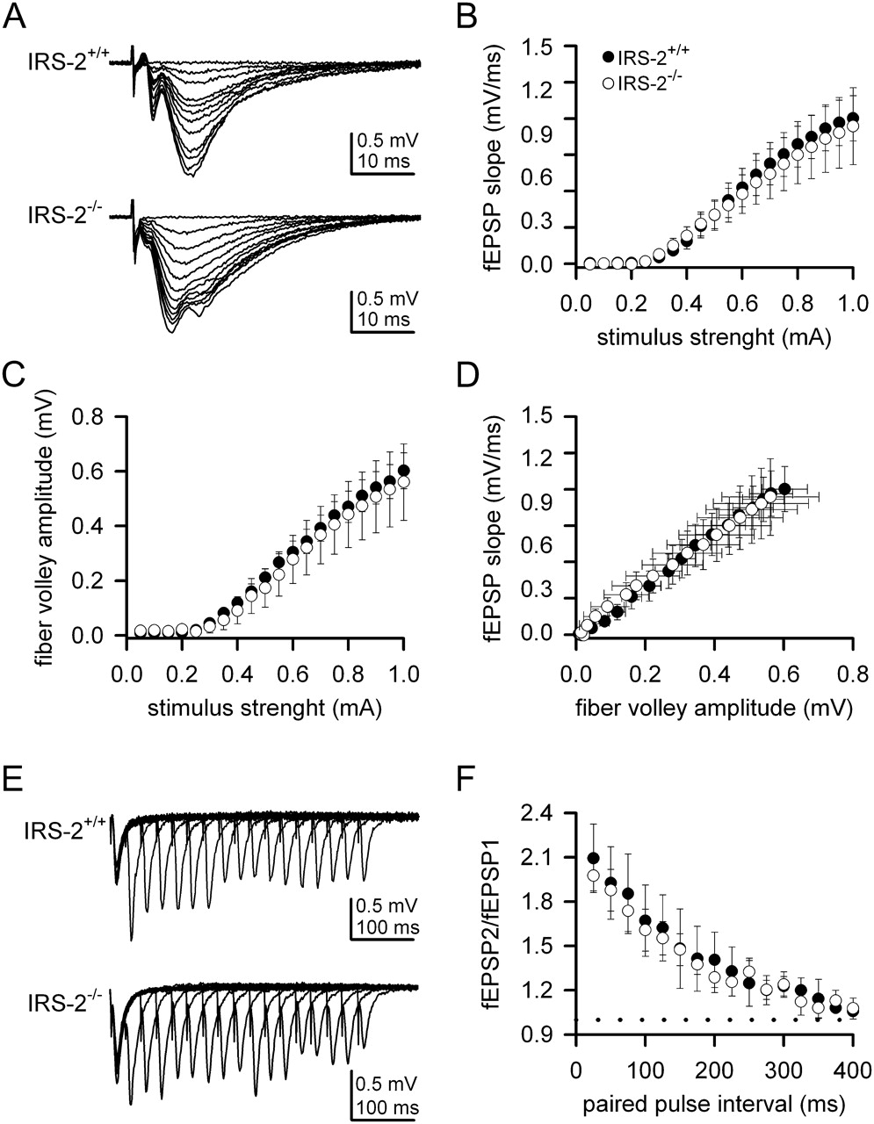
Figure 1. Basal synaptic transmission and PPF at CA1 synapses are not altered in Irs2^{−/−} mice. (A) ...
Notes:
Figure 1. Basal synaptic transmission and PPF at CA1 synapses are not altered in Irs2−/− mice. (A) Representative fEPSP recorded in the stratum radiatum and evoked by stimulation of the Schaffer collateral–commissural pathway with different intensities in WT (top) and Irs2−/− (bottom) mice. (B) fEPSP slopes are comparable between Irs2+/+ (filled circle, n = 6 mice) and Irs2−/− (open circle, n = 6 mice) for a given range of stimulus intensities. (C) Fiber volley amplitudes are similar between Irs2+/+ (filled circle, n = 6) and Irs2−/− (open circle, n = 6) mice for a given range of stimulus intensities. (D) Input/output relationships for control (filled circle, n = 6) and transgenic (open circle, n = 6) mice. Data are presented as mean ± standard error of the mean. (E) Representative fEPSP recorded in stratum radiatum of slices from Irs2+/+ (top) and Irs2−/− (bottom) mice at different interstimulus intervals. (F) PPF of fEPSPs was similar in both Irs2+/+ (n = 6) and Irs2−/− (n = 6) mice. The mean slope of the paired EPSP is plotted against interpulse interval.
Unless provided in the caption above, the following copyright applies to the content of this slide: © The Authors 2011. Published by Oxford University Press.This is an Open Access article distributed under the terms of the Creative Commons Attribution Non-Commercial License (http://creativecommons.org/licenses/by-nc/3.0), which permits unrestricted non-commercial use, distribution, and reproduction in any medium, provided the original work is properly cited.

Slide 2
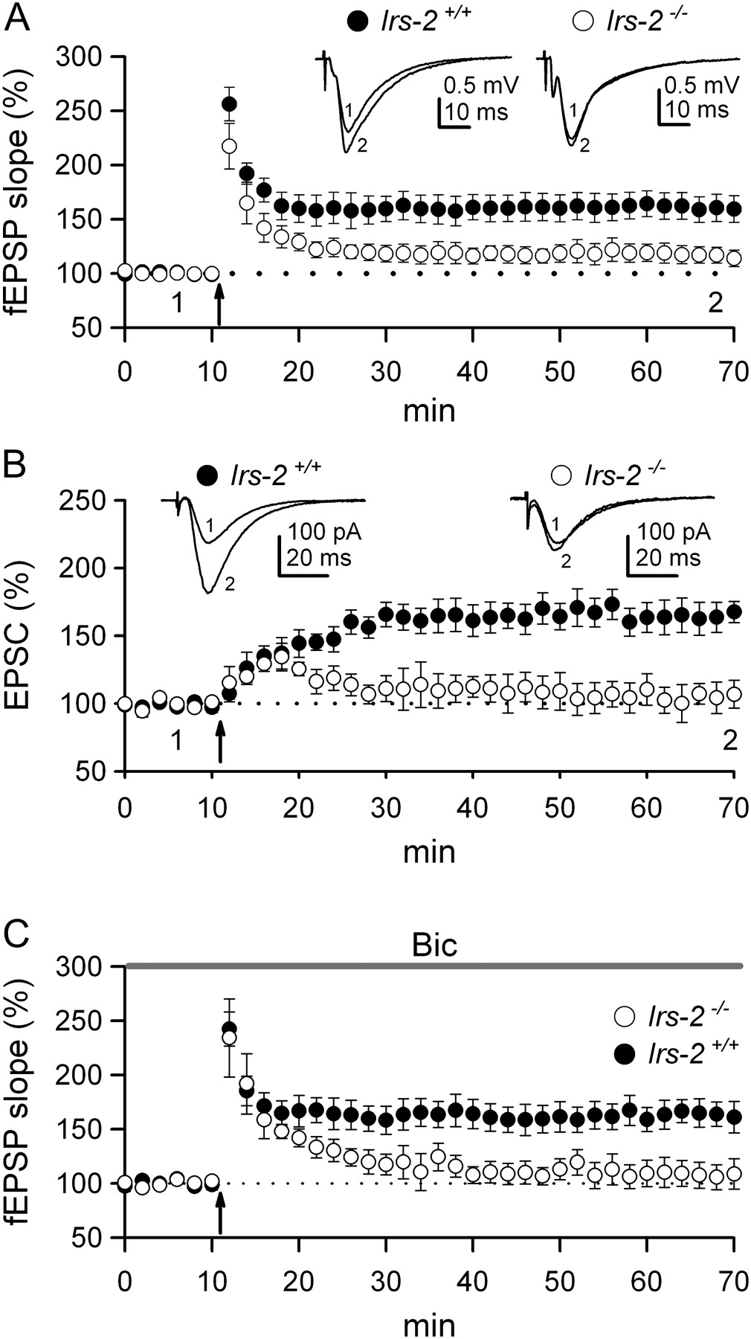
Figure 2. Synaptic plasticity at CA1 synapses is altered in the absence of IRS2 signals. (A) Summary of time course of ...
Notes:
Figure 2. Synaptic plasticity at CA1 synapses is altered in the absence of IRS2 signals. (A) Summary of time course of mean fEPSPs slope in hippocampus slices from WT (filled circle, n = 6 mice) and Irs2−/− (open circle, n = 6 mice) in basal conditions and following induction of LTP. At least 2 slices from each hippocampus used. Data were normalized for each slice with respect to the average slope recorded during baseline. The insert depicts a representative superimposed recording taken before and after LTP induction in both groups of mice. (B) Representative EPSC averages (inset traces) and summary data of LTP induced by pairing postsynaptic depolarization during 60 s with presynaptic stimulation (2 Hz) using patch-clamp techniques, in WT (filled circle, n = 4 mice) and Irs2−/− (open circle, n = 4 mice). (C) The impaired LTP in Irs2−/− (filled circle, n = 4) mice was insensitive to the suppression of inhibition with 50 μM of the GABAA receptor antagonist bicuculline (Bic).
Unless provided in the caption above, the following copyright applies to the content of this slide: © The Authors 2011. Published by Oxford University Press.This is an Open Access article distributed under the terms of the Creative Commons Attribution Non-Commercial License (http://creativecommons.org/licenses/by-nc/3.0), which permits unrestricted non-commercial use, distribution, and reproduction in any medium, provided the original work is properly cited.

Slide 3
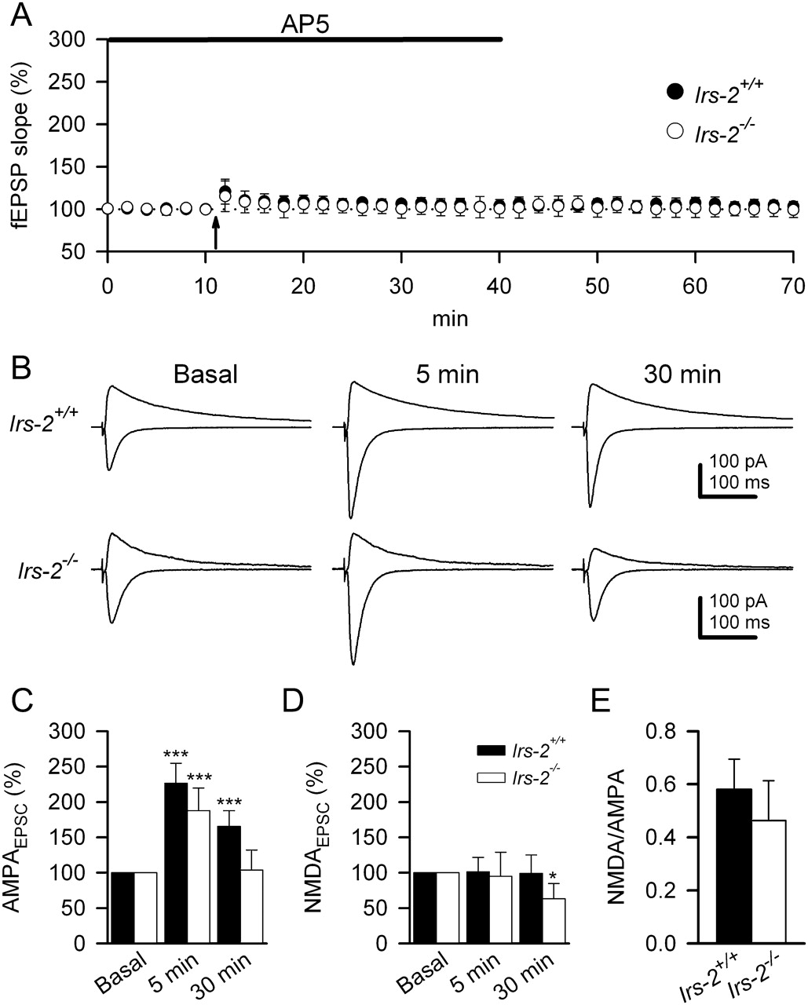
Figure 3. Relative contributions of AMPA and NMDA receptors to the impaired LTP of Irs2-deficient mice. (A) Expression ...
Notes:
Figure 3. Relative contributions of AMPA and NMDA receptors to the impaired LTP of Irs2-deficient mice. (A) Expression of LTP was blocked by 50 μM AP5, an antagonist of NMDA receptors, in both WT and (filled circle, n = 4 mice) and Irs2−/− (open circle, n = 4 mice) hippocampus. (B) Representative EPSC means in WT (top traces) and Irs2−/− (bottom traces) slices recorded at −60 (AMPAEPSCs) and +60 mV (NMDAEPSCs) in basal conditions and 5 and 30 min after LTP induction. (C) Summary of mean AMPAEPSCs peak amplitudes (recorded at −60 mV) in WT (filled bar, n = 4) and Irs2−/− (open bar, n = 4) mice. Whereas AMPAEPSCs in WT slices were significantly potentiated at 30 min following LTP induction, they were reduced to basal values in Irs2−/− slices. (D) Summary graph depicting mean NMDAEPSCs peak amplitudes (recorded at +60 mV at 100 ms delay) in WT (filled bar, n = 4) and Irs2−/− (open bar, n = 4) mice. NMDAEPSCs in Irs2−/− were significantly reduced at 30 min following LTP induction. Error bars indicate standard error of the mean (SEM). Significant differences were established at ***P < 0.001. (E) Ratios of amplitudes of the whole-cell currents recorded at −60 and +60 mV. The NMDA receptor-dependent responses (measure at 100 ms delay) were similar in the Irs2+/+ (filled bar) and Irs2−/− (open bar) slice. Error bars indicate SEM.
Unless provided in the caption above, the following copyright applies to the content of this slide: © The Authors 2011. Published by Oxford University Press.This is an Open Access article distributed under the terms of the Creative Commons Attribution Non-Commercial License (http://creativecommons.org/licenses/by-nc/3.0), which permits unrestricted non-commercial use, distribution, and reproduction in any medium, provided the original work is properly cited.

Slide 4
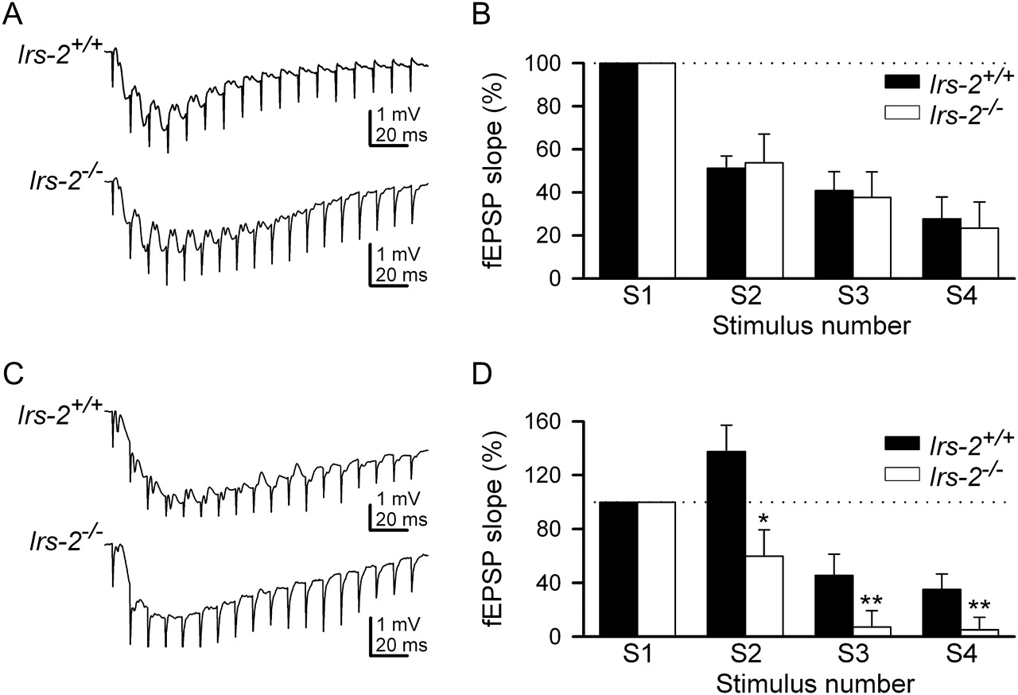
Figure 4. Inadequate activation of synaptic NMDA receptors during the high-frequency stimulation in the ...
Notes:
Figure 4. Inadequate activation of synaptic NMDA receptors during the high-frequency stimulation in the Irs2−/− transgenic mice. (A) Representative field responses of AMPA component evoked by a 100 Hz train during 200 ms in Irs2+/+ (top traces) and Irs2−/− (bottom traces), recorded in the presence of 50 μM AP5 to block NMDA component. (B) Summary data showing mean AMPA isolated fEPSP slopes in Irs2+/+ (filled bar; n = 4) and Irs2−/− (open bar; n = 4) mice, that were plotted against the number of the stimulus during 100 Hz train. The fEPSP slope at the 4 initial stimuli was calculated as the percentage of the first fEPSP slope. (C) Representative field responses of NMDA component evoked by a 100-Hz train during 200 ms in Irs2+/+ (top tracings) and Irs2−/− (bottom tracings), recorded in the presence of 20 μM CNQX to block AMPA component. (D) Summary data showing mean NMDA isolated fEPSP slopes in IRS-2+/+ (filled bar; n = 4) and IRS-2−/− (open bar; n = 4) mice. The fEPSP slope was significantly smaller in the IRS-2−/− for the second, third, and fourth stimuli. Significant differences were established at *P < 0.05 and **P < 0.01.
Unless provided in the caption above, the following copyright applies to the content of this slide: © The Authors 2011. Published by Oxford University Press.This is an Open Access article distributed under the terms of the Creative Commons Attribution Non-Commercial License (http://creativecommons.org/licenses/by-nc/3.0), which permits unrestricted non-commercial use, distribution, and reproduction in any medium, provided the original work is properly cited.

Slide 5
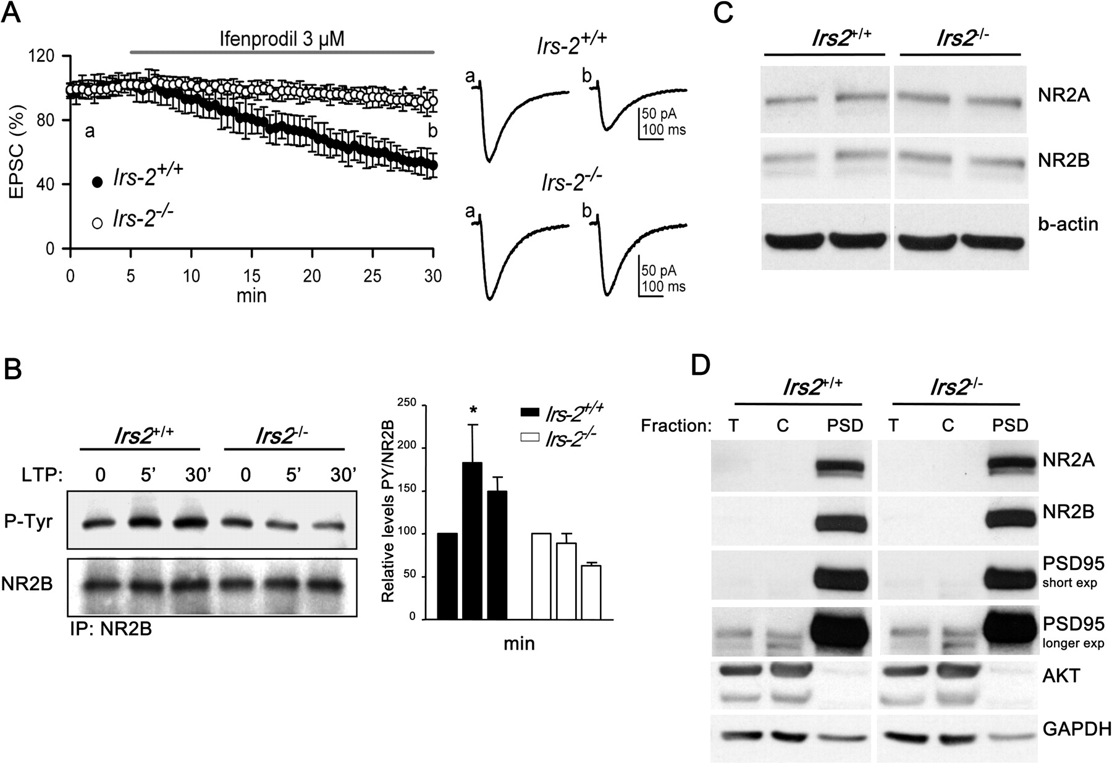
Figure 5. Irs2 deficiency impairs activation of the NR2B subunit of NMDA receptors. (A) Inhibition of NR2B-containing ...
Notes:
Figure 5. Irs2 deficiency impairs activation of the NR2B subunit of NMDA receptors. (A) Inhibition of NR2B-containing NMDAR-mediated EPSCs by ifenprodil. Plots represent normalized NMDAR-mediated EPSCs recorded by whole-cell voltage clamp (Vm = −65 mV) before and after application of ifenprodil (3 μM) as indicated. The experiment was performed in the presence of 50 μM bicuculline, 20 μM CNQX in Mg2+-free external solution. Values represent mean ± standard error of the mean (n = 4 mice of each genotype, at least 2 slice per mouse). Right panel contains sample EPSC traces recorded at different time points. (B) Hippocampus slices were collected before (0 min) and after (5 and 30 min) induction of LTP with tetanus stimulation. Following immunoprecipitation with anti-NR2B antibodies, western blotting was performed with anti-phosphotyrosine antibodies (PY) as well as with anti-NR2B. Western blots were scanned and quantified by Alpha Imager. Tetanus stimulation did not induce tyrosine phosphorylation of NR2B in slices from Irs2−/− animals. Graph represents data from 3 independent experiments, with n of 9 WT and 9 Irs2−/− mice. (C) Western analysis of NMDAR expression. Fifty micrograms of individual hippocampus lysates were probed with antibodies specific for either NR2A or NR2B. Anti-β-tubulin was used to confirm equal protein loading. The images reflect a 40 s exposure of ECL detection. The results shown are representative of 2 independent experiments (WT = 4 mice; Irs2−/− = 4 mice). (D) Western analysis of subcellular fractions isolated from hippocampus. Four hippocampi of each genotype were pooled to prepare PSD as described in Materials and Methods. Forty micrograms of the indicated fractions were used for immunoblotting. T: total lysate, C: cytosol. With the exception of the image labeled “PSD95 longer exposure,” the exposure time for detecting the indicated proteins by ECL was 15 s. Due to the significant enrichment of NR2A, NR2B, and PSD95 in the PSD fraction, a longer exposure (40 s) was required to detect these proteins in the total lysate as illustrated by the additional image of PSD95.
Unless provided in the caption above, the following copyright applies to the content of this slide: © The Authors 2011. Published by Oxford University Press.This is an Open Access article distributed under the terms of the Creative Commons Attribution Non-Commercial License (http://creativecommons.org/licenses/by-nc/3.0), which permits unrestricted non-commercial use, distribution, and reproduction in any medium, provided the original work is properly cited.

Slide 6
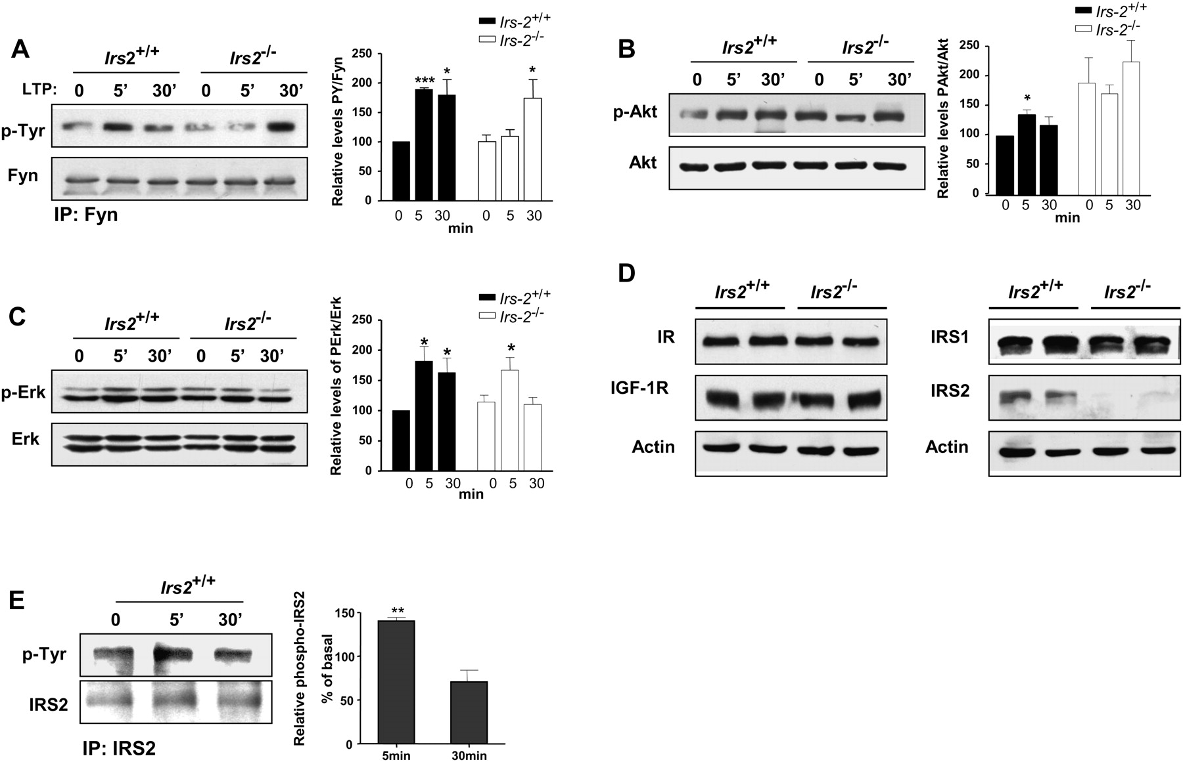
Figure 6. Failed LTP is associated with impaired signaling in hippocampus slices from Irs2^{−/−} mice. (A) ...
Notes:
Figure 6. Failed LTP is associated with impaired signaling in hippocampus slices from Irs2−/− mice. (A) Hippocampus slices were collected before (0 min) and after (5 and 30 min) induction of LTP with tetanus stimulation. Protein lysates were prepared and immunoprecipitated with anti-Fyn antibodies. Subsequent western blotting with anti-PY revealed a significant delay in the tyrosine phosphorylation of Fyn in hippocampus slices from Irs2 null mice. Graph represents data from 3 independent experiments, n = 9 WT mice and 9 Irs2−/− mice. (B) Fifty micrograms of hippocampus lysates were loaded for western blotting. Induction of LTP was coincident with activation of Akt in WT but not Irs2−/− slices due to high basal levels phospho-Akt. Graph represents data from 5 independent experiments, n = 15 WT and 15 Irs2−/− mice. (C) Activation of MAPK in response to LTP induction was not sustained at 30 min in IRS-2 deficient mice. Graph represents data from 7 independent experiments, n = 14 WT and 12 Irs2−/− mice. (D) Fifty micrograms of hippocampus lysates were loaded for western analysis of the expression levels of the insulin receptor (IR), IGF-I receptor (IGFIR), and IRS1. No differences were noted between WT and Irs2 null mice. (E) Following lysis of hippocampus slices as described above, samples were immunoprecipitated for IRS2. Western blotting with anti-PY antibodies revealed that induction of LTP with tetanus stimulation induces the tyrosine phosphorylation of IRS2. Data are representative of 2 independent experiments, n = 6 WT and 6 Irs2 null mice.
Unless provided in the caption above, the following copyright applies to the content of this slide: © The Authors 2011. Published by Oxford University Press.This is an Open Access article distributed under the terms of the Creative Commons Attribution Non-Commercial License (http://creativecommons.org/licenses/by-nc/3.0), which permits unrestricted non-commercial use, distribution, and reproduction in any medium, provided the original work is properly cited.

