Slide 1
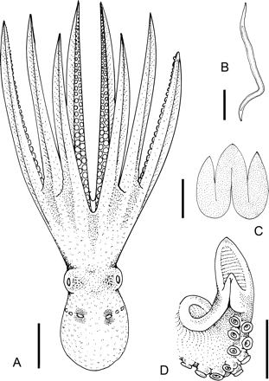
Figure 1. Histoctopus discus n. gen., n. sp. A. Dorsal whole animal, 41.2 mm ML male paratype (MNHN 2109). B. Stylet, ...
Notes:
Figure 1. Histoctopus discus n. gen., n. sp. A. Dorsal whole animal, 41.2 mm ML male paratype (MNHN 2109). B. Stylet, 44.4 mm ML paratype (MNHN 2108). C. Funnel organ, 46.7 mm ML paratype (MNHN 2109). D. Ligula, 46.7 mm ML paratype (MNHN 2109). Scale bars: A = 20 mm; B = 10 mm; C = 5 mm; D = 5 mm.
Unless provided in the caption above, the following copyright applies to the content of this slide: © The Author 2009. Published by Oxford University Press on behalf of The Malacological Society of London, all rights reserved

Slide 2
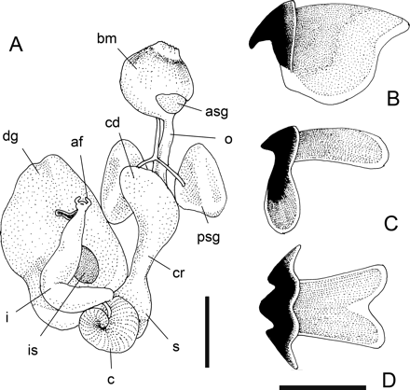
Figure 2. Histoctopus discus n. gen., n. sp. A–E. Digestive components of 46.7 mm ML male (MNHN 2109). A. Digestive ...
Notes:
Figure 2. Histoctopus discus n. gen., n. sp. A–E. Digestive components of 46.7 mm ML male (MNHN 2109). A. Digestive tract. Abbreviations: af, anal flaps; asg, anterior salivary gland; bm, buccal mass; c, caecum; cd, crop diverticulum; cr, crop; dg, digestive gland; I, intestine; is, ink sac; o, oesophagus; psg, posterior salivary gland; s, stomach. B. Lateral view of upper beak. C. Lateral view of lower beak. D. Ventral view of lower beak. Scale bars: A = 10 mm; B–D = 5 mm.
Unless provided in the caption above, the following copyright applies to the content of this slide: © The Author 2009. Published by Oxford University Press on behalf of The Malacological Society of London, all rights reserved

Slide 3
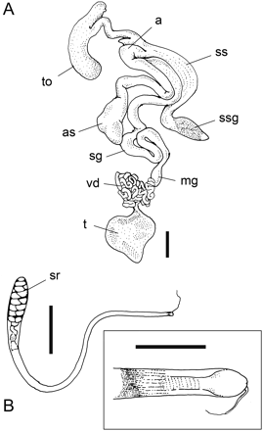
Figure 3. Histoctopus discus n. gen., n. sp. A, B. Male reproductive system of 44.4 mm ML paratype (MNHN 2108). A. ...
Notes:
Figure 3. Histoctopus discus n. gen., n. sp. A, B. Male reproductive system of 44.4 mm ML paratype (MNHN 2108). A. Reproductive tract. Abbreviations: a, appendix; as, accessory spermatophoric gland; mg, mucilagenous gland; sg, spermatophoric gland; ss, spermatophore storage sac; ssg, spermatophore sac gland; t, testes; to, terminal organ; vd, vas deferens. B. Spermatophore. Inset: oral cap end of spermatophore. Abbreviation: sr, sperm reservoir. Scale bars: A = 10 mm; B = 10 mm (inset 2 mm).
Unless provided in the caption above, the following copyright applies to the content of this slide: © The Author 2009. Published by Oxford University Press on behalf of The Malacological Society of London, all rights reserved

Slide 4
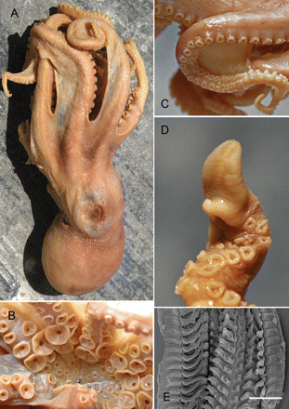
Figure 4. Histoctopus discus n. gen., n. sp. A. Left dorso-lateral view of whole animal, 46.7 mm ML male paratype (MNHN ...
Notes:
Figure 4. Histoctopus discus n. gen., n. sp. A. Left dorso-lateral view of whole animal, 46.7 mm ML male paratype (MNHN 2109). B. Enlarged suckers of 44.4 mm ML male paratype (MNHN 2108). C. Close-up of web margins on arms 2 and 3, 46.7 mm ML male paratype (MNHN 2109). D. Hectocotylus of 51.5 mm ML male holotype (MNHN 3803). E. Radula from 46.7 mm ML male paratype (MNHN 2109). Scale bar E = 0.5 mm. (This figure appears in colour in the online version of Journal of Molluscan Studies.)
Unless provided in the caption above, the following copyright applies to the content of this slide: © The Author 2009. Published by Oxford University Press on behalf of The Malacological Society of London, all rights reserved

Slide 5
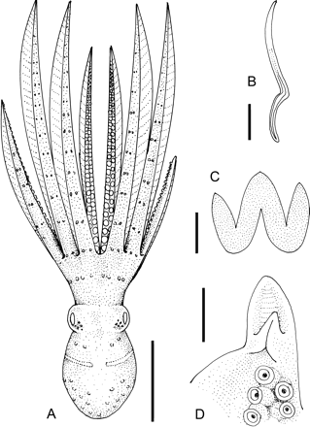
Figure 5. Histoctopus zipkasae n. gen., n. sp. A–D. 61.6.mm ML male holotype (MV F164025). A. Dorsal whole animal. B. ...
Notes:
Figure 5. Histoctopus zipkasae n. gen., n. sp. A–D. 61.6.mm ML male holotype (MV F164025). A. Dorsal whole animal. B. Stylet. C. Funnel organ. D. Ligula. Scale bars: A = 50 mm; B–D = 5 mm.
Unless provided in the caption above, the following copyright applies to the content of this slide: © The Author 2009. Published by Oxford University Press on behalf of The Malacological Society of London, all rights reserved

Slide 6
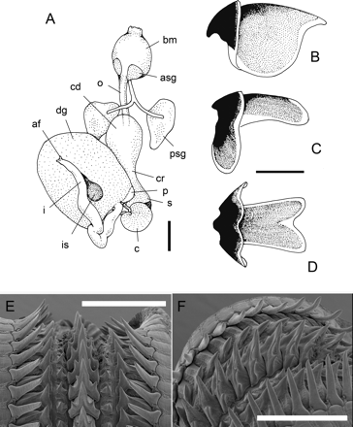
Figure 6. Histoctopus zipkasae n. gen., n. sp. A.–F. Digestive components of 62.7 mm ML male (MV F164031). A. Digestive ...
Notes:
Figure 6. Histoctopus zipkasae n. gen., n. sp. A.–F. Digestive components of 62.7 mm ML male (MV F164031). A. Digestive tract. Abbreviations as in Figure 2 plus p, pancreatic tissue. B. Lateral view of upper beak. C. Lateral view of lower beak. D. Ventral view of lower beak. E., F. Radula. Scale bars: A = 10 mm; B–D = 5 mm; E, F = 1 mm.
Unless provided in the caption above, the following copyright applies to the content of this slide: © The Author 2009. Published by Oxford University Press on behalf of The Malacological Society of London, all rights reserved

Slide 7
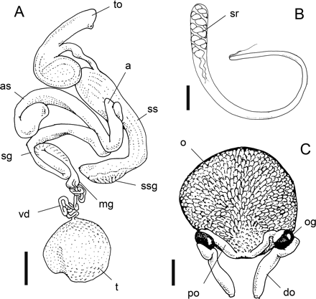
Figure 7. Histoctopus zipkasae n. gen., n. sp. A. Reproductive tract of 61.6 mm ML holotype (MV F164025). Abbreviations ...
Notes:
Figure 7. Histoctopus zipkasae n. gen., n. sp. A. Reproductive tract of 61.6 mm ML holotype (MV F164025). Abbreviations as in Figure 3.B. Spermatophore of 73.8 mm ML male (MV F164020). Abbreviation: SR, sperm reservoir. C. Female reproductive tract of 89.3 mm ML paratype (MV F164036). Abbreviations: do, distal oviduct; o, ovary; og, oviducal gland; po, proximal oviduct. Scale bars: A = 10 mm; B = 5 mm; C = 10 mm.
Unless provided in the caption above, the following copyright applies to the content of this slide: © The Author 2009. Published by Oxford University Press on behalf of The Malacological Society of London, all rights reserved

Slide 8
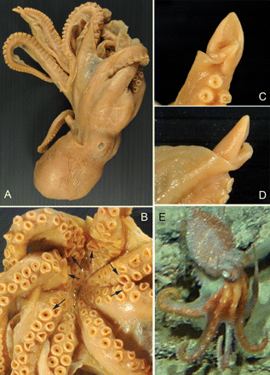
Figure 8. Histoctopus zipkasae n. gen., n. sp. A–D. 61.6 mm ML male holotype (MV F164025). A. Left lateral view of ...
Notes:
Figure 8. Histoctopus zipkasae n. gen., n. sp. A–D. 61.6 mm ML male holotype (MV F164025). A. Left lateral view of whole animal. B. Oral view of arm crown showing slightly enlarged suckers (arrows). C, D. Hectocotylus. E. Live animal image from CSIRO tow camera, 401 m, off Jurien Bay, Western Australia, photo: B. Barker, CSIRO.
Unless provided in the caption above, the following copyright applies to the content of this slide: © The Author 2009. Published by Oxford University Press on behalf of The Malacological Society of London, all rights reserved

Slide 9
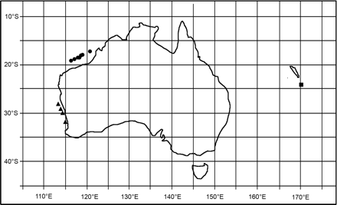
Figure 9. Known distribution for the genus Histoctopus n. gen. Symbols: circle, H. zipkasae material examined; ...
Notes:
Figure 9. Known distribution for the genus Histoctopus n. gen. Symbols: circle, H. zipkasae material examined; triangle, H. zipkasae video records; square, H. discus material examined.
Unless provided in the caption above, the following copyright applies to the content of this slide: © The Author 2009. Published by Oxford University Press on behalf of The Malacological Society of London, all rights reserved

Slide 10
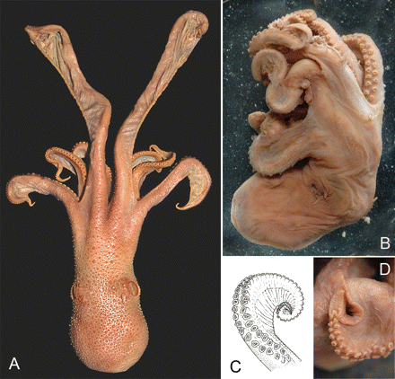
Figure 10. Other octopodid genera with flared distal web margins. A.Velodona togata, whole animal, South Africa Museum, ...
Notes:
Figure 10. Other octopodid genera with flared distal web margins. A.Velodona togata, whole animal, South Africa Museum, Cape Town. B–D.Pteroctopus sp., Muséum National d'Histoire Naturelle, Paris, B. Whole animal. C. Distal arm tip. D. Hectocotylized arm. (This figure appears in colour in the online version of Journal of Molluscan Studies.)
Unless provided in the caption above, the following copyright applies to the content of this slide: © The Author 2009. Published by Oxford University Press on behalf of The Malacological Society of London, all rights reserved

