Slide 1
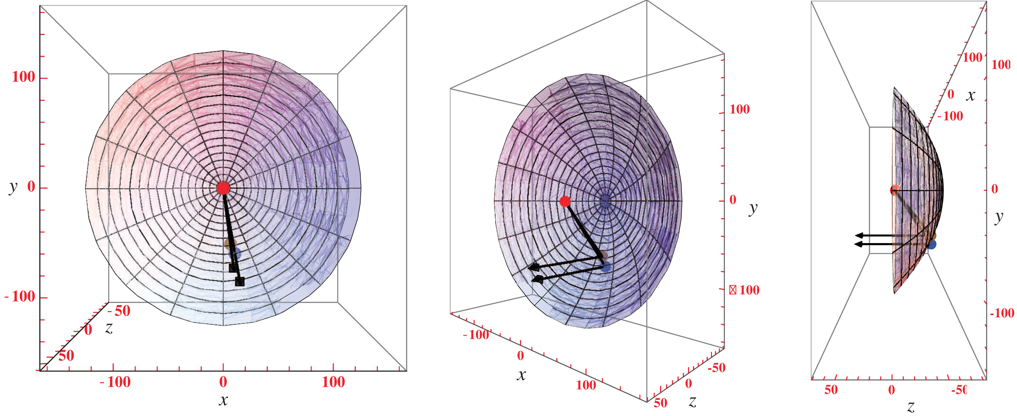
Figure 4. Plots of the 3D light path. North is toward the positive y-axis (up), east is toward the negative x-axis ...
Notes:
Figure 4. Plots of the 3D light path. North is toward the positive y-axis (up), east is toward the negative x-axis (left), and the positive $z$-axis points toward the observer with the origin at η Car. The red, brown, and blue circles indicate η Car, EC2, and the EC1 echoes from our first paper (Rest et al. 2012), respectively. The parabolic relation between the spatial parameters of the scattering dust and the time since outburst is described by the well-known light echo equation (Couderc 1939). Assuming a time since outburst of 160 yr for EC2 and 169 yr for the EC1 echo, and a distance of 7660 light-years (Smith 2006b), we find that the scattering dust is at a position (x, y, $z$) = (10, −77, −61) ly for EC2 and (x, y, $z$) = (14, −78, −66) ly for EC1. The black lines show the path of the light scattering from the light echo-producing dust concentrations. The two echoes both view η Car from a similar direction near the equatorial plane of the Homunculus, but EC2 is closer to η Car, and therefore sees later times in the eruption.
Unless provided in the caption above, the following copyright applies to the content of this slide: © 2018 The Author(s) Published by Oxford University Press on behalf of the Royal Astronomical SocietyThis article is published and distributed under the terms of the Oxford University Press, Standard Journals Publication Model ( https://academic.oup.com/journals/pages/open_access/funder_policies/chorus/standard_publication_model)

Slide 2
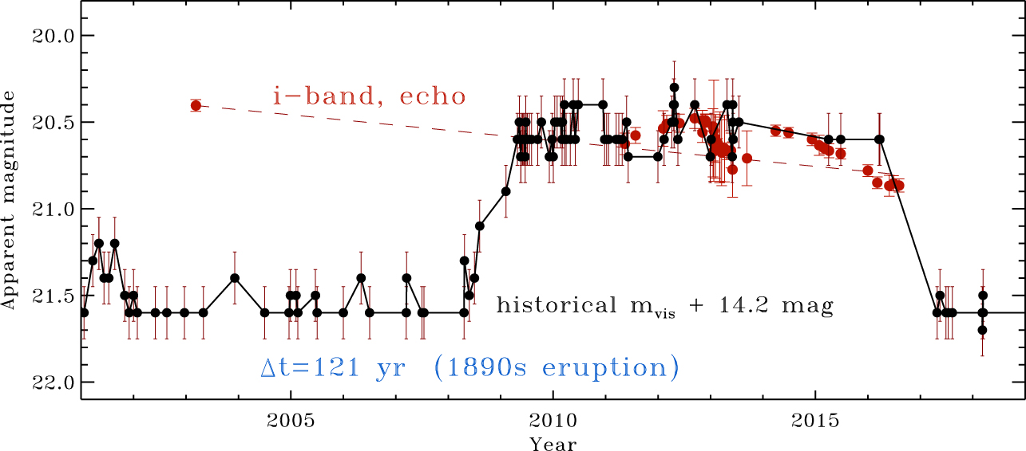
Figure 3. Same as Fig. 2, but showing the historical light curve with a smaller delay time of 121 yr, comparing EC2’s ...
Notes:
Figure 3. Same as Fig. 2, but showing the historical light curve with a smaller delay time of 121 yr, comparing EC2’s light curve to that of the Lesser Eruption in the 1890s. Clearly EC2 cannot be reflecting light from the 1890s eruption, because it was far too bright in 2003. (In addition, the expansion speed observed directly in spectra of the 1890s eruption was far slower than in EC2’s echo spectra; see the text.) We assume fairly generous 0.15 mag error bars for the historical light curve in the 1890s (see Smith & Frew 2011).
Unless provided in the caption above, the following copyright applies to the content of this slide: © 2018 The Author(s) Published by Oxford University Press on behalf of the Royal Astronomical SocietyThis article is published and distributed under the terms of the Oxford University Press, Standard Journals Publication Model ( https://academic.oup.com/journals/pages/open_access/funder_policies/chorus/standard_publication_model)

Slide 3
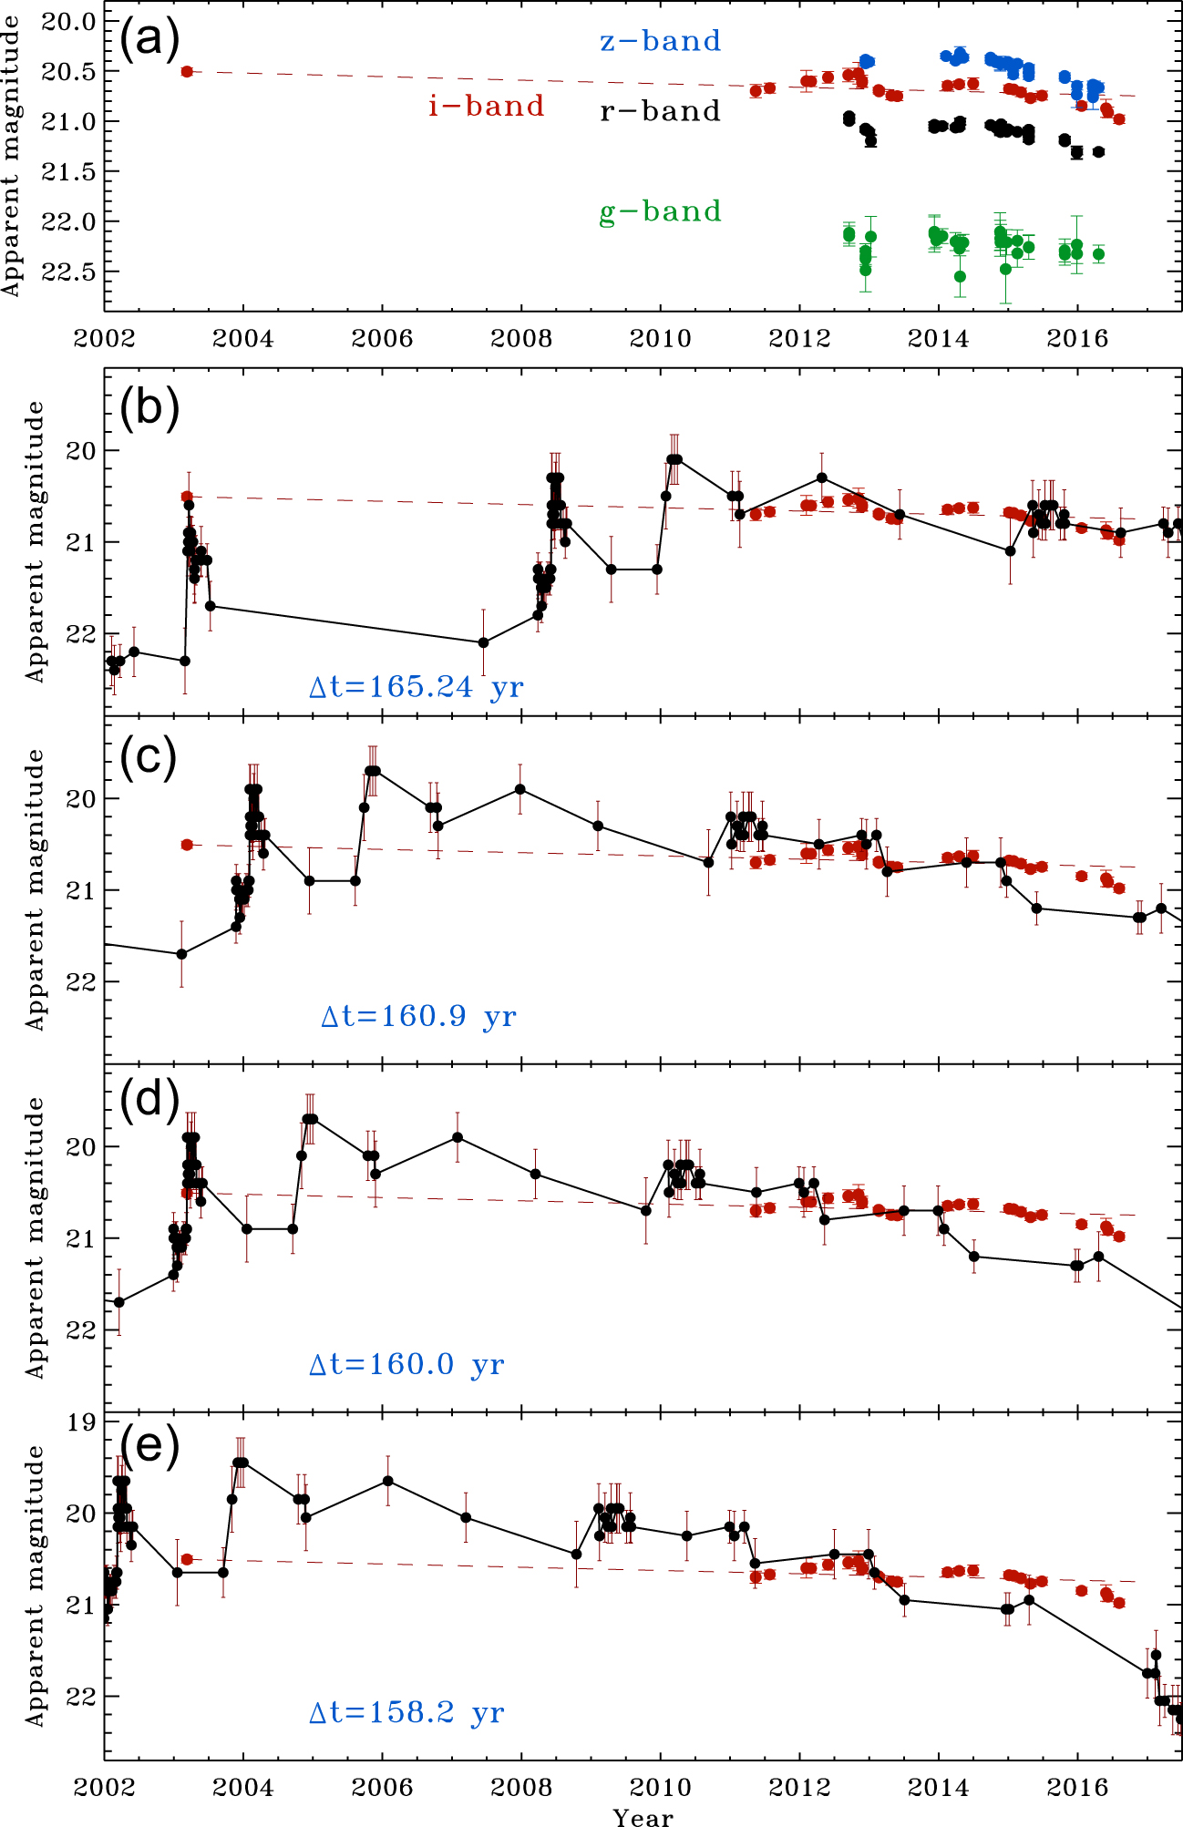
Figure 2. Photometry of EC2 compared to the historical light curve of η Carinae from Smith & Frew (2011). Panel (a) ...
Notes:
Figure 2. Photometry of EC2 compared to the historical light curve of η Carinae from Smith & Frew (2011). Panel (a) shows our griz photometry of EC2. The first i-band point refers to the apparent magnitude of EC2 in our first epoch 2003 March i-band reference image obtained with the MOSAIC camera on the CTIO 4 m telescope. The dashed line shows a representative slope of the fading EC2 echo, forced to pass through the 2003 point and then fit to the later measurements. The decline rate is 0.062 mag yr−1. Panels (b–e) show the same i-band light curve and decline rate as panel (a), compared to the historical visual light curve from Smith & Frew (2011). In each successive panel, the historical light curve is shifted through EC2’s light curve by different amounts (Δt = 165.24, 160.9, 160.0, and 158.2 yr, respectively).
Unless provided in the caption above, the following copyright applies to the content of this slide: © 2018 The Author(s) Published by Oxford University Press on behalf of the Royal Astronomical SocietyThis article is published and distributed under the terms of the Oxford University Press, Standard Journals Publication Model ( https://academic.oup.com/journals/pages/open_access/funder_policies/chorus/standard_publication_model)

Slide 4
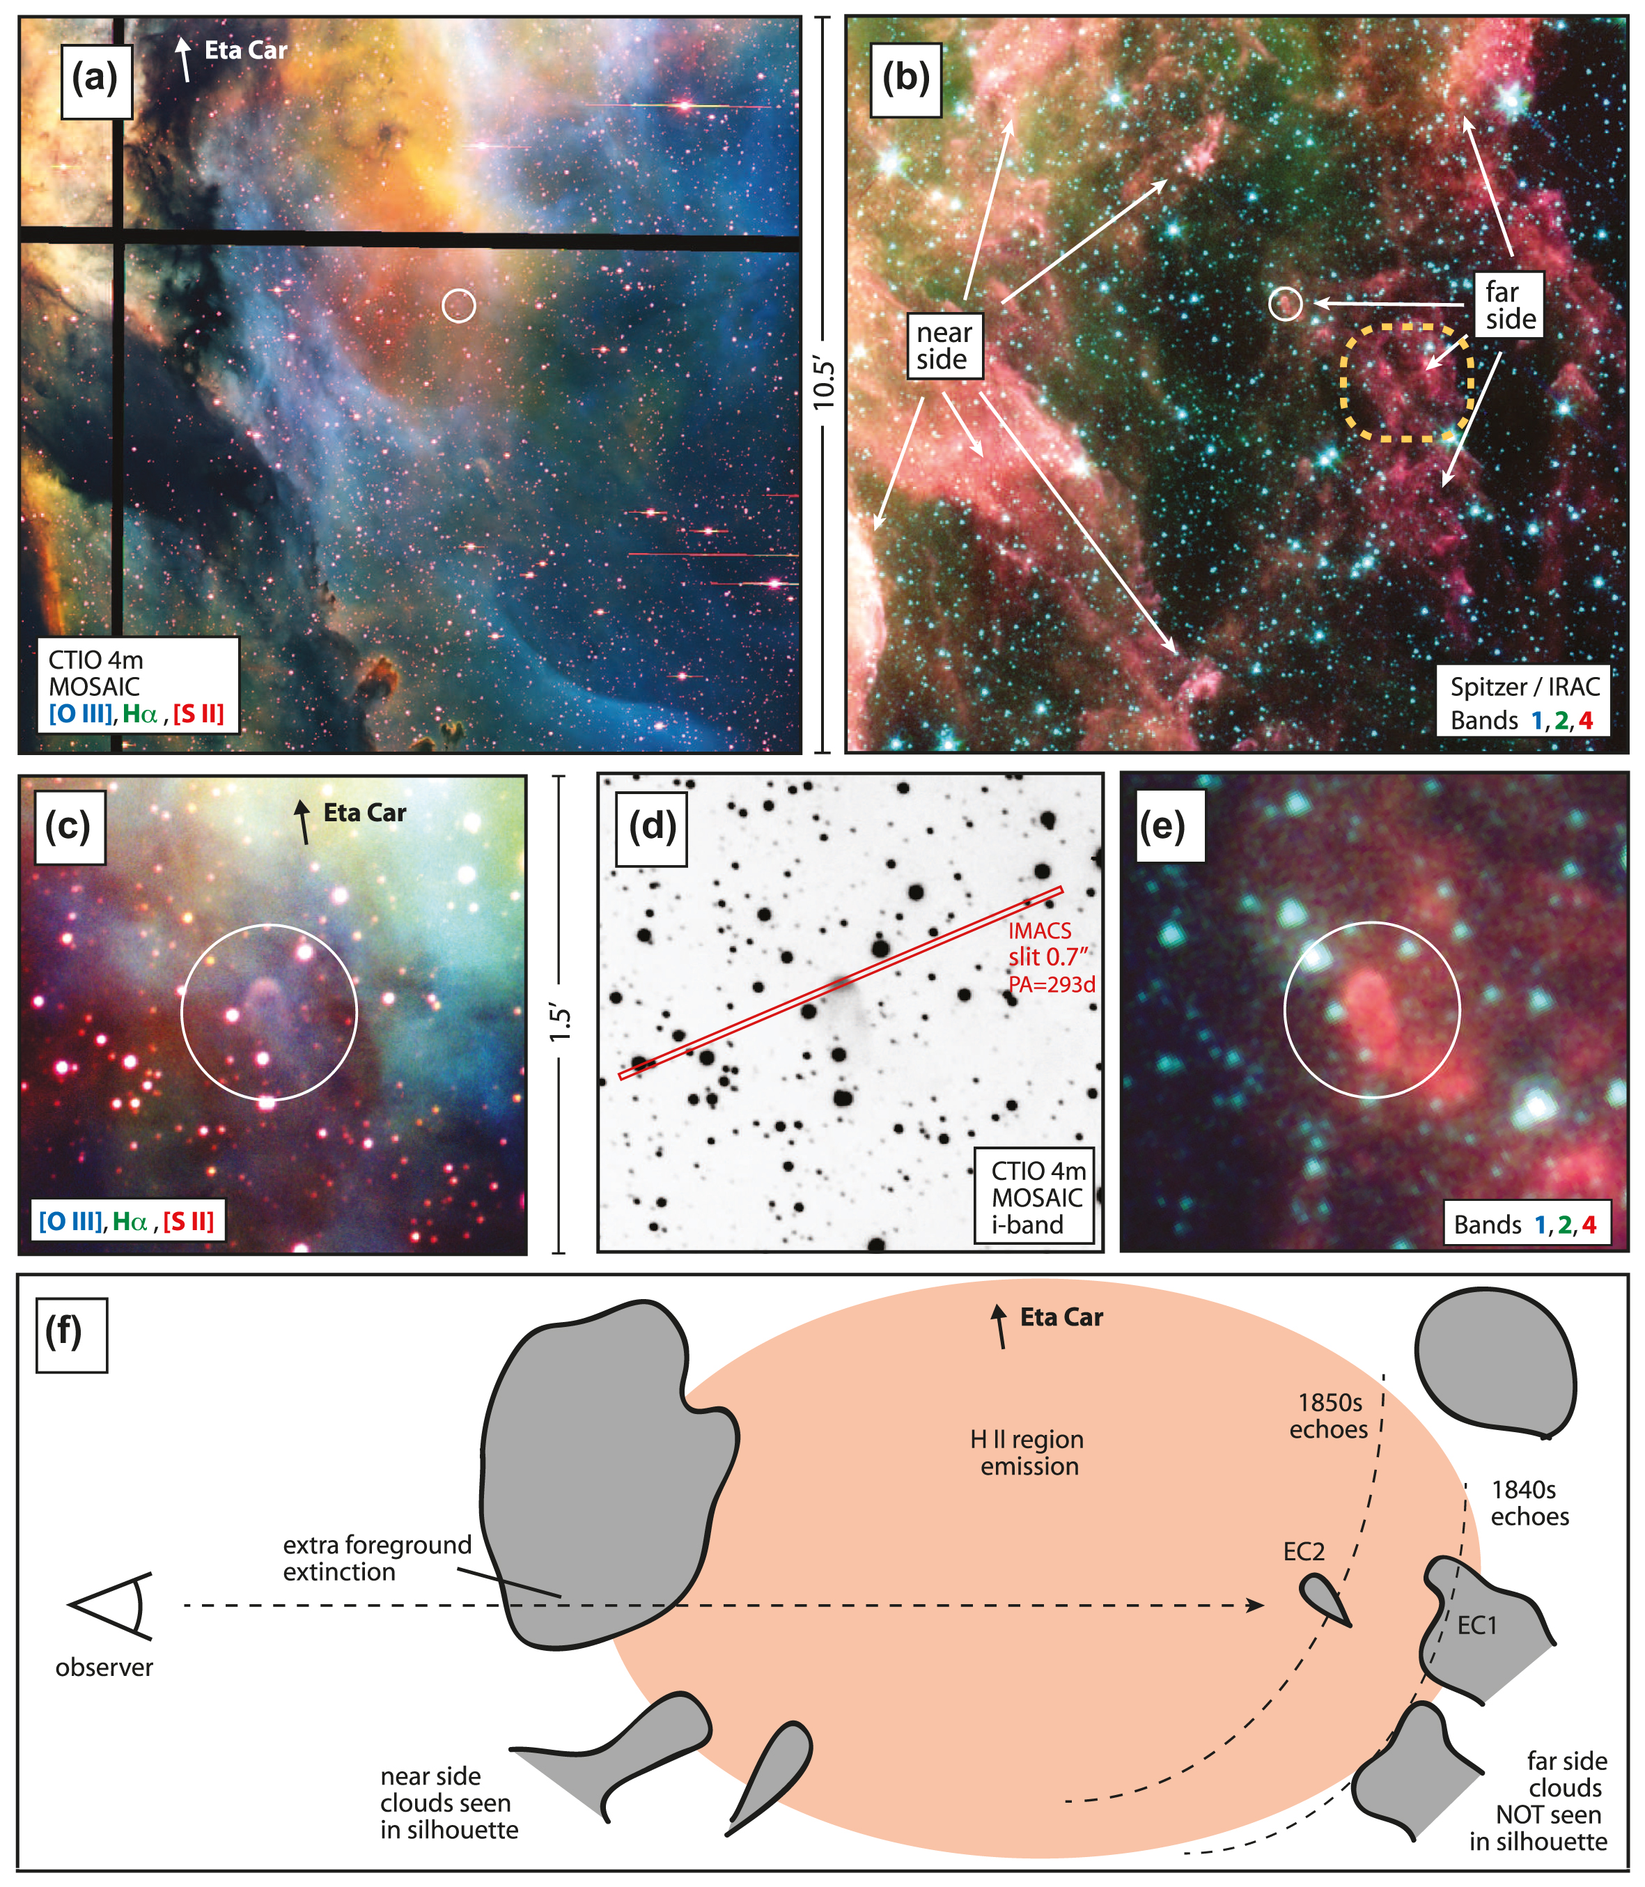
Figure 1. The environment around the EC2 light echo. (a) Large field-of-view 3-colour composite image at visible ...
Notes:
Figure 1. The environment around the EC2 light echo. (a) Large field-of-view 3-colour composite image at visible wavelengths, with [O iii] λ5007 in blue, Hα in green, and [S ii] λλ6717,6731 in red. The images were obtained in 2003 with the MOSAIC2 camera on the CTIO 4 m telescope (Smith et al. 2003c). An arrow points towards the location of η Car itself, off the top of the image. (b) Same field of view as (a), but showing IR images obtained with the IRAC camera on Spitzer, in Bands 1 (blue), 2 (green), and 3 (red) (Smith et al. 2010b). (c) Same image and colour scheme as (a) but zoomed in on a smaller field around EC2. (d) Same field as (c) but showing only the i-band CTIO4m/MOSAIC image in grey-scale, also obtained in 2003. The red box shows the location of our most commonly used imacs slit aperture. (e) Same field as (c) and (d) but in the IR, with the same Spitzer images and colour scheme as (b). (f) A sketch showing the global geometry involved. An Earth-based observer is to the left, looking through the cold clouds on the near side of the nebula, which appear dark in optical images and glow in PAH emission in the IR. They are seen in silhouette against the bright screen of H ii region emission that fills the interior of the nebula. Cold clouds on the far side are also seen in PAH emission in the IR, but cannot be seen in silhouette at visible wavelengths, because they are behind the line emission. This is the case for the EC2 cloud, as well as the EC1 group of echoes discussed in our previous papers (Rest et al. 2012; Prieto et al. 2014). Dashed curves denote the rough locations of the light echo parabolas corresponding to the light-curve peaks in the 1830s–1840s, as well as the 1850s plateau.
Unless provided in the caption above, the following copyright applies to the content of this slide: © 2018 The Author(s) Published by Oxford University Press on behalf of the Royal Astronomical SocietyThis article is published and distributed under the terms of the Oxford University Press, Standard Journals Publication Model ( https://academic.oup.com/journals/pages/open_access/funder_policies/chorus/standard_publication_model)

Slide 5
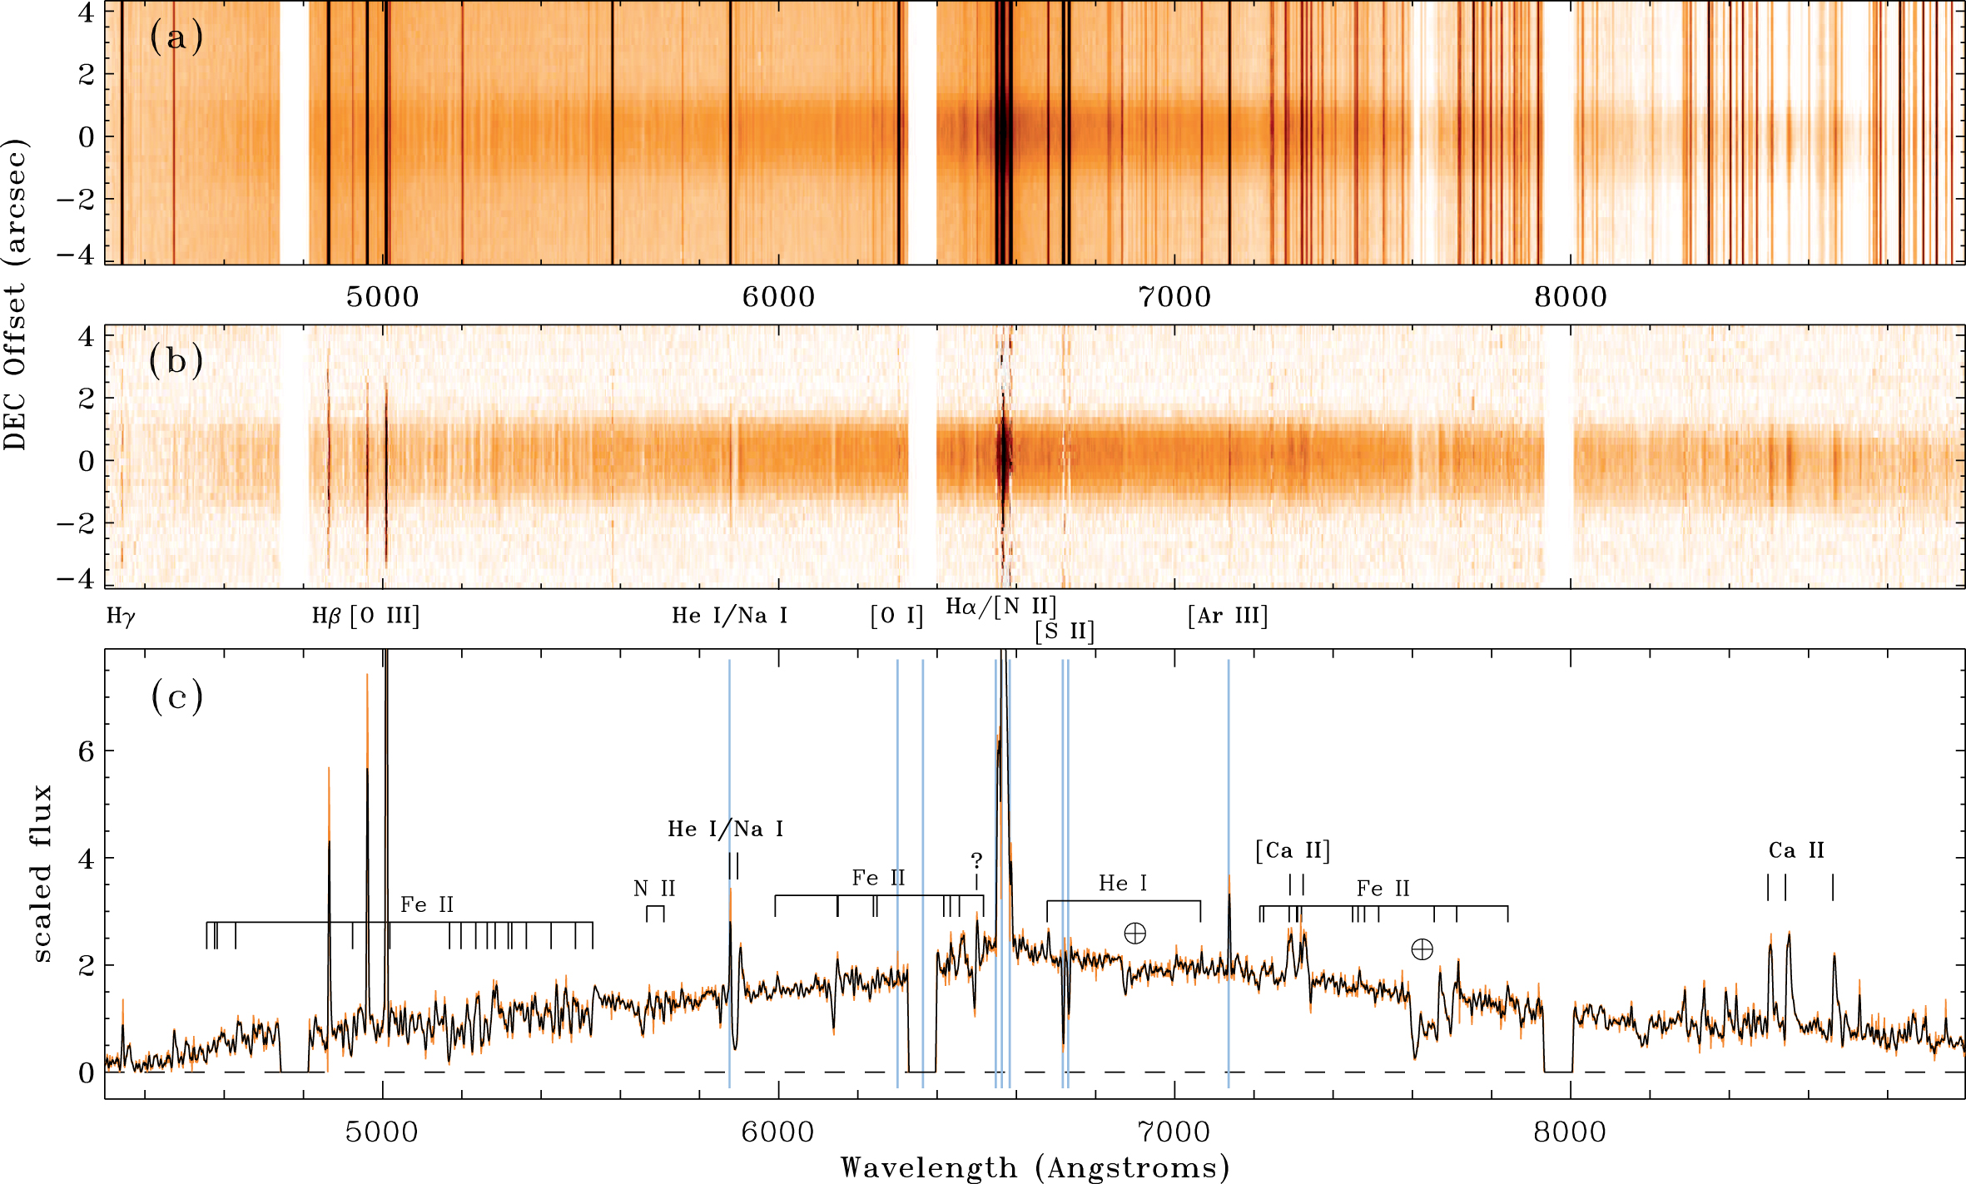
Figure 5. An example of our 2D spectra before (a) and after (b) background subtraction. These are from the ...
Notes:
Figure 5. An example of our 2D spectra before (a) and after (b) background subtraction. These are from the Magellan/imacs observation on 2015 January 20, taken with the low-resolution 300 lpm grating. Wavelengths where strong H ii region lines leave residual emission are noted below panel (b). The background subtraction removes sky lines quite well, but there is some residual emission from the ionization front and photoevaporative flow off the surface of the reflecting globule itself. The bottom panel (c) is the 1D spectrum of EC2 extracted from the background-subtracted 2D spectrum in (b), before any flux calibration or sensitivity correction. Several likely line identifications are given.
Unless provided in the caption above, the following copyright applies to the content of this slide: © 2018 The Author(s) Published by Oxford University Press on behalf of the Royal Astronomical SocietyThis article is published and distributed under the terms of the Oxford University Press, Standard Journals Publication Model ( https://academic.oup.com/journals/pages/open_access/funder_policies/chorus/standard_publication_model)

Slide 6
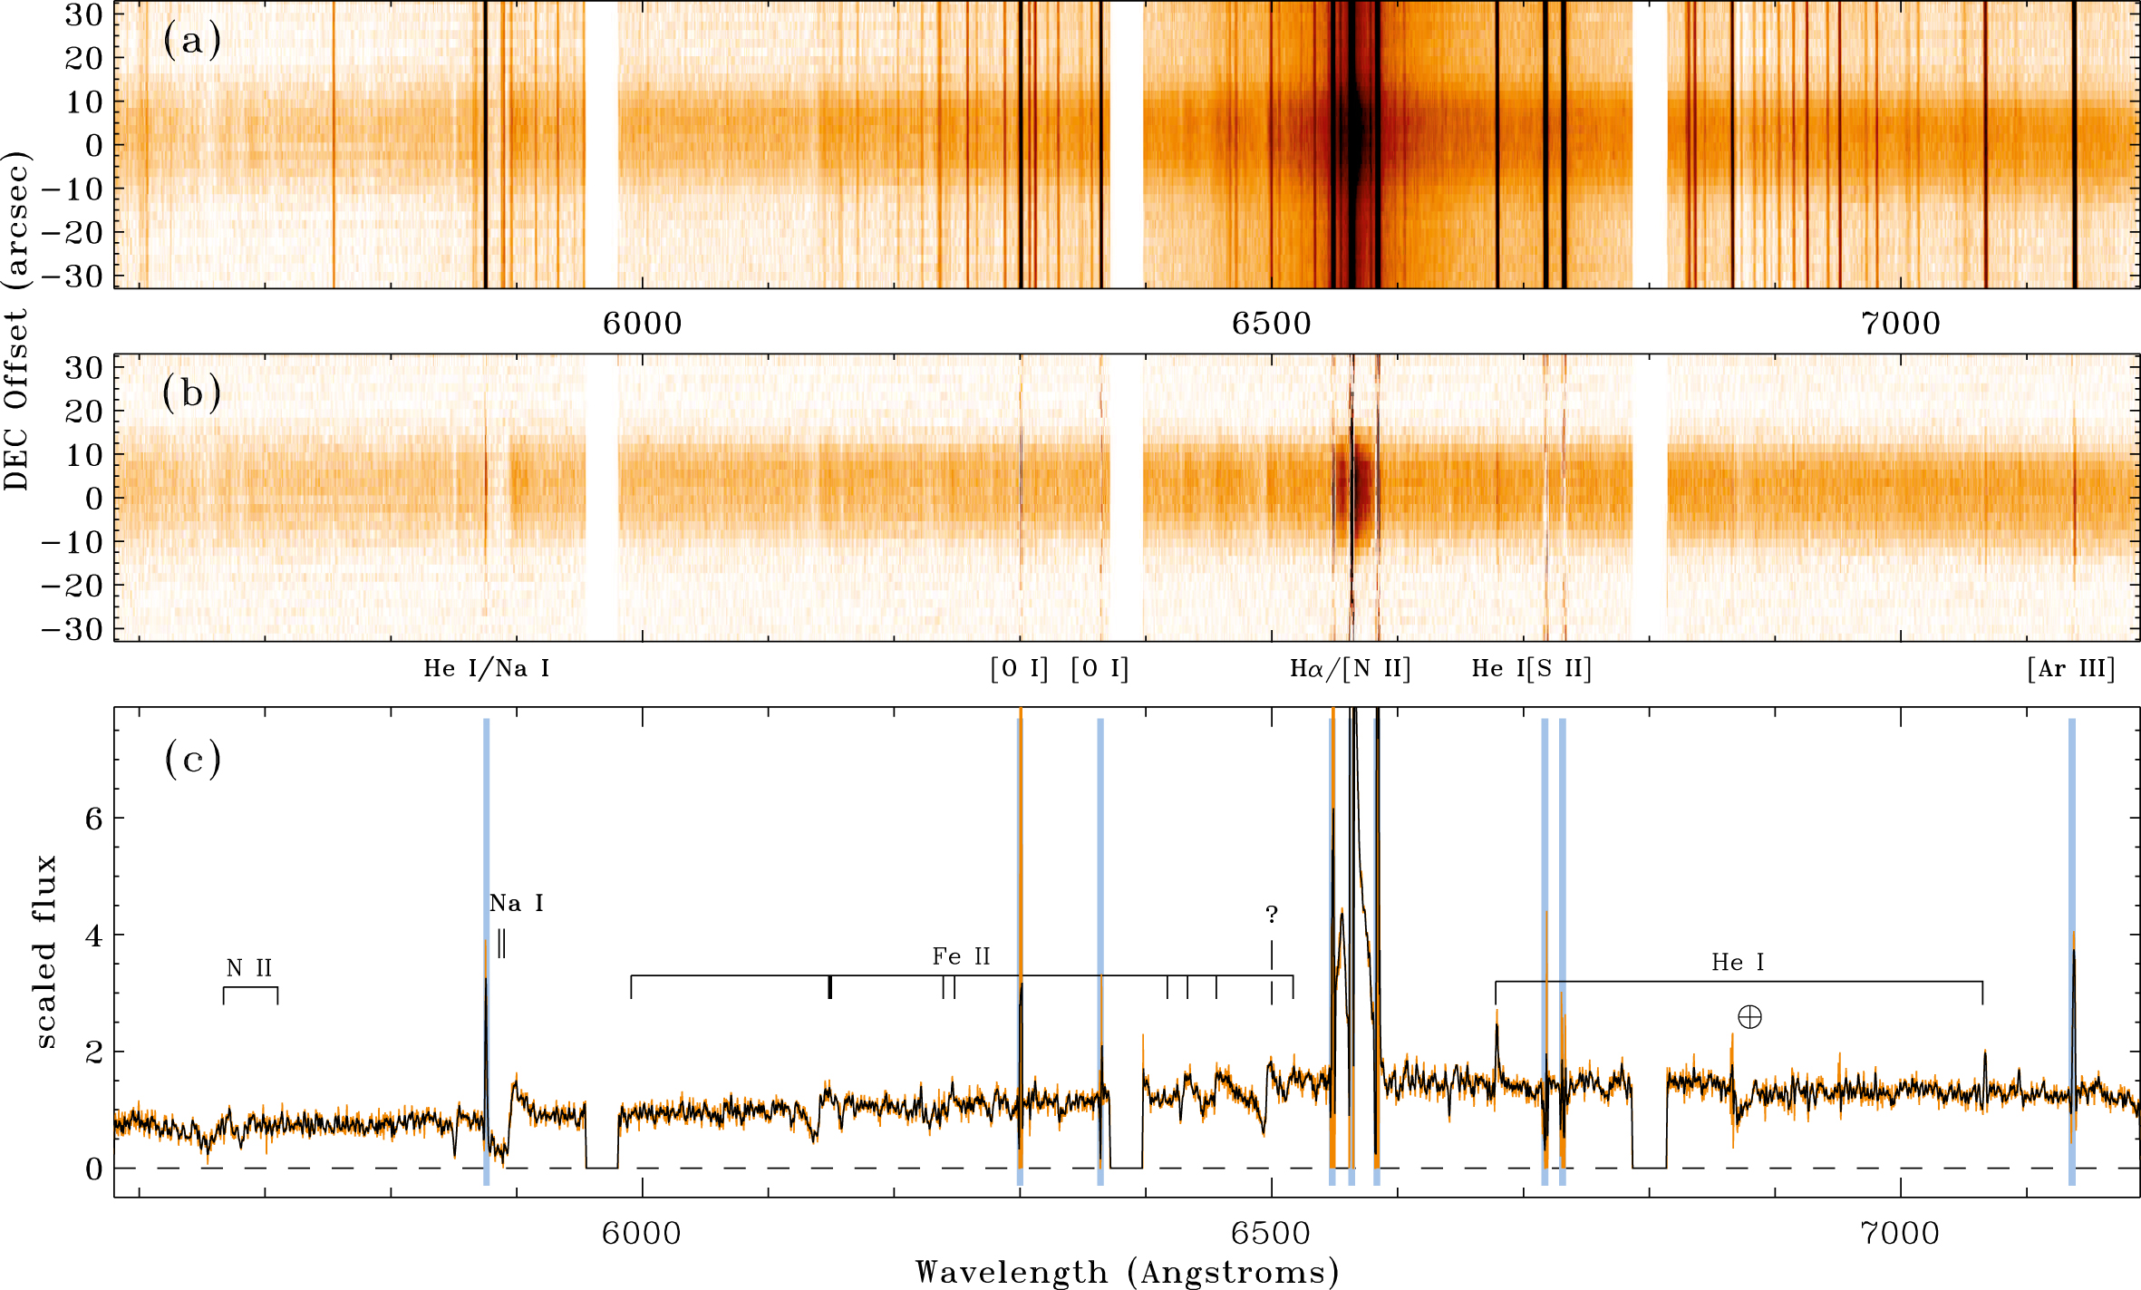
Figure 6. Same as Fig. 5, but for the higher resolution 1200 lpm grating, obtained with imacs on the same night.
Notes:
Figure 6. Same as Fig. 5, but for the higher resolution 1200 lpm grating, obtained with imacs on the same night.
Unless provided in the caption above, the following copyright applies to the content of this slide: © 2018 The Author(s) Published by Oxford University Press on behalf of the Royal Astronomical SocietyThis article is published and distributed under the terms of the Oxford University Press, Standard Journals Publication Model ( https://academic.oup.com/journals/pages/open_access/funder_policies/chorus/standard_publication_model)

Slide 7
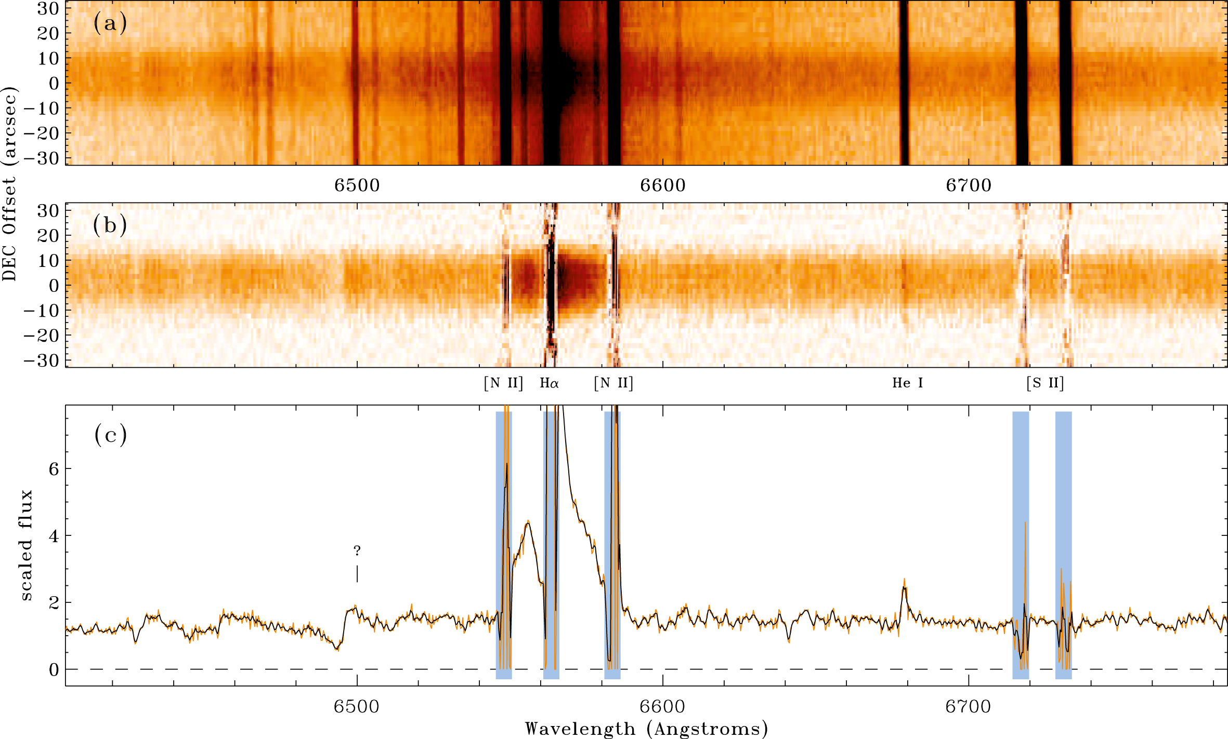
Figure 7. Same as Fig. 6, but zoomed-in on the region immediately around Hα.
Notes:
Figure 7. Same as Fig. 6, but zoomed-in on the region immediately around Hα.
Unless provided in the caption above, the following copyright applies to the content of this slide: © 2018 The Author(s) Published by Oxford University Press on behalf of the Royal Astronomical SocietyThis article is published and distributed under the terms of the Oxford University Press, Standard Journals Publication Model ( https://academic.oup.com/journals/pages/open_access/funder_policies/chorus/standard_publication_model)

Slide 8
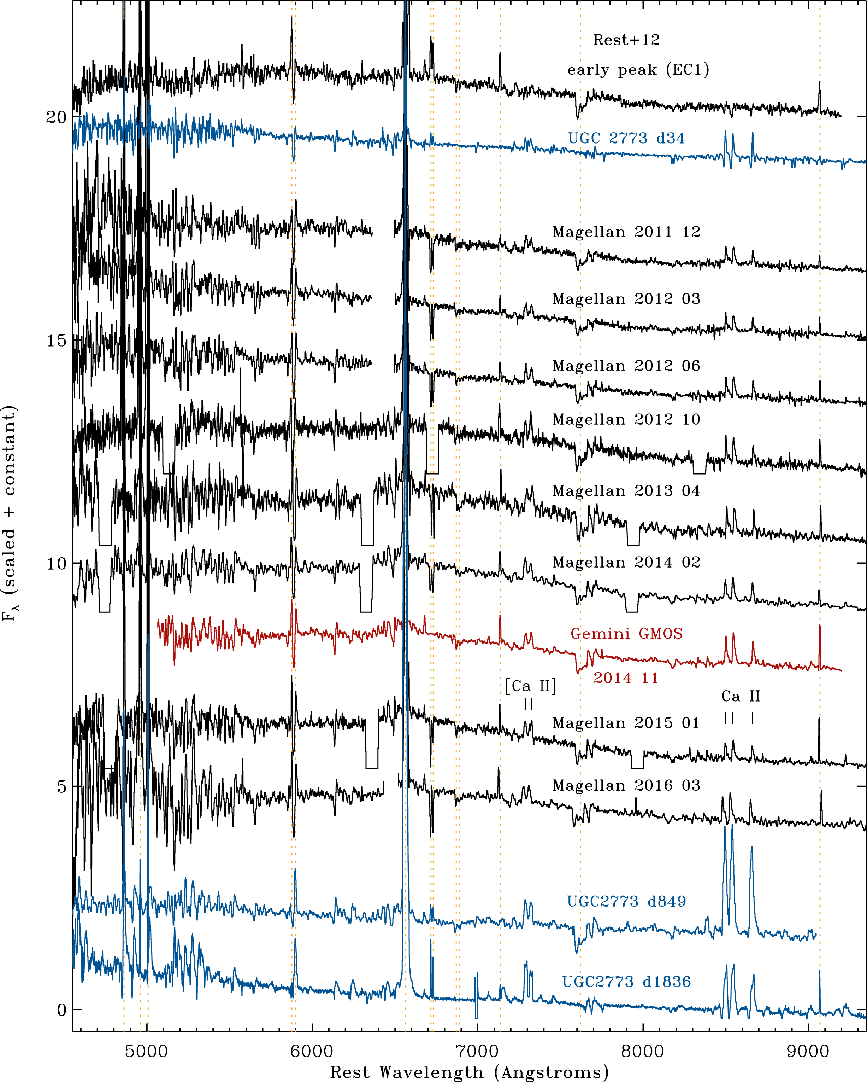
Figure 8. Evolution of the low-resolution spectra of EC2. Included for comparison are the first epoch spectra of the ...
Notes:
Figure 8. Evolution of the low-resolution spectra of EC2. Included for comparison are the first epoch spectra of the EC1 echo discussed by Rest et al. (2012), which samples an early peak in 1843 or 1838, and both early and late-time spectra of UGC 2773-OT (in blue), from Smith et al. (2016a). All spectra of η Car’s echoes have been dereddened by E(B − V) = 1.0 mag; this amount of reddening is probably a minimum, but the true line-of-sight reddening is complicated by the fact that we are also observing reflected light. The vertical orange dashed lines identify wavelengths of bright emission lines in the H ii region and telluric absorption (see previous figures). Several of the Magellan/imacs spectra have breaks in wavelength coverage due to gaps between detector chips.
Unless provided in the caption above, the following copyright applies to the content of this slide: © 2018 The Author(s) Published by Oxford University Press on behalf of the Royal Astronomical SocietyThis article is published and distributed under the terms of the Oxford University Press, Standard Journals Publication Model ( https://academic.oup.com/journals/pages/open_access/funder_policies/chorus/standard_publication_model)

Slide 9
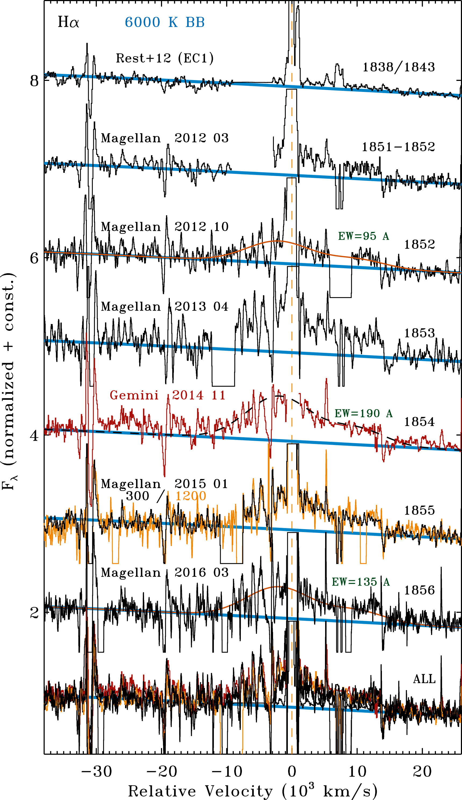
Figure 9. Spectra of light echoes concentrating on the region around Hα, showing the broad Hα wings plotted as a ...
Notes:
Figure 9. Spectra of light echoes concentrating on the region around Hα, showing the broad Hα wings plotted as a function of velocity relative to the centroid of the narrow Hα line denoted by a vertical dashed orange line (note that the horizontal axis is in units of 1000 km s−1). Several epochs are shown, including a spectrum of the EC1 echo from Rest et al. (2012) corresponding to an early peak in 1838 or 1843. The other spectra are for EC2 obtained on the dates shown, and corresponding roughly to epochs during the Great Eruption noted at right. Each spectrum has been dereddened by E(B − V) = 1.0 mag and is compared to a 6000 K blackbody (blue). For three epochs, an example of a composite Gaussian that approximates the shape of the broad component is shown for comparison, and the EW of the broad feature is noted near those three spectra. The bottom shows all epochs of spectra overplotted. As in previous figures, some of the Magellan/imacs spectra have detector chip gaps.
Unless provided in the caption above, the following copyright applies to the content of this slide: © 2018 The Author(s) Published by Oxford University Press on behalf of the Royal Astronomical SocietyThis article is published and distributed under the terms of the Oxford University Press, Standard Journals Publication Model ( https://academic.oup.com/journals/pages/open_access/funder_policies/chorus/standard_publication_model)

Slide 10
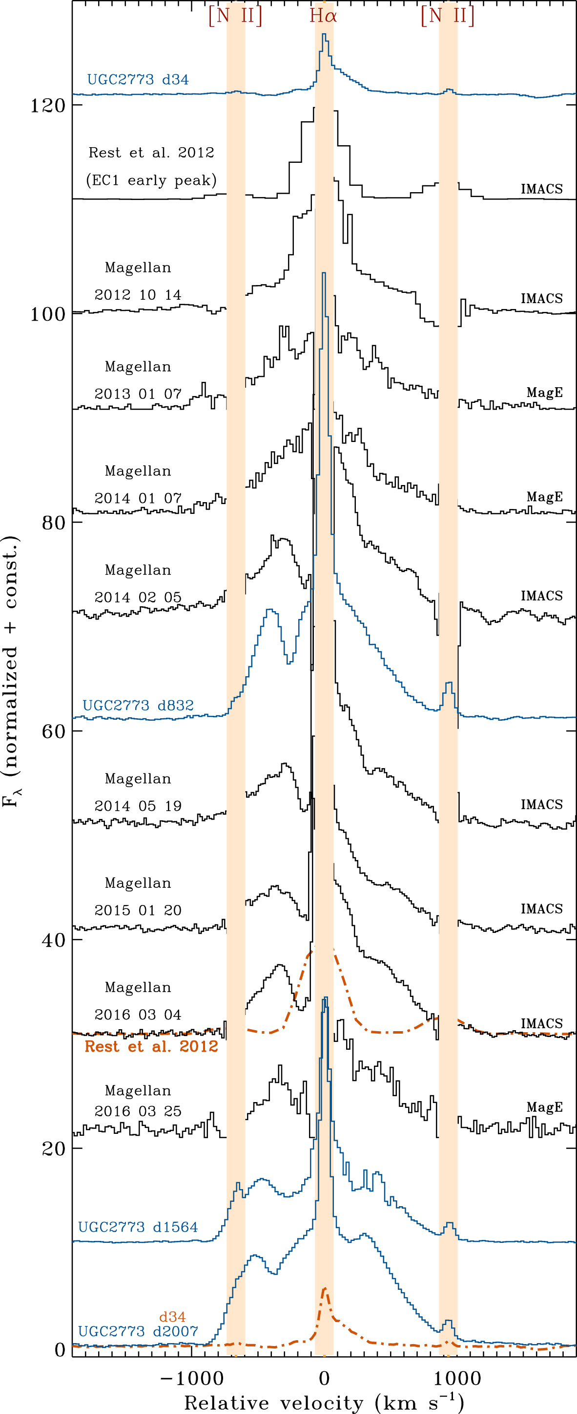
Figure 10. Evolution of the narrow and intermediate-width Hα line profile throughout the eruption, including an early ...
Notes:
Figure 10. Evolution of the narrow and intermediate-width Hα line profile throughout the eruption, including an early EC1 spectrum (Rest et al. 2012) corresponding to a peak in 1843 or 1838. (Note that the very broad emission wings extend far outside the velocity range plotted here.) Except for this first spectrum, the rest have higher dispersion with the imacs 1200 lpm grating or with mage. We also include spectra of the η Car analogue transient UGC 2773-OT (blue) at early and late times (Smith et al. 2016a). Toward the bottom (in orange, dot–dashed) we show the first epoch spectra superposed on the late-time spectra, to emphasize differences. Note that echo spectra of η Car are contaminated by artifacts from the imperfect subtraction of bright nebular lines like Hα and [N ii] λλ6548,6583, so these regions of the spectra are masked in light orange.
Unless provided in the caption above, the following copyright applies to the content of this slide: © 2018 The Author(s) Published by Oxford University Press on behalf of the Royal Astronomical SocietyThis article is published and distributed under the terms of the Oxford University Press, Standard Journals Publication Model ( https://academic.oup.com/journals/pages/open_access/funder_policies/chorus/standard_publication_model)

Slide 11
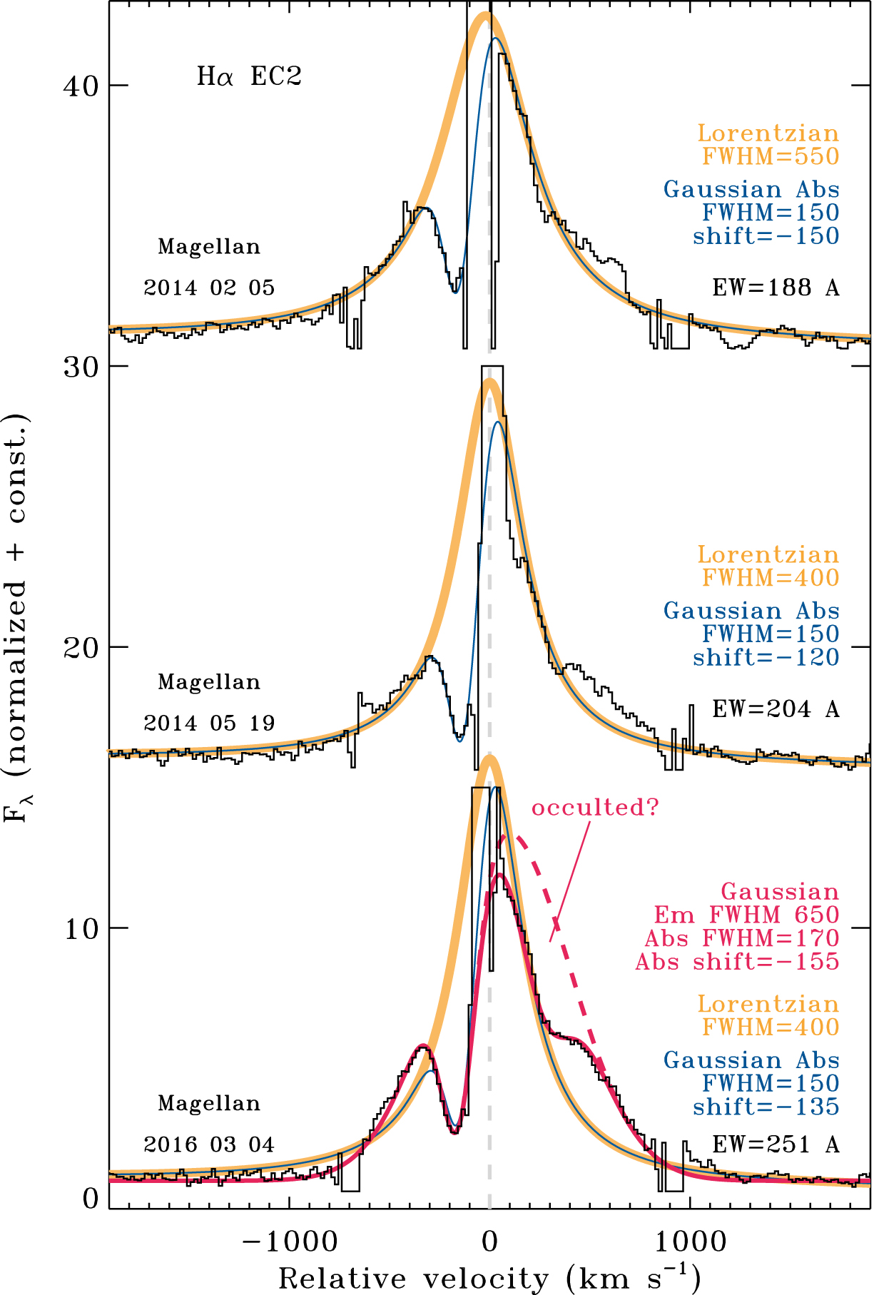
Figure 11. A few of the Hα profiles of the EC2 echo from Fig. 10 with Lorentzian and/or Gaussian fits for comparison. ...
Notes:
Figure 11. A few of the Hα profiles of the EC2 echo from Fig. 10 with Lorentzian and/or Gaussian fits for comparison. Values for the centroid shift and FWHM of these components are noted at right. Values of the total EWs of the fits are also noted (values in Å); a caveat is that the ‘continuum’ level for these fits is actually the wings of the broad component, and so the EW values of the fits quoted here have had a correction applied (factor of 1.4, 1.4, and 1.35 for the top, middle, and bottom, respectively) such that the EW corresponds to the underlying continuum and not the level of the broad wings.
Unless provided in the caption above, the following copyright applies to the content of this slide: © 2018 The Author(s) Published by Oxford University Press on behalf of the Royal Astronomical SocietyThis article is published and distributed under the terms of the Oxford University Press, Standard Journals Publication Model ( https://academic.oup.com/journals/pages/open_access/funder_policies/chorus/standard_publication_model)

Slide 12
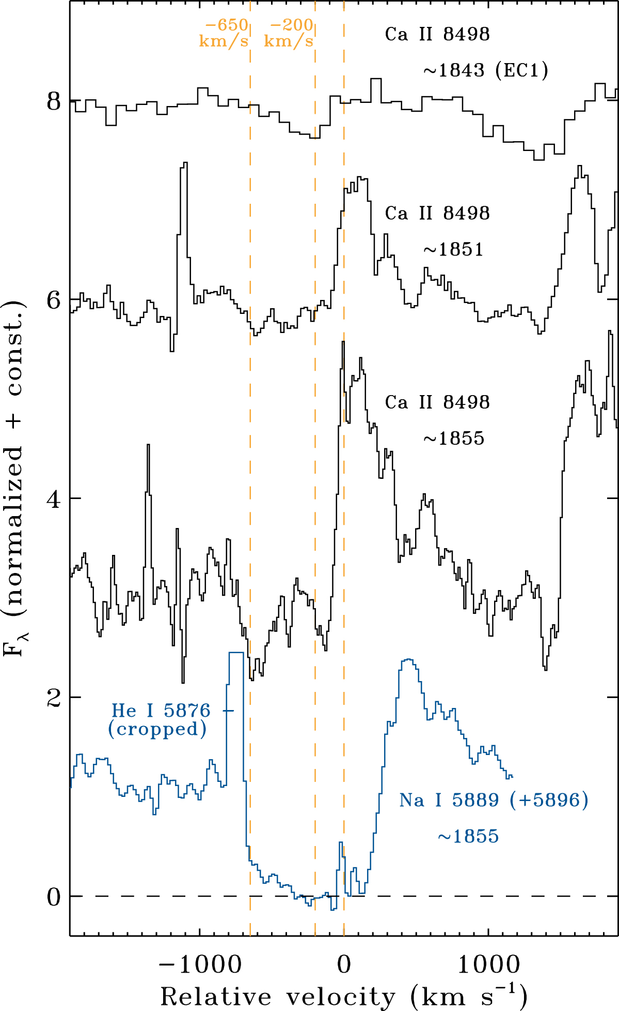
Figure 12. Line profiles of Ca ii λ8498 at three different epochs, as well as Na i D at the last epoch. The top spectrum ...
Notes:
Figure 12. Line profiles of Ca ii λ8498 at three different epochs, as well as Na i D at the last epoch. The top spectrum is from the EC1 echo studied by Rest et al. (2012), and is thought to represent one of the early peaks in the light curve in 1843 (or perhaps 1838). This shows only absorption at a relatively slow speed of −200 km s−1. Later epochs are spectra of EC2 that trace the main plateau in the 1850s; these show higher speed absorption out to −650 km s−1 and also emission from Ca ii, both of which were absent at earlier epochs. The Na i line shows strong absorption all the way out to −650 km s−1.
Unless provided in the caption above, the following copyright applies to the content of this slide: © 2018 The Author(s) Published by Oxford University Press on behalf of the Royal Astronomical SocietyThis article is published and distributed under the terms of the Oxford University Press, Standard Journals Publication Model ( https://academic.oup.com/journals/pages/open_access/funder_policies/chorus/standard_publication_model)

Slide 13
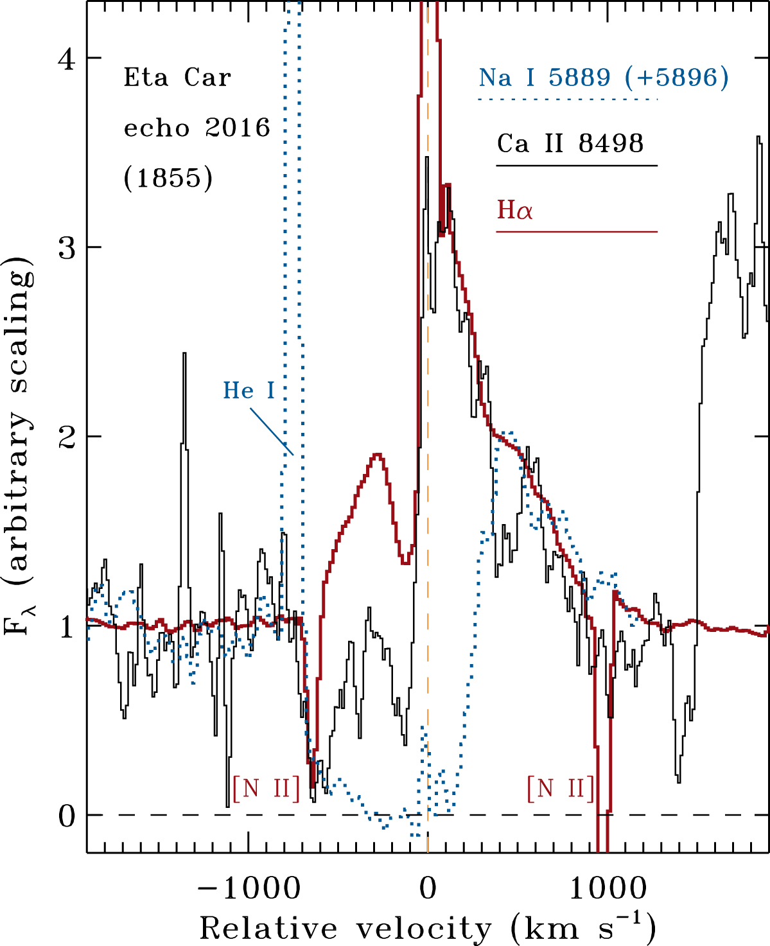
Figure 13. Line profiles of Hα (red), as compared to Ca iiλ8498 (black) and Na i D (blue dotted). These were obtained in ...
Notes:
Figure 13. Line profiles of Hα (red), as compared to Ca iiλ8498 (black) and Na i D (blue dotted). These were obtained in 2016 March, which corresponds to roughly 1855 (give or take a few years), mid-way through the main plateau in η Car’s Great Eruption. The intensity of the lines is scaled arbitrarily for display in order to compare their velocity structure, since the lines have very different emission strengths above the continuum. Features unrelated to the kinematics of the line profiles are the strong narrow emission from He i λ5876, and the oversubtraction of nebular [N ii] λλ6548,6583 (resembling narrow absorption) at −750 and +1000 km s−1. These are marked on the figure. Also note that Na i D is a blend of two lines; the velocity is plotted for λ5889 to correctly demonstrate the blue edge of the absorption, so that the companion line λ5896 causes extra absorption at 0 to +300 km s−1 that is not representative of a true P Cygni profile from a single line.
Unless provided in the caption above, the following copyright applies to the content of this slide: © 2018 The Author(s) Published by Oxford University Press on behalf of the Royal Astronomical SocietyThis article is published and distributed under the terms of the Oxford University Press, Standard Journals Publication Model ( https://academic.oup.com/journals/pages/open_access/funder_policies/chorus/standard_publication_model)

Slide 14
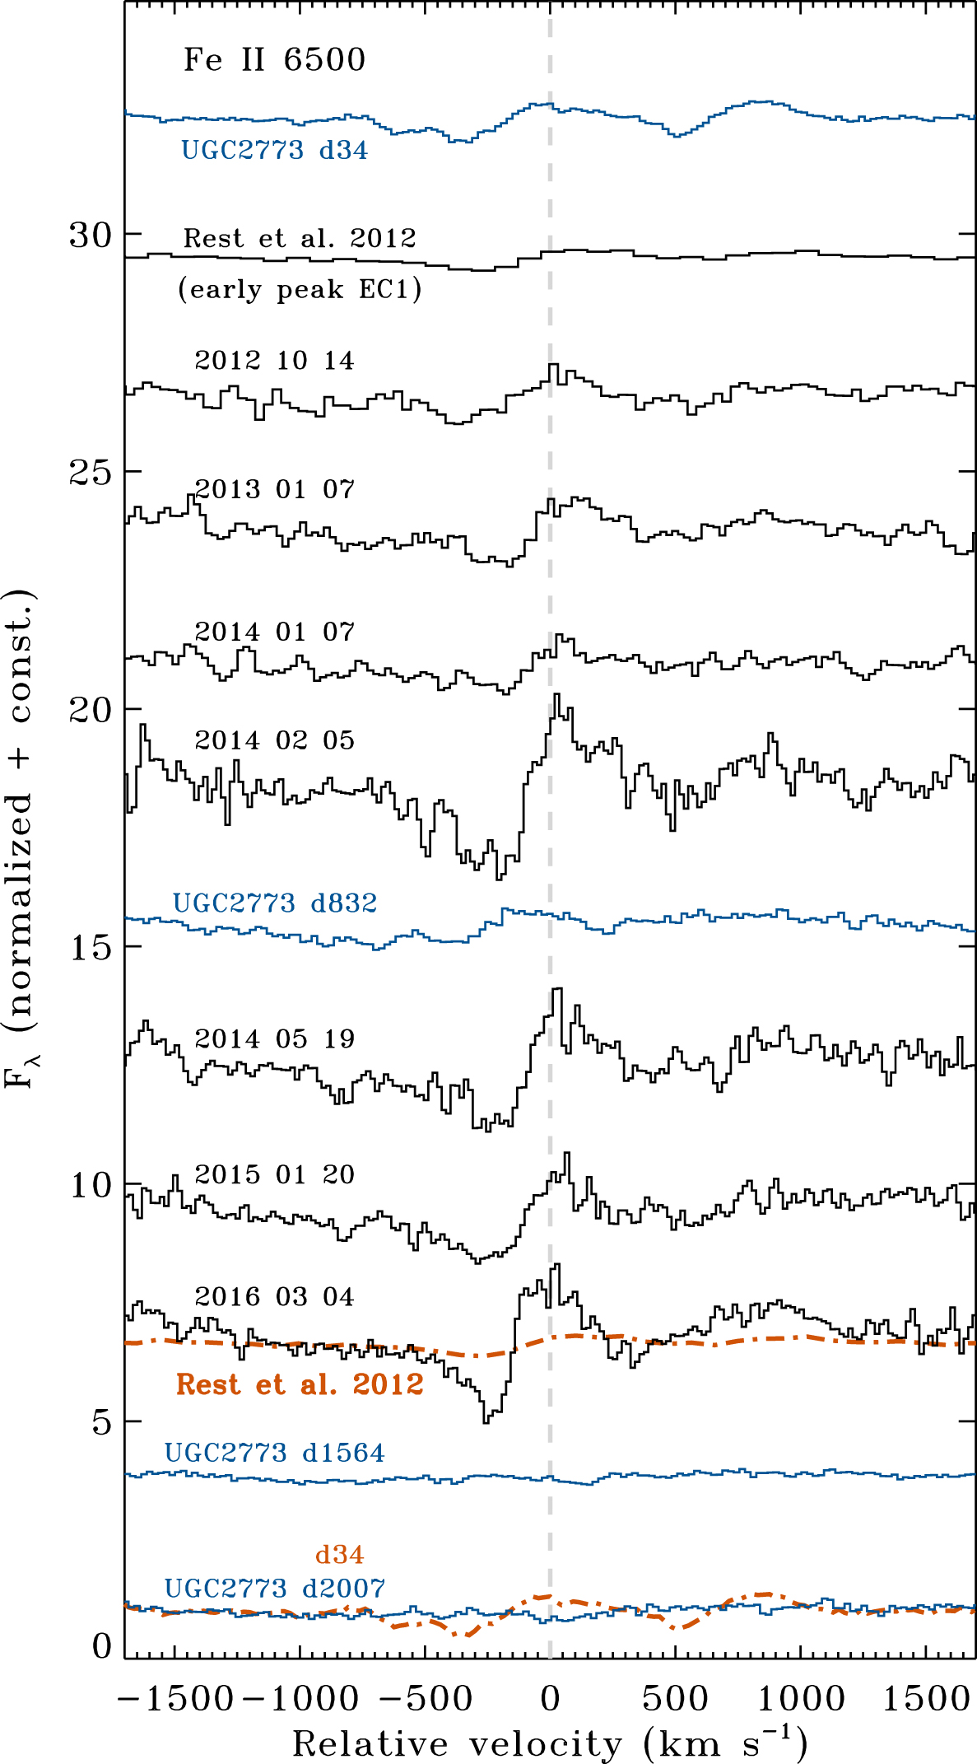
Figure 14. Same as Fig. 10, but for the P Cygni line at 6500 Å, which is presumably Fe ii.
Notes:
Figure 14. Same as Fig. 10, but for the P Cygni line at 6500 Å, which is presumably Fe ii.
Unless provided in the caption above, the following copyright applies to the content of this slide: © 2018 The Author(s) Published by Oxford University Press on behalf of the Royal Astronomical SocietyThis article is published and distributed under the terms of the Oxford University Press, Standard Journals Publication Model ( https://academic.oup.com/journals/pages/open_access/funder_policies/chorus/standard_publication_model)

Slide 15
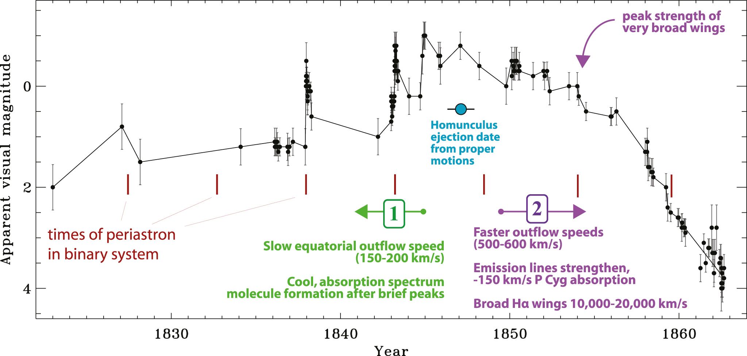
Figure 15. The historical light curve of η Car’s Great Eruption (Smith & Frew 2011) with annotations summarizing some ...
Notes:
Figure 15. The historical light curve of η Car’s Great Eruption (Smith & Frew 2011) with annotations summarizing some key points gleaned from light echo spectroscopy. The red hash marks show expected times of periastron in the eccentric binary system, extrapolating from the orbital cycle observed in modern times. The recently derived apparent ejection date for the Homunculus (Smith 2017) derived from proper motions of the nebula (assuming linear motion) is noted. The main developments of the two-stage eruption revealed by light echo spectroscopy (somewhat simplified) are noted in green (1) and purple (2), corresponding to echoes EC1 and EC2, respectively.
Unless provided in the caption above, the following copyright applies to the content of this slide: © 2018 The Author(s) Published by Oxford University Press on behalf of the Royal Astronomical SocietyThis article is published and distributed under the terms of the Oxford University Press, Standard Journals Publication Model ( https://academic.oup.com/journals/pages/open_access/funder_policies/chorus/standard_publication_model)

Slide 16
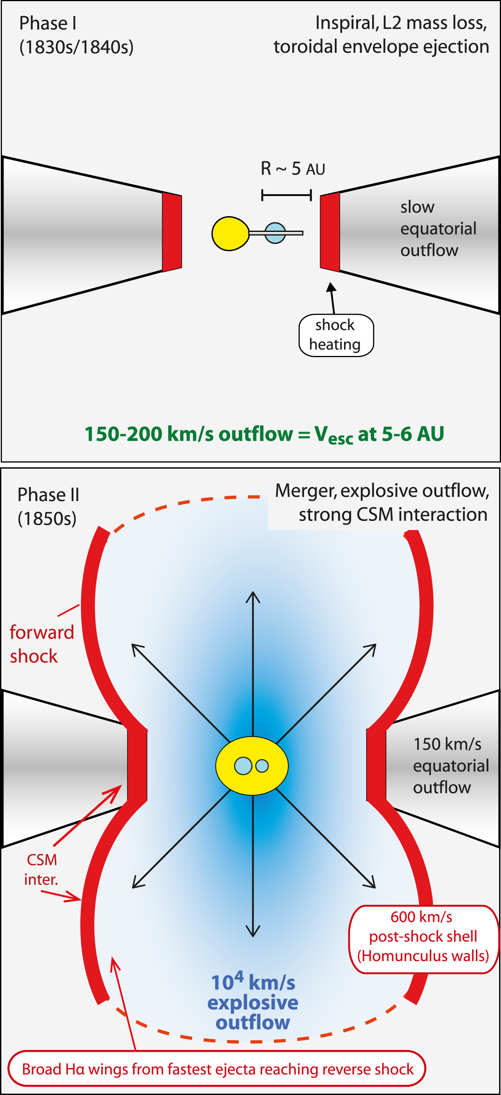
Figure 16. A sketch of the possible geometry in a hypothetical stellar merger model for η Car’s eruption, showing the ...
Notes:
Figure 16. A sketch of the possible geometry in a hypothetical stellar merger model for η Car’s eruption, showing the two phases discussed in Sections 4.3 and 4.6. Top: Phase I corresponds to the decades leading up to the Great Eruption, which in a merger model is the inspiral phase when the orbit decays and there is prodigious mass-loss from the system through L2. This is adapted from the scenario for lower mass mergers like V1309 Sco discussed by Pejcha et al. (2016a,b, 2017). In the case of η Car, light echoes from this period indicate a relatively slow outflow of 150 - 200 km s−1. The luminosity in this phase is a combination of shock heating as the L2 outflow collides with itself in a ‘death spiral’ (Pejcha et al. 2017), as well as stellar photospheric luminosity. Bottom: Phase II corresponds to the 1850s plateau phase of the Great Eruption, when higher velocities are seen. The very broad wings in Hα correspond to a 104 km s−1 explosive ejection or very fast wind (light blue), which is excited as the fast ejecta approach the reverse shock. The intermediate-width ∼600 km s−1 lines (broader than the 150 km s−1 seen in Phase I) correspond to the thin swept up post-shock shell (red). The post-shock gas expanding at 600 km s−1 will cool and will eventually form the dense walls of the Homunculus. This is adapted from the scenario discussed previously by Smith (2013), where strong CSM interaction dominates the luminosity in this phase. During Phase II, the slow 150 km s−1 outflow can still be seen in absorption from favourable directions, although it is eventually swept up and becomes part of the walls and pinched waist of the Homunculus.
Unless provided in the caption above, the following copyright applies to the content of this slide: © 2018 The Author(s) Published by Oxford University Press on behalf of the Royal Astronomical SocietyThis article is published and distributed under the terms of the Oxford University Press, Standard Journals Publication Model ( https://academic.oup.com/journals/pages/open_access/funder_policies/chorus/standard_publication_model)

Slide 17
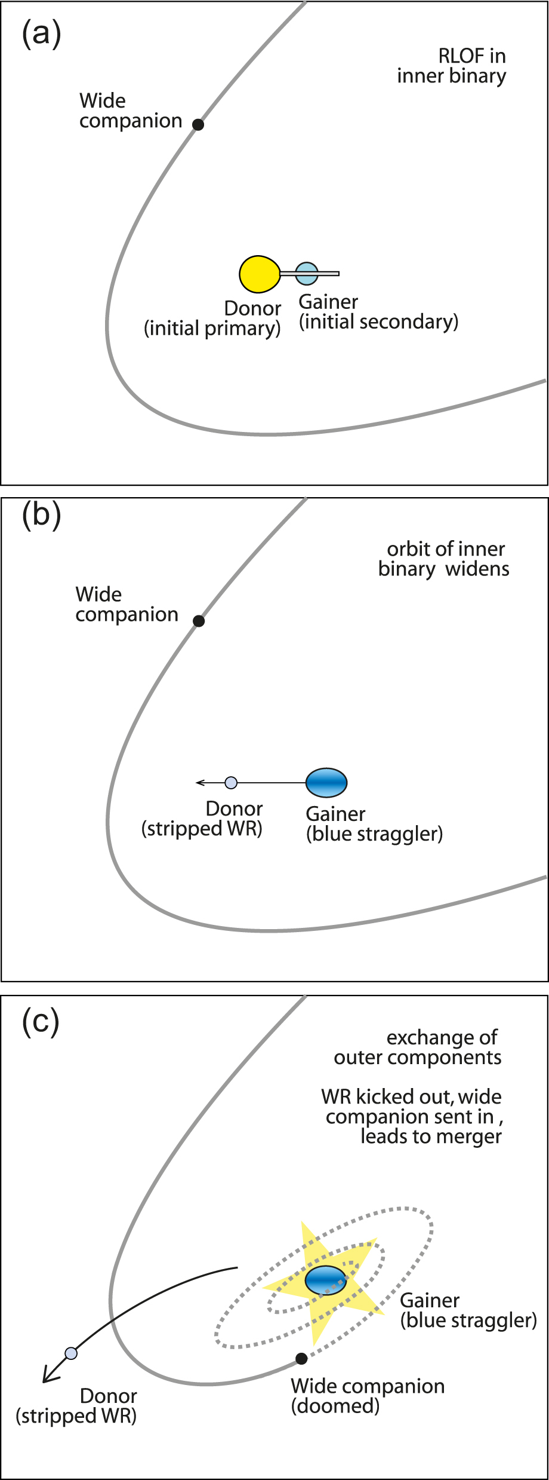
Figure 17. A sketch of the proposed orbital interaction in a hierarchical triple. Panela: As the primary star nears the ...
Notes:
Figure 17. A sketch of the proposed orbital interaction in a hierarchical triple. Panela: As the primary star nears the end of the main sequence, its expansion initiates mass transfer. Panel b: After RLOF ends, the primary is a stripped-envelope WR star, and the mass gainer is spun up, overluminous, and enriched (a blue straggler). The orbit of the inner binary widens at the end of RLOF, and apastron may widen further due to mass-loss or Kozai cycles. Panel c: Eventually the orbit widens enough that the WR interacts with the wide tertiary companion and they exchange places (TEDI; Perets & Kratter 2012), sending the WR star out on an eccentric orbit, and sending the tertiary inward. Various processes influence the orbit until a series of collisions and a final merger occur.
Unless provided in the caption above, the following copyright applies to the content of this slide: © 2018 The Author(s) Published by Oxford University Press on behalf of the Royal Astronomical SocietyThis article is published and distributed under the terms of the Oxford University Press, Standard Journals Publication Model ( https://academic.oup.com/journals/pages/open_access/funder_policies/chorus/standard_publication_model)

