Slide 1
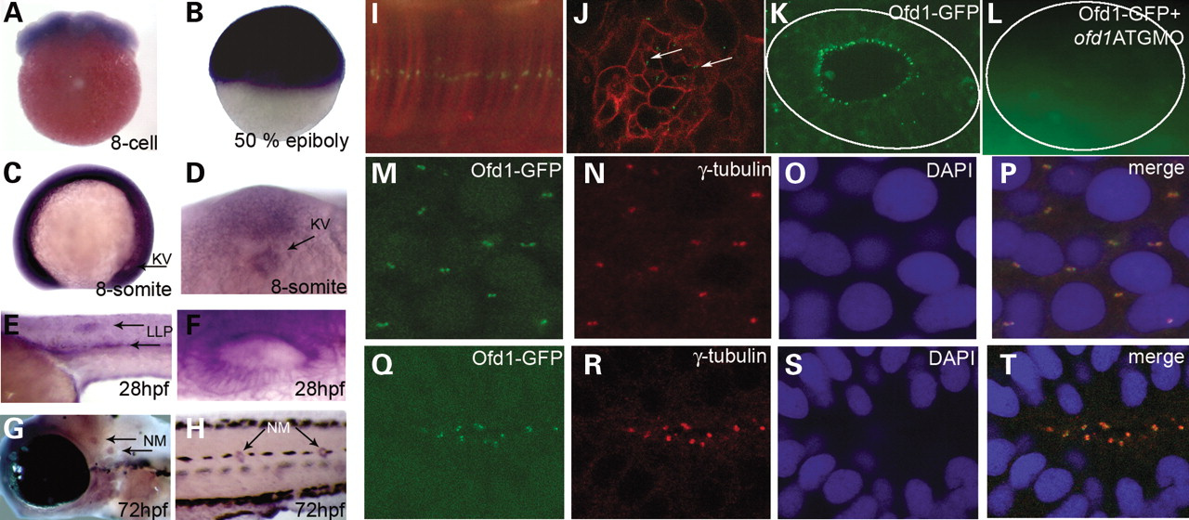
Figure 1. Expression of ofd1 during zebrafish development and Ofd1-GFP localization to centrosomes and basal bodies. ( ...
Notes:
Figure 1. Expression of ofd1 during zebrafish development and Ofd1-GFP localization to centrosomes and basal bodies. ( A – H ) Lateral views of embryos analysed by whole-mount ISH; anterior is to the left and dorsal is to the top, except in A, where the animal pole is uppermost, and in D, which is a ventral view. Positive ofd1 signal is purple. (A) Eight cell stage embryo. (B) 50% epiboly (gastrula) embryo. (C) Eight-somite embryo, arrow points to the Kupffer's vesicle (KV). (D) Magnified view of the KV in the eight-somite embryo seen from the ventral aspect; note ofd1 expression. (E) Detail of the body at 28 hpf, with signal evident in the lateral line primordia (LLP) (arrows). (F) Otic vesicle at 28 hpf. (G and H) Arrows indicate neuromasts (NM) in the head and trunk, respectively, at 72 hpf. (I) Confocal image showing a linear punctuate pattern of fusion protein (green) in the notochord of a 10-somite embryo (lateral view), representing centrosomes in the stack of flat cells. (J) A punctate, basal body-like pattern (arrows) on the apical surface of retinal epithelial cells in 24 hpf embryos. Cell membranes in ( I ) and ( J ) were marked by monomeric red fluorescent protein. ( K ) Ofd1-GFP detected in a basal body-like pattern in the apical aspect of epithelia in the otic vesicle. ( L ) Otic vesicle of an embryo co-injected with Ofd1-GFP and 4 ng ofd1 ATG MO showed no signal above background. The solid line outlines the vesicle in (K) and (L). ( M – P ) In the tail region, Ofd1-GFP signal (green in M) was detected in centrosomes, as confirmed by co-localization with γ-tubulin (red in N), and weakly in nuclei, as confirmed by counterstaining nuclei with DAPI (blue in O). The merged picture is shown in (P). ( Q – T ) Co-localization of Ofd1-GFP signal (green in Q) with γ-tubulin (red in R) at the apical surface of cells in the neural tube of 24 hpf embryos, as viewed from the dorsal aspect. Nuclei are stained blue in (S), with the merged picture shown in (T).
Unless provided in the caption above, the following copyright applies to the content of this slide: © 2008 The Author(s)This is an Open Access article distributed under the terms of the Creative Commons Attribution Non-Commercial License (http://creativecommons.org/licenses/by-nc/2.0/uk/) which permits unrestricted non-commercial use, distribution, and reproduction in any medium, provided the original work is properly cited.

Slide 2
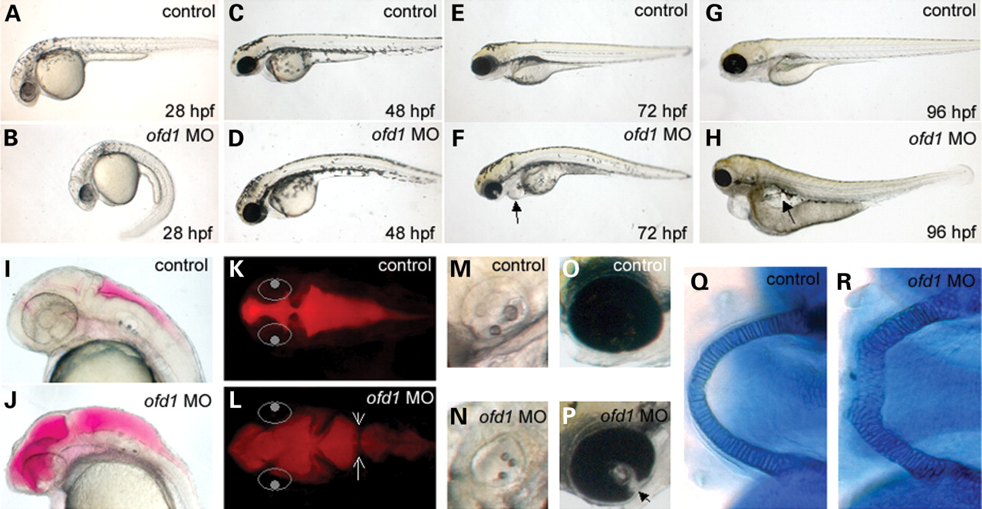
Figure 2. General dysmorphology of ofd1 MO-injected embryos. ( A , C , E and G ) Lateral views of 28, 48, 72 and 96 ...
Notes:
Figure 2. General dysmorphology of ofd1 MO-injected embryos. ( A , C , E and G ) Lateral views of 28, 48, 72 and 96 hpf controls. ( B , D , F and H ) Time-matched 4 ng ofd1 SPL6 MO-injected embryos. (B) An embryo injected with ofd1 MO displaying bent body axis. (F) Pericardial oedema in an ofd1 MO-injected embryo, indicated by the arrow. (H) Generalized oedema in an ofd1 MO-injected embryo (arrow). ( I – L ) 30 hpf embryos injected with rhodamine-dextran into hindbrain ventricles. In (K) and (L), the eyes are indicated by white circles to help orientation. (I and K) Lateral and dorsal views of the fluid-filled ventricles (red) in controls. (J and L) Lateral and dorsal views of ofd1 MO-injected embryo with widespread dilatation in the ventricular system. Note the abnormal tissue bridge in the hindbrain ventricle (arrows in L). ( M and N ) The control otic vesicle contained two otoliths (M), whereas three small otoliths were noted in this MO-injected embryo (N). ( O and P ) In 72 hpf controls, fusion of the retina in the optic cup is nearly complete (O) but a cleft (coloboma) was noted in this ofd1 MO-injected embryo (arrowhead in P). ( Q and R ) Alcian blue stained lower jaws at 5 days post fertilization. In controls (Q), Meckel's cartilage cells are arranged in a column of cuboidal cells, forming a U-shaped structure. In contrast, in the ofd1 MO-injected embryo (R), the structure was shorter and wider, and was composed of rounded cells.
Unless provided in the caption above, the following copyright applies to the content of this slide: © 2008 The Author(s)This is an Open Access article distributed under the terms of the Creative Commons Attribution Non-Commercial License (http://creativecommons.org/licenses/by-nc/2.0/uk/) which permits unrestricted non-commercial use, distribution, and reproduction in any medium, provided the original work is properly cited.

Slide 3
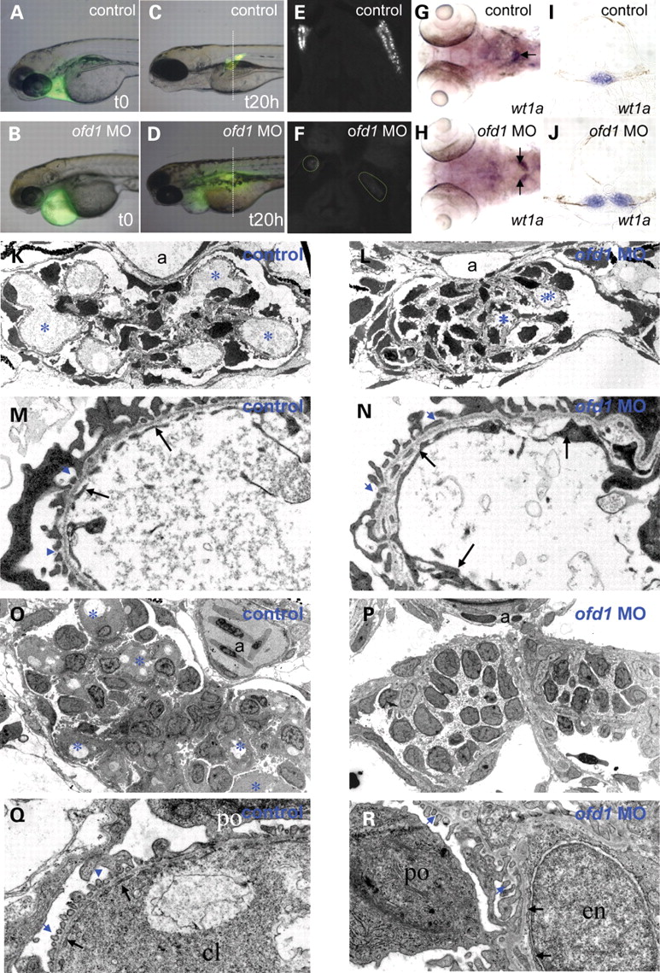
Figure 3. Glomerular function and structure in ofd1 MO-injected embryos. ( A – F ) Control and ofd1 MO-injected ...
Notes:
Figure 3. Glomerular function and structure in ofd1 MO-injected embryos. ( A – F ) Control and ofd1 MO-injected embryos treated with 10 kDa dextran injected into the pericardial space at 72 hpf to assess glomerular filtration. (A and B) Control and ofd1 MO-injected embryos imaged immediately after injection. Fluorescence was detected in the pericardium. (C) 20 h after injection, dextran had been excreted from the circulation in live control embryos, and fluorescence was detected in proximal tubules after endocytosis of glomerular filtrate. (D) Time-matched ofd1 SPL6 MO (4 ng) injected embryo in which fluorescence remained visible in the pericardium and systemically, but could not be detected in pronephric tubules. Note that the vertical lines in C and D represent the planes of section depicted in (E) and (F). (E and F) Transverse sections of control and MO-injected embryos fixed at 20 h post injection. ( G – J ) wt1a ISH at 72 hpf. Note the fused glomerulus in the midline of the control (arrow in the whole mount in G) but two separate structures in the ofd1 SPL6 MO-injected embryo (arrows in H). These two embryos are shown in transverse histological sections in (I) and (J). ( K – N ) Transmission electron microscopy of 72 hpf larvae. Low power (3000×) views show a control glomerulus (K) with prominent capillary loops (asterisks), and a glomerulus from an ofd1 SPL6 MO-injected embryo with less prominent loops (L). Dorsal aorta (a) is evident in both control and ofd1 MO-injected embryos (K and L). 25 000× magnification of control capillary loop (M) showing the thin endothelial cytoplasmic layer (arrows) interrupted by numerous gaps, or fenestrae, and of a MO-injected embryo capillary loop (N) with normal endothelia (arrows) but almost devoid of fenestrae. ( O – R ) Glomeruli at 4 days post fertilization. Low power views (3000×) in (O) and (P) and high power views in (Q) and R (25000×). In control glomeruli (O and Q), note numerous capillary loops (cl) (asterisks in O), a patent aorta (a) and fenestrated endothelia (arrows in Q). In ofd1 MO-injected embryos (P and R), glomeruli lacked loops and a patent aorta (P) and endothelia (arrows in R) lacked fenestrae; podocytes (po), however, had grossly normal foot processes (blue arrowheads in R). Some endothelial nuclei (en) appeared amorphous and swollen.
Unless provided in the caption above, the following copyright applies to the content of this slide: © 2008 The Author(s)This is an Open Access article distributed under the terms of the Creative Commons Attribution Non-Commercial License (http://creativecommons.org/licenses/by-nc/2.0/uk/) which permits unrestricted non-commercial use, distribution, and reproduction in any medium, provided the original work is properly cited.

Slide 4
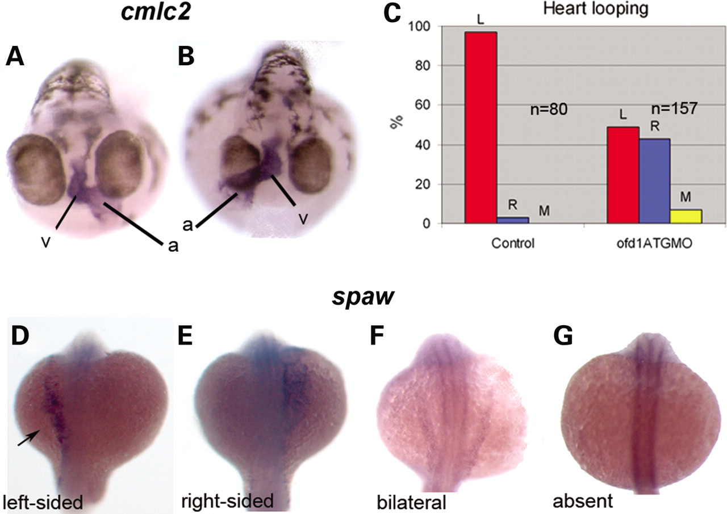
Figure 4. Left-right patterning is altered in ofd1 MO-injected embryos. ISH for cardiac myosin light chain 2 ( cmcl2 ) ...
Notes:
Figure 4. Left-right patterning is altered in ofd1 MO-injected embryos. ISH for cardiac myosin light chain 2 ( cmcl2 ) was used to visualize the heart tube in 48 hpf embryos. ( A ) In wild-type embryos, the atrium (a) loops to the left (v), ventricle. ( B ) In this ofd1 MO-injected embryo, the loop was reversed. ( C ) Frequencies of heart looping positions in 80 controls embryos and 157 embryos injected with ofd1 ATG MO (5 ng). ( D – G ) In ofd1 MO-injected embryos at 20 hpf (19-21 somites) southpaw ( spaw ) could be expressed either on the left only (D), on the right only (E), bilaterally (F) or could be absent (G). Arrow in (D) indicates expression in the left lateral plate mesoderm, the normal position.
Unless provided in the caption above, the following copyright applies to the content of this slide: © 2008 The Author(s)This is an Open Access article distributed under the terms of the Creative Commons Attribution Non-Commercial License (http://creativecommons.org/licenses/by-nc/2.0/uk/) which permits unrestricted non-commercial use, distribution, and reproduction in any medium, provided the original work is properly cited.

Slide 5
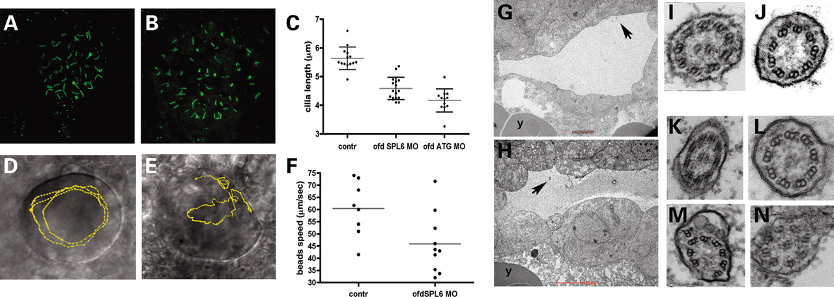
Figure 5. Effects of ofd1 MOs on KV cilia and intravesicular flow. ( A and B ) Cilia in KVs of 10 somite control ...
Notes:
Figure 5. Effects of ofd1 MOs on KV cilia and intravesicular flow. ( A and B ) Cilia in KVs of 10 somite control embryos (A) and ofd1 MO-injected embryos (B) visualized after immunostaining (green) for acetylated α-tubulin. ( C ) Plots of cilia lengths in KVs. Each dot represents the average size of all cilia in a single vesicle. Note that both the ofd1 SPL6 and ATG MOs cause significant reductions in length. ( D and E ) Injected beads were tracked using video microscopy. (D) KV of a control embryo: beads follow an anti-clockwise circular path (yellow line). (E) KV of an ofd1 SPL6 MO (4 ng) injected embryo where beads had irregular trajectories, characterized by loops and zig-zags (yellow line). ( F ) Average bead speed/KV was reduced in ofd1 MO-injected embryos. ( G and H ) Ultrathin sections showing a 10-somite stage KV in control (G) and in an ofd1 ATG MO (5 ng) injected (H) embryo. Arrows indicate cilia and ‘y’ marks the yolk. ( I – N ) Transmission electron micrographs show transverse sections of KV cilia. Both 9 + 2 and 9 + 0 arrangements of axonemal microtubules were seen this control KV (I and J) and in a vesicle of an embryo injected with ofd1 MO (K and L). Cilia with inclusions under the membrane and/or disrupted axonemal microtubules were detected after MO injection (M and N).
Unless provided in the caption above, the following copyright applies to the content of this slide: © 2008 The Author(s)This is an Open Access article distributed under the terms of the Creative Commons Attribution Non-Commercial License (http://creativecommons.org/licenses/by-nc/2.0/uk/) which permits unrestricted non-commercial use, distribution, and reproduction in any medium, provided the original work is properly cited.

Slide 6
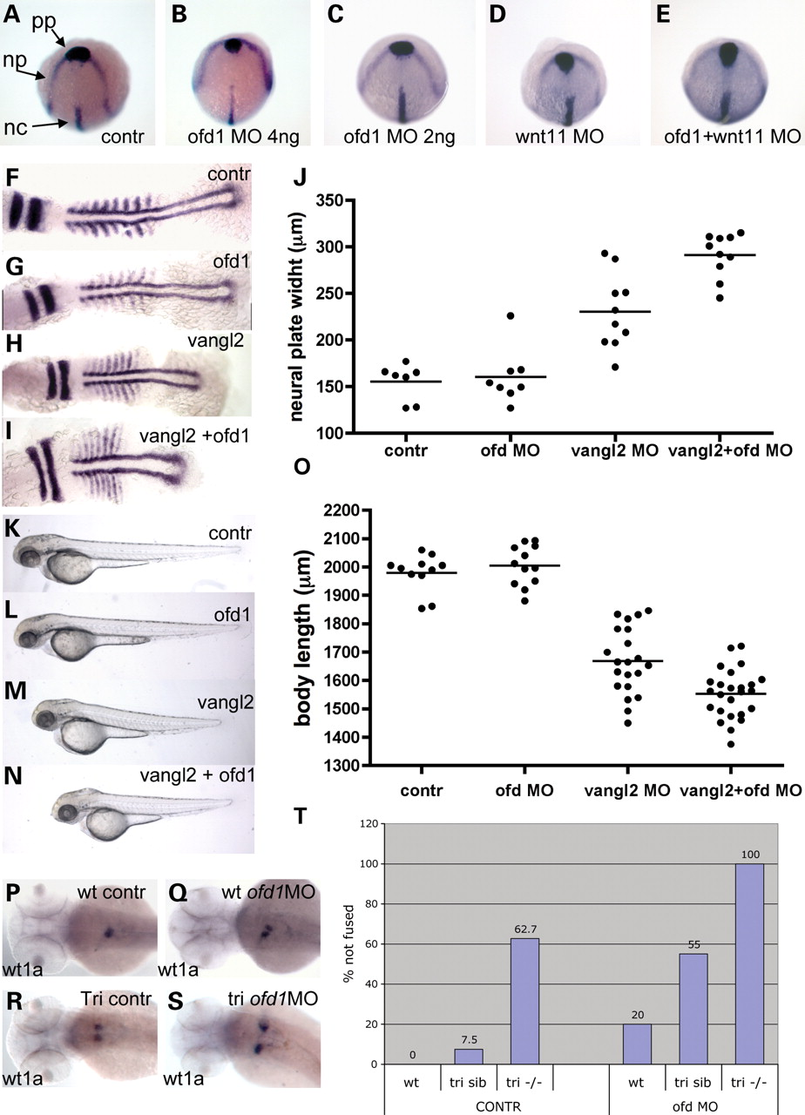
Figure 6. CE failure in ofd1 MO-injected embryos. ( A – E ) Tailbud stage embryos hybridized with a cocktail of ...
Notes:
Figure 6. CE failure in ofd1 MO-injected embryos. ( A – E ) Tailbud stage embryos hybridized with a cocktail of riboprobes: hgg1 as a marker for prechordal plate (pp), dlx3 as a marker for anterior margin of the neural plate (np) and ntl as a notochord (nc) marker. pp migration was delayed and the neural plate was wider in some embryos injected with 4 ng ofd1 SPL6 MO (B), but not in those injected with 2 ng only (C). Similar CE defects were observed in a subset of wnt11 MO-injected embryos (D), while all embryos showed the defects upon co-injection (E). ( F – I ) Embryos at the seven-somite stage hybridized with riboprobes for myoD , a marker of somite and adaxial cells, and krox20 , a marker for rhombomeres 3 and 5. Representative embryos are shown: control (F), injected with ofd1 SLP MO (G), injected with vangl2 MO (H) and co-injected (I), with neural plate widths shown in ( J ). Note that co-injection of low dose ofd1 MO with vangl2 MO accentuated rhombomere widening and axis shortening versus vangl2 MO-injected embryos (see Results text for details). ( K – O ) When assessed at 60 hpf, ofd1 and vangl2 MO co-injected embryos had shorter bodies than those injected with vanlg2 MO alone (see Results text for details). ( P – S ) wt1a ISH to detect glomeruli at 60 hpf. Note the fused glomerulus in controls (P), with examples of failed fusion in wild-type embryos injected with ofd1 SPL6 MO (4 ng) (Q), tri mutants without (R) or with (S) ofd1 SP6 MO (4 ng); note the extreme separation of glomeruli in the latter condition. ( T ) Frequencies of failed fusion: note the accentuation of failed fusion in tri siblings upon injection of ofd1 MO.
Unless provided in the caption above, the following copyright applies to the content of this slide: © 2008 The Author(s)This is an Open Access article distributed under the terms of the Creative Commons Attribution Non-Commercial License (http://creativecommons.org/licenses/by-nc/2.0/uk/) which permits unrestricted non-commercial use, distribution, and reproduction in any medium, provided the original work is properly cited.

Slide 7
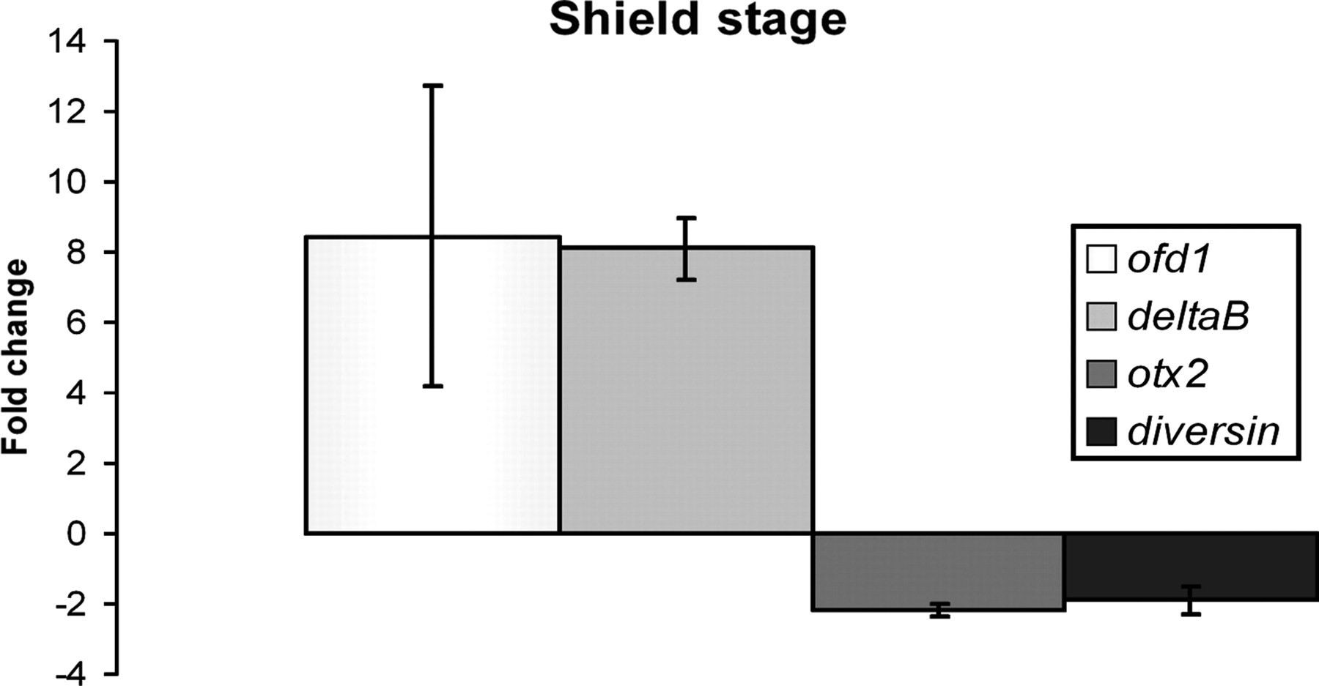
Figure 7. Validation of microarray data using real time RT–PCR. Fold-changes in levels of expression for ofd1 , deltaB ...
Notes:
Figure 7. Validation of microarray data using real time RT–PCR. Fold-changes in levels of expression for ofd1 , deltaB , otx2 and diversin in embryos injected with 5 ng of ofd1 ATG MO and collected at shield stage. Results depict the average and standard deviations of three different experiments.
Unless provided in the caption above, the following copyright applies to the content of this slide: © 2008 The Author(s)This is an Open Access article distributed under the terms of the Creative Commons Attribution Non-Commercial License (http://creativecommons.org/licenses/by-nc/2.0/uk/) which permits unrestricted non-commercial use, distribution, and reproduction in any medium, provided the original work is properly cited.

