Slide 1
Fig. 1. Illustrative example of the incorporation of grouping information into the similarity score. Each node in the ...
Notes:
Fig. 1. Illustrative example of the incorporation of grouping information into the similarity score. Each node in the figure is a peak feature, and dotted ovals represent groups of related peaks, e.g. isotopes, fragments, etc. Initially weights (e.g. WAE) are computed for pairs of peaks (one from each run) with m/z and RT within pre-defined thresholds. These weights are converted into an overall score by incorporating grouping information. For example, peak pairs (A, E) and (B, G) are both within the threshold. As A and B are in the same group, and E and G are in the same group, the weights between pairs (A, E) and (B, G) are upweighted. Peak J is not related to any peaks that could be matched with A’s related peaks and the similarity between A and J is therefore downweighted (because α≤1). The same applies to similarities between pairs (C, H) and (D, I)
Unless provided in the caption above, the following copyright applies to the content of this slide: © The Author 2015. Published by Oxford University Press.This is an Open Access article distributed under the terms of the Creative Commons Attribution License (http://creativecommons.org/licenses/by/4.0/), which permits unrestricted reuse, distribution, and reproduction in any medium, provided the original work is properly cited.

Slide 2
Fig. 2. Precision and recall training performance for all parameters (m/z, RT tolerance, α and g_{tol}) ...
Notes:
Fig. 2. Precision and recall training performance for all parameters (m/z, RT tolerance, α and gtol) varied in the experiment for the fractions containing the most (Fig. 2a and c) and least (Fig. 2b and d) number of features in the P1 and P2 datasets. Plots for all the remaining fractions can be found in Figures 1 and 2 of Supplementary Material
Unless provided in the caption above, the following copyright applies to the content of this slide: © The Author 2015. Published by Oxford University Press.This is an Open Access article distributed under the terms of the Creative Commons Attribution License (http://creativecommons.org/licenses/by/4.0/), which permits unrestricted reuse, distribution, and reproduction in any medium, provided the original work is properly cited.

Slide 3
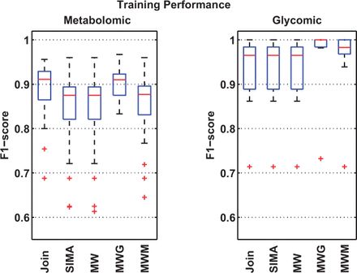
Fig. 3. Training performance shows the best F₁ scores obtained by each method on 30 pairs of randomly ...
Notes:
Fig. 3. Training performance shows the best F1 scores obtained by each method on 30 pairs of randomly selected metabolomic and glycomic training sets
Unless provided in the caption above, the following copyright applies to the content of this slide: © The Author 2015. Published by Oxford University Press.This is an Open Access article distributed under the terms of the Creative Commons Attribution License (http://creativecommons.org/licenses/by/4.0/), which permits unrestricted reuse, distribution, and reproduction in any medium, provided the original work is properly cited.

Slide 4
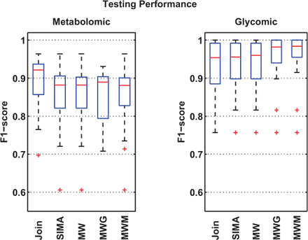
Fig. 4. Testing performance shows how well each method generalize on the 30 different testing sets, each evaluated ...
Notes:
Fig. 4. Testing performance shows how well each method generalize on the 30 different testing sets, each evaluated using the optimal training parameters from its corresponding training set
Unless provided in the caption above, the following copyright applies to the content of this slide: © The Author 2015. Published by Oxford University Press.This is an Open Access article distributed under the terms of the Creative Commons Attribution License (http://creativecommons.org/licenses/by/4.0/), which permits unrestricted reuse, distribution, and reproduction in any medium, provided the original work is properly cited.

