Slide 1
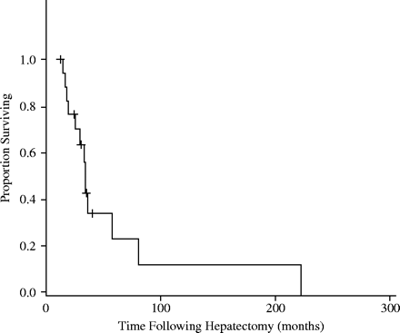
Figure 1. Survival after initial hepatectomy for metastases from GIST.
Notes:
Figure 1. Survival after initial hepatectomy for metastases from GIST.
Unless provided in the caption above, the following copyright applies to the content of this slide: © 2005 Foundation for Promotion of Cancer Research

