Slide 1
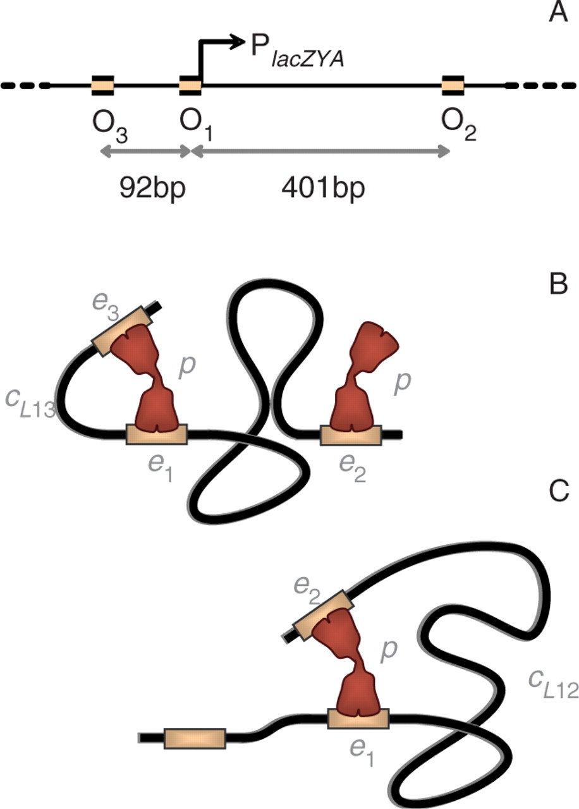
Figure 1. Operators controlling expression of the lacZ, lacY, and lacA genes in the lac operon. (A) Location of the ...
Notes:
Figure 1. Operators controlling expression of the lacZ, lacY, and lacA genes in the lac operon. (A) Location of the main (O1) and the two auxiliary (O2 and O3) operators, shown as orange rectangles on the thick black segment representing DNA. Binding of the lac repressor to O1 prevents transcription of the three lacZYA genes. (B, C) The bidentate repressor can bind to any of the three operators and simultaneously to any two of them by looping the intervening DNA, resulting in different protein–DNA complexes. Two of the three possible loops are shown: (B) one lac repressor (shown in red) loops DNA by binding simultaneously to O1 and O3 (loop L13) whereas another repressor binds to O2; (C) only one repressor is bound to DNA, forming a loop between O1 and O2 (loop L12). In both cases, the lacZYA genes are repressed. The different contributions to the free energy of the lac repressor–DNA complexes, which include positional (p), interaction (e1, e2, and e3), and conformational (cL12, cL13, and cL23) contributions, are explicitly indicated in these two cases.
Unless provided in the caption above, the following copyright applies to the content of this slide: © 2007 The Author(s)This is an Open Access article distributed under the terms of the Creative Commons Attribution Non-Commercial License (http://creativecommons.org/licenses/by-nc/2.0/uk/) which permits unrestricted non-commercial use, distribution, and reproduction in any medium, provided the original work is properly cited.

Slide 2
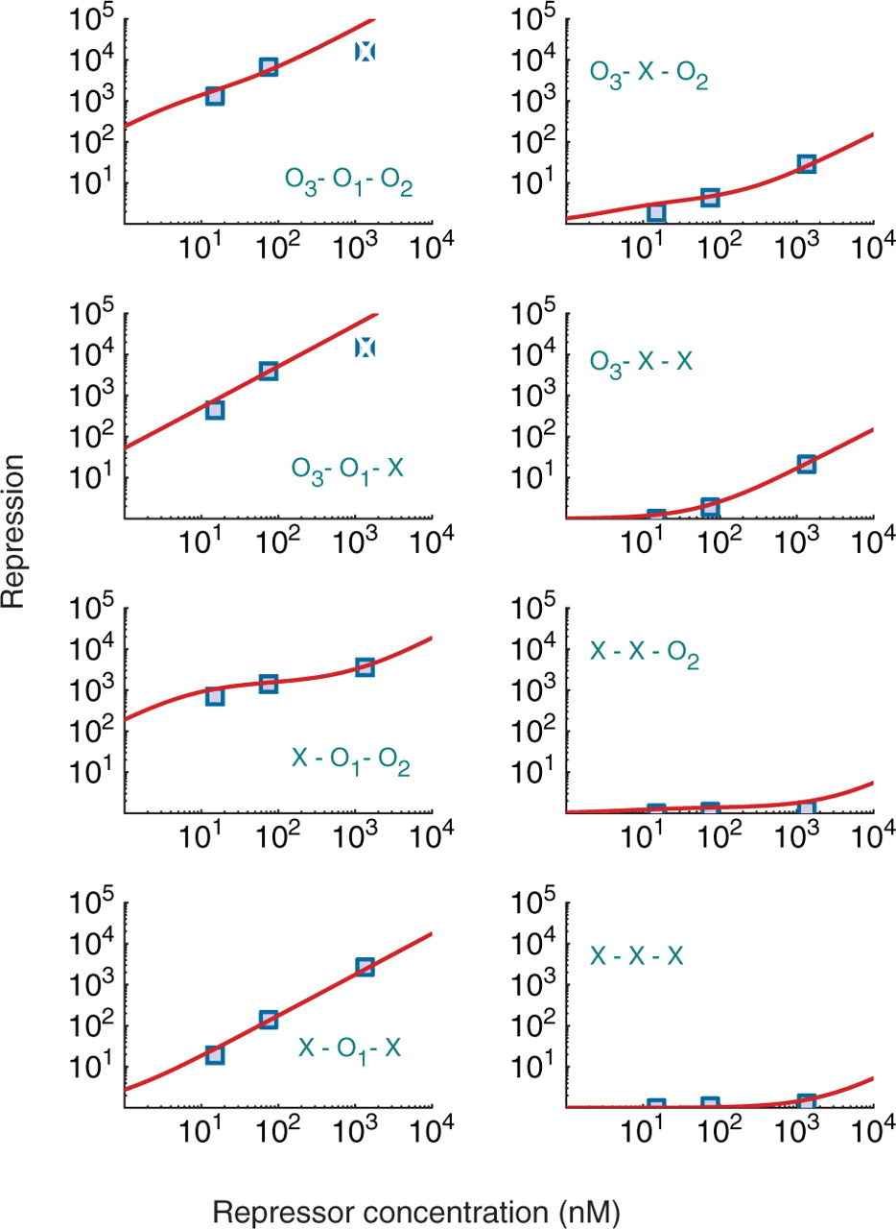
Figure 2. Repression level as a function of the repressor concentration for WT and all seven combinations of deletions ...
Notes:
Figure 2. Repression level as a function of the repressor concentration for WT and all seven combinations of deletions of three operators. The repression levels in the presence of active CAP were obtained for WT and seven mutants accounting for all the combinations of deletions of the three operators. For each of the eight cases, the results of the model (red curves) as a function of the repressor concentration are compared with the experimental data (shaded blue squares) (22) available for three concentrations corresponding to 10 (WT cells), 50, and 900 repressors per cell. The particular set of WT or deleted (X) operators is indicated for each curve; for instance, O3-O1-O2 corresponds to WT lac operon and X-X-X, to the mutant with all three operators deleted. The excellent agreement indicates that the model not only captures the repression values quantitatively but also the shapes of the curves, which are very different depending on the mutant. The values of the parameters used are: e1=−27.8 kcal/mol, e2=−26.3 kcal/mol, e3=−24.1 kcal/mol, cL12 = 23.35 kcal/mol, cL13 = 22.05 kcal/mol, cL23 = 23.50 kcal/mol, p°= 15 kcal/mol, and χ = 0.03. A deleted operator is modeled by increasing its free energy by 5 kcal/mol. The two repression levels represented by broken squares in the graphs for O3-O1-O2 and O3-O1-X were not accurately measured in the experiments, as described by the authors in a subsequent publication (16).
Unless provided in the caption above, the following copyright applies to the content of this slide: © 2007 The Author(s)This is an Open Access article distributed under the terms of the Creative Commons Attribution Non-Commercial License (http://creativecommons.org/licenses/by-nc/2.0/uk/) which permits unrestricted non-commercial use, distribution, and reproduction in any medium, provided the original work is properly cited.

Slide 3
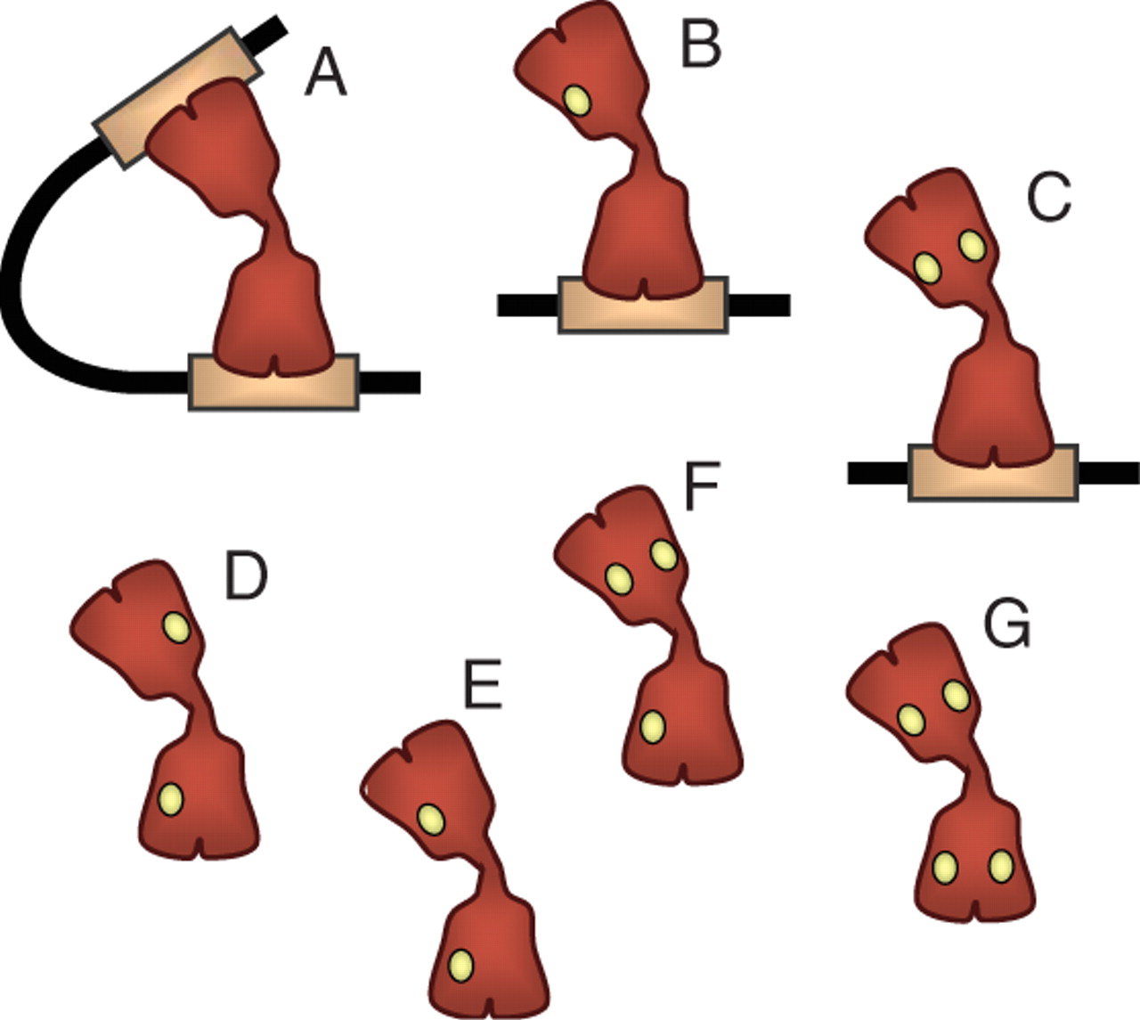
Figure 3. Inducer binding to the lac repressor. An inducer molecule, such as IPTG, can bind independently to each of ...
Notes:
Figure 3. Inducer binding to the lac repressor. An inducer molecule, such as IPTG, can bind independently to each of the four identical monomeric units that form the lac repressor and impair its function. Without IPTG bound, each of the two dimers of the tetrameric repressor (in red) has a functional DNA-binding domain and can bind strongly to the operators (orange rectangle) and loop the intervening DNA (A). With one or two IPTG molecules (small yellow circles) bound to the same domain, the repressor can bind strongly to one operator but cannot loop DNA (B,C). With two or more IPTG molecules bound to different domains of the repressor, strong operator binding is abolished (D,E,F,G).
Unless provided in the caption above, the following copyright applies to the content of this slide: © 2007 The Author(s)This is an Open Access article distributed under the terms of the Creative Commons Attribution Non-Commercial License (http://creativecommons.org/licenses/by-nc/2.0/uk/) which permits unrestricted non-commercial use, distribution, and reproduction in any medium, provided the original work is properly cited.

Slide 4
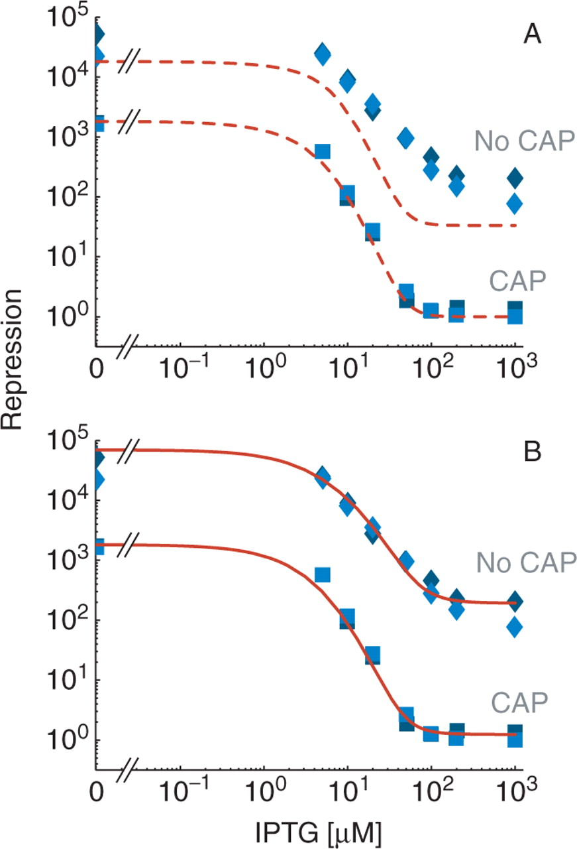
Figure 4. Induction curves of the lac operon for cellular conditions with and without active CAP. (A) The repression ...
Notes:
Figure 4. Induction curves of the lac operon for cellular conditions with and without active CAP. (A) The repression level in the presence of active CAP (lower curves labeled ‘CAP’) was obtained as a function of the concentration of the inducer IPTG for the model given by ΔG(s), τ(s), and (dashed red lines) and compared with the experimental data from Ref. (17) (blue squares). The values of the parameters are the same as in Figure 2, with additional parameters KI = 6.9μM and nT = 15 nM. In the absence of active CAP (upper curves, labeled ‘No CAP’), the model (dashed red lines) does not accurately reproduce the experimental data from Ref. (17) (blue diamonds). We consider that without active CAP, in addition to a reduced transcription , the formation of the O1-O3 loop is 0.9 kcal/mol more costly (c'L13 = 22.95 kcal/mol) than with CAP. (B) The excellent agreement with induction experiments in the absence of active CAP is recovered when the model is generalized to include an arbitrary number of repressor molecules per cell through the expressions ΔGF(s), τF(s), n, nd, and ni, with same values of the parameters as in panel A, with the additional parameter r = 2.8 kcal/mol and 200 repressors per cell (nT = 300 nM) (upper continuous red line). In the presence of active CAP, the generalized model (lower continuous red line) recovers the results in panel A for low number of repressors (nT = 15 nM).
Unless provided in the caption above, the following copyright applies to the content of this slide: © 2007 The Author(s)This is an Open Access article distributed under the terms of the Creative Commons Attribution Non-Commercial License (http://creativecommons.org/licenses/by-nc/2.0/uk/) which permits unrestricted non-commercial use, distribution, and reproduction in any medium, provided the original work is properly cited.

