Slide 1
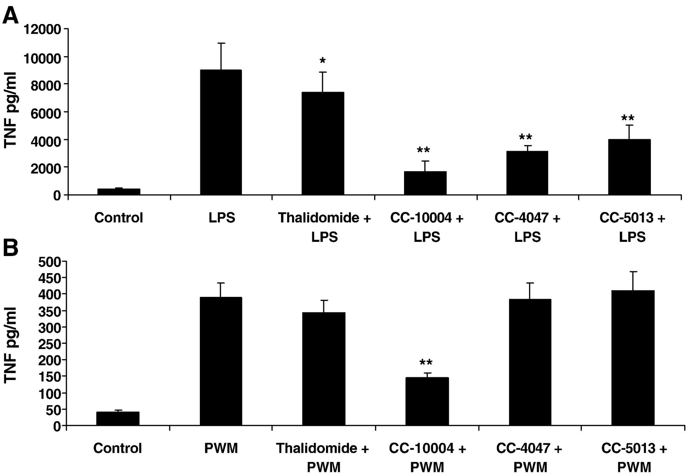
Figure 1 The effect of thalidomide, immunomodulatory imide drugs CC-4047 and CC-5013, and the PDE4 inhibitor CC-10004 ...
Notes:
Figure 1 The effect of thalidomide, immunomodulatory imide drugs CC-4047 and CC-5013, and the PDE4 inhibitor CC-10004 on PBMC and LPMC TNF-α production. A. LPS stimulated PBMCs were cultured with vehicle control, thalidomide, CC-10004, CC-4047, or CC-5013 (all 10 μg/ml). The graph shows the percentage reduction in TNF-α production compared with controls (Data shown are the mean +/− SEM, n = 4; * p < 0.01, ** p < 0.001). B. PWM stimulated LPMCs were cultured with 10 μg/ml of either thalidomide, CC-10004, CC-4047 or CC-5013 (Data shown are the mean +/− SEM, n = 8; * p < 0.01, ** p < 0.001).
Unless provided in the caption above, the following copyright applies to the content of this slide: © 2009 European Crohn's and Colitis Organisation

Slide 2
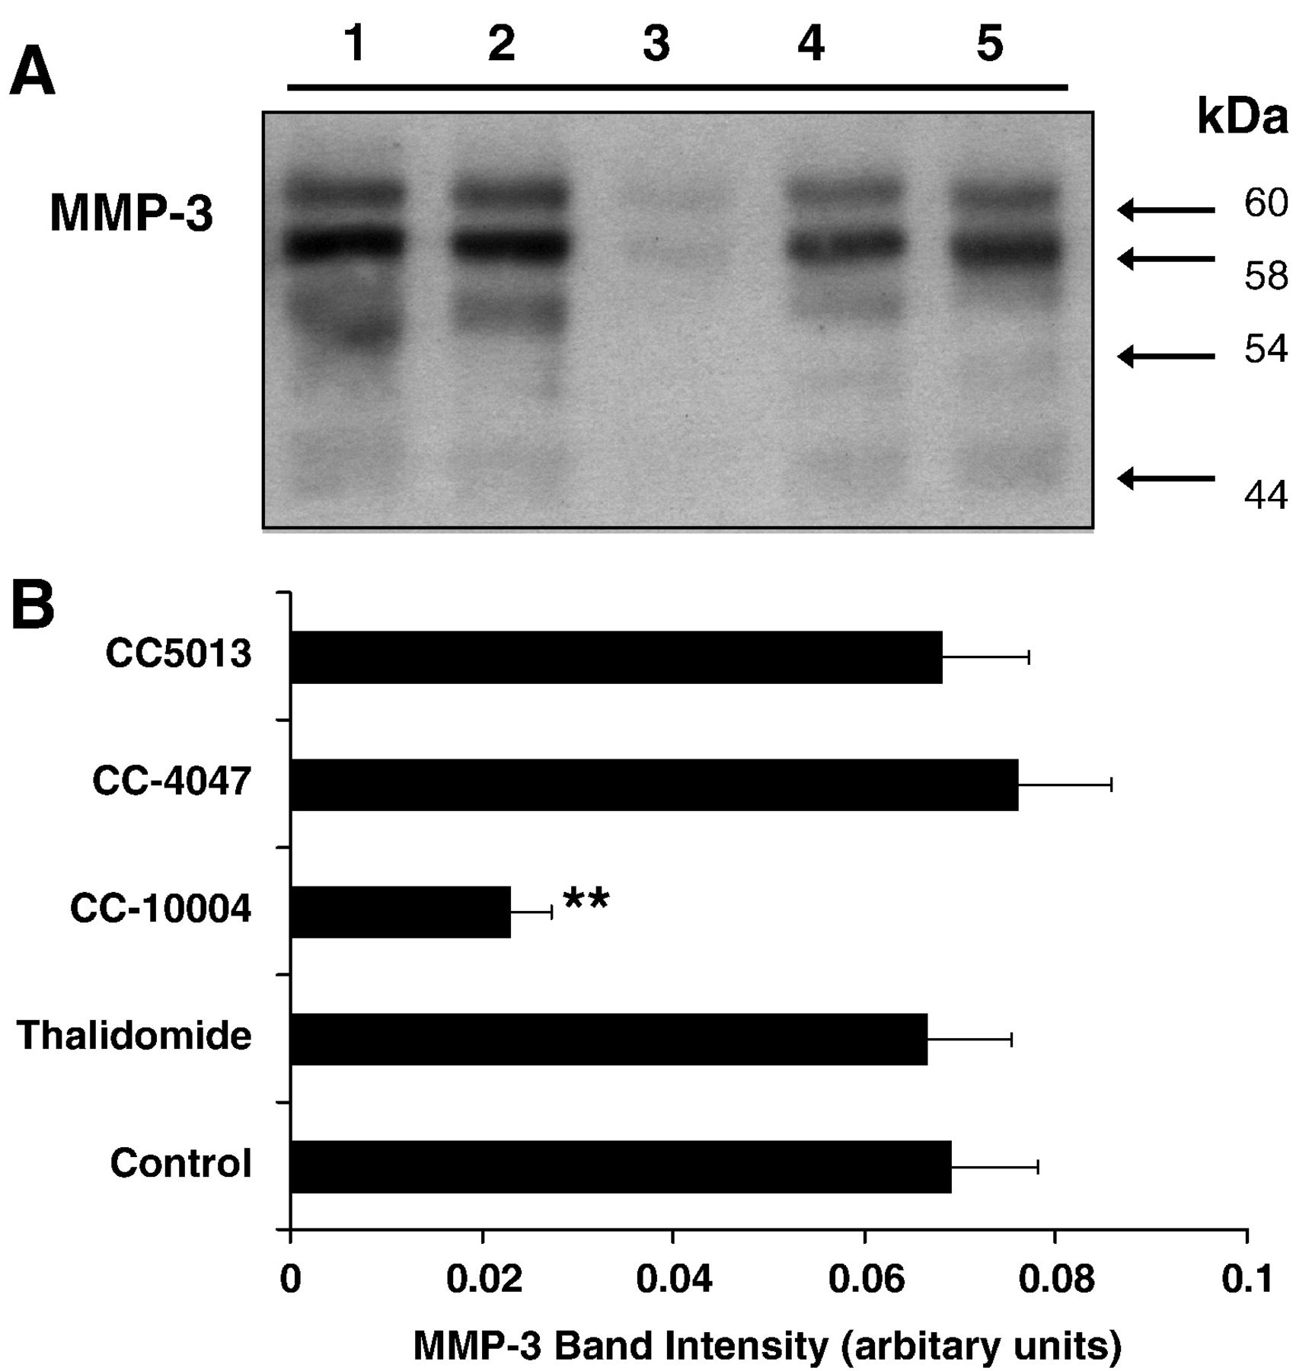
Figure 2 Effect of thalidomide, CC-10004, CC-4047, or CC-5013 on MMP-3 production by gut LPMCs. A. LPMCs were ...
Notes:
Figure 2 Effect of thalidomide, CC-10004, CC-4047, or CC-5013 on MMP-3 production by gut LPMCs. A. LPMCs were cultured with 10 μg/ml of either vehicle control (A), thalidomide (B), CC-10004 (C), CC-4047 (D) or CC-5013 (E). MMP-3 protein was detected in supernatants by western blotting. The example shown is representative of 7 separate experiments. B. Densitometry of western blots. (Data shown are mean +/− SEM, n = 7; * p < 0.01, ** p < 0.001).
Unless provided in the caption above, the following copyright applies to the content of this slide: © 2009 European Crohn's and Colitis Organisation

Slide 3
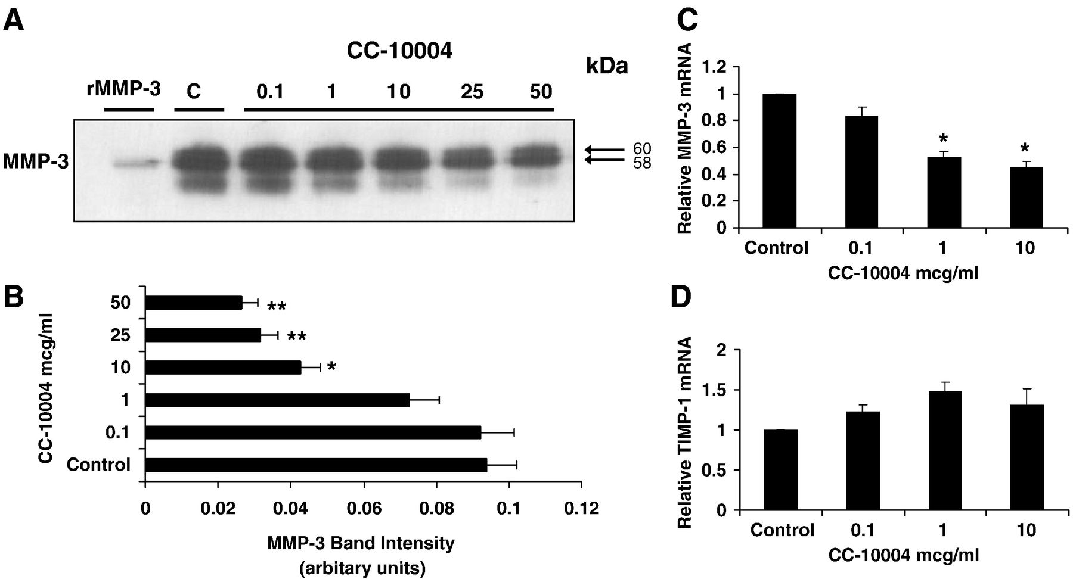
Figure 3 A. Dose response of the effect of CC-10004 on MMP-3 protein and MMP-3 and TIMP-1 mRNA production by gut ...
Notes:
Figure 3 A. Dose response of the effect of CC-10004 on MMP-3 protein and MMP-3 and TIMP-1 mRNA production by gut LPMCs. LPMCs were cultured with either vehicle control or CC-10004 in a concentration ranging from 0.1–50 μg/ml. A. MMP-3 protein was detected in supernatants by western blotting. The example shown is representative of 5 separate experiments. B. Densitometry of western blots for MMP-3 (Data represented are mean +/− SEM; * p = 0.05, ** p < 0.001 compared with control). C and D MMP-3 and TIMP-1 mRNA was quantified using realtime Taqman PCR and compared to vehicle control.
Unless provided in the caption above, the following copyright applies to the content of this slide: © 2009 European Crohn's and Colitis Organisation

Slide 4
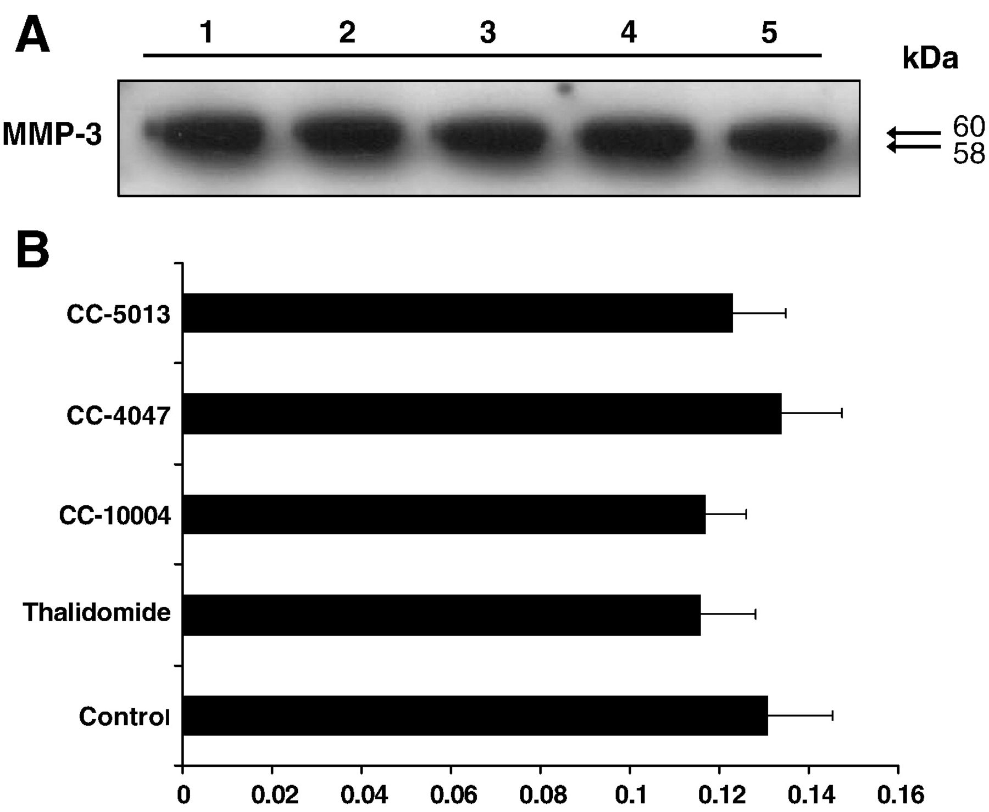
Figure 4 Effect of thalidomide, CC-10004, CC-4047, or CC-5013 on MMP-3 protein production by cultured myofibroblasts. ...
Notes:
Figure 4 Effect of thalidomide, CC-10004, CC-4047, or CC-5013 on MMP-3 protein production by cultured myofibroblasts. Myofibroblasts were cultured with vehicle control, thalidomide, CC-10004, CC-4047, or CC-5013 (all 10 μg/ml). A. MMP-3 protein in supernatant was determined by western blotting. The example shown is representative of 4 separate experiments. B. Densitometry of western blots for MMP-3 (Data represented are mean +/− SEM).
Unless provided in the caption above, the following copyright applies to the content of this slide: © 2009 European Crohn's and Colitis Organisation

