Slide 1
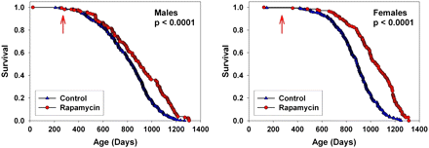
Figure 1. Survival curves comparing control to rapamycin-treated mice, pooled across sites. The p values reflect ...
Notes:
Figure 1. Survival curves comparing control to rapamycin-treated mice, pooled across sites. The p values reflect outcome of stratified log-rank test. The arrows at 270 days indicate the age at which rapamycin treatment was initiated.
Unless provided in the caption above, the following copyright applies to the content of this slide: © The Author 2010. Published by Oxford University Press on behalf of The Gerontological Society of America. All rights reserved. For permissions, please e-mail: journals.permissions@oup.com.

Slide 2
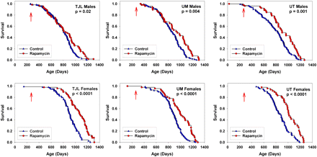
Figure 2. Survival curves for control and rapamycin-treated mice, each site plotted individually. The p values reflect ...
Notes:
Figure 2. Survival curves for control and rapamycin-treated mice, each site plotted individually. The p values reflect outcome of log-rank tests. The arrows at 270 days indicate the age at which rapamycin treatment was initiated.
Unless provided in the caption above, the following copyright applies to the content of this slide: © The Author 2010. Published by Oxford University Press on behalf of The Gerontological Society of America. All rights reserved. For permissions, please e-mail: journals.permissions@oup.com.

Slide 3
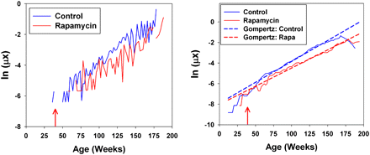
Figure 3. Raw (left) and smoothed (right) plots of the logarithm of the mortality risk for control and ...
Notes:
Figure 3. Raw (left) and smoothed (right) plots of the logarithm of the mortality risk for control and rapamycin-treated mice as a function of age. Data have been pooled across gender and test site. Dashed diagonal lines on the right panel indicate fits to the Gompertz model. Arrows at 39 weeks indicate start of rapamycin exposure.
Unless provided in the caption above, the following copyright applies to the content of this slide: © The Author 2010. Published by Oxford University Press on behalf of The Gerontological Society of America. All rights reserved. For permissions, please e-mail: journals.permissions@oup.com.

Slide 4
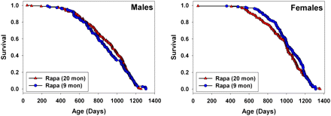
Figure 4. Comparison of survival for rapamycin administered from 9 or from 20 months of age in separate yearly cohorts, ...
Notes:
Figure 4. Comparison of survival for rapamycin administered from 9 or from 20 months of age in separate yearly cohorts, pooled across sites. See text for discussion of statistical significance tests. Data for the mice exposed to rapamycin from 20 months of age are from Harrison and colleagues (2).
Unless provided in the caption above, the following copyright applies to the content of this slide: © The Author 2010. Published by Oxford University Press on behalf of The Gerontological Society of America. All rights reserved. For permissions, please e-mail: journals.permissions@oup.com.

Slide 5
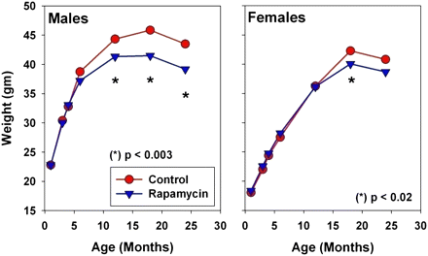
Figure 5. Body weight values for control mice and for mice exposed to rapamycin from 9 months of age. The p values ...
Notes:
Figure 5. Body weight values for control mice and for mice exposed to rapamycin from 9 months of age. The p values reflect t tests, pooling across sites, for the hypothesis that rapamycin has no effect on body weight.
Unless provided in the caption above, the following copyright applies to the content of this slide: © The Author 2010. Published by Oxford University Press on behalf of The Gerontological Society of America. All rights reserved. For permissions, please e-mail: journals.permissions@oup.com.

Slide 6
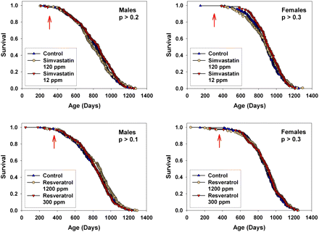
Figure 6. Survival curves for mice exposed to simvastatin from 10 months of age (top), or to resveratrol from 12 months ...
Notes:
Figure 6. Survival curves for mice exposed to simvastatin from 10 months of age (top), or to resveratrol from 12 months (bottom). Data are pooled across sites. Males are shown in the left panels, and females in the right panels. Each curve shows results for both high and low doses. The p values reflect log-rank tests, stratified by test site. None of the agents had a significant effect on life span, compared with control mice, at any dose tested. The arrows indicate the age at which the drug treatment was initiated.
Unless provided in the caption above, the following copyright applies to the content of this slide: © The Author 2010. Published by Oxford University Press on behalf of The Gerontological Society of America. All rights reserved. For permissions, please e-mail: journals.permissions@oup.com.

Slide 7
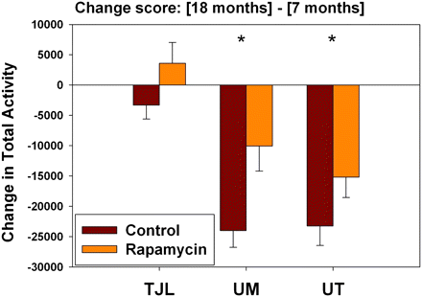
Figure 7. Age effects on total activity in male mice, comparing control to rapamycin-treated mice. The y-axis shows ...
Notes:
Figure 7. Age effects on total activity in male mice, comparing control to rapamycin-treated mice. The y-axis shows change score, calculated as (activity at 18 months) minus (activity at 7 months in the same mouse). A negative score indicates that the mouse was less active at 18 than at 7 months. (For comparison, the number of beam breaks at 7 months of age for males was approximately 45,000 at The Jackson Laboratory [TJL], 75,000 at University of Michigan [UM], and 71,000 at University of Texas [UT].) The bars show mean and SEM for the change scores. Number of mice tested: 35, 43, and 43 controls and 19, 19, 24 rapamycin-treated mice at TJL, UM, UT, respectively. Asterisks indicate a significant difference between control and rapamycin males at p = .004 at UM and p = .04 at UT.
Unless provided in the caption above, the following copyright applies to the content of this slide: © The Author 2010. Published by Oxford University Press on behalf of The Gerontological Society of America. All rights reserved. For permissions, please e-mail: journals.permissions@oup.com.

