Slide 1
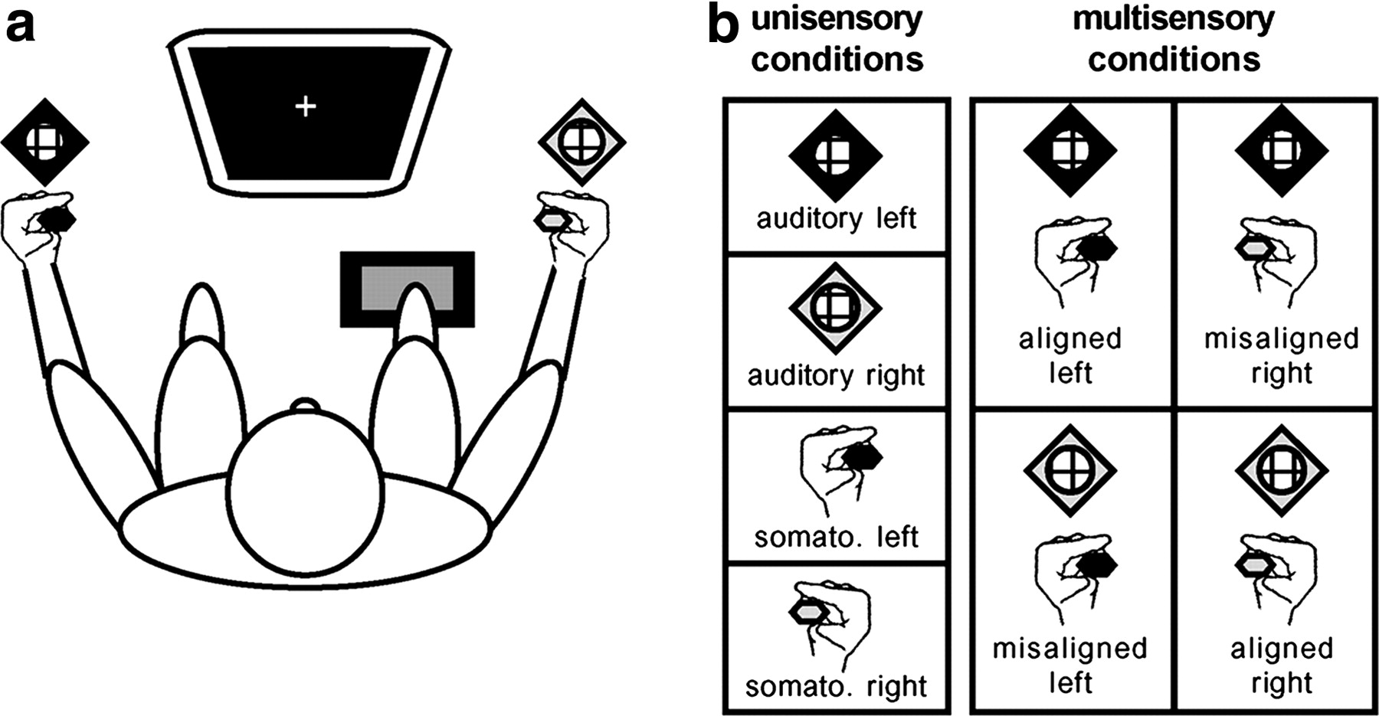
Figure 1. Experimental paradigm. (a) Subjects sat comfortably in a darkened room, centrally fixating a computer monitor ...
Notes:
Figure 1. Experimental paradigm. (a) Subjects sat comfortably in a darkened room, centrally fixating a computer monitor and responding via a foot pedal. Vibrotactile stimulators were held between the thumb and index finger of each hand, as subjects rested their arms on those of the chair. Speakers were placed next to each hand. Left-sided stimuli are coded by black symbols, and right-sided by white symbols. (b) Stimulus conditions. There were a total of eight stimulus conditions: four unisensory and four multisensory. Multisensory conditions counterbalanced spatially aligned and misaligned combinations.
Unless provided in the caption above, the following copyright applies to the content of this slide: Cerebral Cortex V 15 N 7 © Oxford University Press 2004; all rights reserved

Slide 2
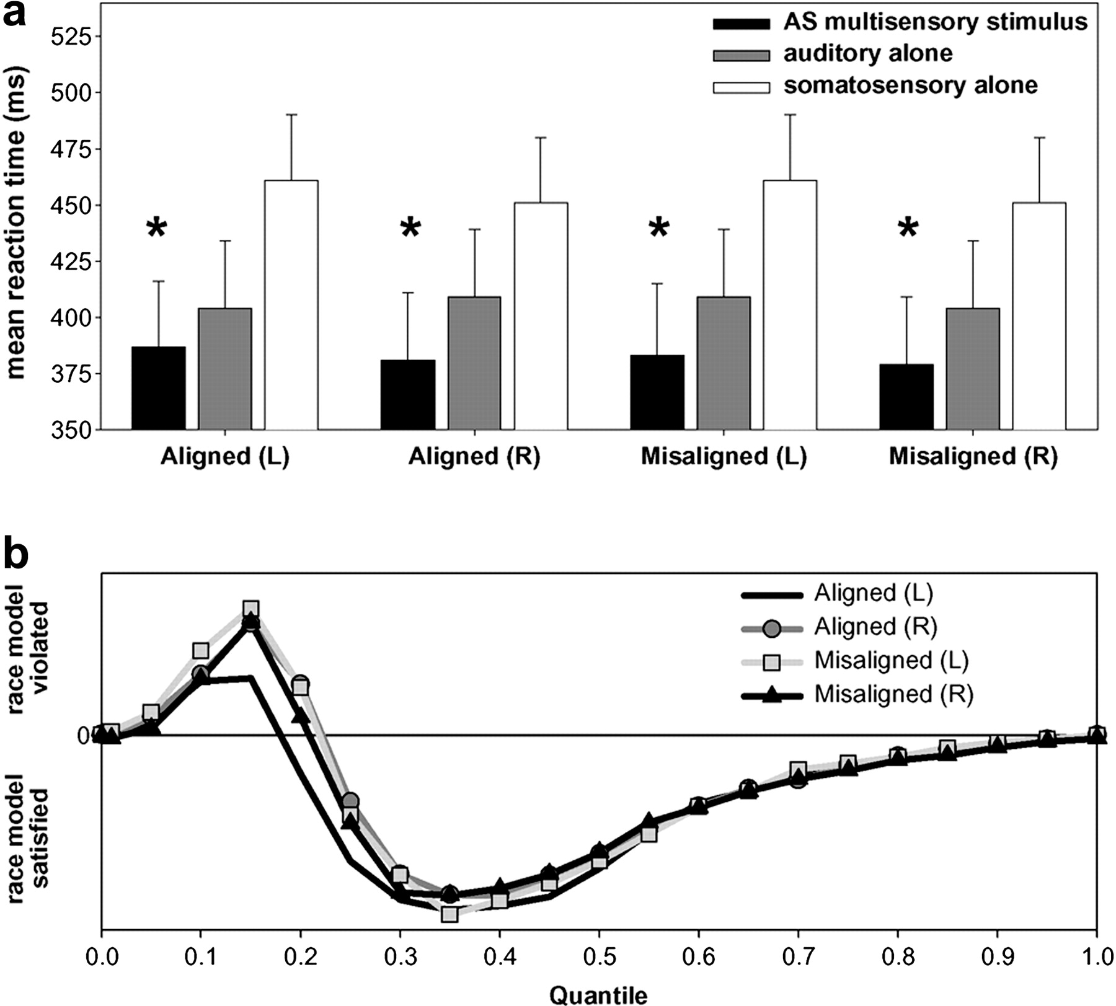
Figure 2. Behavioral results. (a) Mean reaction times (standard error shown) for auditory–somatosensory multisensory ...
Notes:
Figure 2. Behavioral results. (a) Mean reaction times (standard error shown) for auditory–somatosensory multisensory pairs (black bars) and the corresponding auditory and somatosensory unisensory stimuli (gray and white bars respectively). Asterisks indicate that a redundant signals effect was observed for all spatial combinations. (b) Results of applying Miller's (1982) inequality to the cumulative probability of reaction times to each of multisensory stimulus conditions and unisensory counterparts. This inequality tests the observed reaction time distribution against that predicted by probability summation of the race model. Positive values indicate violation of the race model, and negative its satisfaction.
Unless provided in the caption above, the following copyright applies to the content of this slide: Cerebral Cortex V 15 N 7 © Oxford University Press 2004; all rights reserved

Slide 3
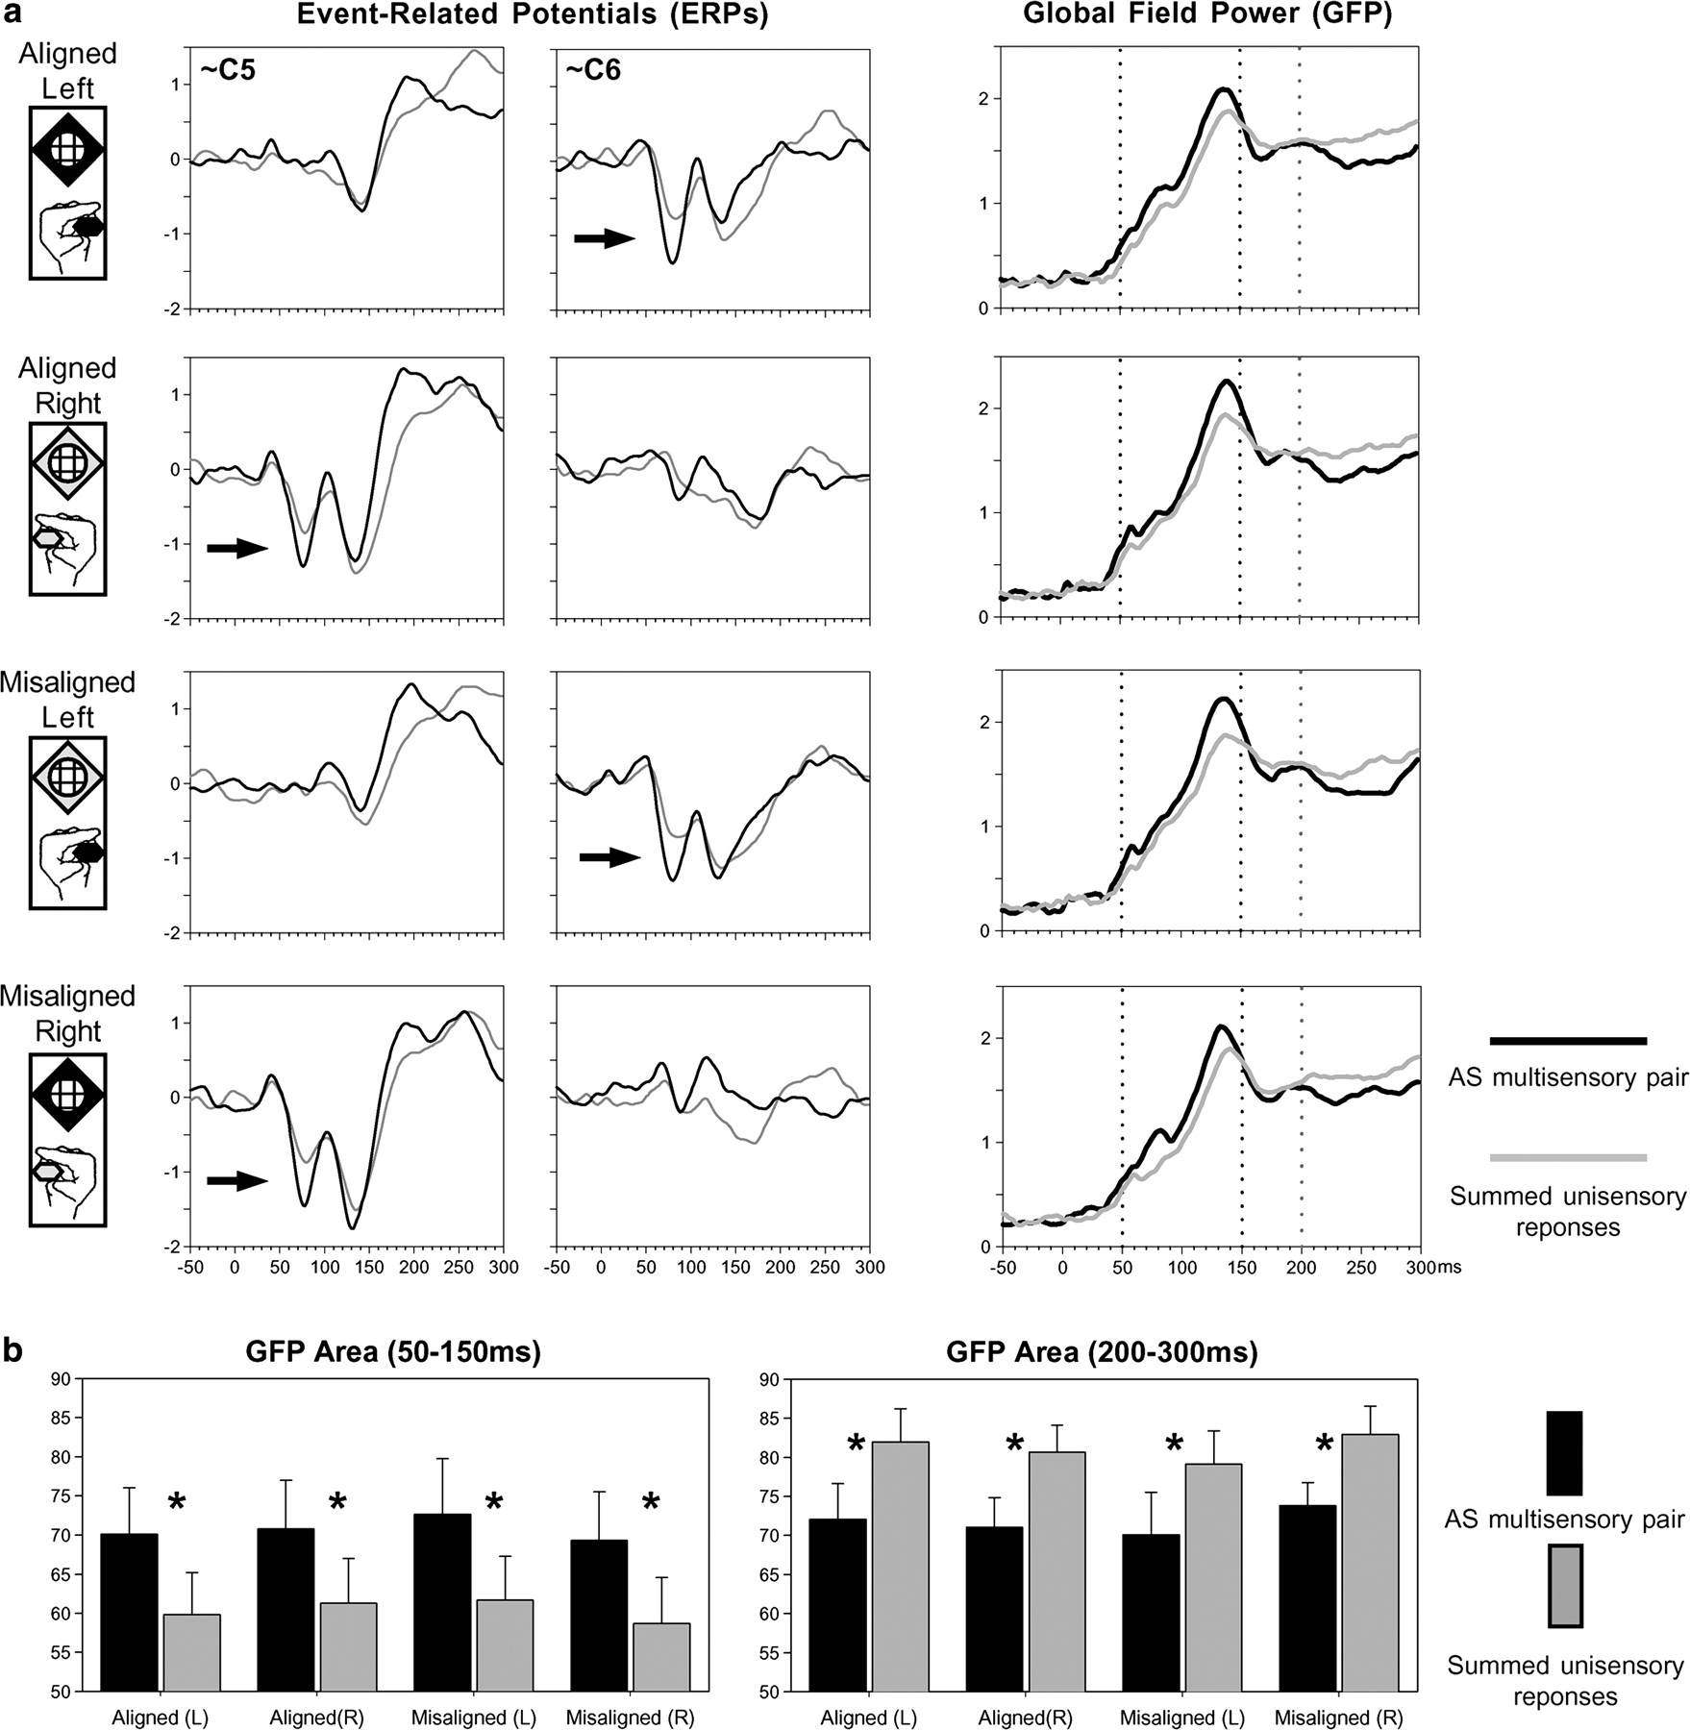
Figure 3. Waveform analyses. (a) Group-averaged (n = 8) ERPs from selected electrodes over the lateral central scalp ...
Notes:
Figure 3. Waveform analyses. (a) Group-averaged (n = 8) ERPs from selected electrodes over the lateral central scalp (left) reveal the presence of early, nonlinear multisensory neural response interactions over the hemiscalp contralateral to the stimulated hand (arrows). Multisensory interactions were statistically assessed from the group-averaged global field power (right), which revealed two periods of neural response interaction. (b) Mean GFP area over the 50–150 ms and 200–300 ms periods (left and right respectively) for each spatial combination.
Unless provided in the caption above, the following copyright applies to the content of this slide: Cerebral Cortex V 15 N 7 © Oxford University Press 2004; all rights reserved

Slide 4
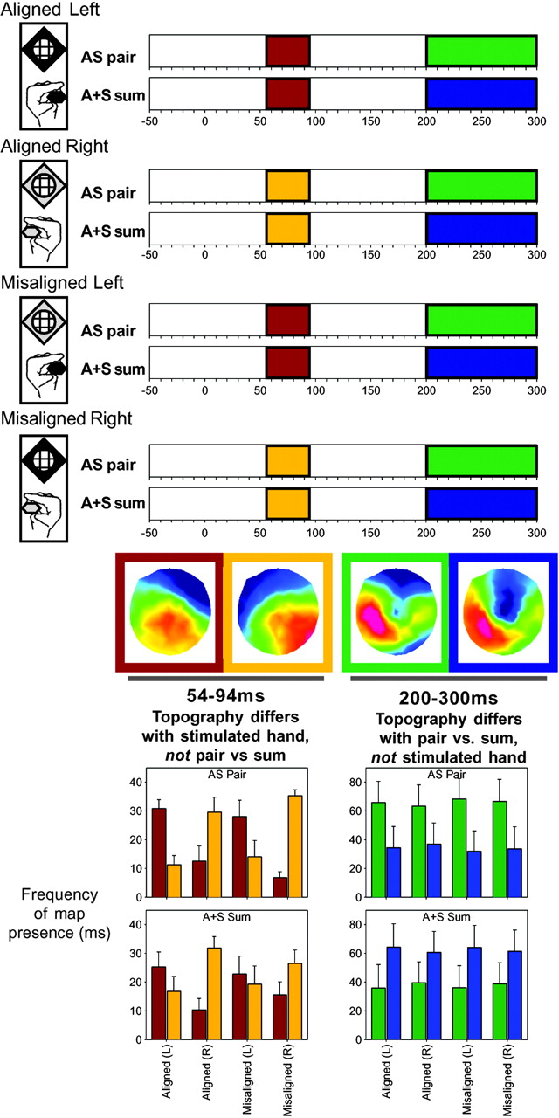
Figure 4. Results of the spatio-temporal topographic pattern analysis of the scalp electric field for each of the AS ...
Notes:
Figure 4. Results of the spatio-temporal topographic pattern analysis of the scalp electric field for each of the AS pair and A+S sum ERPs. Over the 54–94 ms period, different scalp topographies were observed for conditions involving somatosensory stimulation of the left and right hand (red and gold bars respectively). These maps are shown in similarly colored frames, and their respective presence in the data of individual subjects was statistically assessed with a fitting procedure (left bar graph). Over the 200–300 ms period, different scalp topographies were observed for multisensory stimulus pairs versus summed responses from the constituent unisensory stimuli (green and blue bars respectively).
Unless provided in the caption above, the following copyright applies to the content of this slide: Cerebral Cortex V 15 N 7 © Oxford University Press 2004; all rights reserved

Slide 5
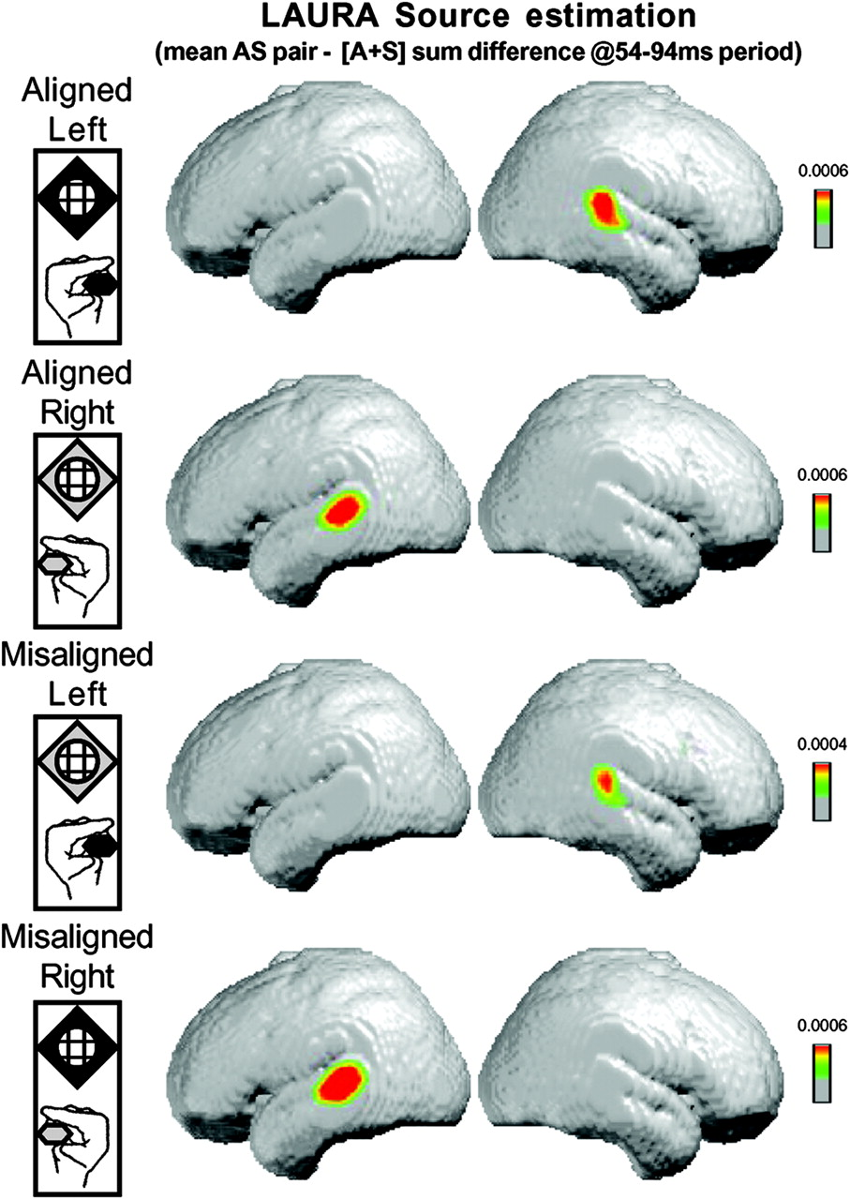
Figure 5. Results of the LAURA linear distributed inverse solution averaged across subjects for the difference between ...
Notes:
Figure 5. Results of the LAURA linear distributed inverse solution averaged across subjects for the difference between simultaneous auditory–somatosensory stimulation and the summed responses from the constituent unisensory conditions. For each AS stimulus combination (see insets on left), this source estimation revealed activity in the posterior superior temporal lobe contralateral to the hand of somatosensory stimulation (see text for full details).
Unless provided in the caption above, the following copyright applies to the content of this slide: Cerebral Cortex V 15 N 7 © Oxford University Press 2004; all rights reserved

