Slide 1
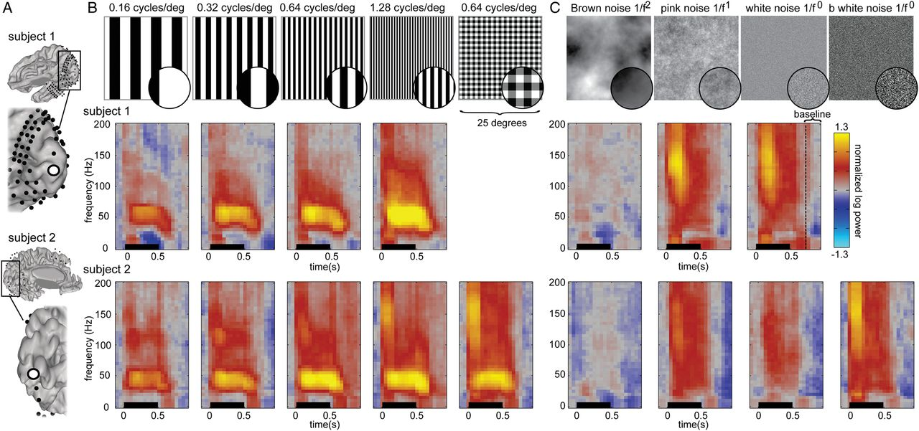
Figure 1. Time–frequency power estimates in V1/V2 for gratings and noise stimuli. (A) ECoG electrode locations in ...
Notes:
Figure 1. Time–frequency power estimates in V1/V2 for gratings and noise stimuli. (A) ECoG electrode locations in Subjects 1 and 2. (B) Grating stimuli were presented for 500 ms, insets in circles show a magnified portion of the stimuli for visibility. Time–frequency power estimates (“spectrograms”) from an electrode in V1/V2 from Subject 1 (top row) and Subject 2 (bottom row). (C) Noise patterns were presented for 500 ms. Spectrograms from the same early visual electrode in Subject 1 (top row) and Subject 2 (bottom row). All spectrograms are normalized with respect to the same baseline: the inter-stimulus interval between all trials (from 750–1000 ms after stimulus onset). Spectrograms are cut off at a maximum of ±1.3 log10 units. The multitaper approach results in a temporal smoothing of 200 ms and a frequency smoothing of ±15 Hz. Spectrograms represent averages across all trials of a given type.
Unless provided in the caption above, the following copyright applies to the content of this slide: © The Author 2014. Published by Oxford University Press. All rights reserved. For Permissions, please e-mail: journals.permissions@oup.com

Slide 2
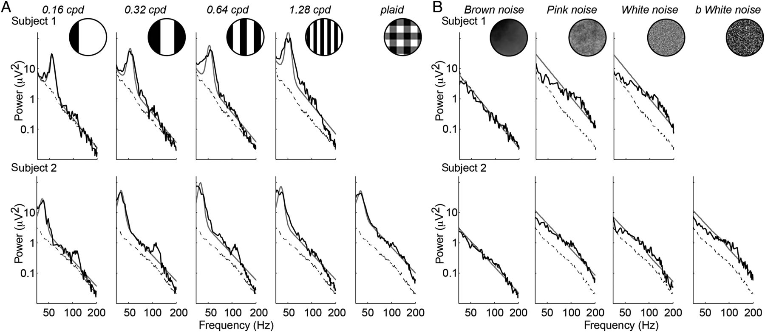
(1) Power spectra in V1/V2 for gratings and noise stimuli. Power spectra to the grating stimuli for the same ...
Notes:
(1) Power spectra in V1/V2 for gratings and noise stimuli. Power spectra to the grating stimuli for the same electrodes shown in Figure 1 on a log–log plot (top, Subject 1; bottom, Subject 2). The black line shows the power spectrum from the grating stimuli (A) and noise stimuli (B). The dashed line shows the power spectrum from the baseline periods. A line plus Gaussian (model) was fitted to the average power spectra of each condition (data) in log–log space, resulting in one weight for broadband and one weight for narrowband increases relative to baseline. The fit from this model is plotted in gray.
Unless provided in the caption above, the following copyright applies to the content of this slide: © The Author 2014. Published by Oxford University Press. All rights reserved. For Permissions, please e-mail: journals.permissions@oup.com

Slide 3
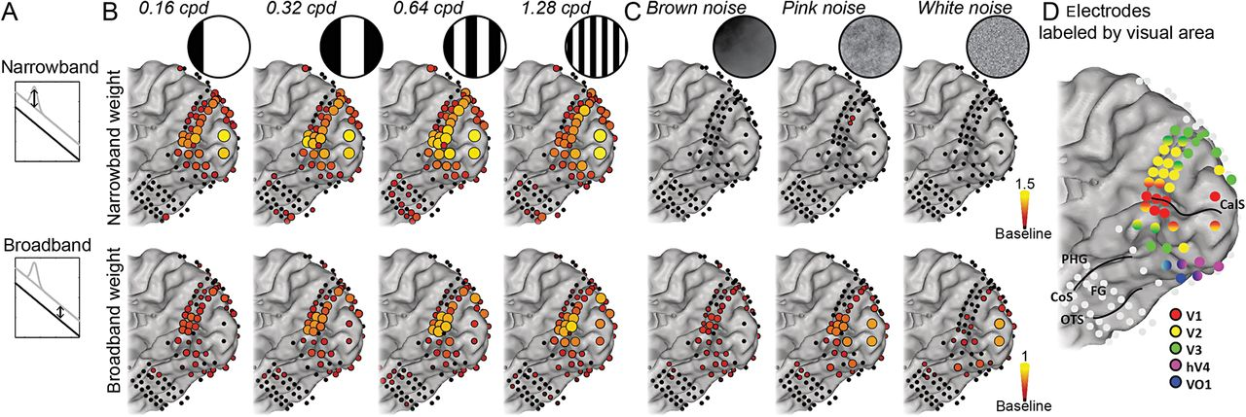
Figure 3. Spatial distribution of narrowband (gamma) and broadband weights. (A) Spectral power changes during visual ...
Notes:
Figure 3. Spatial distribution of narrowband (gamma) and broadband weights. (A) Spectral power changes during visual stimulation compared with baseline were separated in increases in narrowband gamma rhythms and broadband increases by fitting a power law shape with a Gaussian. (B) Spatial distribution of narrowband gamma (top) and broadband weights (bottom) in Subject 1 during grating stimuli. (C) Spatial distribution of narrowband gamma (top) and broadband weights (bottom) in Subject 1 during noise stimuli. Electrodes that showed a significant increase compared with baseline are plotted in color on the rendered brain surface (P < 0.05 uncorrected). (D) ECoG electrodes labeled by visual field mapping experiment (Winawer et al. 2013). CalS = calcarine sulcus, PHG = parahippocampal gyrus, CoS = collateral sulcus, FG = fusiform gyrus, and OTS = occipital-temporal sulcus.
Unless provided in the caption above, the following copyright applies to the content of this slide: © The Author 2014. Published by Oxford University Press. All rights reserved. For Permissions, please e-mail: journals.permissions@oup.com

Slide 4
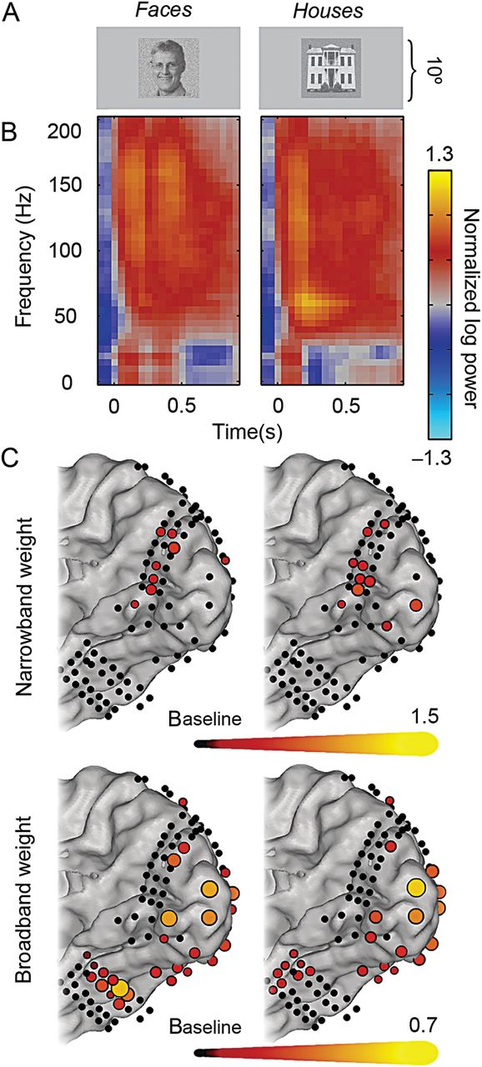
Figure 4. Spectral power changes during face and house viewing. (A) Examples of face and house stimuli presented during ...
Notes:
Figure 4. Spectral power changes during face and house viewing. (A) Examples of face and house stimuli presented during experiment 2. (B) Spectrograms from an early visual electrode in Subject 1 (Fig. 1A) while seeing faces (left) and houses (right). (C) Spatial distribution of significant increases in narrowband and broadband weights (P < 0.05 uncorrected). Early visual areas show little or no narrowband gamma increases while viewing faces (top left) and houses (top right), but large increases in broadband power (bottom). The fusiform gyrus and parahippocampal gyrus show significant broadband increases, but no gamma increases, while viewing faces and houses, respectively.
Unless provided in the caption above, the following copyright applies to the content of this slide: © The Author 2014. Published by Oxford University Press. All rights reserved. For Permissions, please e-mail: journals.permissions@oup.com

Slide 5
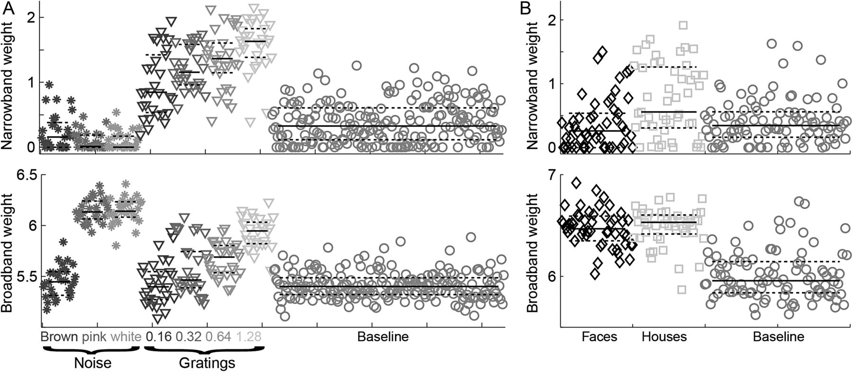
Figure 5. Narrowband (gamma) and broadband power in individual trials. (A) Increases in narrowband gamma (top row) and ...
Notes:
Figure 5. Narrowband (gamma) and broadband power in individual trials. (A) Increases in narrowband gamma (top row) and broadband (bottom row) in a V1/V2 electrode in Subject 1 during all individual trials of Experiment 1. Horizontal bars indicate the median (solid) and quartiles (dotted) for each condition. (B) The same for Experiment 2. This electrode shows increased gamma oscillations for only some face and house stimuli, it shows a broadband increase for almost all stimuli.
Unless provided in the caption above, the following copyright applies to the content of this slide: © The Author 2014. Published by Oxford University Press. All rights reserved. For Permissions, please e-mail: journals.permissions@oup.com

Slide 6
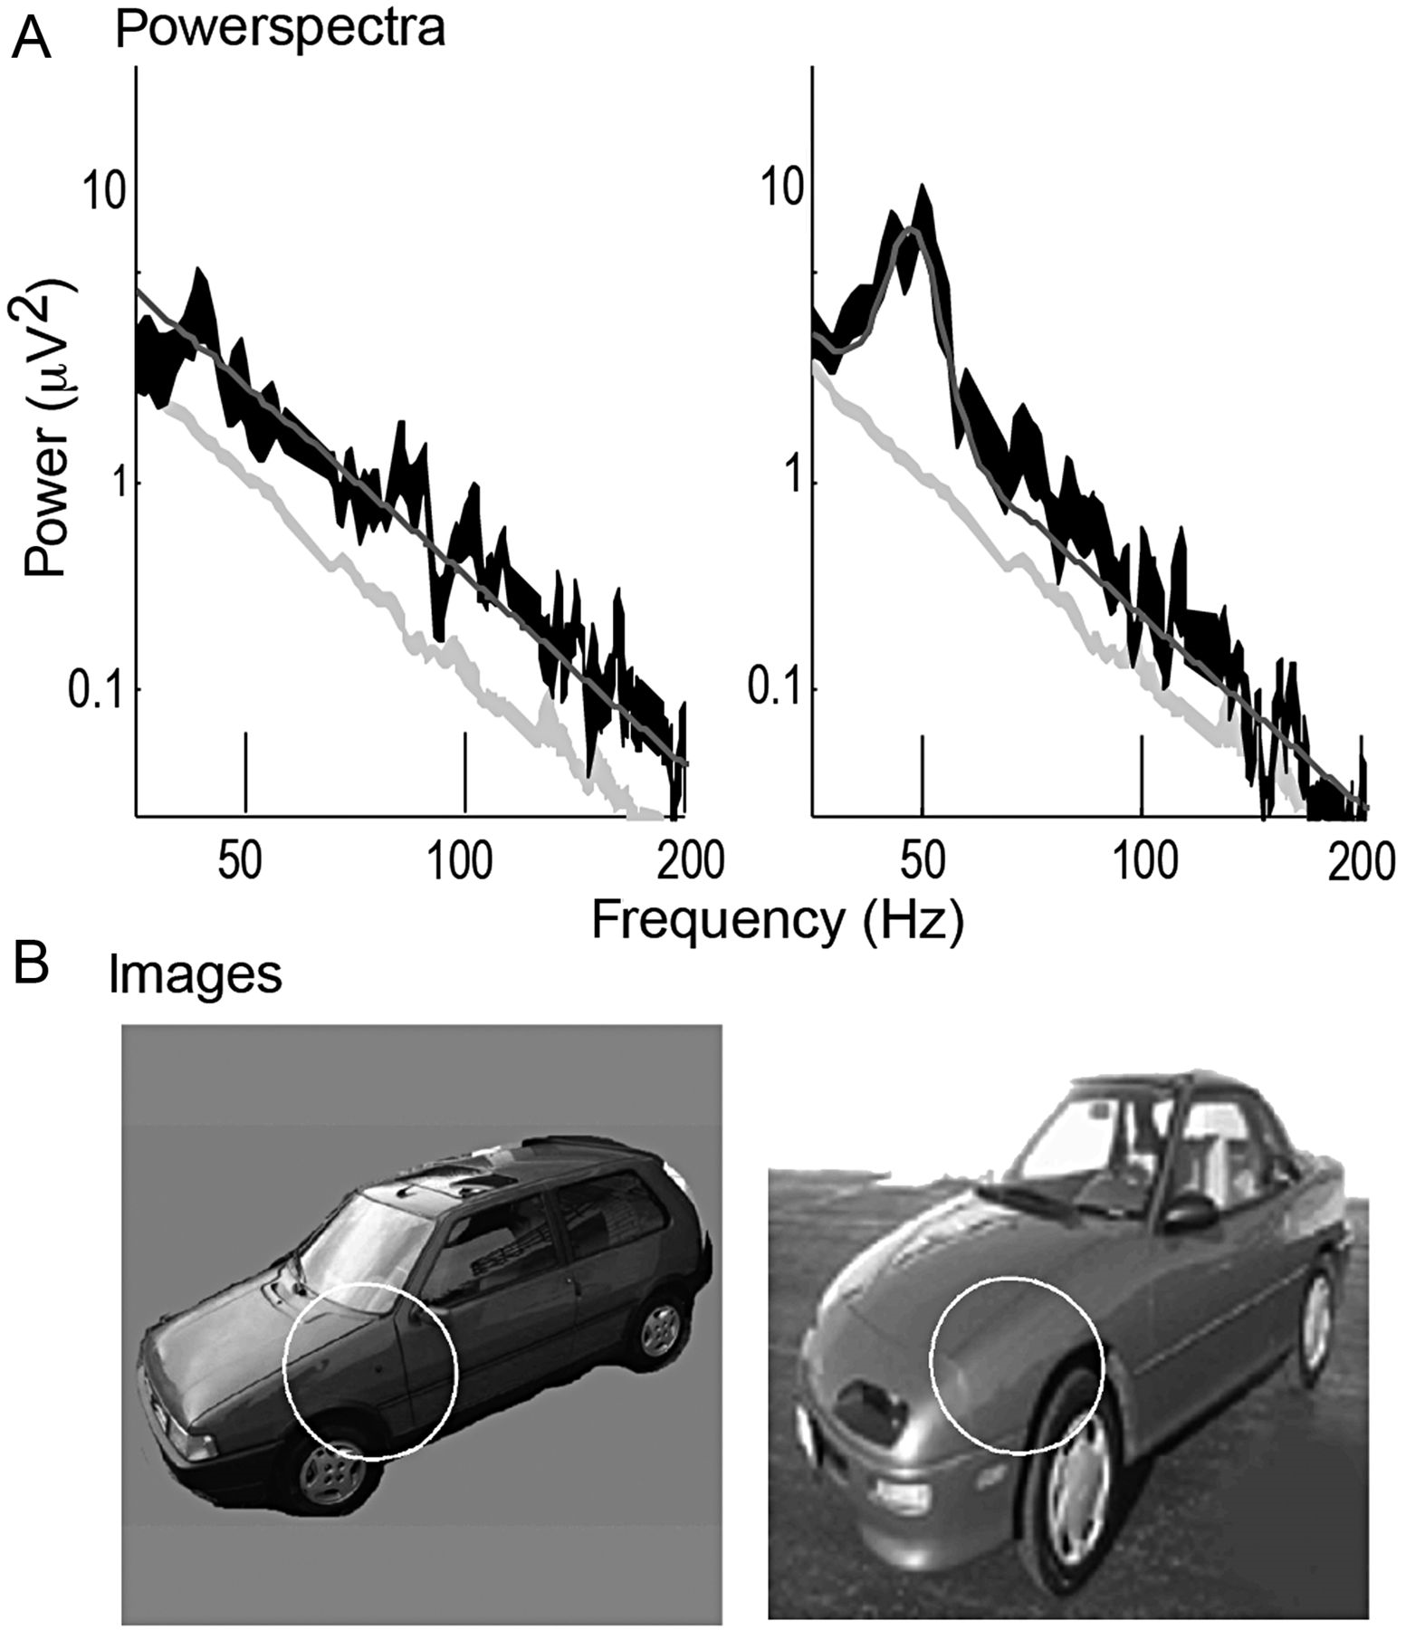
Figure 6. Two example stimuli that induced different levels of narrowband gamma power in V1. (A) Power spectra from a ...
Notes:
Figure 6. Two example stimuli that induced different levels of narrowband gamma power in V1. (A) Power spectra from a foveal V1 electrode for 2 example stimuli (from a set of 72 stimuli, see Supplementary Data) that were shown to a separate subject in a prior study (Parvizi et al. 2012). Each stimulus was shown 6 times in random order. The 95% confidence intervals are shown in black and the baseline periods are shown in light gray. The baseline is identical for all images. The model fits (power law plus Gaussian) are plotted as a dark gray line. (B) The 2 images with the population receptive field (pRF) from the measured electrode indicated by a white circle (2 SD of the pRF Gaussian). The pRF models were obtained from a prior study (Winawer et al. 2013). The car image on the left elicited only a broadband response but no clear gamma oscillation. The car image on the right elicited both a broadband response and a large gamma oscillation.
Unless provided in the caption above, the following copyright applies to the content of this slide: © The Author 2014. Published by Oxford University Press. All rights reserved. For Permissions, please e-mail: journals.permissions@oup.com

