Slide 1
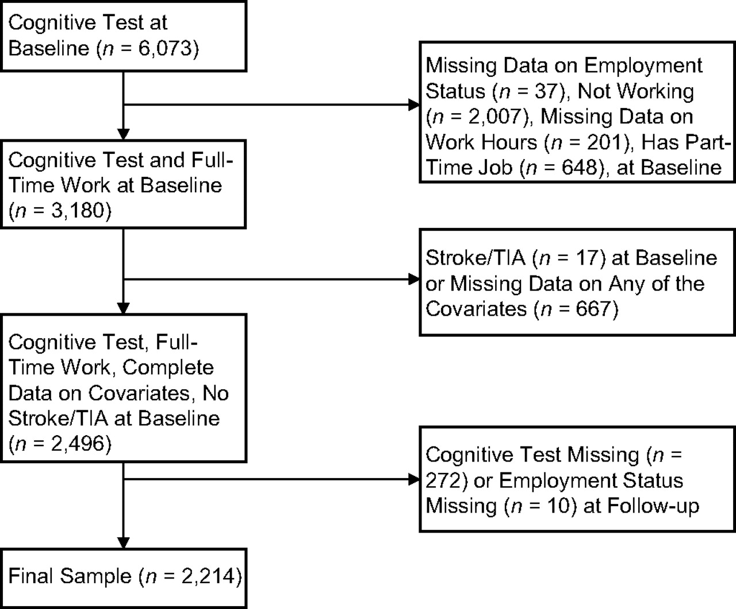
Figure 1. Sample selection, the Whitehall II study, 1997–2004. TIA, transient ischemic attack.
Notes:
Figure 1. Sample selection, the Whitehall II study, 1997–2004. TIA, transient ischemic attack.
Unless provided in the caption above, the following copyright applies to the content of this slide: American Journal of Epidemiology © The Author 2009. Published by the Johns Hopkins Bloomberg School of Public Health. All rights reserved. For permissions, please e-mail: journals.permissions@oxfordjournals.org.

