Slide 1
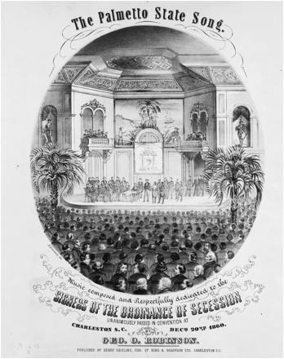
Figure 1. On December 20, 1860, delegates to the South Carolina state convention voted to secede from the Union. Their ...
Notes:
Figure 1. On December 20, 1860, delegates to the South Carolina state convention voted to secede from the Union. Their declaration issued four days later makes it clear that defense of the institution of slavery was their prime motivation. But like many subsequent historical accounts, “The Palmetto State Song,” written in 1861 by George O. Robinson, obscured the key role of slavery. Instead, it promoted the view that secession flowed from the desire of South Carolinian “freemen” for “liberty” from a “power that threatens our peace.” (Courtesy of Library of Congress)
Unless provided in the caption above, the following copyright applies to the content of this slide: © The Author 2011. Published by Oxford University Press on behalf of the Organization of American Historians. All rights reserved. For permissions, please e-mail: journals.permissions@oup.com

Slide 2
Figure 2. Teachers may want to have students contemplate the South Carolina state seal, adopted in 1776, when analyzing ...
Notes:
Figure 2. Teachers may want to have students contemplate the South Carolina state seal, adopted in 1776, when analyzing secession. In the left portion of the seal, a palmetto tree representing South Carolina is bound to twelve pikes that symbolize the other former colonies. They are united by a banner in Latin whose text—“Quis separabit?”—means “Who Shall Separate [Us]?” In the historical narrative that begins its “Declaration of Causes,” delegates never let on that such thinking ever existed within South Carolina. (Courtesy of South Carolina Government Webmasters Association)
Unless provided in the caption above, the following copyright applies to the content of this slide: © The Author 2011. Published by Oxford University Press on behalf of the Organization of American Historians. All rights reserved. For permissions, please e-mail: journals.permissions@oup.com

Slide 3
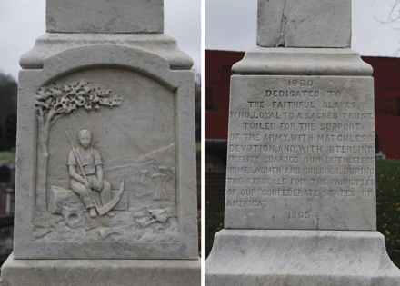
Figure 3. During the Nadir of race relations, from 1890 to 1940, neo-Confederates rewrote the history of secession to ...
Notes:
Figure 3. During the Nadir of race relations, from 1890 to 1940, neo-Confederates rewrote the history of secession to minimize the role played by slavery and to burnish the image of slavery itself. They also built memorials such as this obelisk erected in Fort Mill, South Carolina in 1895 by the Jefferson Davis Memorial Association. At left, its south-facing side depicts an enslaved field hand resting comfortably. At right, the text heralds the “matchless devotion” and “sterling fidelity” of enslaved people to their masters and to the Confederacy. (Photograph by Michael Sean Nix; Courtesy of )
Unless provided in the caption above, the following copyright applies to the content of this slide: © The Author 2011. Published by Oxford University Press on behalf of the Organization of American Historians. All rights reserved. For permissions, please e-mail: journals.permissions@oup.com

Slide 4
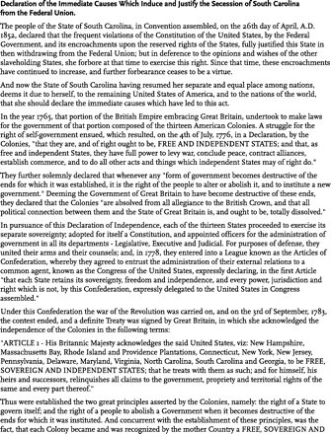
Figure 4. Adopted by the Convention of the People of South Carolina on December 24, 1861, four days after delegates ...
Notes:
Figure 4. Adopted by the Convention of the People of South Carolina on December 24, 1861, four days after delegates voted to secede, this document lays out in detail the political justification for leaving the Union. Its primary author, Charles G. Memminger, was a member of the committee assigned to draft the declaration by Convention president David F. Jamison. Though it does address constitutional matters, this document makes it clear that the institution of slavery was central to the thinking of South Carolina secessionists. (Courtesy of South Carolina Department of Archives and History)
Unless provided in the caption above, the following copyright applies to the content of this slide: © The Author 2011. Published by Oxford University Press on behalf of the Organization of American Historians. All rights reserved. For permissions, please e-mail: journals.permissions@oup.com

Slide 5
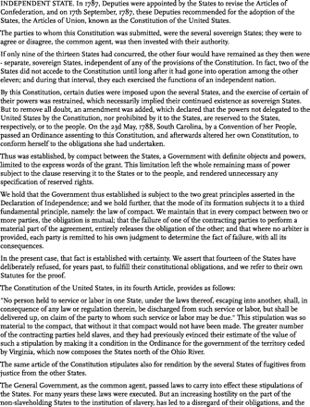
Figure 4. Adopted by the Convention of the People of South Carolina on December 24, 1861, four days after delegates ...
Notes:
Figure 4. Adopted by the Convention of the People of South Carolina on December 24, 1861, four days after delegates voted to secede, this document lays out in detail the political justification for leaving the Union. Its primary author, Charles G. Memminger, was a member of the committee assigned to draft the declaration by Convention president David F. Jamison. Though it does address constitutional matters, this document makes it clear that the institution of slavery was central to the thinking of South Carolina secessionists. (Courtesy of South Carolina Department of Archives and History)
Unless provided in the caption above, the following copyright applies to the content of this slide: © The Author 2011. Published by Oxford University Press on behalf of the Organization of American Historians. All rights reserved. For permissions, please e-mail: journals.permissions@oup.com

Slide 6
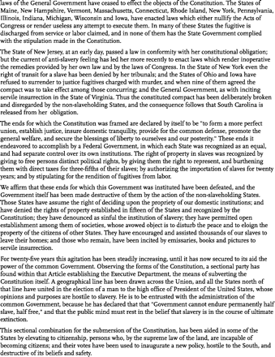
Figure 4. Adopted by the Convention of the People of South Carolina on December 24, 1861, four days after delegates ...
Notes:
Figure 4. Adopted by the Convention of the People of South Carolina on December 24, 1861, four days after delegates voted to secede, this document lays out in detail the political justification for leaving the Union. Its primary author, Charles G. Memminger, was a member of the committee assigned to draft the declaration by Convention president David F. Jamison. Though it does address constitutional matters, this document makes it clear that the institution of slavery was central to the thinking of South Carolina secessionists. (Courtesy of South Carolina Department of Archives and History)
Unless provided in the caption above, the following copyright applies to the content of this slide: © The Author 2011. Published by Oxford University Press on behalf of the Organization of American Historians. All rights reserved. For permissions, please e-mail: journals.permissions@oup.com

Slide 7
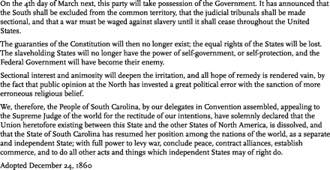
Figure 4. Adopted by the Convention of the People of South Carolina on December 24, 1861, four days after delegates ...
Notes:
Figure 4. Adopted by the Convention of the People of South Carolina on December 24, 1861, four days after delegates voted to secede, this document lays out in detail the political justification for leaving the Union. Its primary author, Charles G. Memminger, was a member of the committee assigned to draft the declaration by Convention president David F. Jamison. Though it does address constitutional matters, this document makes it clear that the institution of slavery was central to the thinking of South Carolina secessionists. (Courtesy of South Carolina Department of Archives and History)
Unless provided in the caption above, the following copyright applies to the content of this slide: © The Author 2011. Published by Oxford University Press on behalf of the Organization of American Historians. All rights reserved. For permissions, please e-mail: journals.permissions@oup.com

