Slide 1
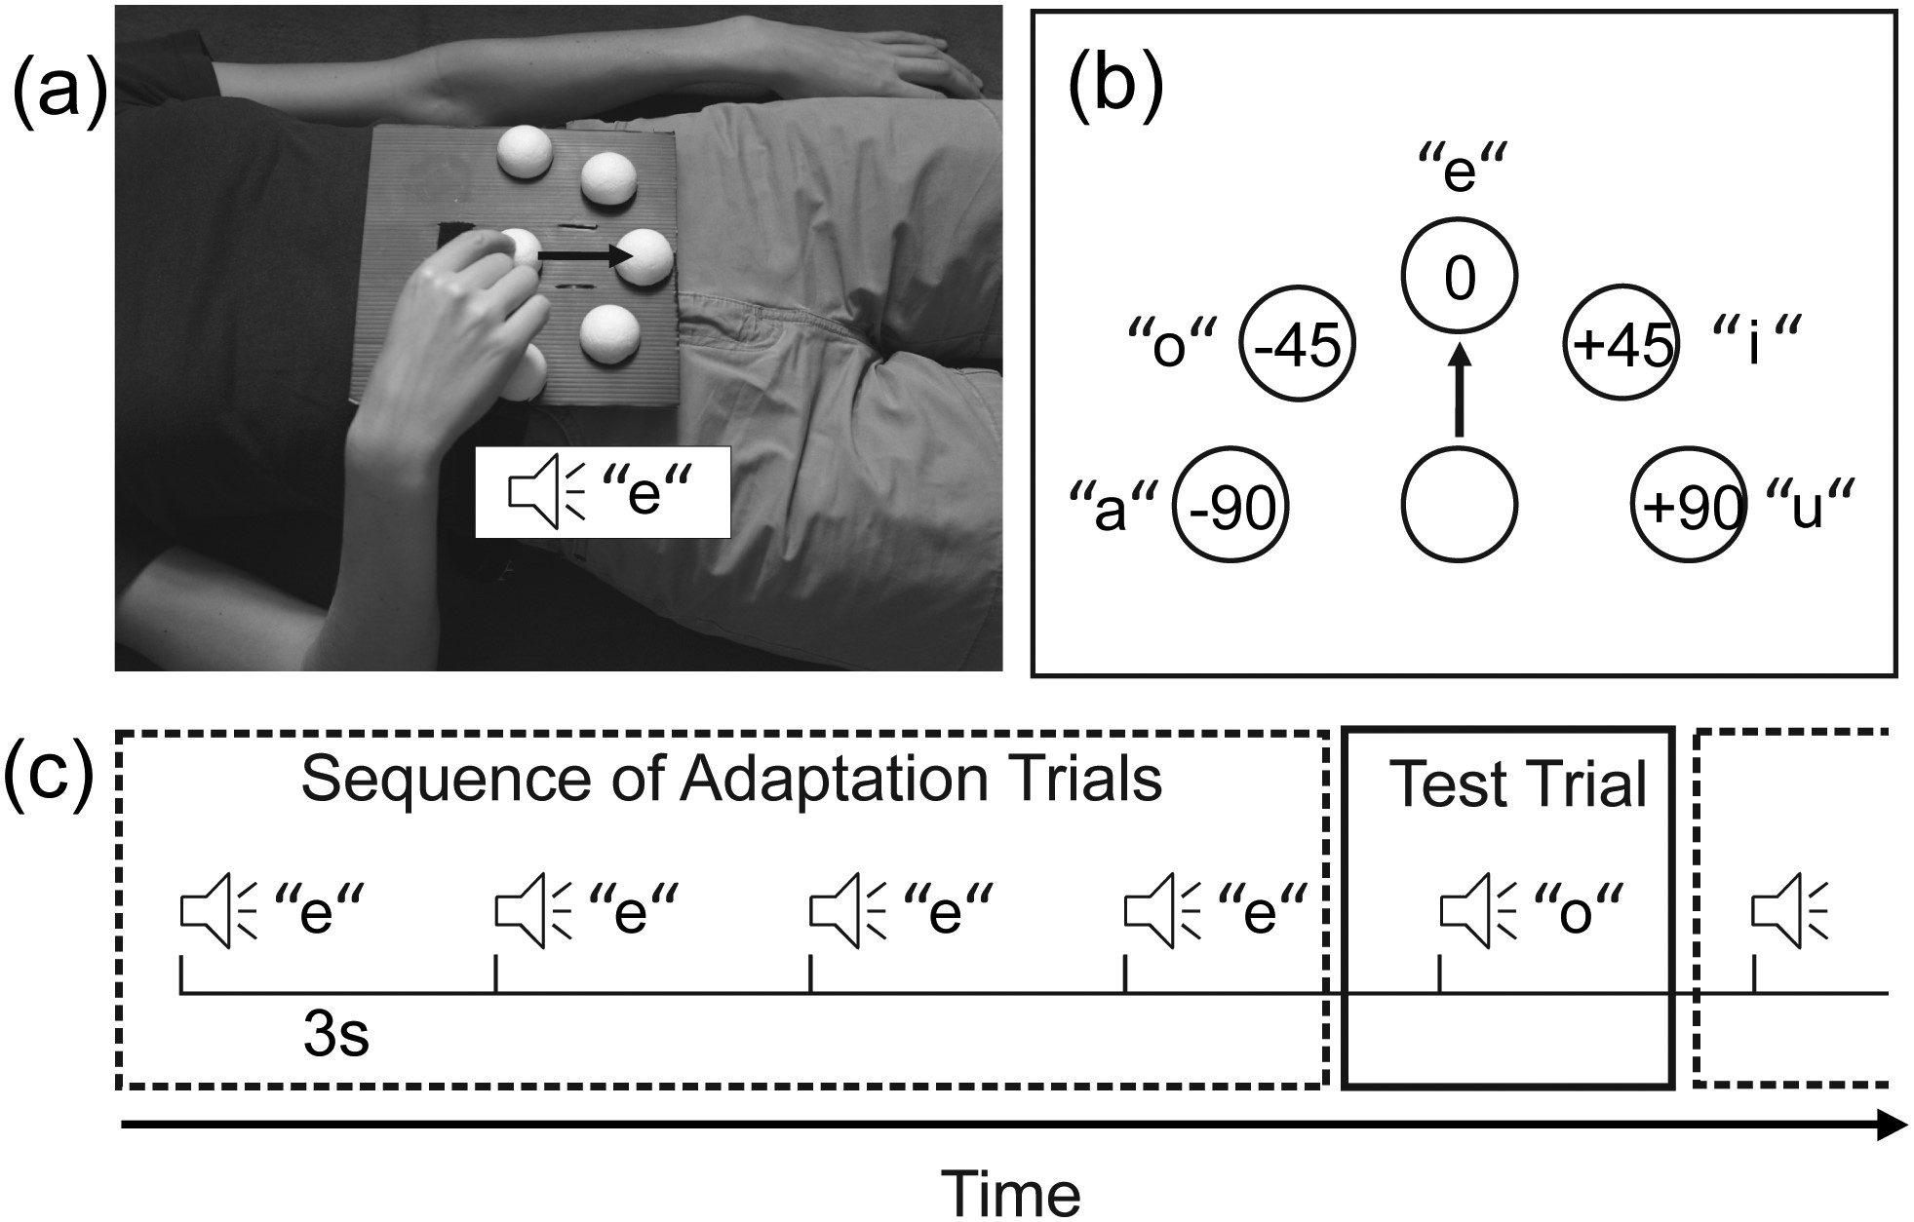
Figure 1. Experimental setup and behavioral task. (a) The response device used in the experiment. The device consists ...
Notes:
Figure 1. Experimental setup and behavioral task. (a) The response device used in the experiment. The device consists of a board with target locations and the starting location marked with plastic half-spheres. The response device was strapped to the lower torso of the subject. During the experiment, participants lay on their back in the fMRI scanner, and could not see their hand while performing the required reaching actions at the target locations. At the beginning of each trial, participants had the index finger of their right hand resting at the target location. The target location and the Type of Motor Act to be performed were indicated by an auditory cue. The cue consisted of a vowel pronounced by a male or a female speaker. The gender of the speaker indicated the Type of Motor Act (Point, Grasp), and each vowel corresponded to one of the 5 different reach directions. (b) A schematic layout of the target locations on the response device. Reach directions during test trials represented different angular deviations from the adapted direction (−90, −45, 0, +45, +90°). Note that the vowels used as instructions followed the Chinese alphabetical order from the left-most to the right-most (i.e. a, o, e, i, and u) target location. (c) Participants performed a variable number of adaptation trials (pointing, Reach Direction 0°), which were followed by a single test trial that differed in the Reach Direction, the Type of Motor Act, or both. Note that for data analysis, only test trials were considered.
Unless provided in the caption above, the following copyright applies to the content of this slide: © The Author 2012. Published by Oxford University Press. All rights reserved. For Permissions, please e-mail: journals.permissions@oup.com

Slide 2
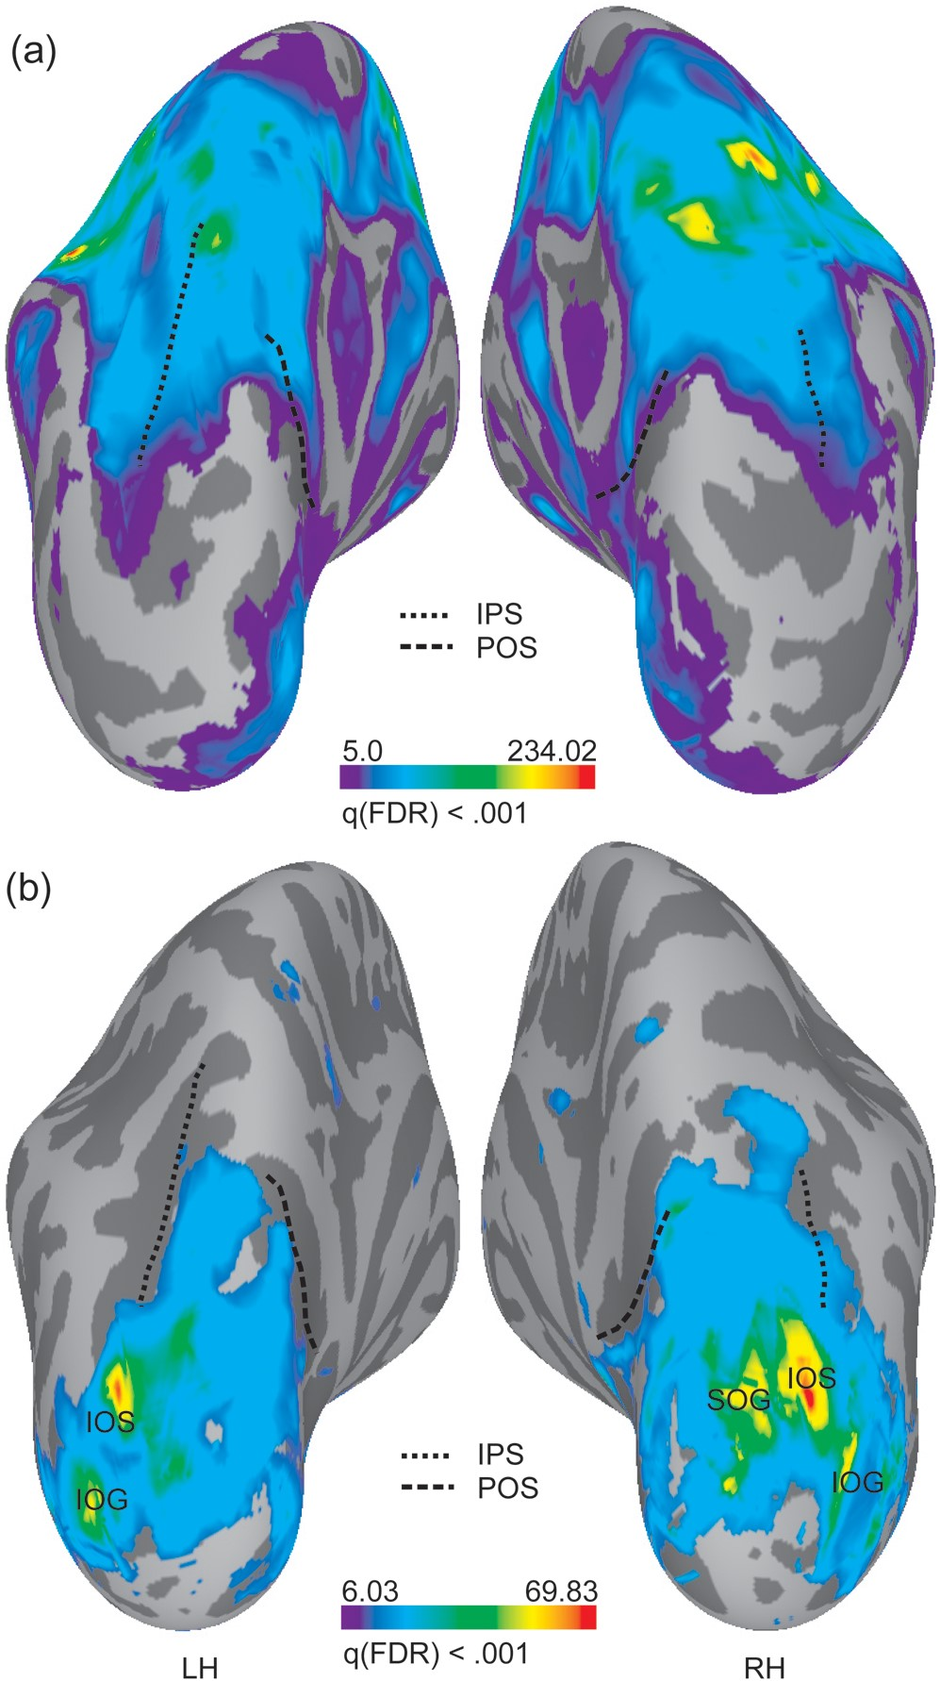
Figure 2. (a) Whole-brain RFX GLM contrast for the factor Reach Direction (thresholded at FDR < 0.001), collapsed over ...
Notes:
Figure 2. (a) Whole-brain RFX GLM contrast for the factor Reach Direction (thresholded at FDR < 0.001), collapsed over Type of Motor Act and Group. IPS, intraparietal sulcus; POS, parietooccipital sulcus. (b) Whole-brain RFX GLM contrast for the interaction “Reach Direction × Type of Motor Act × Group,” thresholded at FDR < 0.001. IOS, inferior occipital sulcus; IOG, inferior occipital gyrus; SOG, superior occipital gyrus.
Unless provided in the caption above, the following copyright applies to the content of this slide: © The Author 2012. Published by Oxford University Press. All rights reserved. For Permissions, please e-mail: journals.permissions@oup.com

Slide 3
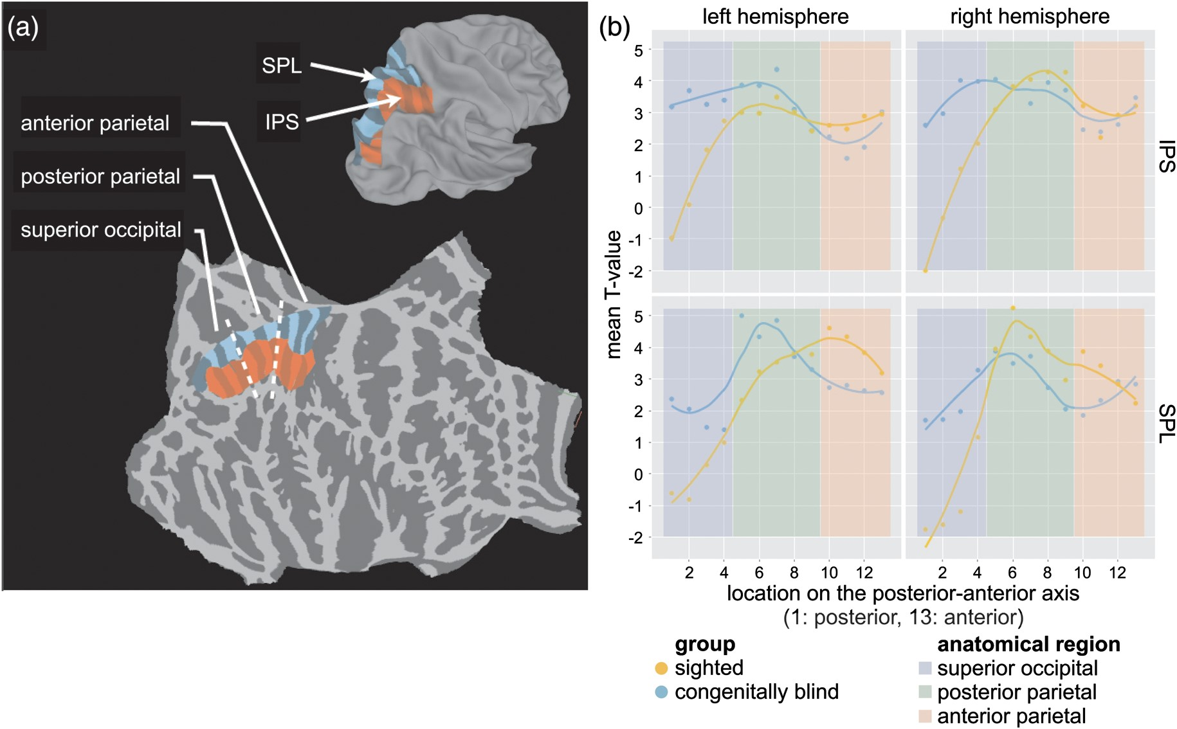
Figure 3. Sensitivity to reach direction as a function of anatomical location in PPC. To investigate the spatial ...
Notes:
Figure 3. Sensitivity to reach direction as a function of anatomical location in PPC. To investigate the spatial patterns of sensitivity to reach direction (independent of the type of motor act) in PPC, we plot the T values from the random effects model of the contrast nonadapted motor act, Reach Direction ±90, ±45° >nonadapted motor act, Reach Direction 0° for each group as a function of anatomical location. (a) We divide PPC and a portion of the superior occipital cortex into 2 large regions, labeled SPL (marked in blue) and IPS (marked in red). Each of these regions is further subdivided into 13 smaller cells along the anterior–posterior axis, indicated by the shading on the color patches in the figure. (b) We computed the mean T value from the above random effects model of all of the surface nodes included in each cell. For each cell, we then plotted the mean T value as a function of the cell's position along the posterior–anterior axis. The congenitally blind exhibit systematically higher T values in posterior parietal and superior occipital areas. This effect is particularly pronounced in the left hemisphere.
Unless provided in the caption above, the following copyright applies to the content of this slide: © The Author 2012. Published by Oxford University Press. All rights reserved. For Permissions, please e-mail: journals.permissions@oup.com

