Slide 1
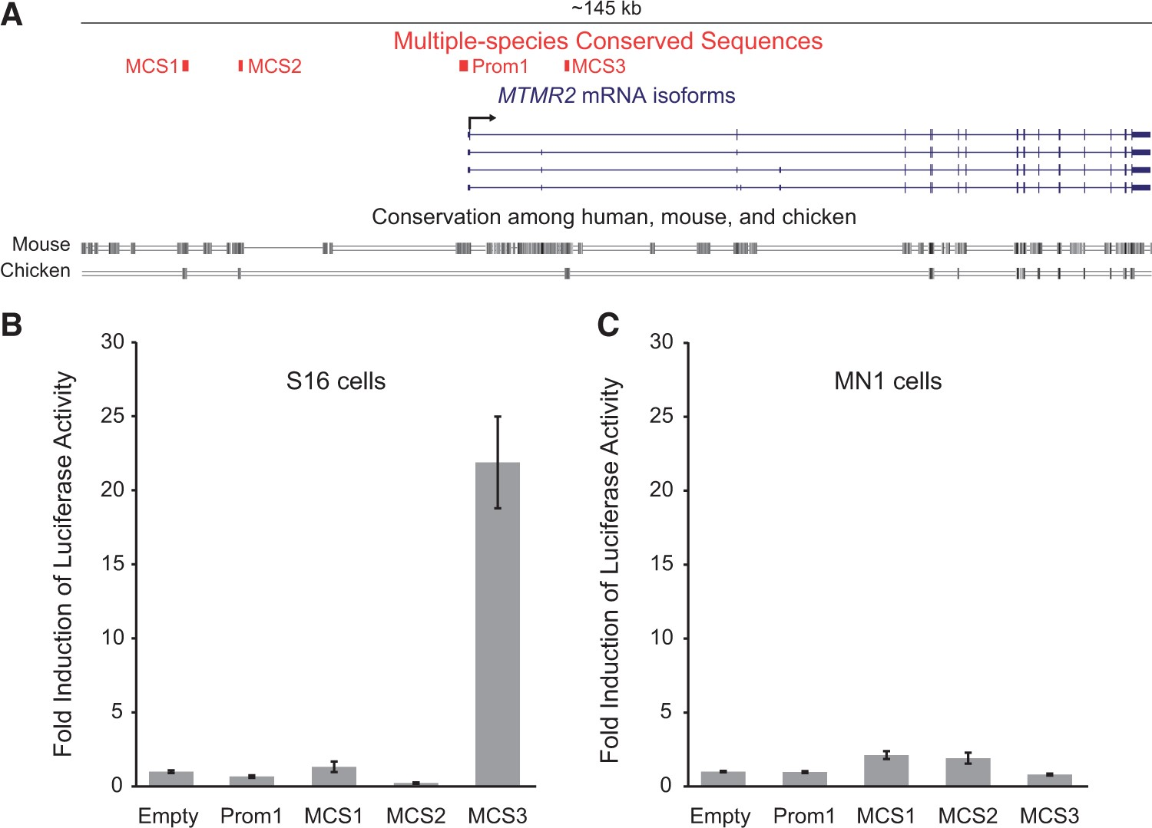
Figure 1. MTMR2-MCS3 is an active regulatory element in immortalized rat Schwann cells. (A) The ∼145 kb MTMR2 locus was ...
Notes:
Figure 1. MTMR2-MCS3 is an active regulatory element in immortalized rat Schwann cells. (A) The ∼145 kb MTMR2 locus was analysed for non-coding regions conserved between human, mouse, and chicken genomes (indicated along the bottom in black). The locations of the three multiple-species conserved sequences (MCS1-3) and the proximal promoter (Prom1) are indicated in red along with the four described MTMR2 mRNA isoforms (indicated in blue, see text for details), which are transcribed from left to right (black arrow). (B and C) The four elements identified in (A) were cloned upstream of a luciferase reporter gene and tested for induction of luciferase activity in S16 cells (B) and MN-1 cells (C) relative to an ‘empty’ control vector with no genomic insert. Error bars indicate standard deviation. Putative transcriptional regulatory elements at MTMR2 Element IDGenomic LocationaSize (bp)MTMR2-Prom1chr11:95,657,371-95,658,4781,108MTMR2-MCS1chr11:95,694,768-95,695,577810MTMR2-MCS2chr11:95,687,566-95,688,075510MTMR2-MCS3 (Prom2)chr11:95,643,795-95,644,453659aCoordinates are from the February 2009 UCSC Human Genome Browser (hg19).
Unless provided in the caption above, the following copyright applies to the content of this slide: © The Author 2016. Published by Oxford University Press. All rights reserved. For Permissions, please email: journals.permissions@oup.com

Slide 2
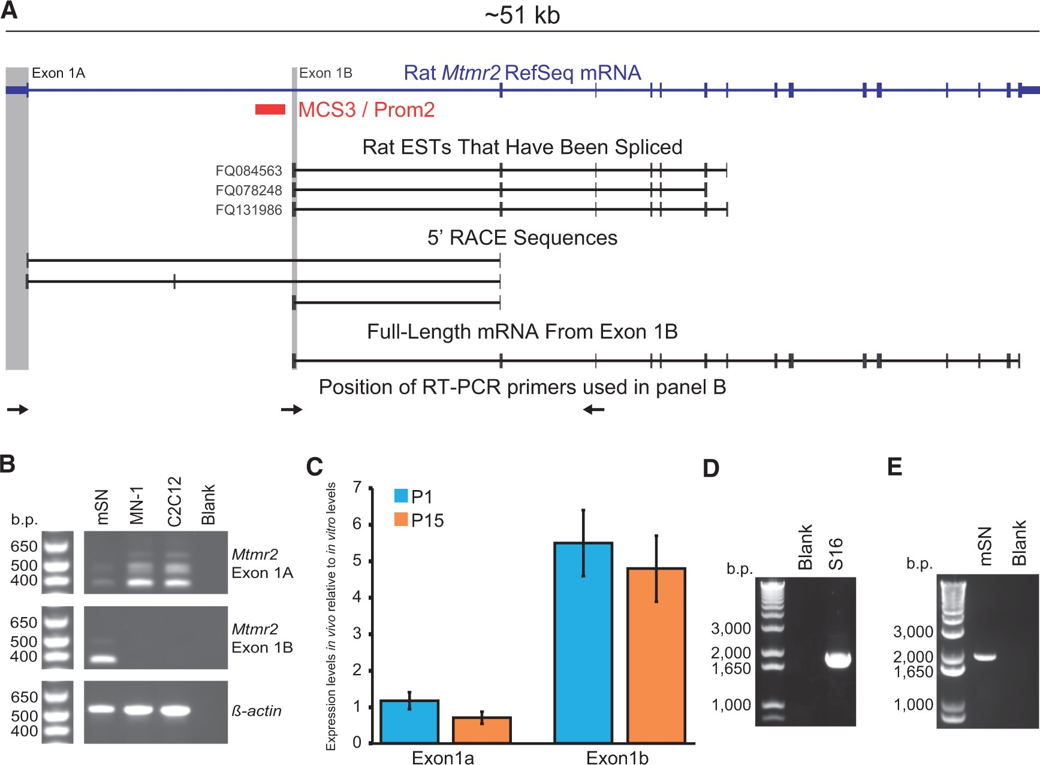
Figure 2. MTMR2-MCS3 is an alternative promoter that is active in Schwann cells. (A) The ∼51 kb rat Mtmr2 ...
Notes:
Figure 2. MTMR2-MCS3 is an alternative promoter that is active in Schwann cells. (A) The ∼51 kb rat Mtmr2 transcriptional unit (indicated in blue) from the UCSC Genome Browser is shown along with MCS3 (red), rat expressed sequence tags (ESTs), three distinct Mtmr2 mRNA 5’ ends identified by 5’ RACE, and the full-length Mtmr2 mRNA generated from exon 1B. The grey shading indicates the position of exons 1A and 1B. (B) RT-PCR assay to test for the presence of exon 1A- and exon 1B-containing transcripts in mouse sciatic nerve (mSN), immortalized motor neurons (MN-1), and immortalized muscle cells (C2C12). Negative controls without cDNA (Blank) were included for each primer pair and primers for β-actin were used as a positive control. Base pair (b.p.) sizes of markers are provided on the left. (C) Quantitative RT-PCR was performed to determine the expression levels of exon 1A- and 1B-containing Mtmr2 transcripts in P1 and P15 rat sciatic nerve relative to the levels in the S16 Schwann cell line, after normalization to 18S rRNA. Average and standard deviations are shown for three biological replicates. (D) A full-length mRNA was amplified from Schwann (S16) cell cDNA using long-range RT-PCR and primers designed in exon 1B and in the last coding exon of Mtmr2. A negative control without cDNA was included (Blank). (E) A full-length mRNA was amplified from mouse sciatic nerve cDNA using long-range RT-PCR and primers designed in exon 1B and in the last coding exon of Mtmr2. A negative control without cDNA was included (Blank).
Unless provided in the caption above, the following copyright applies to the content of this slide: © The Author 2016. Published by Oxford University Press. All rights reserved. For Permissions, please email: journals.permissions@oup.com

Slide 3
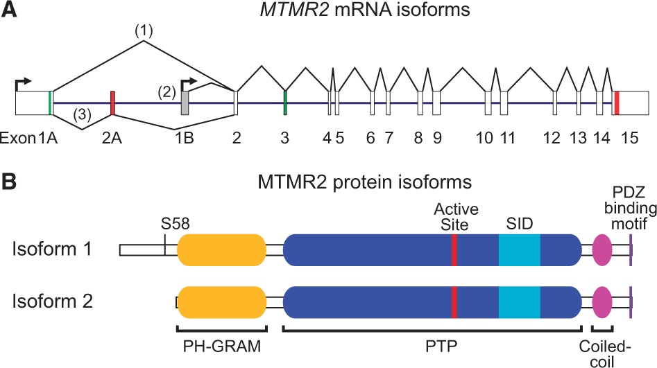
Figure 3. A new model of transcriptional activity at the MTMR2 locus. (A) Schematic of the MTMR2 locus including ...
Notes:
Figure 3. A new model of transcriptional activity at the MTMR2 locus. (A) Schematic of the MTMR2 locus including transcription start sites (arrows), translation start codons (green), and stop codons (red). Exon numbers are provided along the bottom. Multiple mRNA isoforms (MTMR2-1, MTMR2-2, and MTMR2-3) are produced via alternative splicing and alternative promoter use. (B) MTMR2 protein isoforms are shown indicating the pleckstrin homology/glucosyltransferases, Rab-like GTPase activators, and myotubularins (PH-GRAM; yellow), protein tyrosine phosphatase (PTP; blue), active site (red), SET interaction (SID; aqua), coiled coil (magenta), and PSD-95, Discs-large, ZO-1 binding (PDZ; purple) domains. Please note that isoform 2 lacks 72 amino acids at the N terminus, including the phosphorylation site Serine 58 (S58).
Unless provided in the caption above, the following copyright applies to the content of this slide: © The Author 2016. Published by Oxford University Press. All rights reserved. For Permissions, please email: journals.permissions@oup.com

Slide 4
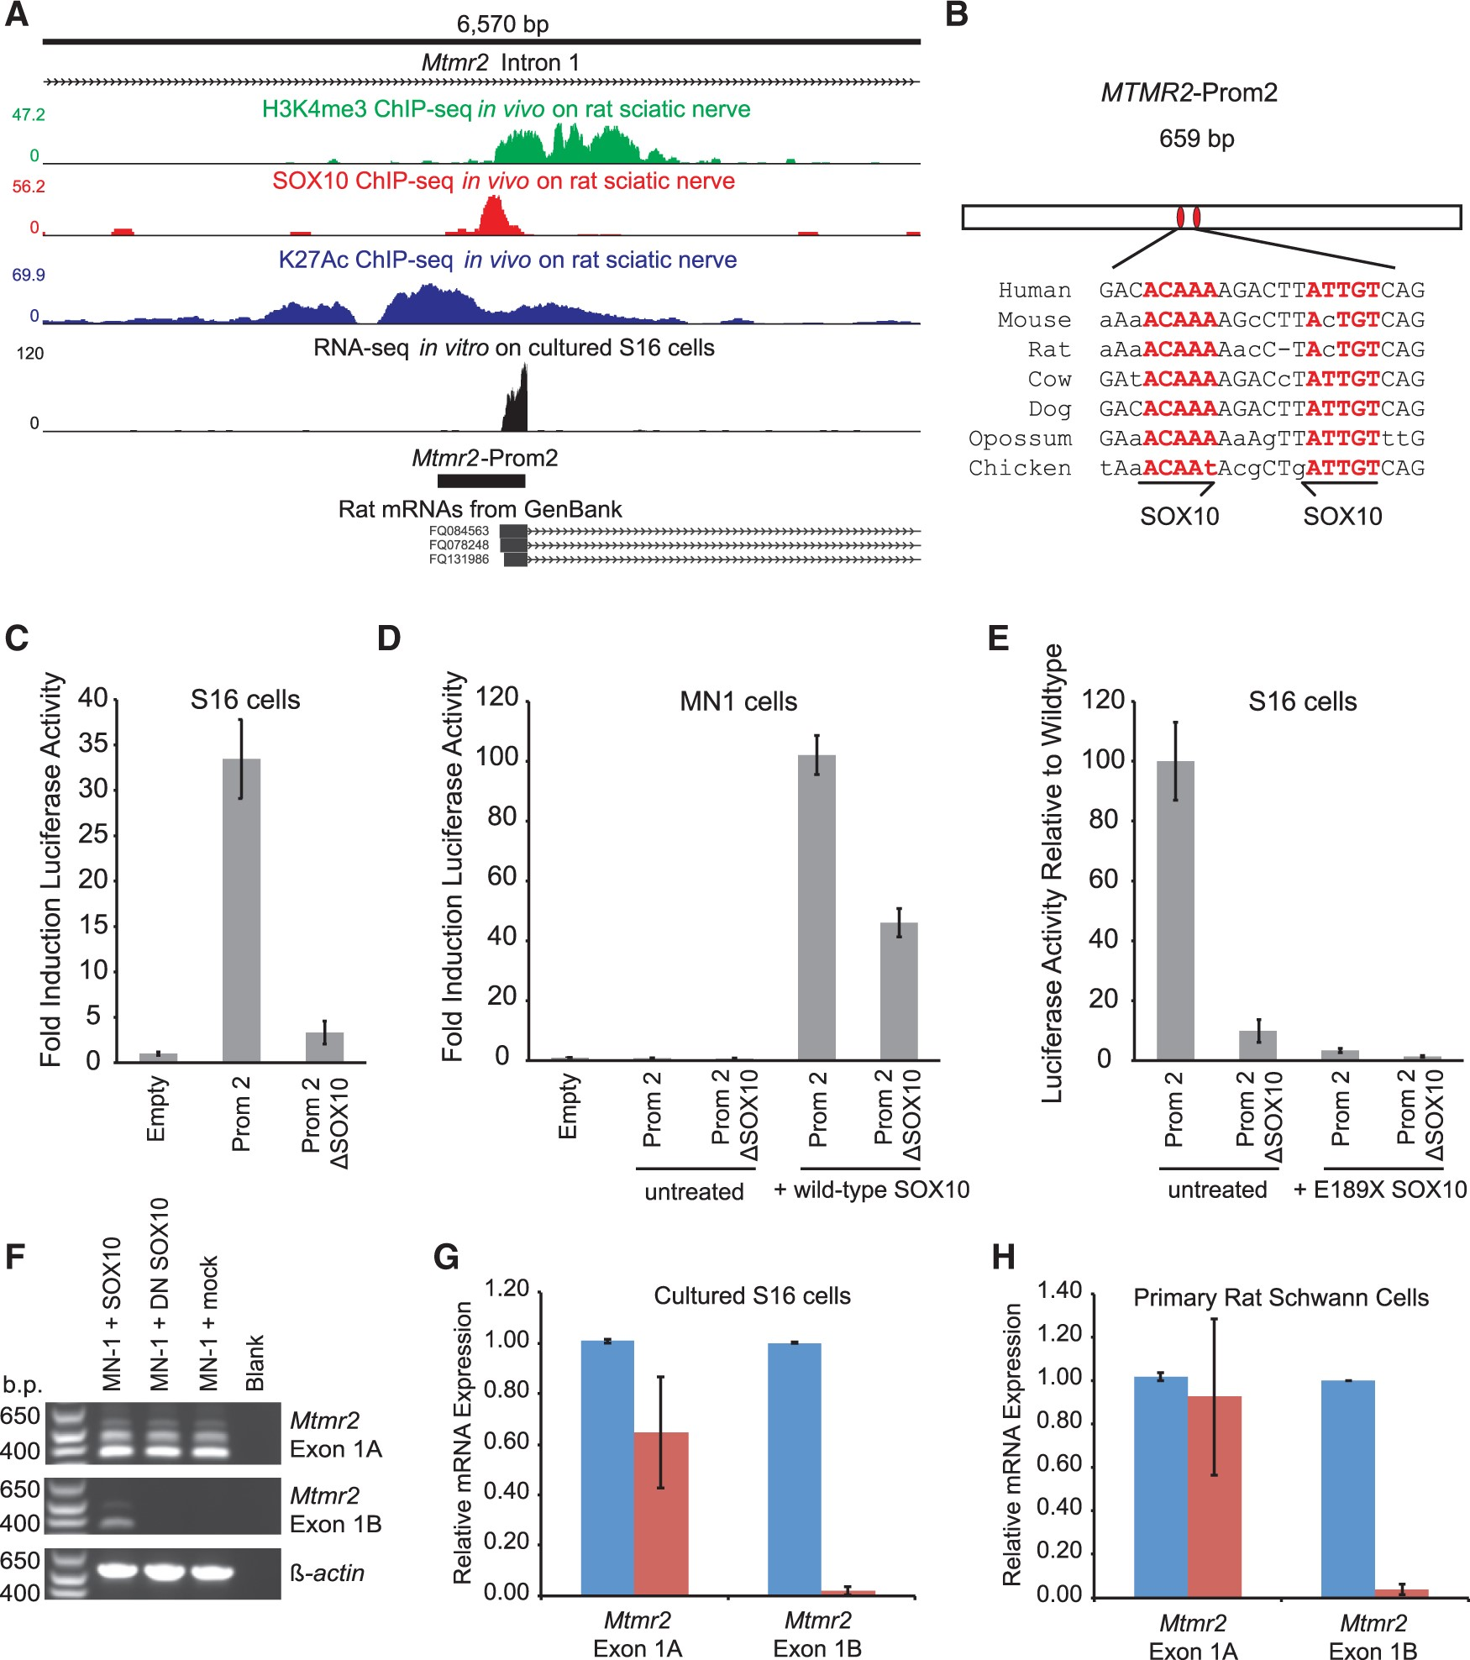
Figure 4. SOX10 regulates the activity of MTMR2-Prom2 and the expression of the MTMR2-2 mRNA. (A) A ∼6.6 kb region of ...
Notes:
Figure 4. SOX10 regulates the activity of MTMR2-Prom2 and the expression of the MTMR2-2 mRNA. (A) A ∼6.6 kb region of MTMR2 intron 1 is shown along with ChIP-Seq data for histone 3 lysine 4 trimethylation (H3K4me3; green), SOX10 (red), and histone 3 lysine 27 acetylation (H3K27Ac; blue) all performed on rat sciatic nerve. RNA-Sequencing reads, showing per-base read depth across 2 samples of S16 cells, MTMR2-Prom2, and spliced rat MTMR2 ESTs are also indicated. (B) The 659 base pair MTMR2-Prom2 is shown along with the position of the two SOX10 monomeric consensus sequences (red ovals and red text). The seven species utilized for comparative sequence analysis are shown on the left, with lower-case letters indicating bases not conserved among all seven species. Half arrows indicate the position and orientation of the two monomeric SOX10 consensus sequences. (C) MTMR2-Prom2 with or without (ΔSOX10) the dimeric SOX10 sequence was cloned upstream of a luciferase reporter gene, transfected into cultured Schwann (S16) cells, and tested for activity in luciferase assays compared to an empty vector containing no genomic insert. The fold induction of luciferase activity is indicated along the y axis and error bars indicate standard deviations. (D) Wild-type and ΔSOX10 MTMR2-Prom2 were evaluated for regulatory activity in MN1 cells using luciferase assays as in (C) in the presence and absence of a construct to express SOX10. (E) Wild-type and ΔSOX10 MTMR2-Prom2 were evaluated for regulatory activity in S16 cells using luciferase assays as in (C) in the presence and absence of a construct to express dominant-negative (E189X) SOX10. (F) RT-PCR assays were performed as in Figure 2B using cDNA prepared from MN-1 cells transfected with a construct to express either wild-type or dominant-negative SOX10, or mock transfected without a SOX10 expression construct. Note that transfection of the wild-type SOX10 expression construct was sufficient to allow detection of endogenous Mtmr2 exon 1B-harbouring transcripts. (G and H) S16 cells and rat Schwann cells were treated with siRNA targeted against SOX10 (red) or control siRNA (blue). Quantitative RT-PCR was used to measure expression levels of Mtmr2 exon 1A- and exon 1B-containing transcripts. Error bars indicate standard deviations.
Unless provided in the caption above, the following copyright applies to the content of this slide: © The Author 2016. Published by Oxford University Press. All rights reserved. For Permissions, please email: journals.permissions@oup.com

Slide 5
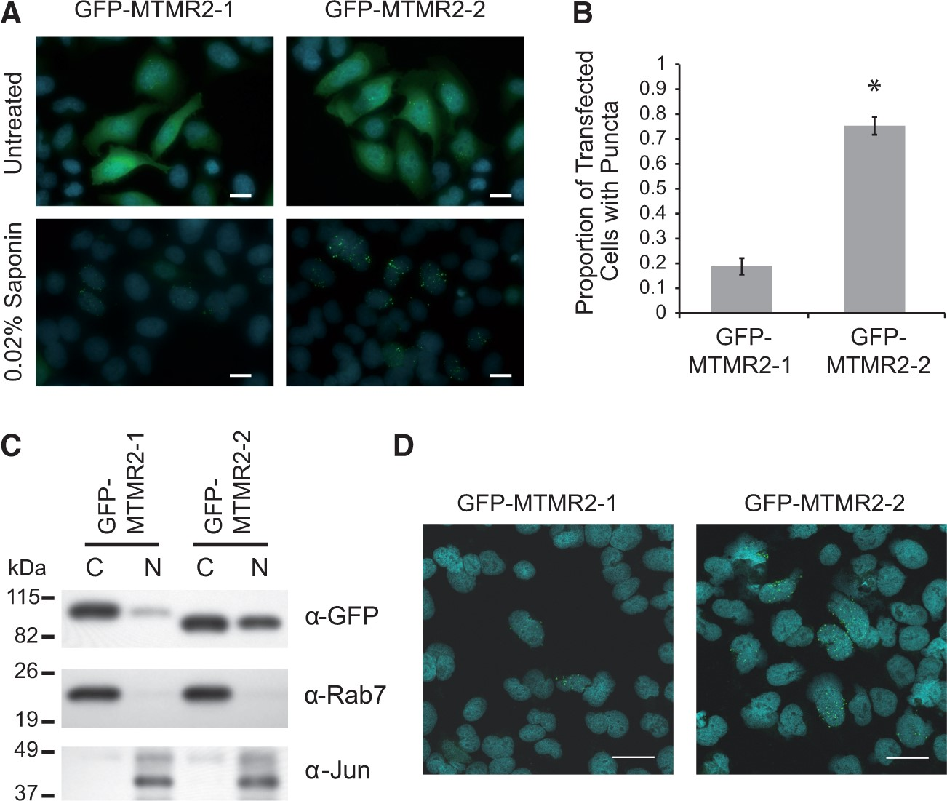
Figure 5. MTMR2 protein isoforms differentially localize to subcellular puncta and to the cell nucleus. (A) HeLa cells ...
Notes:
Figure 5. MTMR2 protein isoforms differentially localize to subcellular puncta and to the cell nucleus. (A) HeLa cells were transfected with constructs to express GFP-MTMR2 isoforms and imaged with standard fluorescence microscopy. Cells were untreated or treated with 0.02% saponin to remove cytosolic proteins and stained with DAPI to visualize nuclei prior to fixation. Scale bars, 20 μm. (B) Quantification of puncta formed by the two MTMR2 isoforms. Statistical analysis: significance test for two-sample proportions (MTMR2-1 n = 542, MTMR2-2 n = 554, P < 0.0001). Error bars represent margin of error for 95% confidence interval. (C) Western blot using an anti-GFP antibody and 20 μg of cytosolic (C) or nuclear protein (N) fractions isolated from HeLa cells transfected with constructs to express either GFP-MTMR2 isoform 1 or isoform 2. Rab7 and cJun antibodies were used on the same blot to assess protein loading and fraction purity. A protein marker in kilodaltons (kDa) is indicated on the left. (D) HeLa cells were transfected with constructs to express either GFP-MTMR2 isoform, treated with 0.02% saponin to clear cytosolic proteins and DAPI to visualize nuclei (blue), and imaged with a confocal fluorescence microscope. Each image was taken from a single 0.3 μm-depth slice in the z-stack. Scale bars, 30 μm.
Unless provided in the caption above, the following copyright applies to the content of this slide: © The Author 2016. Published by Oxford University Press. All rights reserved. For Permissions, please email: journals.permissions@oup.com

