Slide 1
Figure 1. Intended extents of the crossed unilateral ablations of frontal cortex and inferotemporal cortex shown from ...
Notes:
Figure 1. Intended extents of the crossed unilateral ablations of frontal cortex and inferotemporal cortex shown from medial, ventral, and lateral views. The shaded areas indicate the areas of intended removal. CIN, cingulated sulcus; ROS, rosral suclus; LOS, lateral orbital sulcus; MOS, medial orbital suclus; PS, principal suclus; AS, arcuate sulcus; OTS, occipitotemporal sulcus; AMTS, anterior middle temporal sulcus; RS, rhinal suclus; IOS, intraoccipital sulcus; STS, superior temporal suclus; LS, lateral sulcus.
Unless provided in the caption above, the following copyright applies to the content of this slide: © The Author 2006. Published by Oxford University Press. All rights reserved. For permissions, please e-mail: journals.permissions@oxfordjournals.org

Slide 2
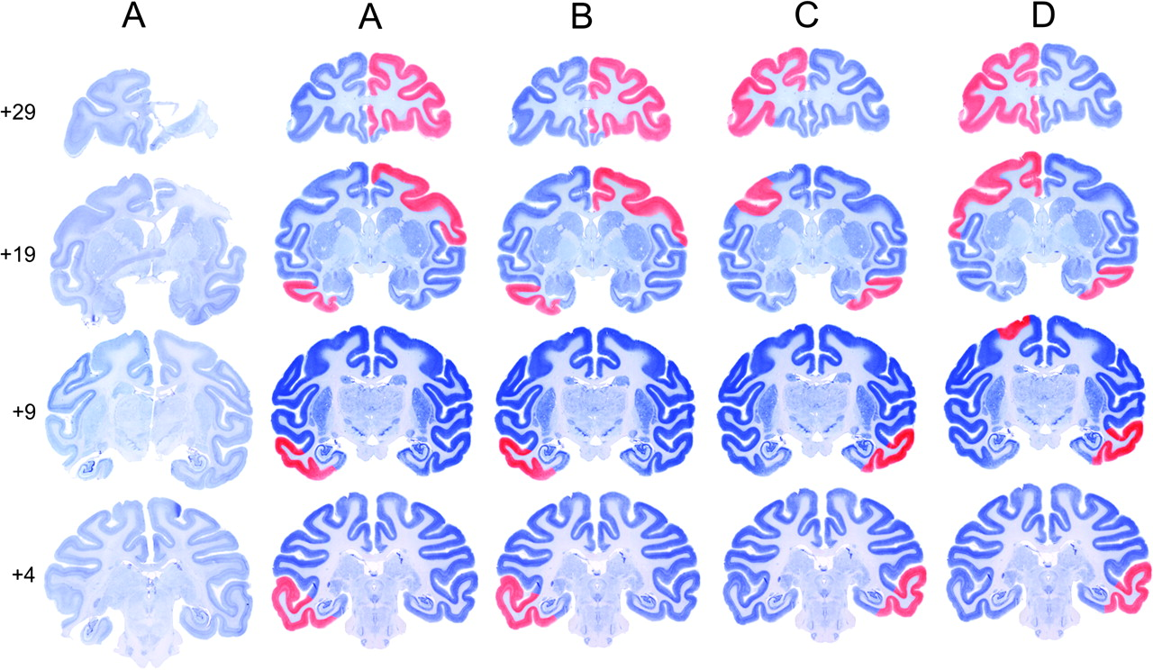
Figure 2. Coronal sections of the actual and reconstructed lesions. The first column shows 4 actual sections at ...
Notes:
Figure 2. Coronal sections of the actual and reconstructed lesions. The first column shows 4 actual sections at different anterior–posterior levels taken from subject A. The second column shows a reconstruction colored in red of the extent of this removal represented on cresyl violet–stained sections taken from a normal macaque brain. The remaining 3 columns show reconstructions of subjects B, C, and D. The numbers to the left indicate millimeters anterior to the interaural line (estimated from Paxinos and others 2000; Szwarcbart).
Unless provided in the caption above, the following copyright applies to the content of this slide: © The Author 2006. Published by Oxford University Press. All rights reserved. For permissions, please e-mail: journals.permissions@oxfordjournals.org

Slide 3
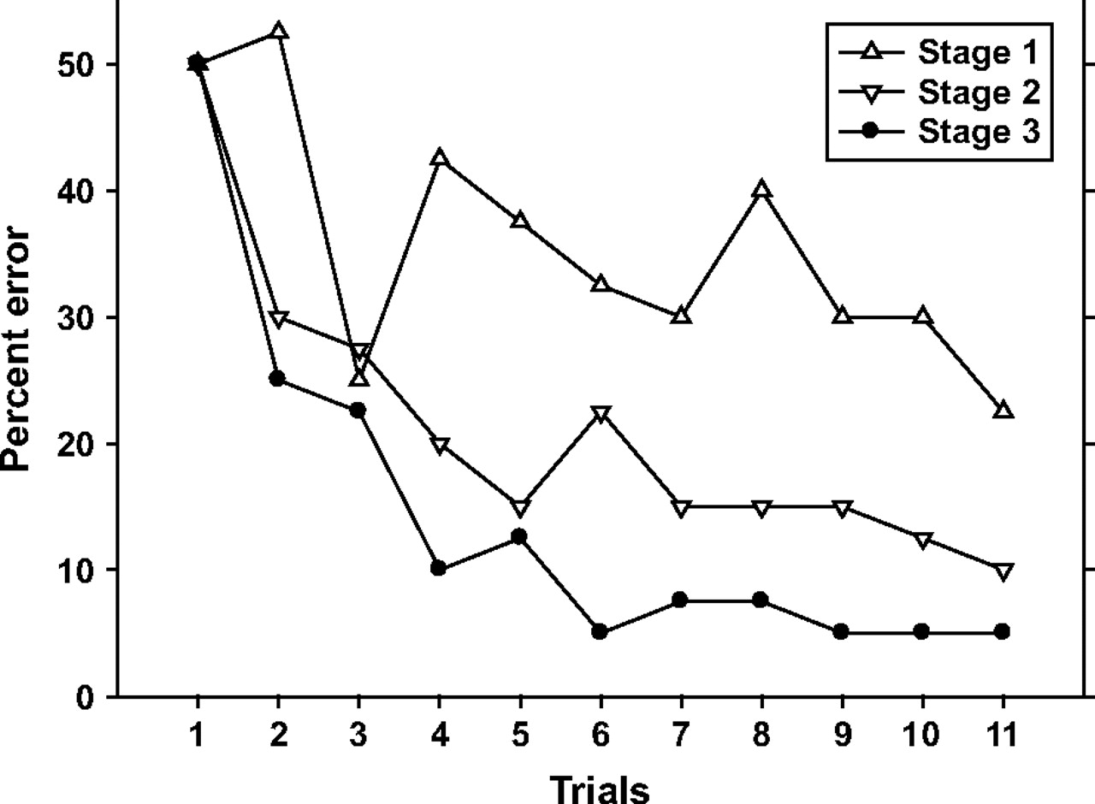
Figure 3. The formation of the object DLS during preoperative training. Learning curves are plotted at 3 stages of ...
Notes:
Figure 3. The formation of the object DLS during preoperative training. Learning curves are plotted at 3 stages of learning set formation. Stage 1, the first 10 problems (open triangles); Stage 2, the middle 10 problems (open inverted triangles); and Stage 3, the last 10 problems (filled circles) of preoperative training.
Unless provided in the caption above, the following copyright applies to the content of this slide: © The Author 2006. Published by Oxford University Press. All rights reserved. For permissions, please e-mail: journals.permissions@oxfordjournals.org

Slide 4
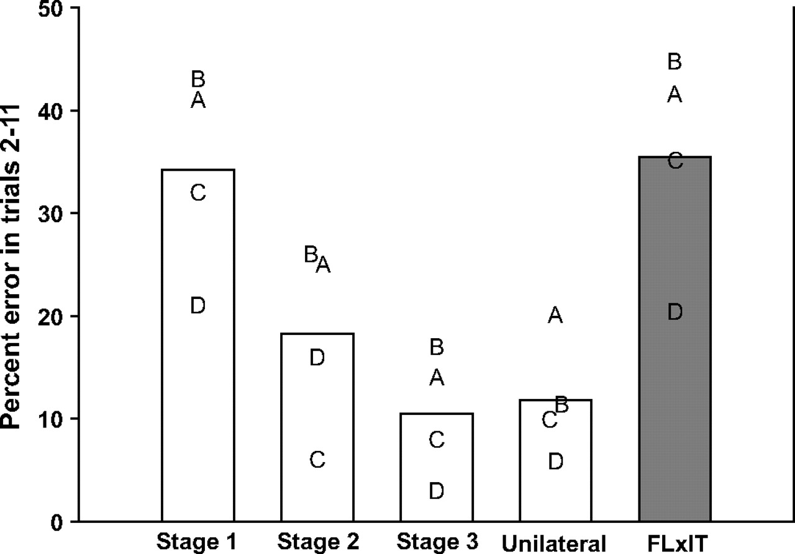
Figure 4. Graph showing mean percent error in trials 2–11 at each performance test on DLS. Stage 1, the first 10 ...
Notes:
Figure 4. Graph showing mean percent error in trials 2–11 at each performance test on DLS. Stage 1, the first 10 problems of preoperative learning set formation; Stage 2, the middle 10 problems; Stage 3, the last 10 problems. Unilateral and FL × IT, control and final postoperative performance tests. Individual monkeys are represented by capital letters A–D.
Unless provided in the caption above, the following copyright applies to the content of this slide: © The Author 2006. Published by Oxford University Press. All rights reserved. For permissions, please e-mail: journals.permissions@oxfordjournals.org

Slide 5
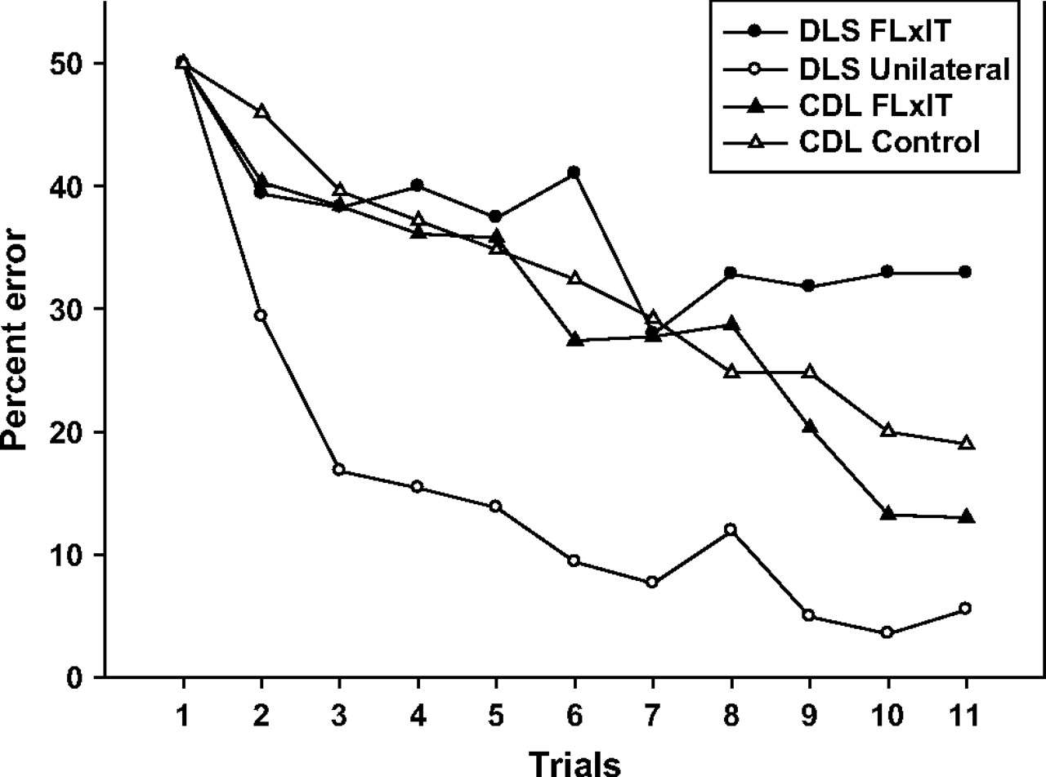
Figure 5. Learning curves in DLS, from the present experiment, and 10-pair CDL, taken from Gaffan and others (2002) and ...
Notes:
Figure 5. Learning curves in DLS, from the present experiment, and 10-pair CDL, taken from Gaffan and others (2002) and Parker and Gaffan (1998b), showing control (open symbols) and postoperative data (filled symbols) over 11 trials. DLS data are represented by circles, and CDL data are represented by triangles.
Unless provided in the caption above, the following copyright applies to the content of this slide: © The Author 2006. Published by Oxford University Press. All rights reserved. For permissions, please e-mail: journals.permissions@oxfordjournals.org

