Slide 1
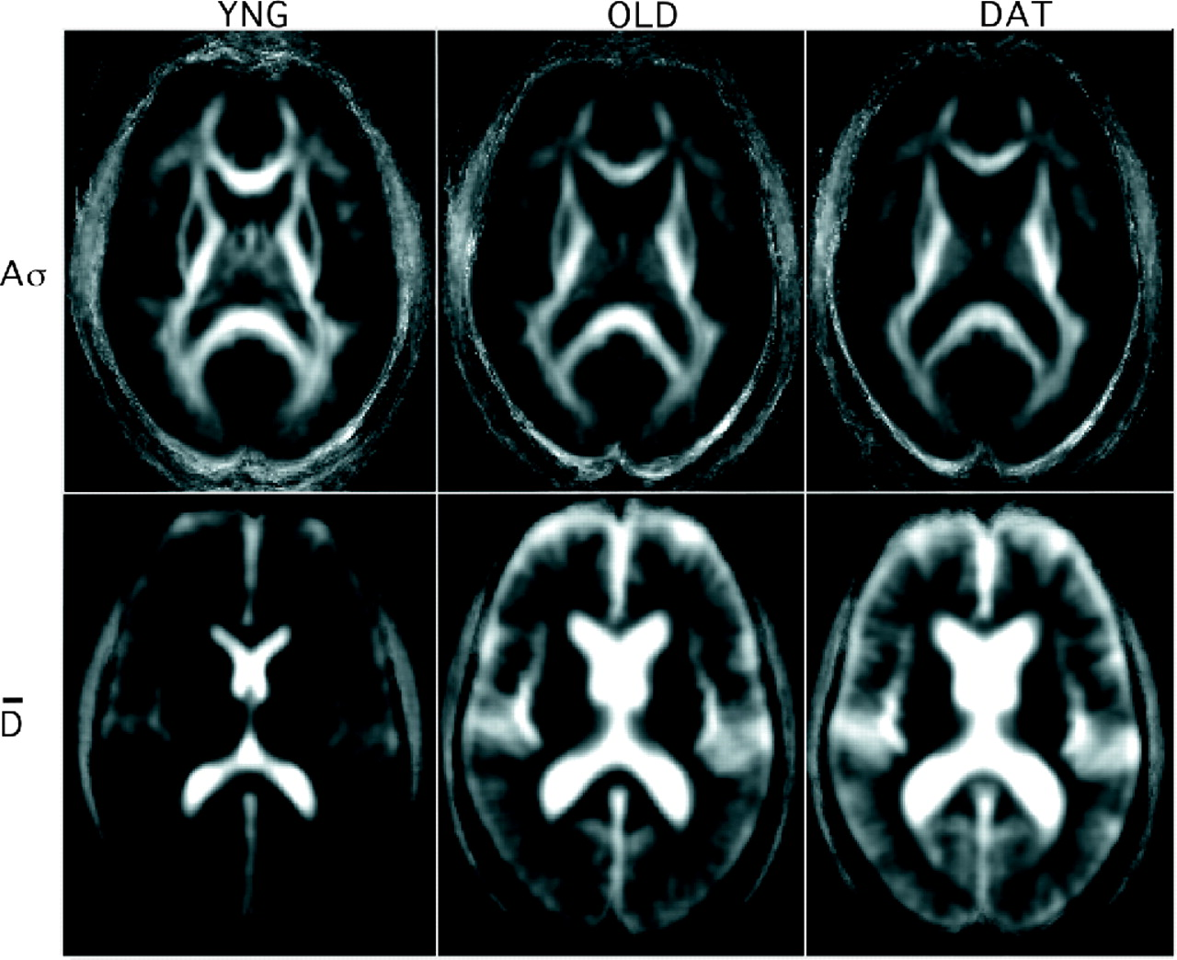
Figure 1. Group-averaged anisotropy (A_{σ}) [0 (dark) to 0.5 (white)] and mean diffusivity ( ) [0.65 ...
Notes:
Figure 1. Group-averaged anisotropy (Aσ) [0 (dark) to 0.5 (white)] and mean diffusivity ( ) [0.65 (dark) to 1.5 (white) µm2/ms] for the three subject groups. The Aσand images were computed from DWI data, transformed into a standard atlas space and then the Aσand images were averaged across the 25 individuals within each group. For all groups the selected slice corresponds to Z = 12 in the atlas of Talairach and Tournoux (1988).
Unless provided in the caption above, the following copyright applies to the content of this slide:

Slide 2
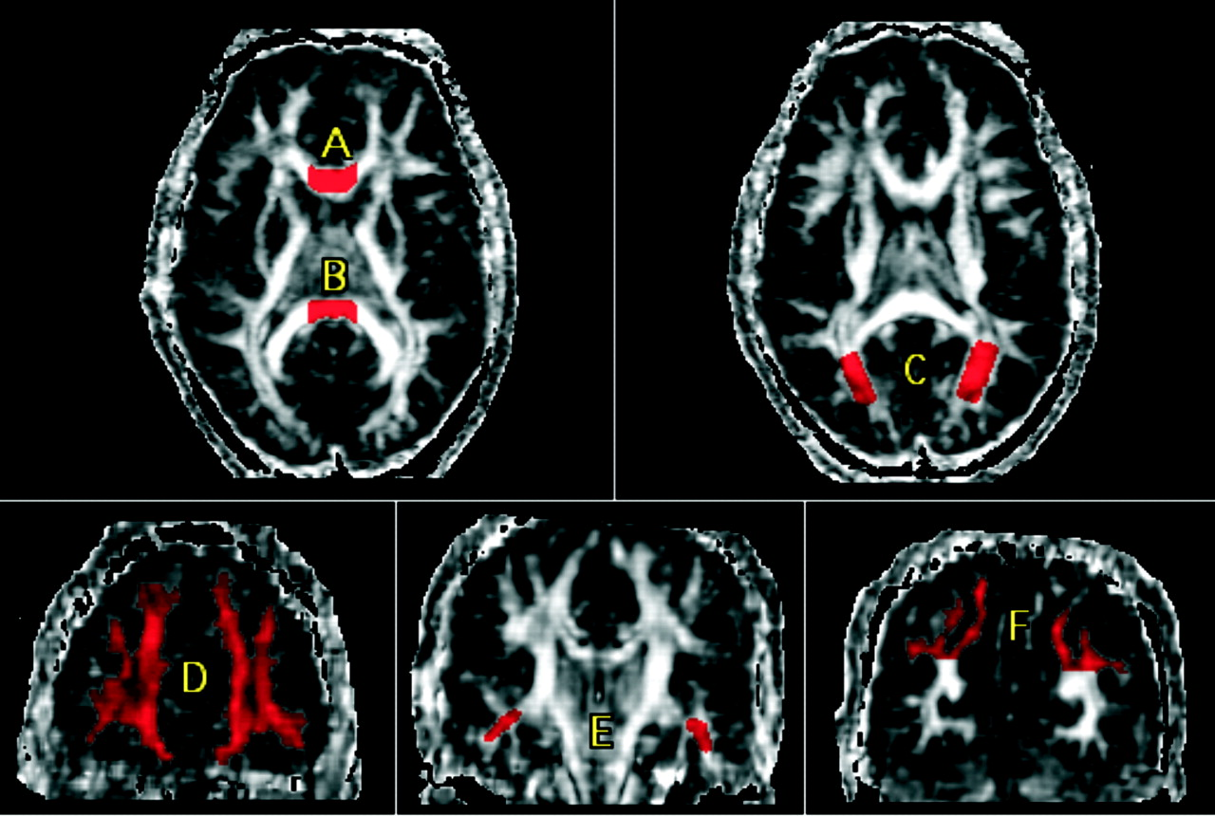
Figure 2. Examples of ROI demarcation on anisotropy images: (A) anterior corpus callosum; (B) posterior ...
Notes:
Figure 2. Examples of ROI demarcation on anisotropy images: (A) anterior corpus callosum; (B) posterior corpus callosum; (C) occipital lobe white matter; (D) frontal lobe white matter; (E) temporal lobe white matter; and (F) parietal lobe white matter
Unless provided in the caption above, the following copyright applies to the content of this slide:

Slide 3
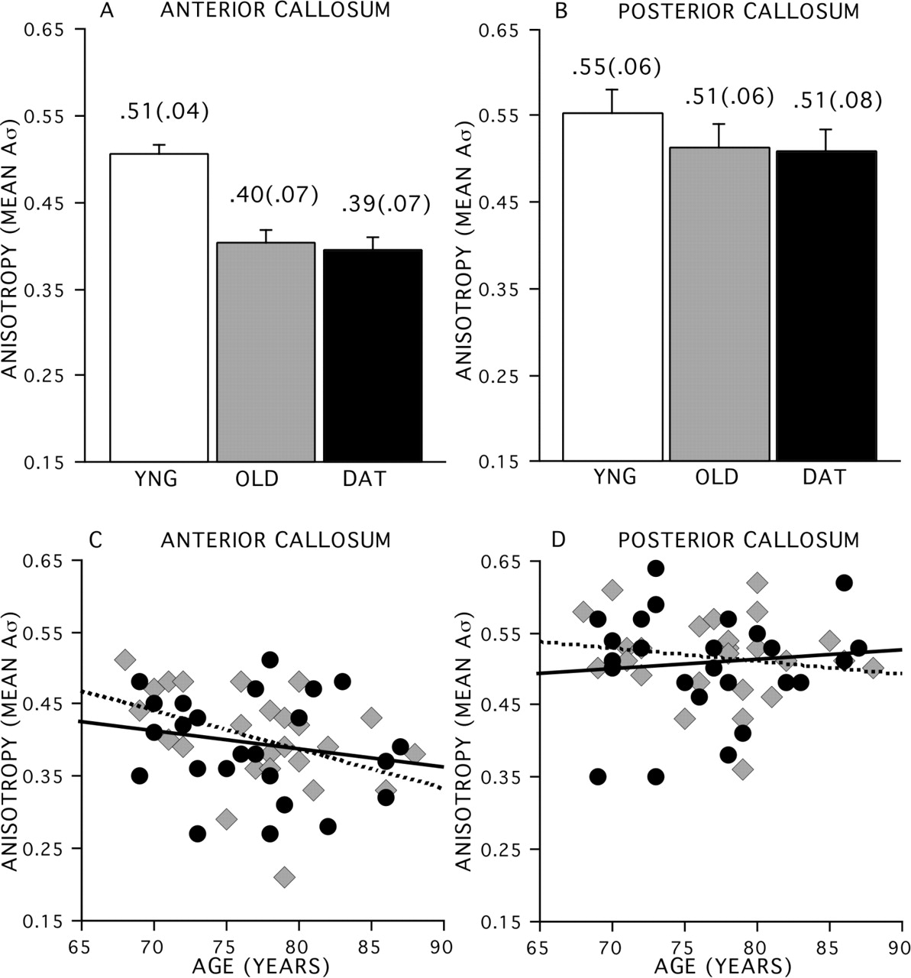
Figure 3. Comparison of anisotropy in the corpus callosum between young (white bars), nondemented older ...
Notes:
Figure 3. Comparison of anisotropy in the corpus callosum between young (white bars), nondemented older adults (gray bars) and demented older adults (black bars). (A) Anterior corpus callosum with mean (SEM). (B) Posterior corpus callosum with mean (SEM). (C) Scatterplot of anisotropy in the anterior corpus callosum in nondemented older adults (gray diamonds) and demented older adults (black circles). (D) Scatterplot of anisotropy in the posterior corpus callosum in nondemented older adults (gray diamonds) and demented older adults (black circles). The dashed and black linear regression lines apply, respectively, to the nondemented and demented older adult groups. Numbers indicate bar values with SD in parentheses.
Unless provided in the caption above, the following copyright applies to the content of this slide:

Slide 4
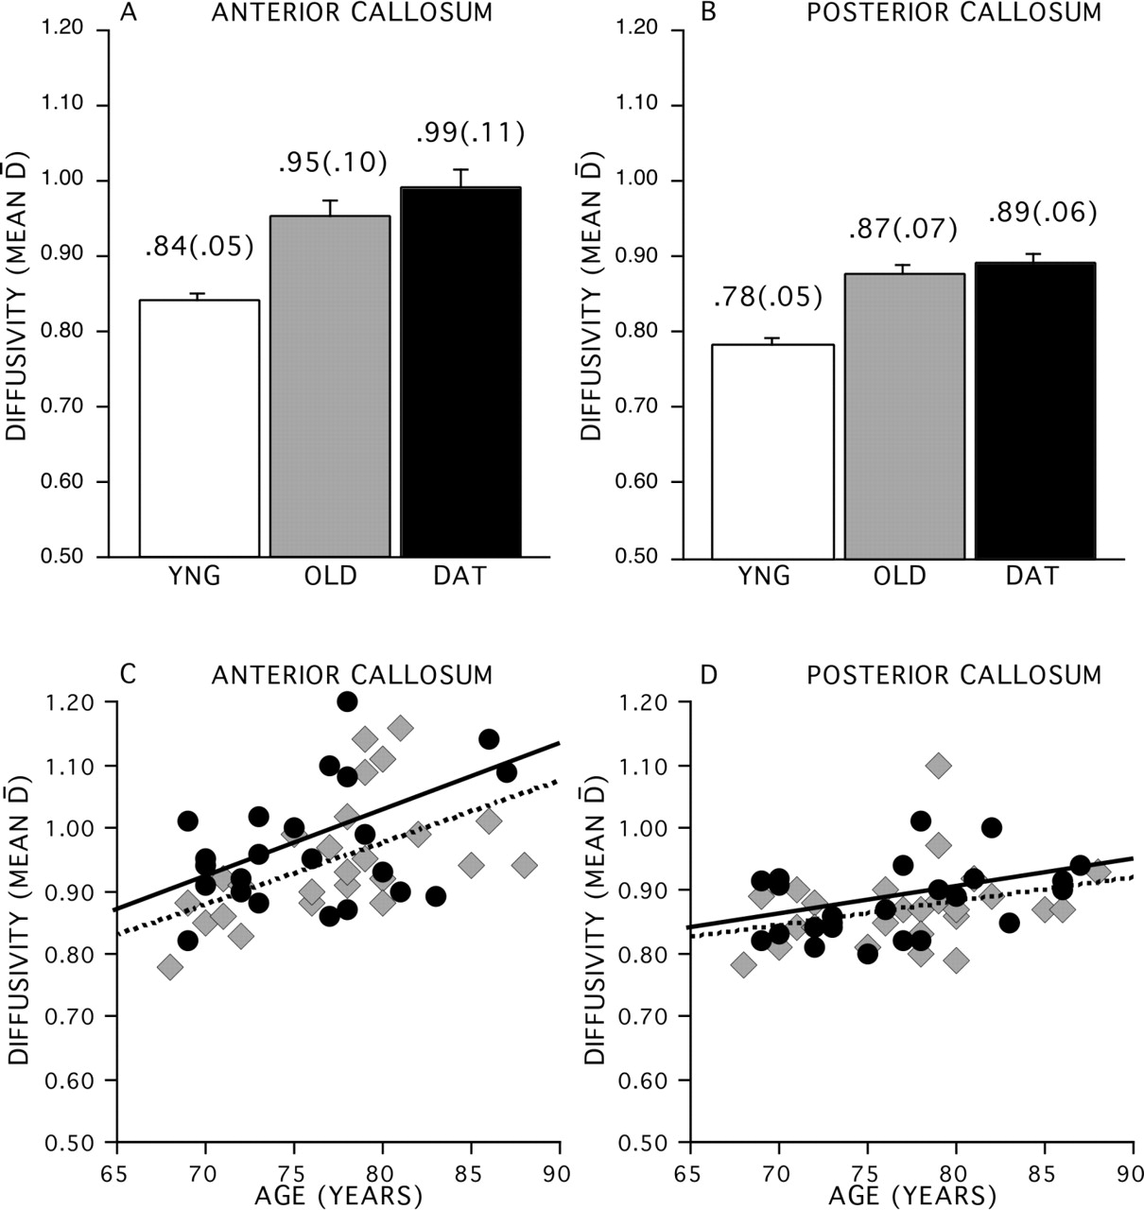
Figure 4. Comparison of diffusivity in the corpus callosum between young (white bars), nondemented older ...
Notes:
Figure 4. Comparison of diffusivity in the corpus callosum between young (white bars), nondemented older adults (gray bars) and demented older adults (black bars). (A) Anterior corpus callosum with mean (SEM). (B) Posterior corpus callosum with mean (SEM). (C) Scatterplot of diffusivity in the anterior corpus callosum in nondemented older adults (gray diamonds) and demented older adults (black circles). (D) Scatterplot of diffusivity in the posterior corpus callosum in nondemented older adults (gray diamonds) and demented older adults (black circles). The dashed and black linear regression lines apply, respectively to the nondemented and demented older adult groups. D is in units of µm2/ms.
Unless provided in the caption above, the following copyright applies to the content of this slide:

Slide 5
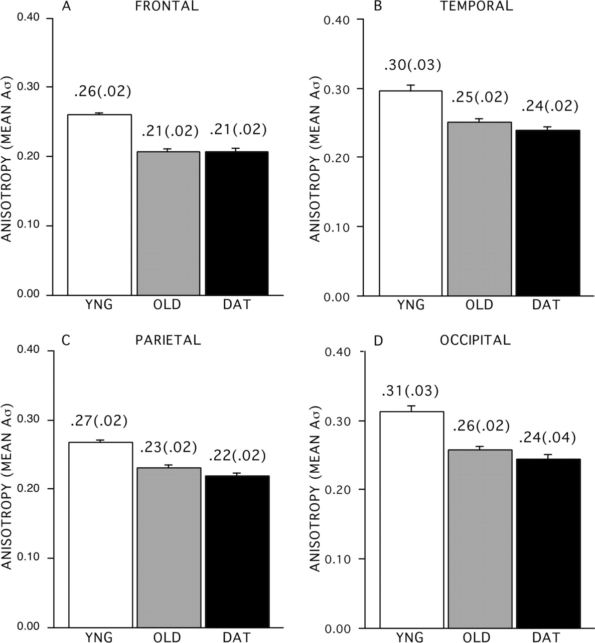
Figure 5. Comparison of anisotropy in the lobar regions between young (white bars), nondemented older adults ...
Notes:
Figure 5. Comparison of anisotropy in the lobar regions between young (white bars), nondemented older adults (gray bars) and demented older adults (black bars). (A) Frontal lobe white matter, (B) temporal lobe white matter, (C) parietal lobe white matter, (D) occipital lobe white matter.
Unless provided in the caption above, the following copyright applies to the content of this slide:

Slide 6
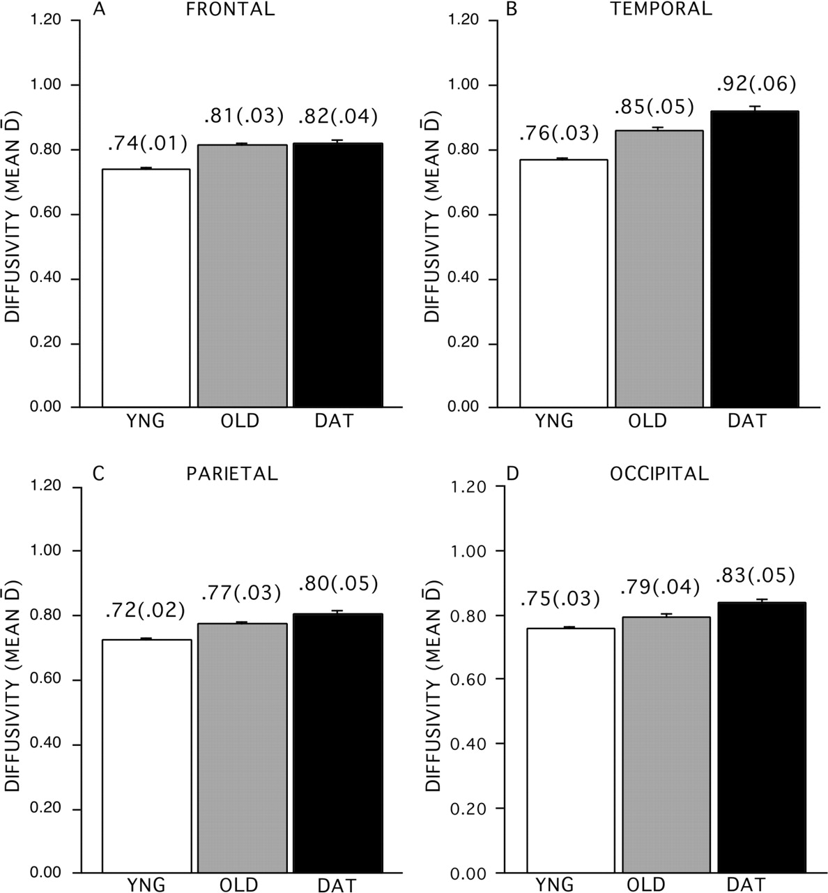
Figure 6. Comparison of diffusivity in the lobar regions between young (white bars), nondemented older adults ...
Notes:
Figure 6. Comparison of diffusivity in the lobar regions between young (white bars), nondemented older adults (gray bars) and demented older adults (black bars). (A) Frontal lobe white matter, (B) temporal lobe white matter, (C) parietal lobe white matter, (D) occipital lobe white matter.
Unless provided in the caption above, the following copyright applies to the content of this slide:

Slide 7
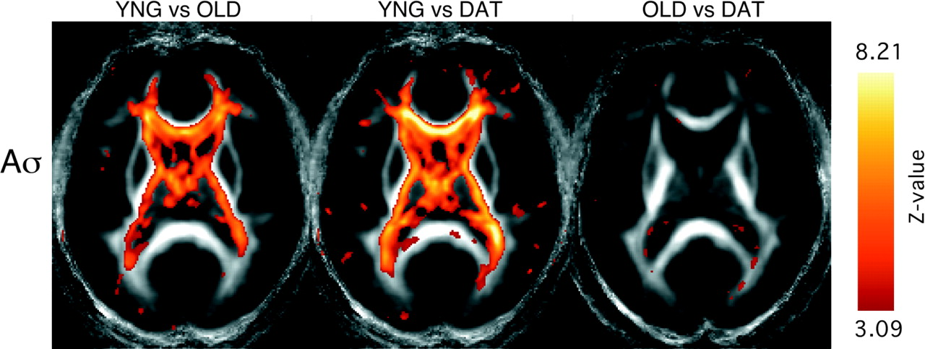
Figure 7. Z-maps of group comparisons of anisotropy on a voxel-by-voxel basis. All voxels are significant at ...
Notes:
Figure 7. Z-maps of group comparisons of anisotropy on a voxel-by-voxel basis. All voxels are significant at the Z = 3.09, P < 0.001 level, uncorrected for multiple comparisons. Color bar represents range of Z values. The axial section corresponds to z = 10 above the plane of the anterior commissure–posterior commissure (Talairach and Tournoux, 1988).
Unless provided in the caption above, the following copyright applies to the content of this slide:

