Slide 1
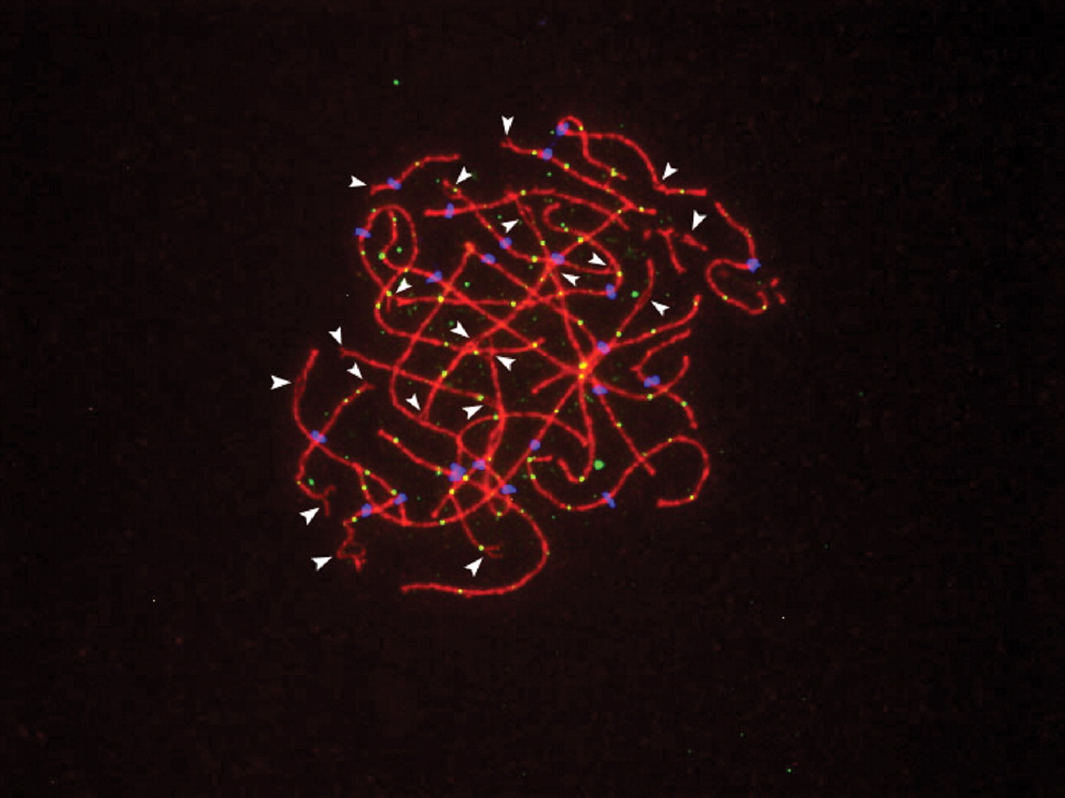
Figure 1. Pachytene stage human oocyte, showing multiple synaptic defects (arrowheads). The syntonemal complex is ...
Notes:
Figure 1. Pachytene stage human oocyte, showing multiple synaptic defects (arrowheads). The syntonemal complex is detected by SCP3 (red), sites of exchanges by MLH1 foci (yellow) and centromeric regions by CREST (blue).
Unless provided in the caption above, the following copyright applies to the content of this slide: © The Author 2007. Published by Oxford University Press. All rights reserved. For Permissions, please email: journals.permissions@oxfordjournals.org

