Slide 1
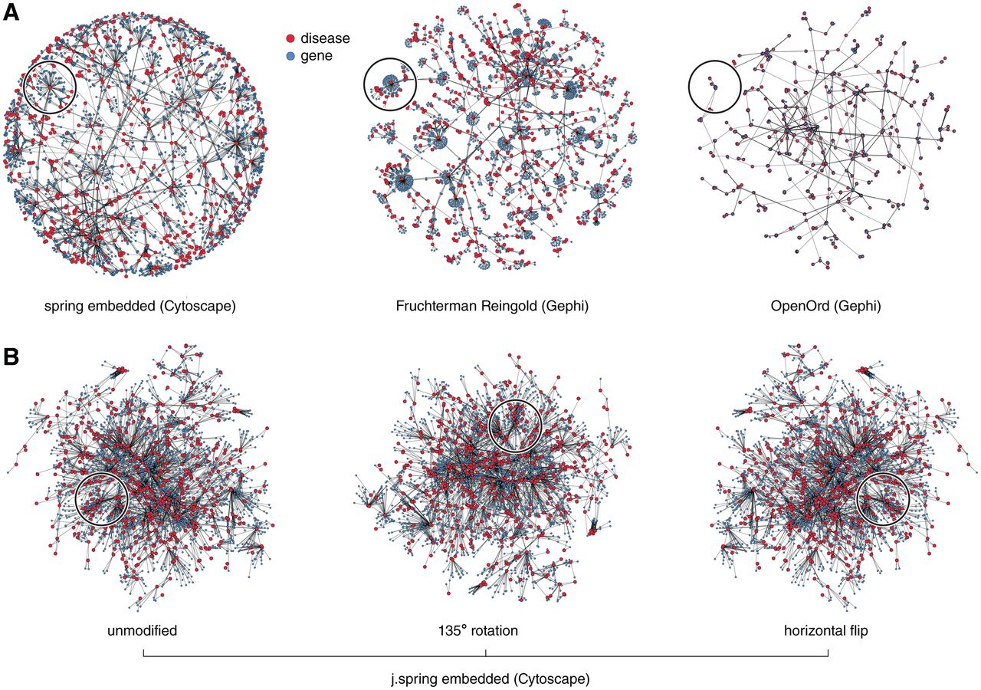
Figure 1: (A) Network drawing algorithms can produce strikingly different layouts when applied to large networks. ...
Notes:
Figure 1: (A) Network drawing algorithms can produce strikingly different layouts when applied to large networks. Visualizations of the largest connected component (2652 nodes, 3941 edges) of the human disease network [38] generated with Cytoscape 2.8.1 [23, 24, 39] and Gephi 0.7 [27]. In each panel, the same group of nodes are highlighted to show the variety of ways in which dense hubs are rendered by each algorithm. (B) Affine transformations of Cytoscape's j.spring embedded algorithm result in layouts that can be easily confused with those of different networks. The same group of nodes as in panel A is highlighted.
Unless provided in the caption above, the following copyright applies to the content of this slide: © The Author 2011. Published by Oxford University Press. For Permissions, please email: journals.permissions@oup.com

Slide 2
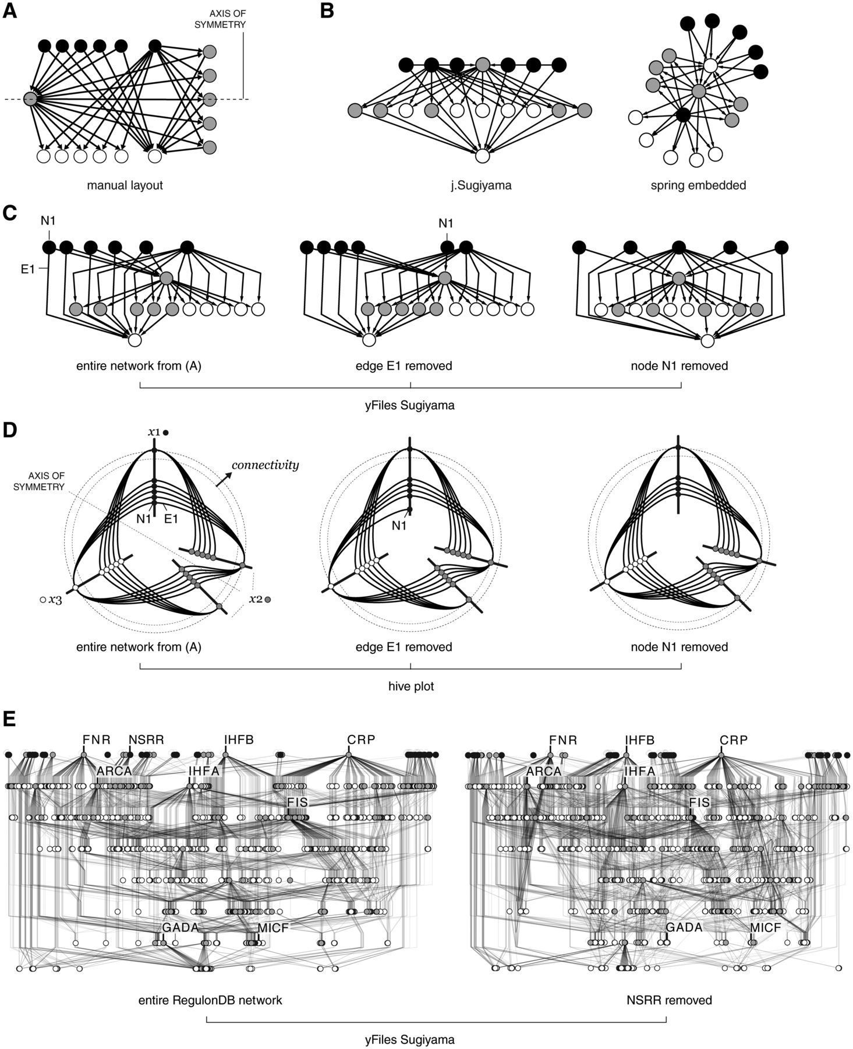
Figure 2: Conventional network drawing algorithms generate layouts that lack robustness—small changes in a network can ...
Notes:
Figure 2: Conventional network drawing algorithms generate layouts that lack robustness—small changes in a network can have a disproportionately large effect on the entire layout. (A) Manual layout of a 15-node symmetric directed network. (B) Cytoscape's layouts of (A) using the j.Sugiyama [32] and force-directed algorithms obscure the simplicity and symmetry of the network. (C) Cytoscape's yFiles hierarchic layout [49] is very efficient and useful for showing the flow in a network, but exemplifies brittleness. The layout of the network from (A) varies considerably when edge E1 and node N1 are removed. (D) HPs of the networks in (C) are robust and globally unaffected by local changes to the network. The rules for these HP are explained in Figure 3C. (E) Brittleness is seen in layouts of large networks. The removal of a single top regulatory gene (NsrR, a regulatory protein, which is a member of the Rrf2 family.) from RegulonDB network [36, 37] alters layout significantly, making it impossible to determine what has changed.
Unless provided in the caption above, the following copyright applies to the content of this slide: © The Author 2011. Published by Oxford University Press. For Permissions, please email: journals.permissions@oup.com

Slide 3
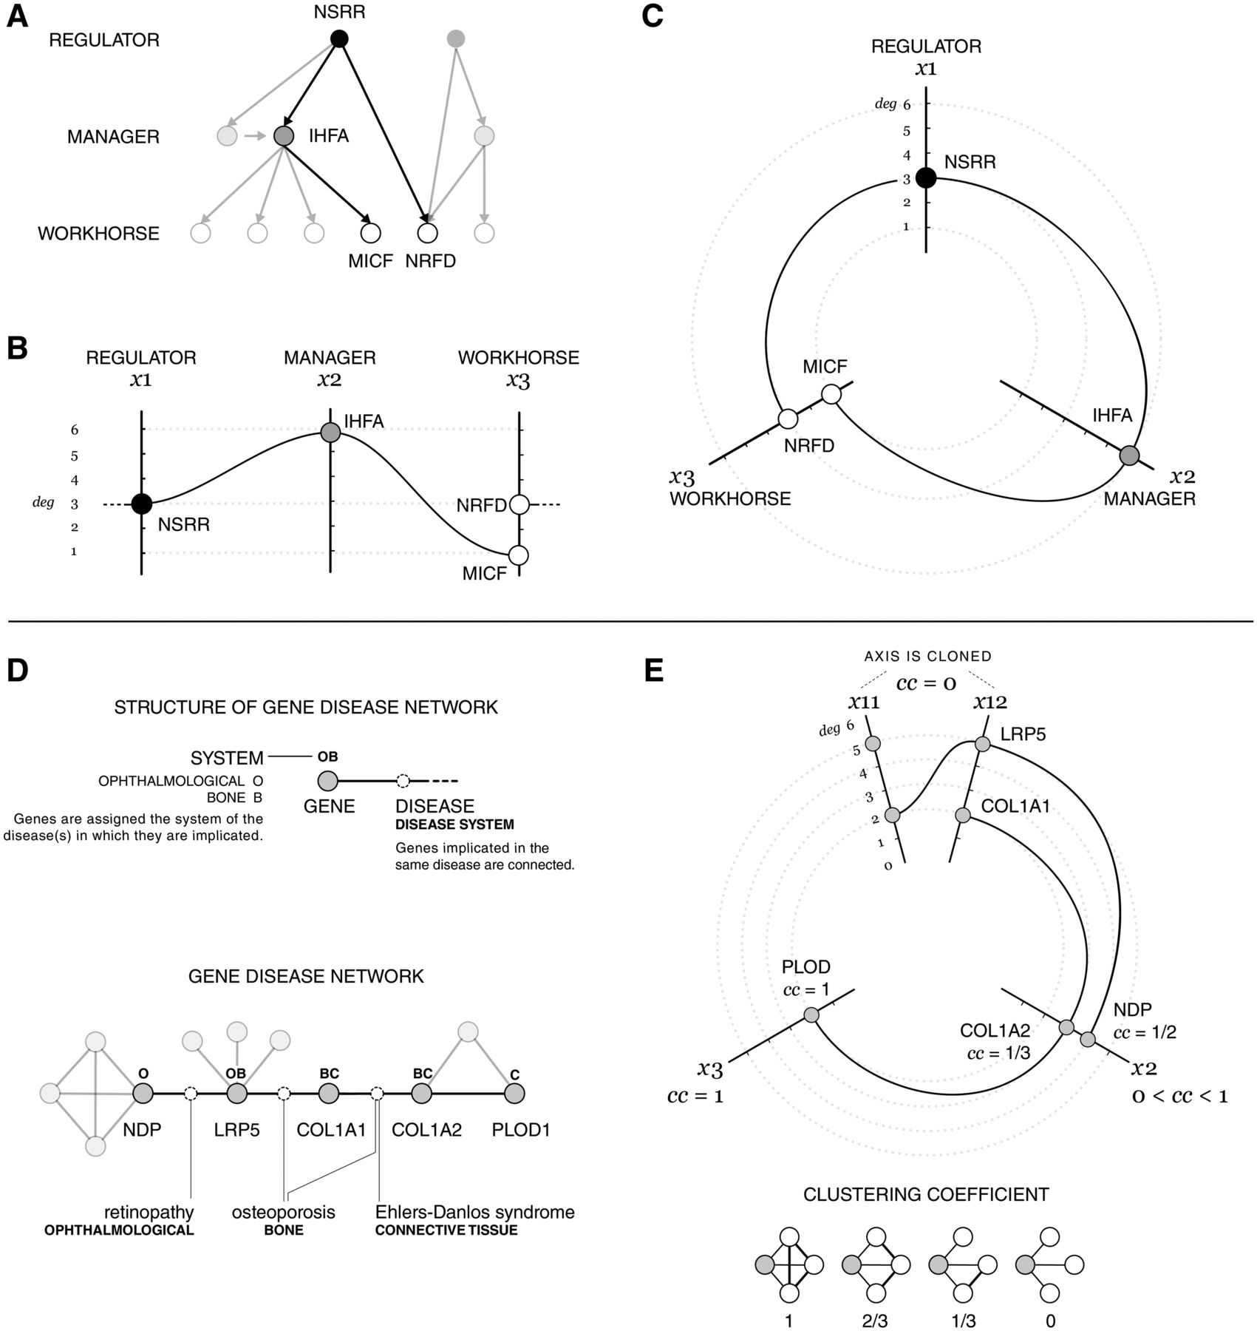
Figure 3: Process of creating HPs from directed and undirected networks. (A) The structure of the RegulonDB network ...
Notes:
Figure 3: Process of creating HPs from directed and undirected networks. (A) The structure of the RegulonDB network [36, 37]. (B) A parallel coordinate plot of the genes highlighted in (A), assigned to axes (x1, x2, x3) based on their role (regulator, manager, workhorse) and positioned on the axis based on connectivity (deg). (C) HP of the genes highlighted in (A), showing the conceptual similarity between the HP and parallel coordinate plot. The circular layout of the HP permits connections between edge axes in the parallel coordinate plot (NSRR/NRFD) to be accommodated within the plot area. (D) The structure of the gene-disease network [38] that connects genes implicated in the same disease. Classification of the connecting diseases (e.g. ophthalmological, bone, connective tissue, etc.) partitions the network into overlapping sets of genes. (E) The clustering coefficient (cc) measures the extent of connections between a node's neighbors and is used to place genes on HP axis. HP of the highlighted nodes in (D) constructed using ranges of the cc, for axis assignment and connectivity for axis scale. The x1-axis is cloned (x11, x12) to reveal connections between cc = 0 nodes.
Unless provided in the caption above, the following copyright applies to the content of this slide: © The Author 2011. Published by Oxford University Press. For Permissions, please email: journals.permissions@oup.com

Slide 4
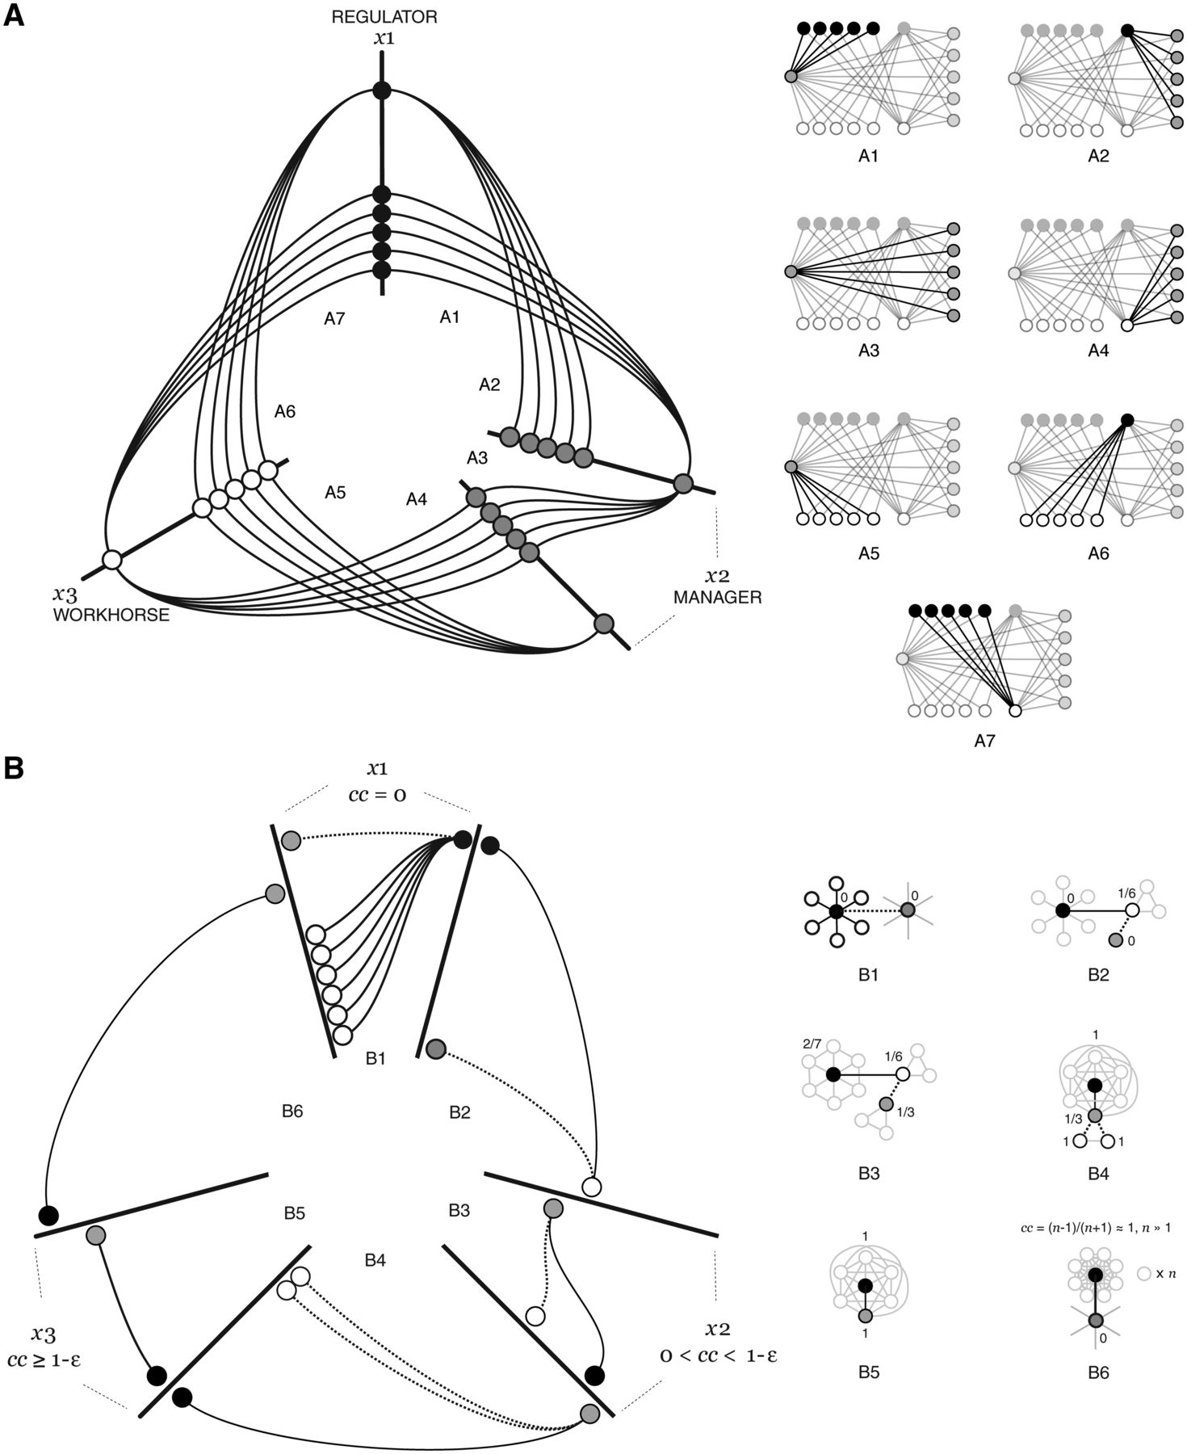
Figure 4: Location of underlying network structures on HPs. (A) HP of a directed network (Figure 2A) using rules from ...
Notes:
Figure 4: Location of underlying network structures on HPs. (A) HP of a directed network (Figure 2A) using rules from Figure 3B. Each bundle of edges (A1–A7) is identified in the manual layout. (B) Position of hubs and clusters in an HP that uses the clustering coefficient (Figure 3E). Hubs have cc = 0 and appear between x1-axis clones (B1), whereas nodes in clusters (cc = 1−ε) show up within the x3-axis (B5). Links in region B6 identify nodes on x1-axis that connect distinct clusters.
Unless provided in the caption above, the following copyright applies to the content of this slide: © The Author 2011. Published by Oxford University Press. For Permissions, please email: journals.permissions@oup.com

Slide 5
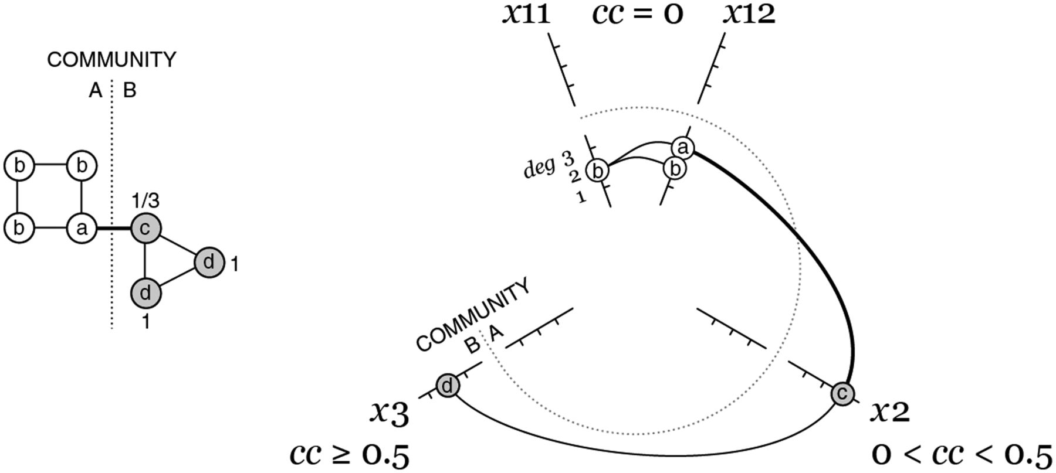
Figure 5: HPS can represent communities by assigning nodes from each community to a different axis segment. In this ...
Notes:
Figure 5: HPS can represent communities by assigning nodes from each community to a different axis segment. In this plot, the two interconnected clusters in a small network are shown by segmenting each axis into two. The link that connects the clusters appears between segments at different radial positions. Where not zero, cc are shown beside the node.
Unless provided in the caption above, the following copyright applies to the content of this slide: © The Author 2011. Published by Oxford University Press. For Permissions, please email: journals.permissions@oup.com

Slide 6
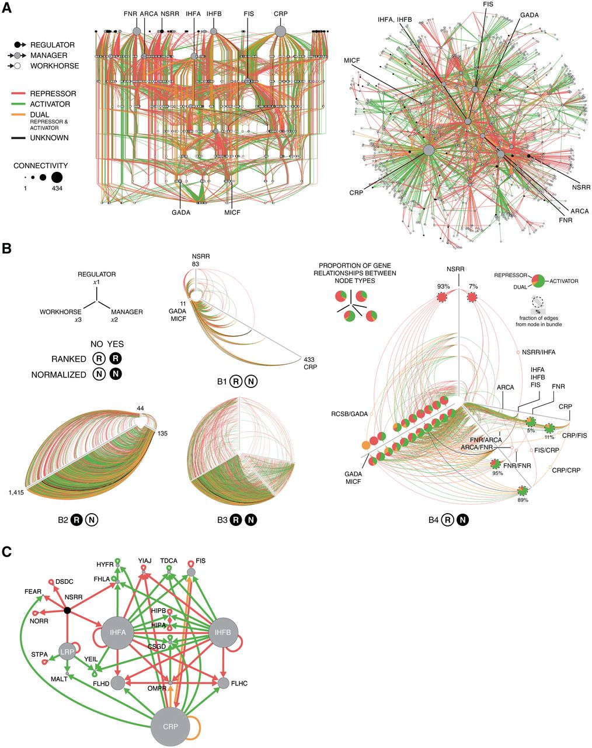
Figure 6: Application of HPs to a large directed network. (A) RegulonDB [37] network of 1584 regulating genes in E. ...
Notes:
Figure 6: Application of HPs to a large directed network. (A) RegulonDB [37] network of 1584 regulating genes in E. coli generated with Cytoscape [39] using yFiles Sugyiama (left) and spring embedded layouts (right). Node size encodes connectivity and edge color encodes the function of the relationship. Genes mentioned in the text are labeled. (B) Four HPs of RegulonDB generated with rules from Figure 3B. The directionality of the edges between cloned axes in B4 is clockwise. Pie charts show the proportion of relationship types within an edge bundle and the fraction of edges from a node in a bundle is identified with a dotted circle. (C) Manual layout of the neighborhood of managers at NSRR. Node sizes reflect the number of workhorses controlled by each gene.
Unless provided in the caption above, the following copyright applies to the content of this slide: © The Author 2011. Published by Oxford University Press. For Permissions, please email: journals.permissions@oup.com

Slide 7
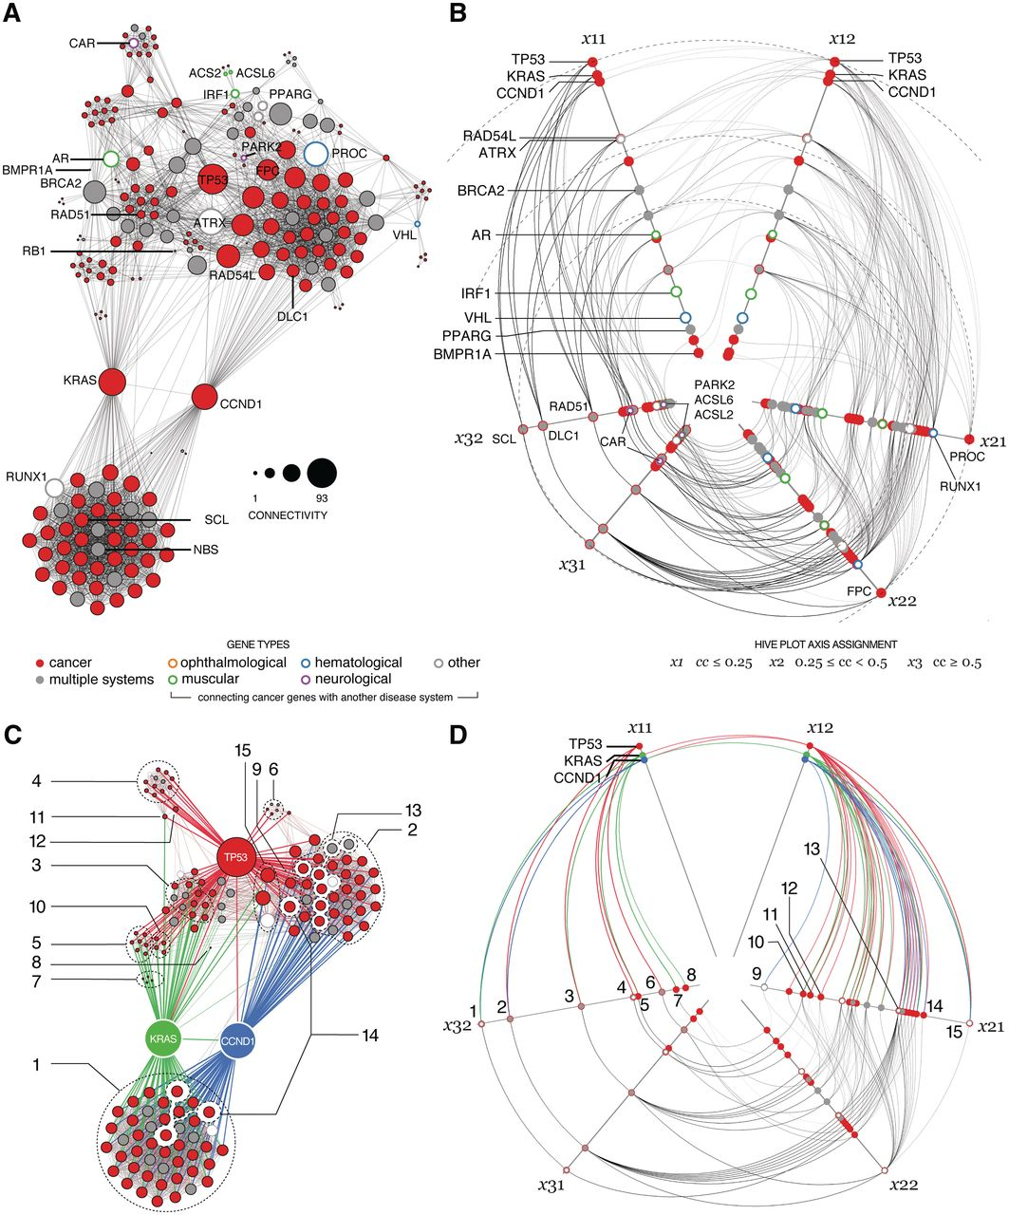
Figure 7: Application of HPs to a large undirected network. (A) Force atlas layout generated with Gephi [25] of the ...
Notes:
Figure 7: Application of HPs to a large undirected network. (A) Force atlas layout generated with Gephi [25] of the cancer component of the gene-disease network showing 258 genes and 3057 edges. Highly connected genes are labeled. Genes that connect the cancer subsystem to other systems are represented by hollow glyphs, colored by the target system. (B) HP of the network, with overlapping nodes drawn in decreasing size by color frequency to maintain visibility. Clustering coefficient ranges for the axes are x1: cc < 0.25, x2: 0.25 ≤ cc < 0.5, x3: cc ≥ 0.5, chosen to effectively separate the nodes. (C) Force atlas layout of genes TP53, KRAS and CCND1, their immediate neighbors in the network and any genes connecting the neighbors. (D) Corresponding HP, with axis length normalized. Corresponding clusters, defined as nodes with the same connectivity and clustering coefficient, are identified with an index in (C) and (D).
Unless provided in the caption above, the following copyright applies to the content of this slide: © The Author 2011. Published by Oxford University Press. For Permissions, please email: journals.permissions@oup.com

Slide 8
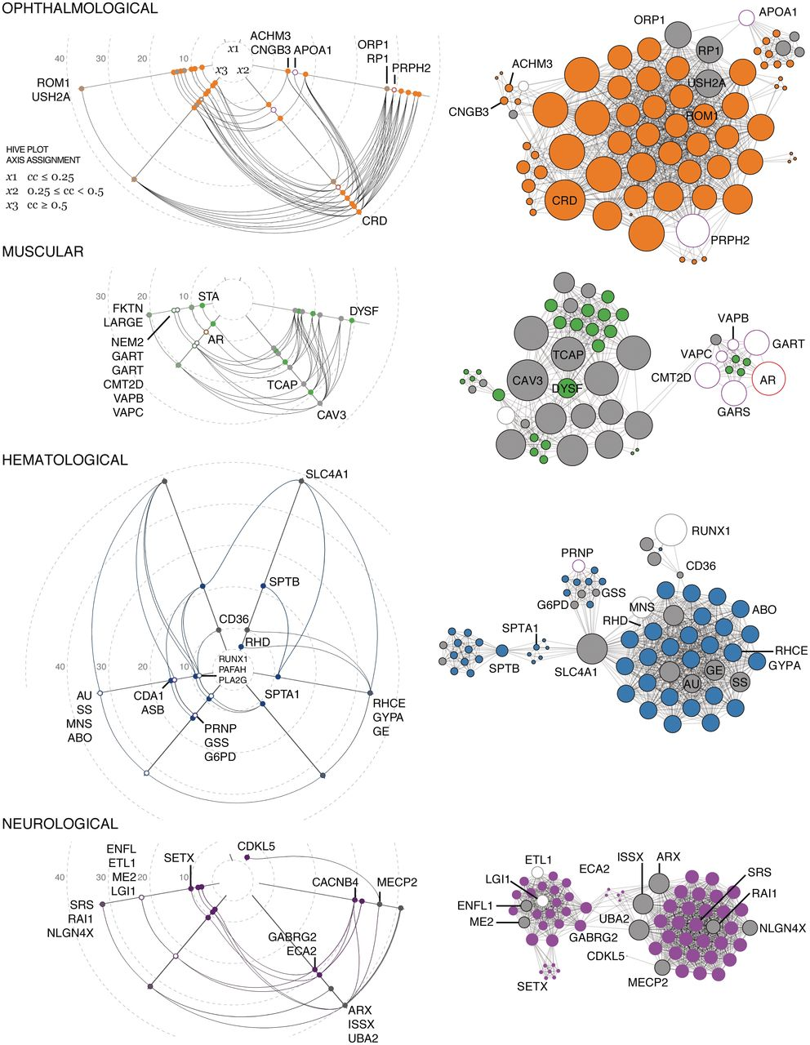
Figure 8: Comparison of largest connected components of ophthalmological, muscular, hematological and neurological ...
Notes:
Figure 8: Comparison of largest connected components of ophthalmological, muscular, hematological and neurological subsystems in the DGN, drawn with the same layout rules as Figures 7A and 6B. Node size encodes the connectivity of the gene in the entire DGN. HP grid shows connectivity in steps of 10 edges.
Unless provided in the caption above, the following copyright applies to the content of this slide: © The Author 2011. Published by Oxford University Press. For Permissions, please email: journals.permissions@oup.com

Slide 9
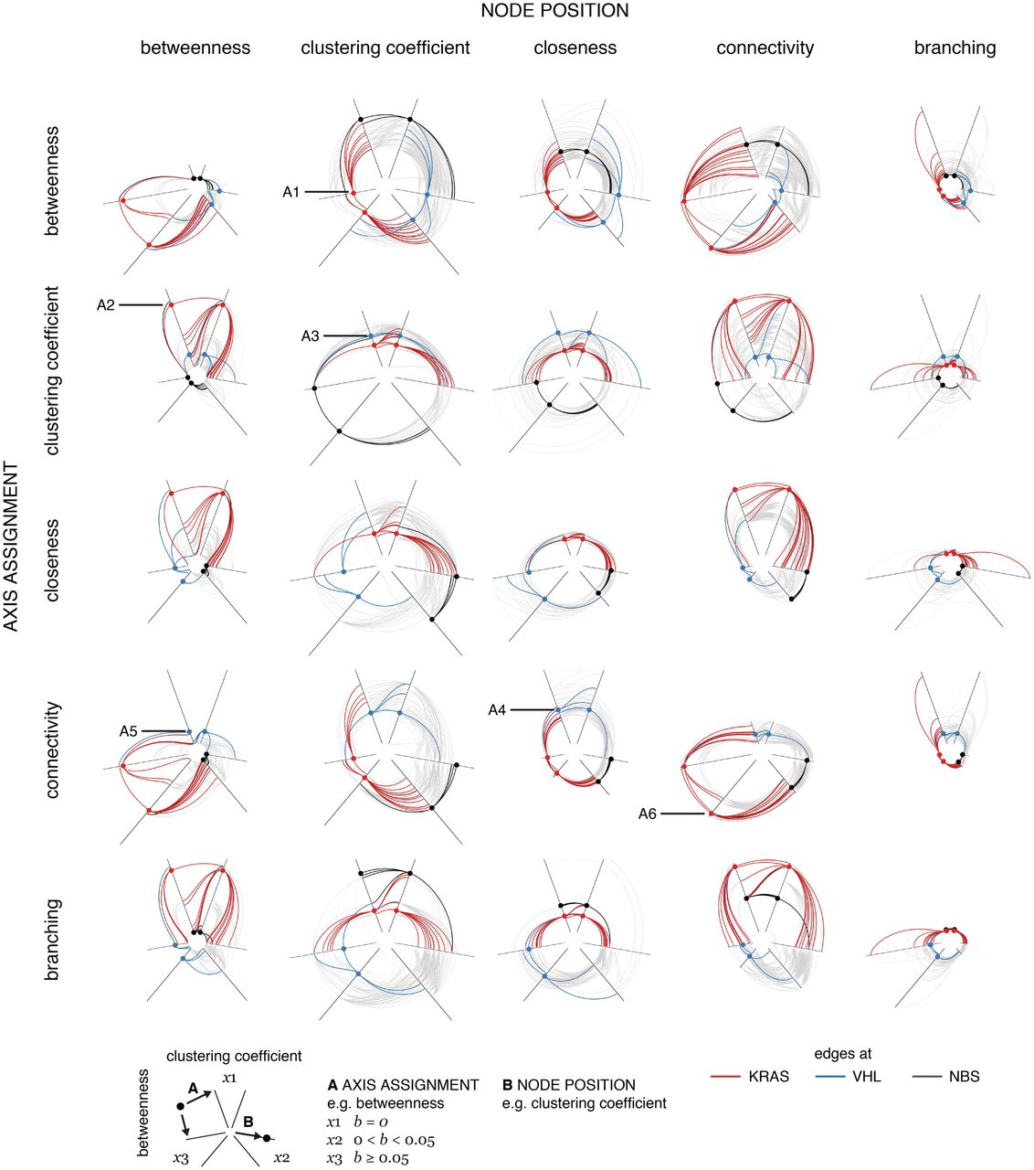
Figure 9: Demonstration of correlation between pairs of structural components in a network using a hive panel. The ...
Notes:
Figure 9: Demonstration of correlation between pairs of structural components in a network using a hive panel. The cancer DGN from Figure 7A is shown as a matrix of HPs. Links to KRAS, VHL and NBS are highlighted to illustrate how a panel can be used to distinguish nodes of this kind (KRAS mediates connections between two clusters, VHL is a sparsely connected gene at the edge of the network and NBS is within the largest fully connected cluster). Each HP uses a unique combination of parameters for axis assignment (shown in rows) and node placement (shown in columns) from the set: betweenness (b), clustering coefficient (cc), closeness (c, remapped to c−1), connectivity (deg) and branching (nn/n, ratio of next-neighbors to neighbors). For example, the plot in row betweenness (b) and column clustering coefficient (cc) uses b for axis assignment and cc for node placement. Parameter cutoffs for b, cc, c, deg and nn/n used to determine node axis assignment to x1, x2 and x3-axes for are b:(0, 0–0.05, > 0.05), cc:(0–0.7, 0.7–1, 1), c:(2.5), deg:(60) and nn/n:(5). These cutoffs were selected heuristically to efficiently populate all axes of the graph.
Unless provided in the caption above, the following copyright applies to the content of this slide: © The Author 2011. Published by Oxford University Press. For Permissions, please email: journals.permissions@oup.com

