Slide 1
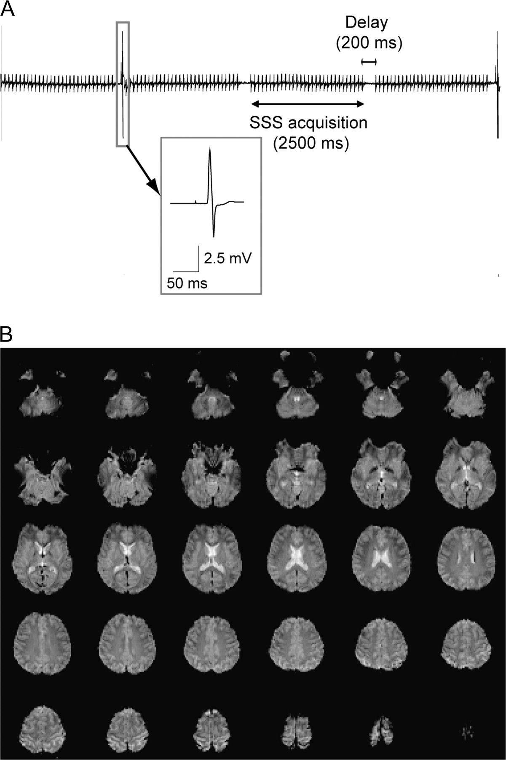
Figure 1. (A) An example EMG recording during concurrent TMS-fMRI using the “SSS” method. Imaging artifacts are ...
Notes:
Figure 1. (A) An example EMG recording during concurrent TMS-fMRI using the “SSS” method. Imaging artifacts are overlain onto the EMG record during fMRI scanning, as subtraction of imaging artifacts was not performed. Even without artifact subtraction, MEPs are much larger than scanning artifacts. (B) An example of the functional imaging volume acquired with the SSS imaging sequence just after a single TMS pulse.
Unless provided in the caption above, the following copyright applies to the content of this slide: © The Author 2009. Published by Oxford University Press. All rights reserved. For permissions, please e-mail: journals.permissions@oxfordjournals.org

Slide 2
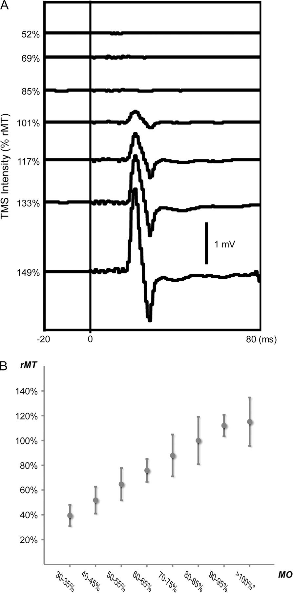
Figure 2. (A) Intensity-dependent changes in MEPs recorded from a representative subject in the MRI environment. (B) ...
Notes:
Figure 2. (A) Intensity-dependent changes in MEPs recorded from a representative subject in the MRI environment. (B) The relationship between physical intensity of stimulation relative to the default maximum machine output (MO) and physiological intensity of stimulation relative to the rMT is shown. The data are averaged across 16 subjects while the data for 100% MO are from 7 subjects only.
Unless provided in the caption above, the following copyright applies to the content of this slide: © The Author 2009. Published by Oxford University Press. All rights reserved. For permissions, please e-mail: journals.permissions@oxfordjournals.org

Slide 3
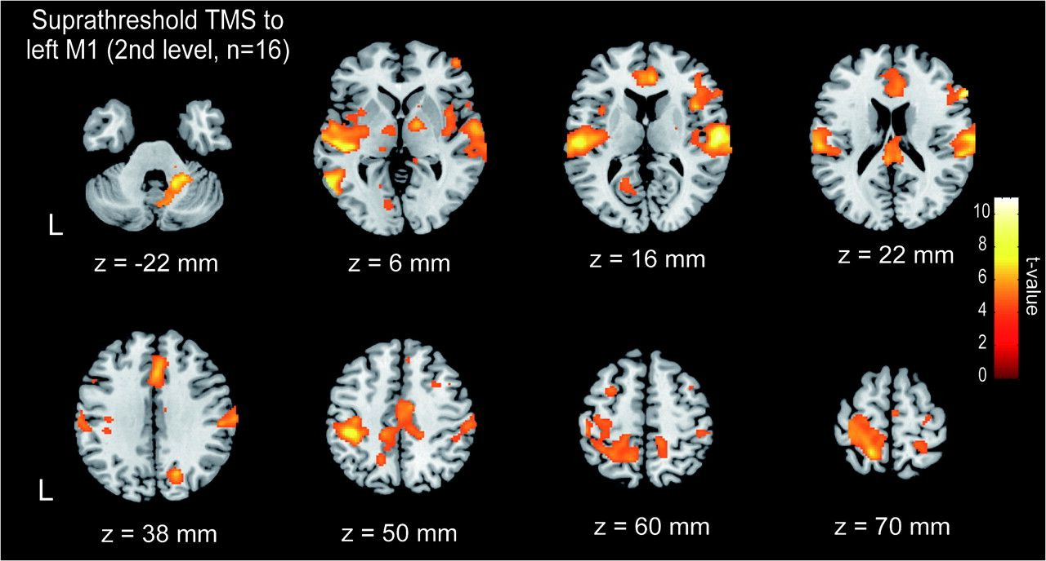
Figure 3. Group-level statistical parametric mapping showing the categorical comparison of hemodynamic changes between ...
Notes:
Figure 3. Group-level statistical parametric mapping showing the categorical comparison of hemodynamic changes between the maximal stimulation condition at the suprathreshold level (95–110% of the default machine output) and the control stimulation condition (30% of the default machine output).
Unless provided in the caption above, the following copyright applies to the content of this slide: © The Author 2009. Published by Oxford University Press. All rights reserved. For permissions, please e-mail: journals.permissions@oxfordjournals.org

Slide 4
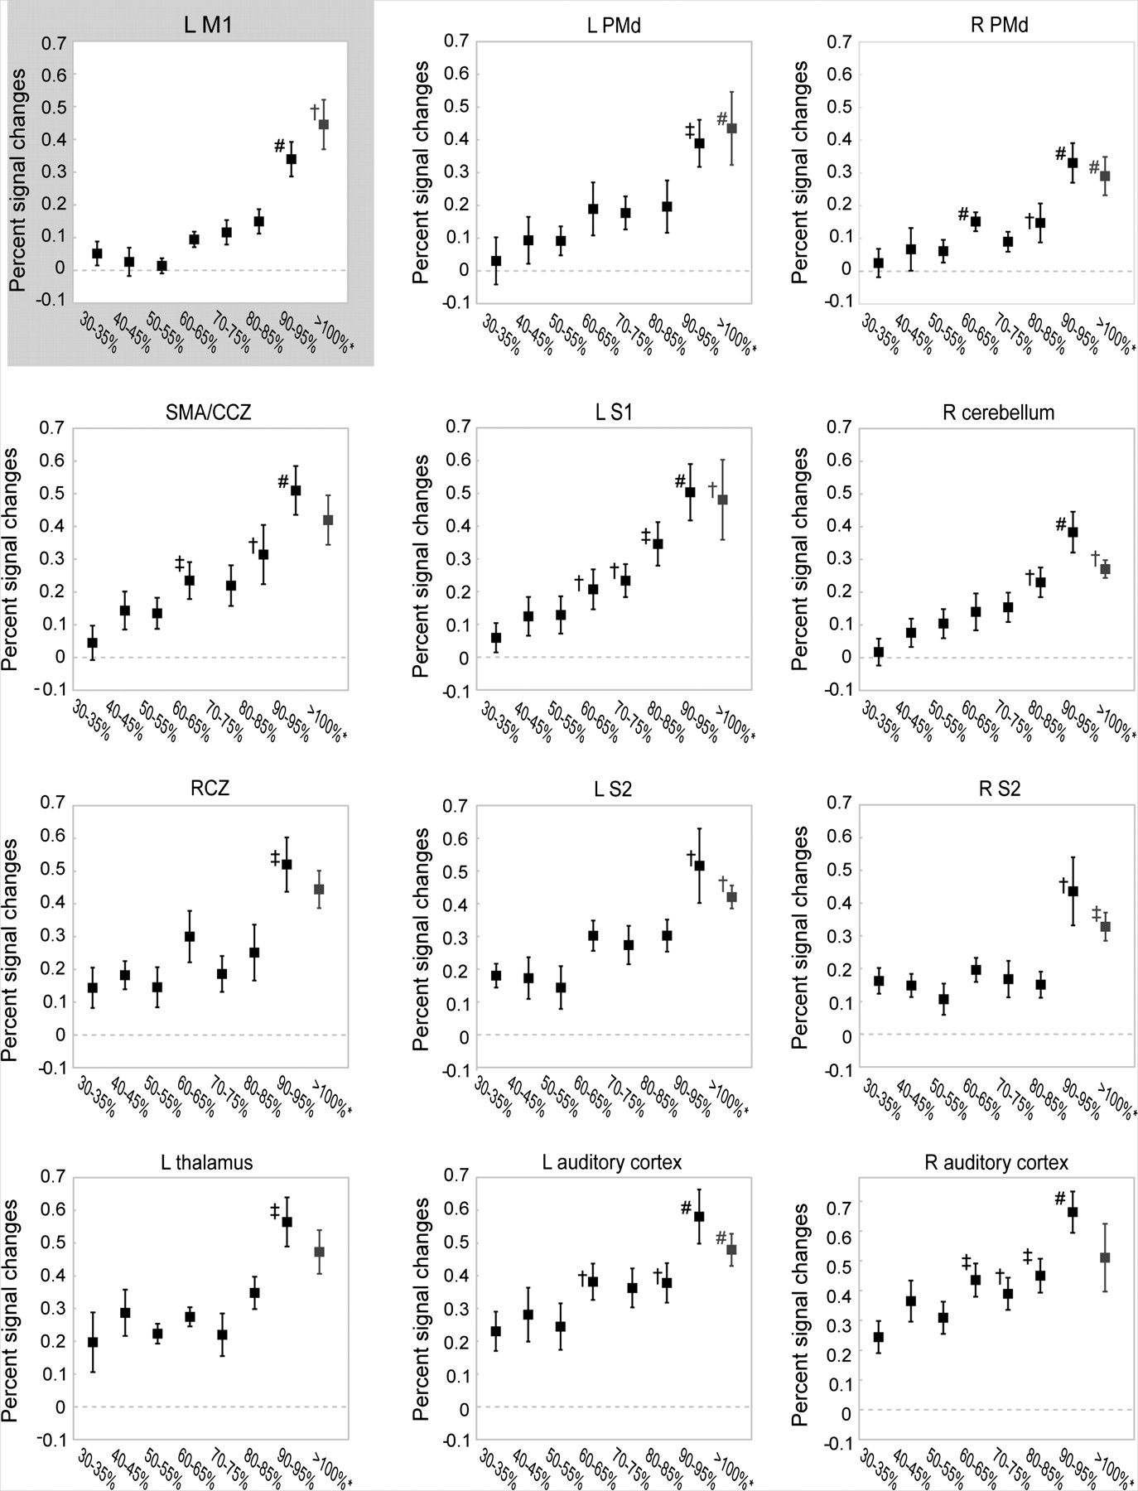
Figure 4. Stimulus–response profiles in the directly stimulated (left M1) and remote areas with regard to the physical ...
Notes:
Figure 4. Stimulus–response profiles in the directly stimulated (left M1) and remote areas with regard to the physical intensity (percentage of the default machine output) of TMS stimulation. An error bar represents the standard error of the mean. All regions showed a significant effect of stimulus intensity as shown by rmANOVA. Activity in each bin was compared with that in the 30% bin (†P < 0.05, ‡P < 0.01, #P < 0.001). M1 = primary motor cortex, S1 = primary somatosensory cortex, SMAv/CCZ = ventral supplementary motor area/caudal cingulate motor zone, S2 = second somatosensory area, RCZ = rostral cingulate zone.
Unless provided in the caption above, the following copyright applies to the content of this slide: © The Author 2009. Published by Oxford University Press. All rights reserved. For permissions, please e-mail: journals.permissions@oxfordjournals.org

Slide 5
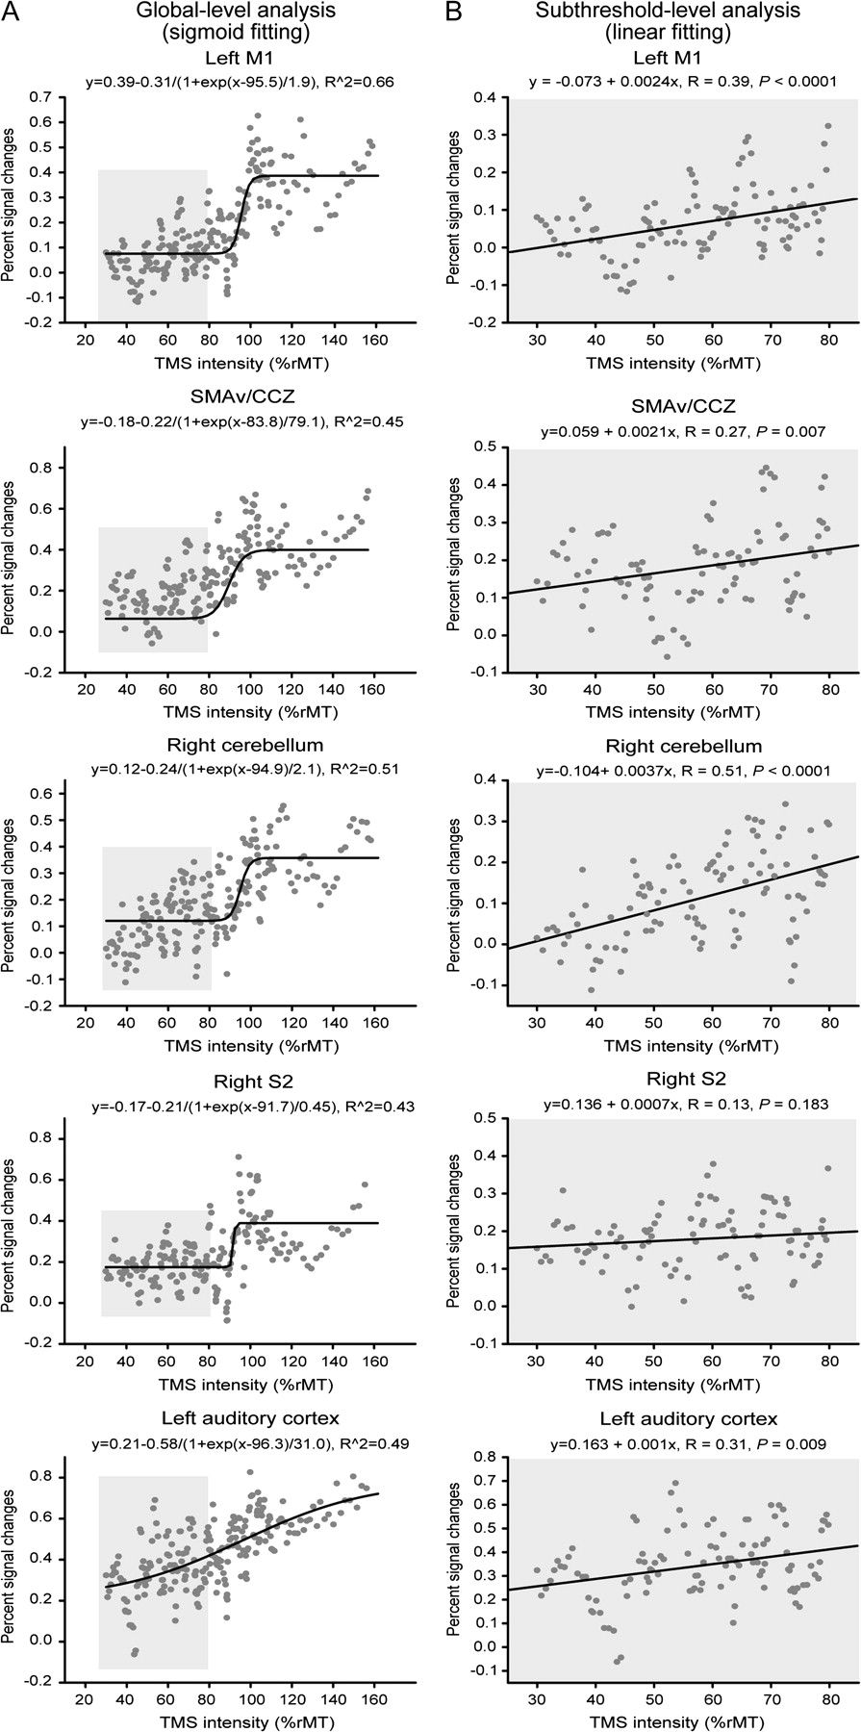
Figure 5. (A) Global-level analysis of stimulus–response profiles as fitted with a sigmoid function. Stimulus intensity ...
Notes:
Figure 5. (A) Global-level analysis of stimulus–response profiles as fitted with a sigmoid function. Stimulus intensity is expressed as the physiological intensity (% of rMT) of TMS stimulation. All the sub- and suprathreshold stimulus conditions were taken into account. Nonlinearity is evident at around 100% of the rMT in the directly stimulated left primary motor cortex (M1) as well as in the SMAv/CCZ, and the right second somatosensory area (S2). The left auditory cortex showed an almost linear stimulus–response profile. The gray dots represent a single data point from each stimulus-intensity condition from each subject. (B) Subthreshold-level analysis of physiological intensity-response profiles as fitted with a linear function. All areas except the right S2 showed a mild yet significant increase in activity as a linear function of stimulus intensity. The gray dots represent a single data point from each stimulus-intensity condition from each subject.
Unless provided in the caption above, the following copyright applies to the content of this slide: © The Author 2009. Published by Oxford University Press. All rights reserved. For permissions, please e-mail: journals.permissions@oxfordjournals.org

