Slide 1
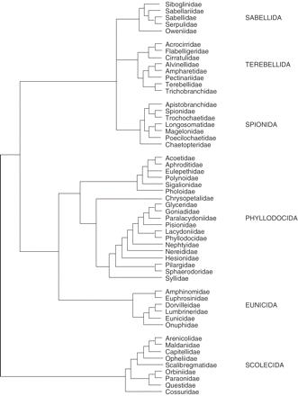
Fig. 1 After cladogram produced by Rouse and Fauchald (1997, their Figure 73) based on morphological traits.
Notes:
Fig. 1 After cladogram produced by Rouse and Fauchald (1997, their Figure 73) based on morphological traits.
Unless provided in the caption above, the following copyright applies to the content of this slide: © The Author 2006. Published by Oxford University Press on behalf of The Society for Integrative and Comparative Biology. All rights reserved. For permissions, please email: journals.permissions@oxfordjournals.org.

Slide 2
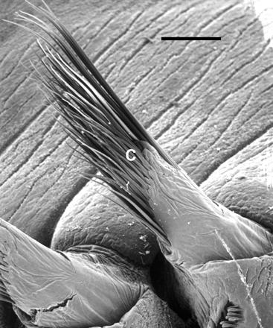
Fig. 2 Capillary chaetae (C) of the sabellid polychaete Sabellastarte magnifica, scale 200 μm.
Notes:
Fig. 2 Capillary chaetae (C) of the sabellid polychaete Sabellastarte magnifica, scale 200 μm.
Unless provided in the caption above, the following copyright applies to the content of this slide: © The Author 2006. Published by Oxford University Press on behalf of The Society for Integrative and Comparative Biology. All rights reserved. For permissions, please email: journals.permissions@oxfordjournals.org.

Slide 3
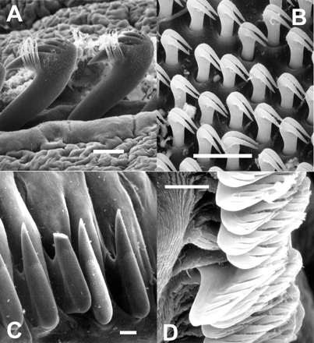
Fig. 3 Examples of hooked chaetae. (A) Clymenella torquata, dentate hooks emerging from neuropodium, scale 15 μm. ...
Notes:
Fig. 3 Examples of hooked chaetae. (A) Clymenella torquata, dentate hooks emerging from neuropodium, scale 15 μm. (B) Owenia fusiformis, detail within a patch of tiny dentate hooks on the torus of one setiger, scale 10 μm. (C) Schizobranchia insignis, row of uncini, note broken chaetal tip, scale 10 μm. (D) Pectinaria gouldii, multi-dentate uncini, scale 5 μm.
Unless provided in the caption above, the following copyright applies to the content of this slide: © The Author 2006. Published by Oxford University Press on behalf of The Society for Integrative and Comparative Biology. All rights reserved. For permissions, please email: journals.permissions@oxfordjournals.org.

Slide 4
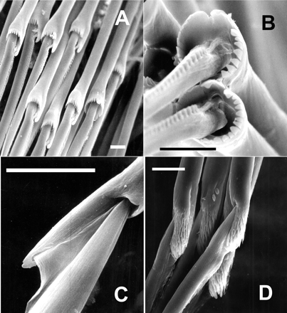
Fig. 4 Examples of compound or jointed chaetae. These joints function outside the body of the worm without direct ...
Notes:
Fig. 4 Examples of compound or jointed chaetae. These joints function outside the body of the worm without direct connection to muscles or nerves. (A) Neanthes brandti, classic blade and socket jointed chaetae from the neuropodium. (B) N. brandti, chaetae, view into the joint of notopodial chaetae showing the single ligament that anchors the blade in the socket. (C) Ophiodromus pugettensis with a much shallower socket. (D) Phyllodoce groenlandia with dentate sculpturing associated with the socket. All scales 10 μm.
Unless provided in the caption above, the following copyright applies to the content of this slide: © The Author 2006. Published by Oxford University Press on behalf of The Society for Integrative and Comparative Biology. All rights reserved. For permissions, please email: journals.permissions@oxfordjournals.org.

Slide 5
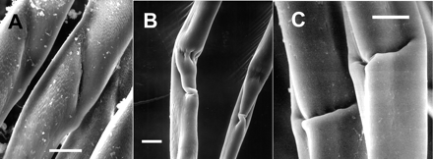
Fig. 5 Examples of pseudocompound chaetae: (A) Lumbrinereis inflata, (B) Nothria elegans, (C) Diopatra ornata. All ...
Notes:
Fig. 5 Examples of pseudocompound chaetae: (A) Lumbrinereis inflata, (B) Nothria elegans, (C) Diopatra ornata. All scales 10 μm.
Unless provided in the caption above, the following copyright applies to the content of this slide: © The Author 2006. Published by Oxford University Press on behalf of The Society for Integrative and Comparative Biology. All rights reserved. For permissions, please email: journals.permissions@oxfordjournals.org.

