Slide 1
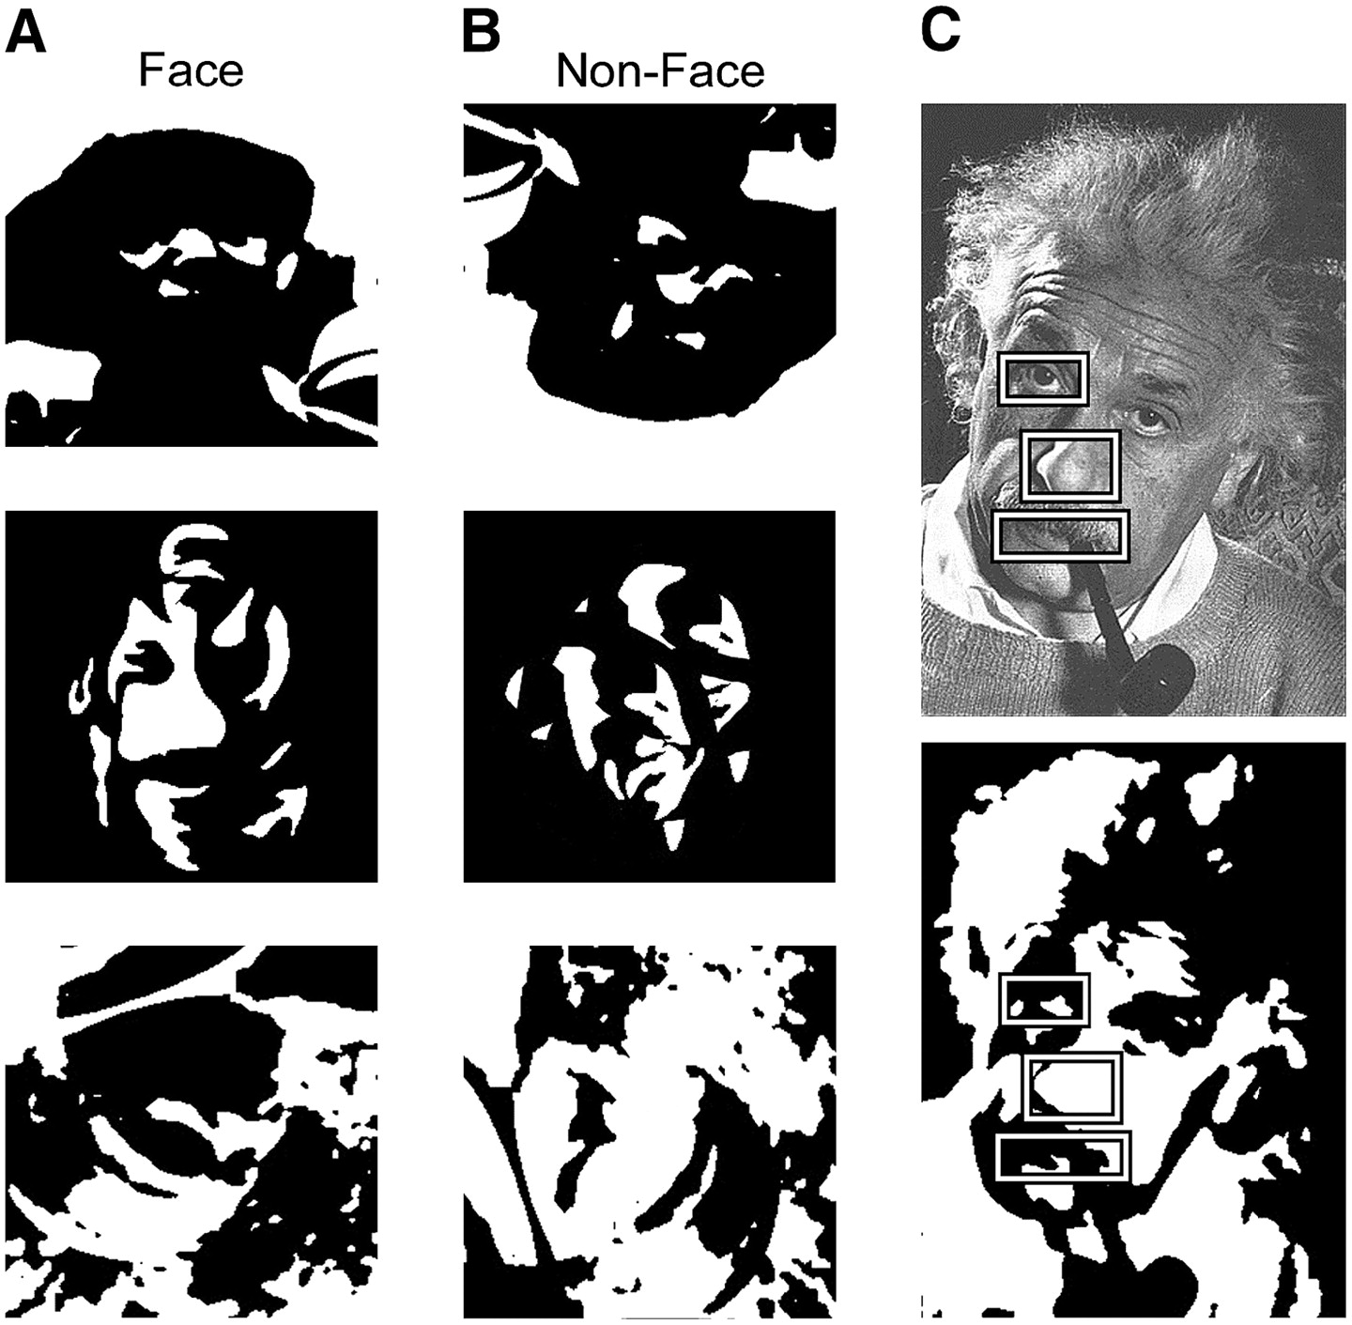
Figure 1. Examples of (A) Mooney face stimuli and (B) nonface stimuli. Nonface stimuli were generated by scrambling and ...
Notes:
Figure 1. Examples of (A) Mooney face stimuli and (B) nonface stimuli. Nonface stimuli were generated by scrambling and altering intact Mooney faces. Note that most Mooney faces were not presented upright and could appear in any orientation, in order to increase the time required to perceive the face. (C) Comparison of local feature information in a grayscale and a thresholded Mooney face. Thresholding severely impairs recognition of individual features; however, the entire face can still be recognized based on the global configuration of these ambiguous local features.
Unless provided in the caption above, the following copyright applies to the content of this slide: © The Author 2006. Published by Oxford University Press. All rights reserved. For permissions, please e-mail: journals.permissions@oxfordjournals.org

Slide 2
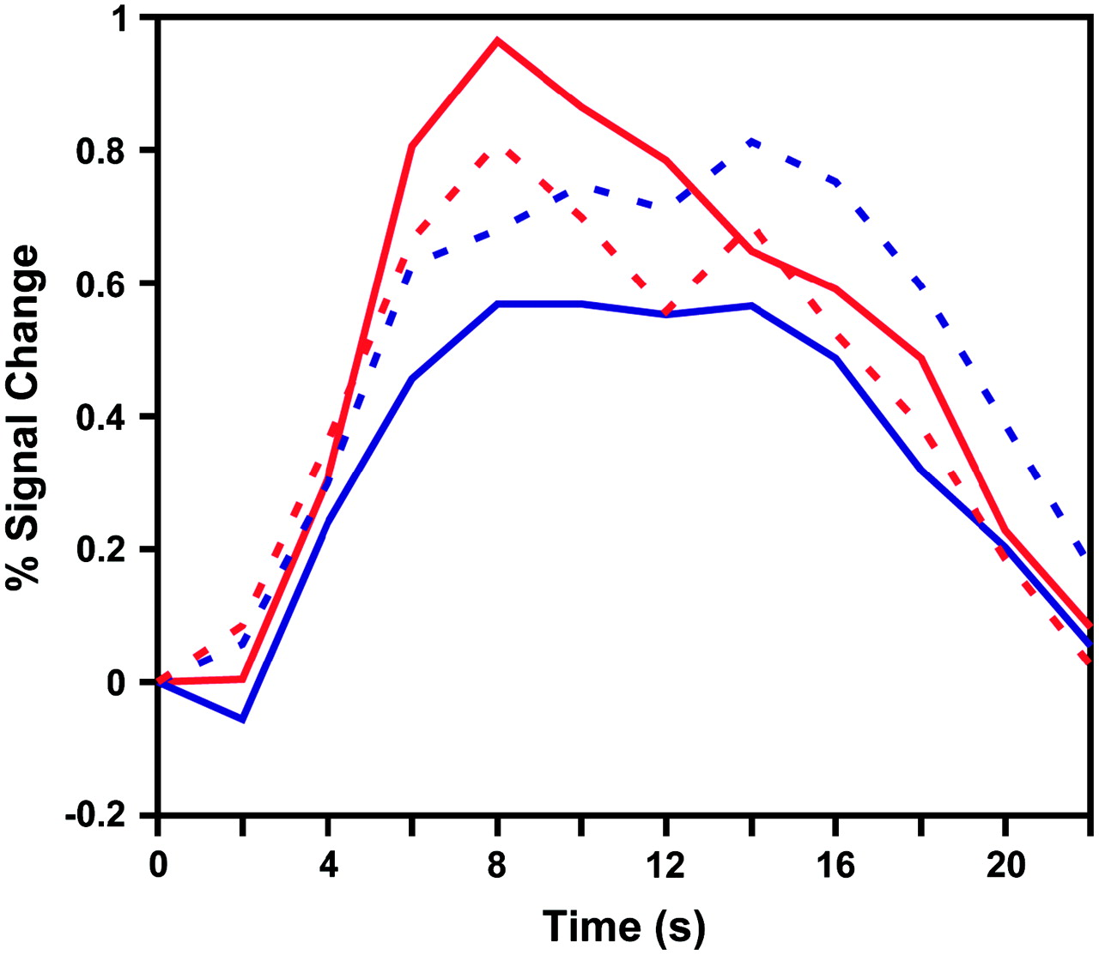
Figure 2. Time course of fMRI activity in the FFA for correctly and incorrectly classified faces and nonfaces. FFA ...
Notes:
Figure 2. Time course of fMRI activity in the FFA for correctly and incorrectly classified faces and nonfaces. FFA activity was significantly greater when face stimuli were correctly identified as faces (red solid curve) than when they were incorrectly classified as nonfaces (red dashed curve). FFA activity was also greater when nonface stimuli were incorrectly classified as faces (blue dashed curve) than when they were correctly identified as nonfaces (blue solid curve). fMRI data were normalized by converting magnetic resonance signal intensities to percent signal change relative to time point 0 s for each trial. The stimulus was presented from time 0 to 2 s and replaced by a fixation point from time 12 to 24 s. Average fMRI time courses were calculated for each of the 5 subjects who made errors in this task and then analyzed using within-subjects analysis of variance (ANOVA) with response category and time (time points 2–22 s, TR 2 s) as separate factors. Planned contrasts were performed using the mean squared error and degrees of freedom from the 2-way ANOVA to test for differences in fMRI peak amplitudes (time points 6–12 s) across conditions.
Unless provided in the caption above, the following copyright applies to the content of this slide: © The Author 2006. Published by Oxford University Press. All rights reserved. For permissions, please e-mail: journals.permissions@oxfordjournals.org

Slide 3
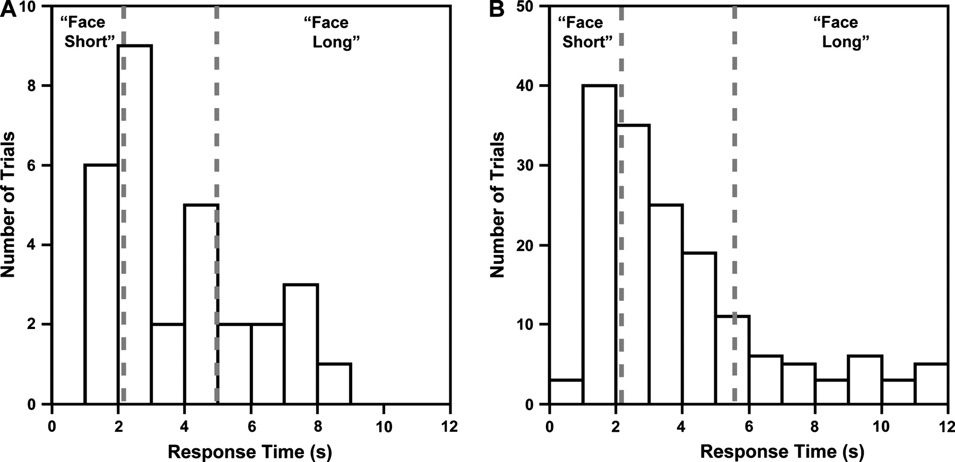
Figure 3. Histograms of behavioral response times for correct face responses. Response times are tallied in 1-s bins ...
Notes:
Figure 3. Histograms of behavioral response times for correct face responses. Response times are tallied in 1-s bins for 1 representative subject (A) and all subjects (B). Dashed lines indicate upper and lower quartile boundaries. The fastest 25% of response times for each subject were labeled as face-short responses (mean 1.66 s, SD across subjects 0.47 s); the slowest 25% of response times were labeled as face-long responses (mean 7.68 s, SD 2.14 s). Valid responses had to occur within the 12-s stimulus presentation period.
Unless provided in the caption above, the following copyright applies to the content of this slide: © The Author 2006. Published by Oxford University Press. All rights reserved. For permissions, please e-mail: journals.permissions@oxfordjournals.org

Slide 4
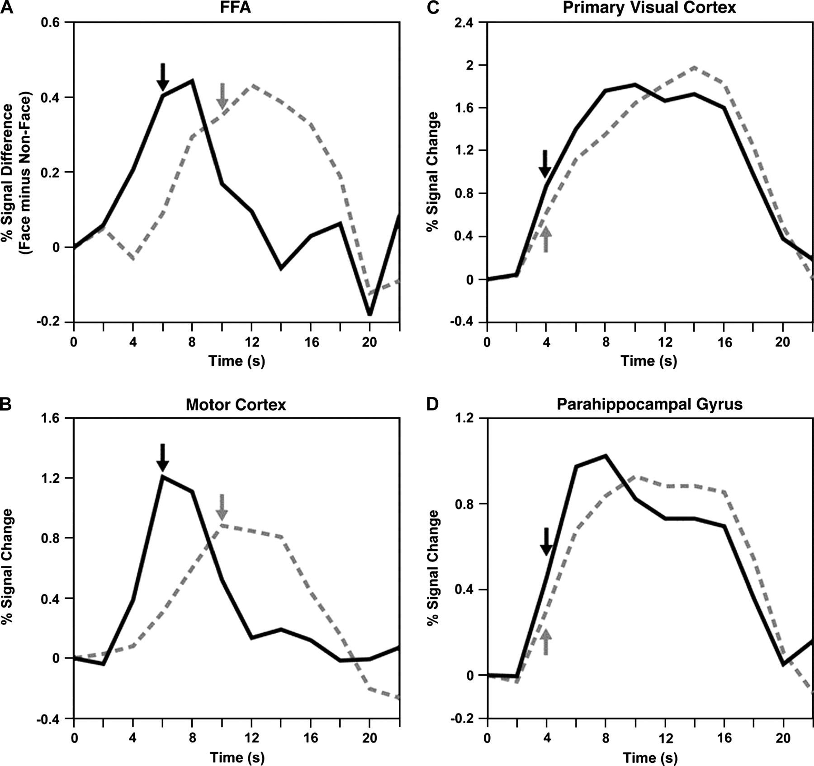
Figure 4. Time course of fMRI activity for face-short and face-long responses. Plots show fMRI time courses, averaged ...
Notes:
Figure 4. Time course of fMRI activity for face-short and face-long responses. Plots show fMRI time courses, averaged across subjects, for all correct face-short responses (black solid curves) and face-long responses (gray dashed curves) in 4 ROIs. Arrows indicate the time point at which activity first rose significantly above baseline levels. (A) Face-specific FFA activity rose significantly above baseline levels at 6 s after stimulus onset for face-short responses (black arrow) and at 10 s for face-long responses (gray arrow). (B) Effects of perceptual decision time in motor cortex are strikingly similar to those in the FFA, with activity increasing above baseline at 6 s for face-short responses and 10 s for face-long responses. (C) Primary visual cortex shows no effect of perceptual decision time; both face-short and face-long responses led to significant increases in activity at 4-s poststimulus onset, indicating the stimulus-driven nature of the fMRI response. (D) Object-selective regions of parahippocampal gyrus also show no effect of perceptual decision time.
Unless provided in the caption above, the following copyright applies to the content of this slide: © The Author 2006. Published by Oxford University Press. All rights reserved. For permissions, please e-mail: journals.permissions@oxfordjournals.org

Slide 5
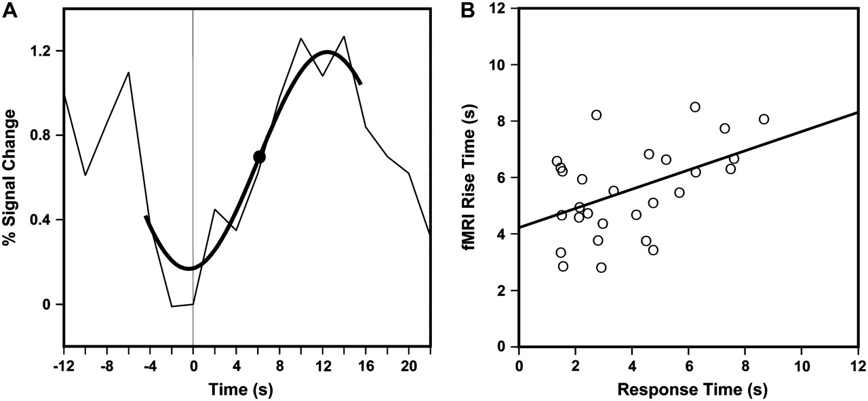
Figure 5. Relationship between behavioral response time and fMRI rise time across individual trials. (A) The time of ...
Notes:
Figure 5. Relationship between behavioral response time and fMRI rise time across individual trials. (A) The time of rising fMRI activity was quantified on individual trials by calculating the best-fitting sine function and deriving the point of inflection as an objective estimate of when fMRI activity rose above baseline levels. (B) Correlation between fMRI rise times in the FFA and behavioral response times on correct face-response trials for a representative subject (S3).
Unless provided in the caption above, the following copyright applies to the content of this slide: © The Author 2006. Published by Oxford University Press. All rights reserved. For permissions, please e-mail: journals.permissions@oxfordjournals.org

