Slide 1
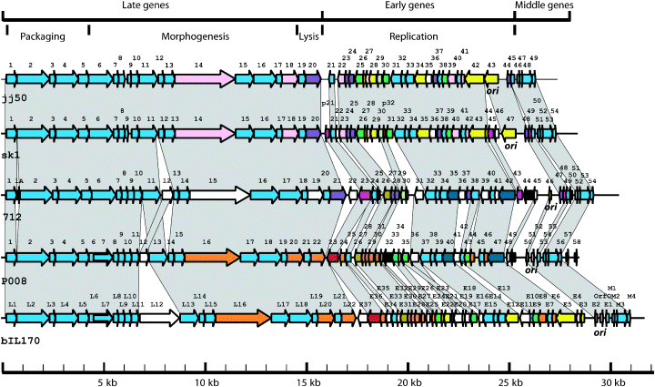
1 Schematic representation of the genomic organization of the 936-type phages, jj50, sk1 (Chandryet al,1997), ...
Notes:
1 Schematic representation of the genomic organization of the 936-type phages, jj50, sk1 (Chandryet al,1997), 712, P008 and bIL170 (Crutz-Le Coqet al,2002), highlighting functional modules within the temporally transcribed regions. Genomic regions connected by a grey block are indicative of those possessing at least 60% identity at the amino acid level. The putative origins of replication (ori) of the phages are indicated below the relevant region of the individual phages. ORFs of the same colour represent those with at least 80% identity at the amino acid level.
Unless provided in the caption above, the following copyright applies to the content of this slide: © 2006 Federation of European Microbiological Societies

Slide 2
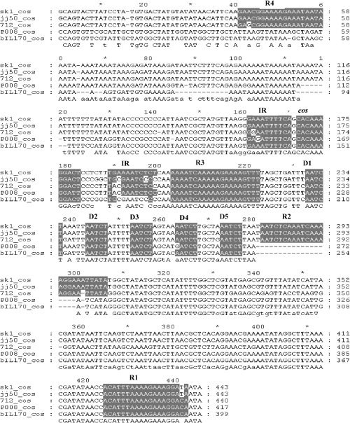
2 Comparison of the cos terminal regions of the 936-type phages. Shaded are the cos sites, inverted repeats ...
Notes:
2 Comparison of the cos terminal regions of the 936-type phages. Shaded are the cos sites, inverted repeats (IR), direct repeats (D1–5) and the putative terminase binding sites (R1–4).
Unless provided in the caption above, the following copyright applies to the content of this slide: © 2006 Federation of European Microbiological Societies

