Slide 1
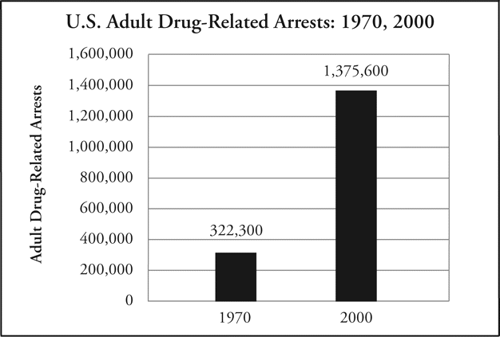
Notes:
Unless provided in the caption above, the following copyright applies to the content of this slide: © 2010 by the Organization of American Historians

Slide 2
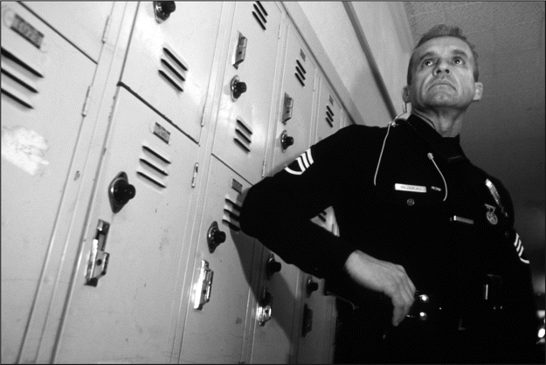
A police officer patrolling the halls of El Sereno Middle School in East Los Angeles in 2000. © Najlah ...
Notes:
A police officer patrolling the halls of El Sereno Middle School in East Los Angeles in 2000. © Najlah Feanny/Corbis.
Unless provided in the caption above, the following copyright applies to the content of this slide: © 2010 by the Organization of American Historians

Slide 3
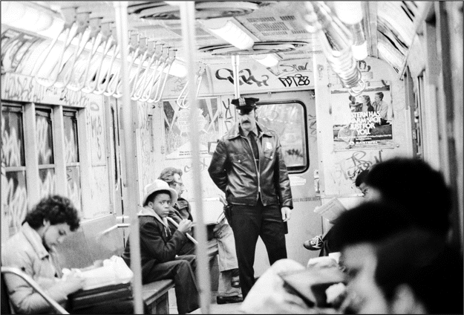
A policeman joins a force of nine hundred uniformed officers patrolling New York City subway trains in a new ...
Notes:
A policeman joins a force of nine hundred uniformed officers patrolling New York City subway trains in a new anticrime campaign in 1979. © Bettman/Corbis.
Unless provided in the caption above, the following copyright applies to the content of this slide: © 2010 by the Organization of American Historians

Slide 4
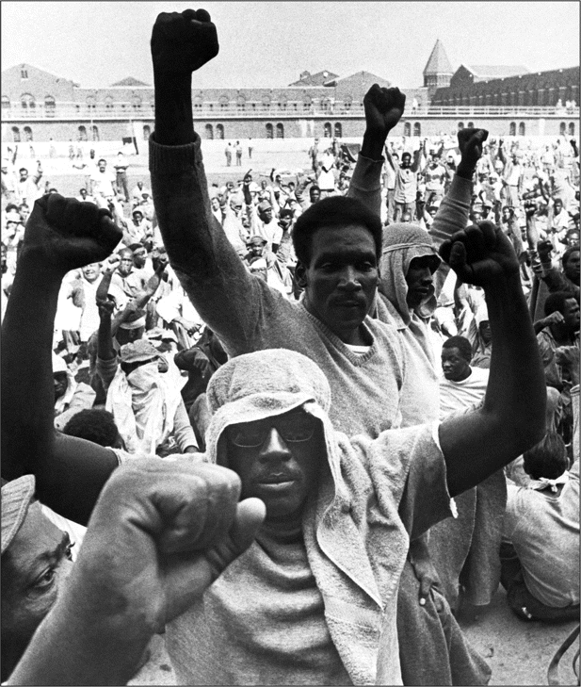
Prisoners protesting their working and living conditions at the Attica State Correctional Facility in New ...
Notes:
Prisoners protesting their working and living conditions at the Attica State Correctional Facility in New York in 1971. © Bettman.
Unless provided in the caption above, the following copyright applies to the content of this slide: © 2010 by the Organization of American Historians

Slide 5
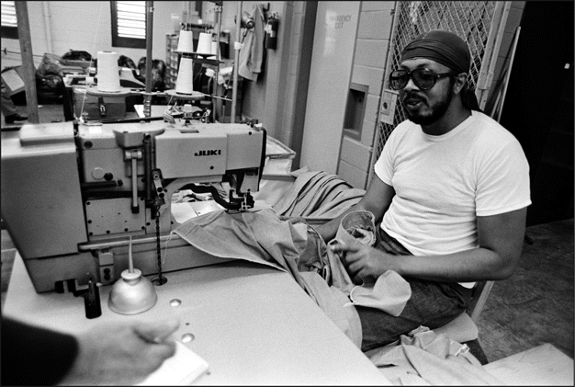
An inmate and Vietnam War veteran making shirts in a Virginia correctional facility in 1985. © ...
Notes:
An inmate and Vietnam War veteran making shirts in a Virginia correctional facility in 1985. © Bettman/Corbis.
Unless provided in the caption above, the following copyright applies to the content of this slide: © 2010 by the Organization of American Historians

Slide 6
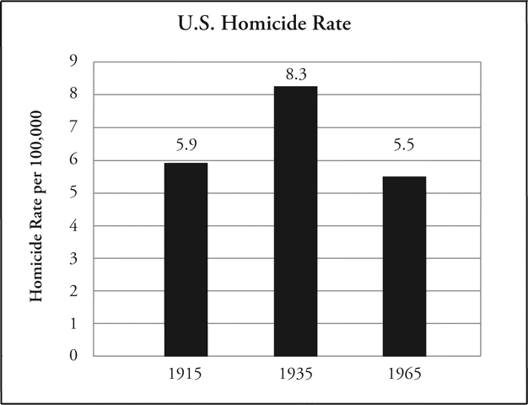
Source: “Homicide Rate Trends, 1900–1926,” Bureau of Justice Statistics, ...
Notes:
Source: “Homicide Rate Trends, 1900–1926,” Bureau of Justice Statistics, http//bjs.ojp.usdoj.gov/content/glance/tables/hmrttab.cfm.
Unless provided in the caption above, the following copyright applies to the content of this slide: © 2010 by the Organization of American Historians

Slide 7
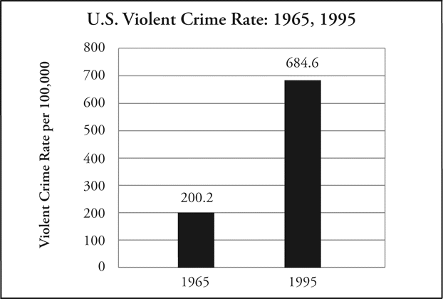
Source: “United States Crime Index Rates per 100,000 Inhabitants, 1960–2009,” Data: Federal Bureau of ...
Notes:
Source: “United States Crime Index Rates per 100,000 Inhabitants, 1960–2009,” Data: Federal Bureau of Investigation, Uniform Crime Reports, http//www.disastercenter.com/crime/uscrime.html.
Unless provided in the caption above, the following copyright applies to the content of this slide: © 2010 by the Organization of American Historians

Slide 8
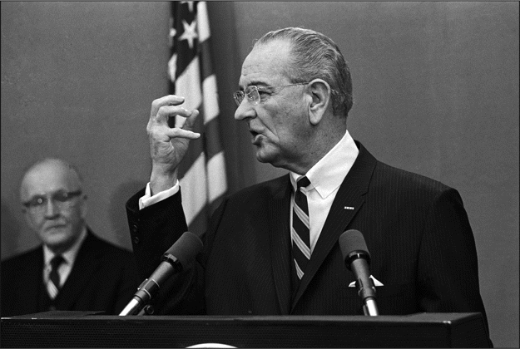
President Lyndon B. Johnson submits a twenty-three-point anticrime program to Congress in 1968. © ...
Notes:
President Lyndon B. Johnson submits a twenty-three-point anticrime program to Congress in 1968. © Bettman/Corbis.
Unless provided in the caption above, the following copyright applies to the content of this slide: © 2010 by the Organization of American Historians

