Slide 1
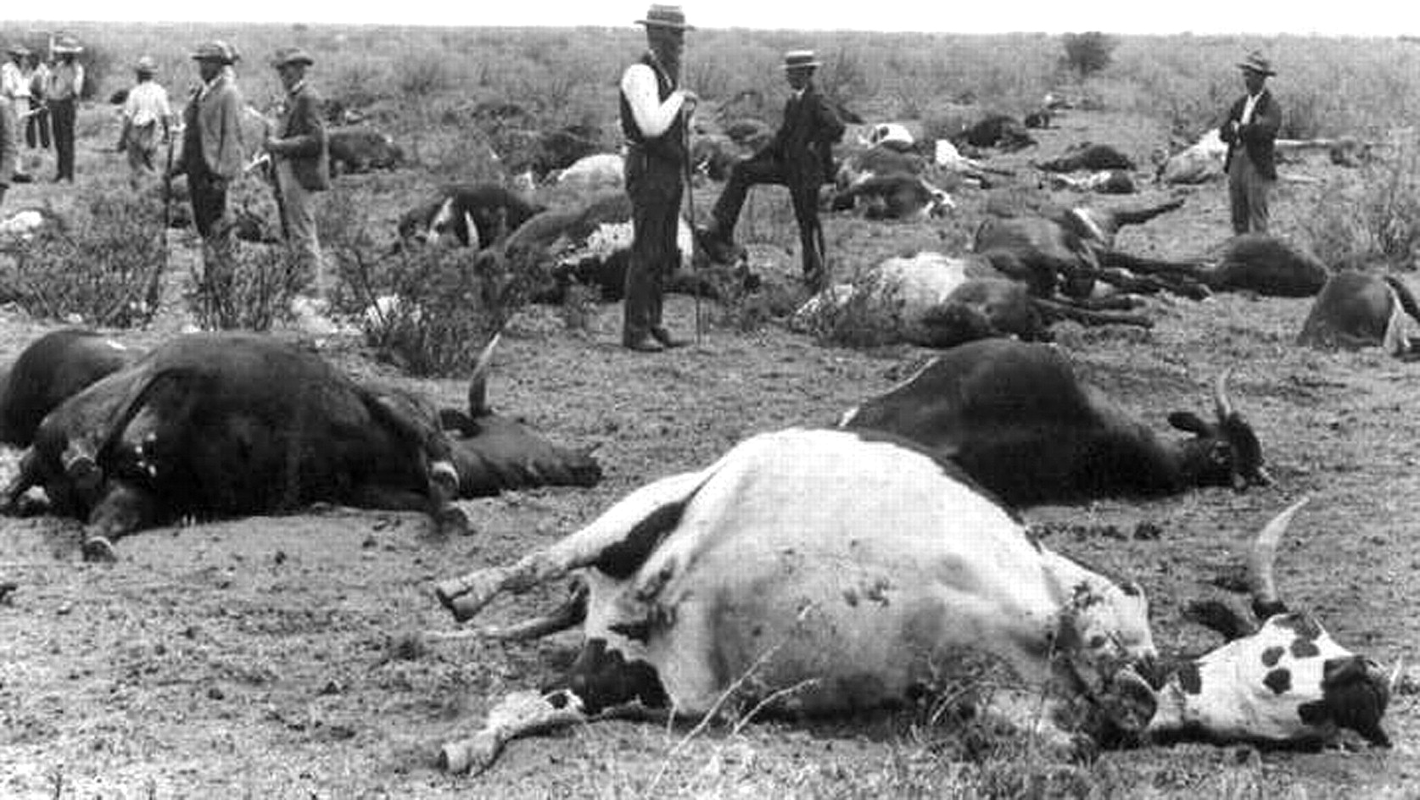
Figure 1. Cattle dead of rinderpest in the years after the devastating African rinderpest panzootic, which began in ...
Notes:
Figure 1. Cattle dead of rinderpest in the years after the devastating African rinderpest panzootic, which began in 1887. This photograph was probably taken around 1896 near Vryburg, Transvaal, South Africa (Veterinary History Society of Onderstepoort Veterinary Research Institute).
Unless provided in the caption above, the following copyright applies to the content of this slide: Published by Oxford University Press on behalf of the Infectious Diseases Society of America 2011

