Slide 1
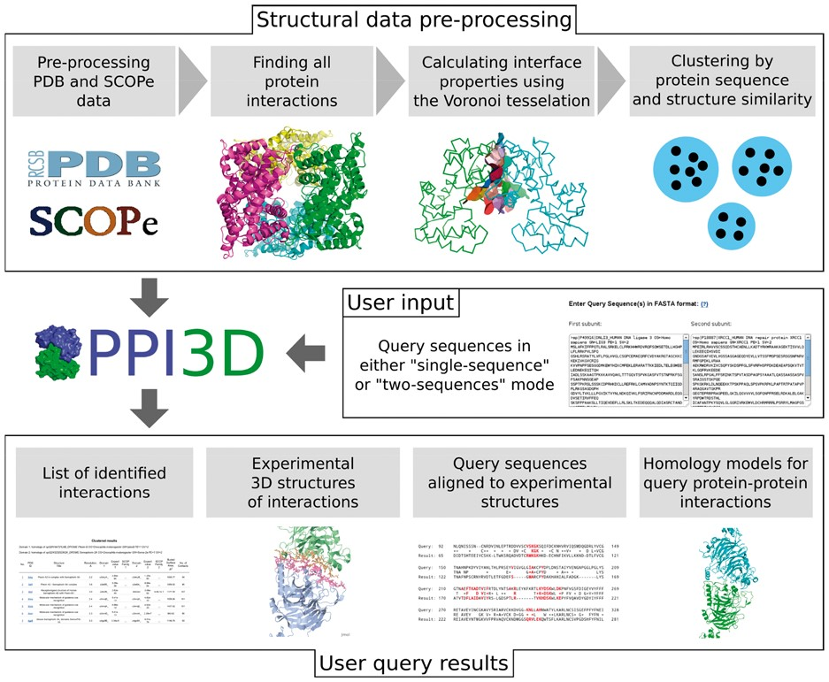
Fig. 1. Schematic workflow of the PPI3D web server
Notes:
Fig. 1. Schematic workflow of the PPI3D web server
Unless provided in the caption above, the following copyright applies to the content of this slide: © The Author 2016. Published by Oxford University Press. All rights reserved. For Permissions, please e-mail: journals.permissions@oup.comThis article is published and distributed under the terms of the Oxford University Press, Standard Journals Publication Model (https://academic.oup.com/journals/pages/about_us/legal/notices)

