Slide 1
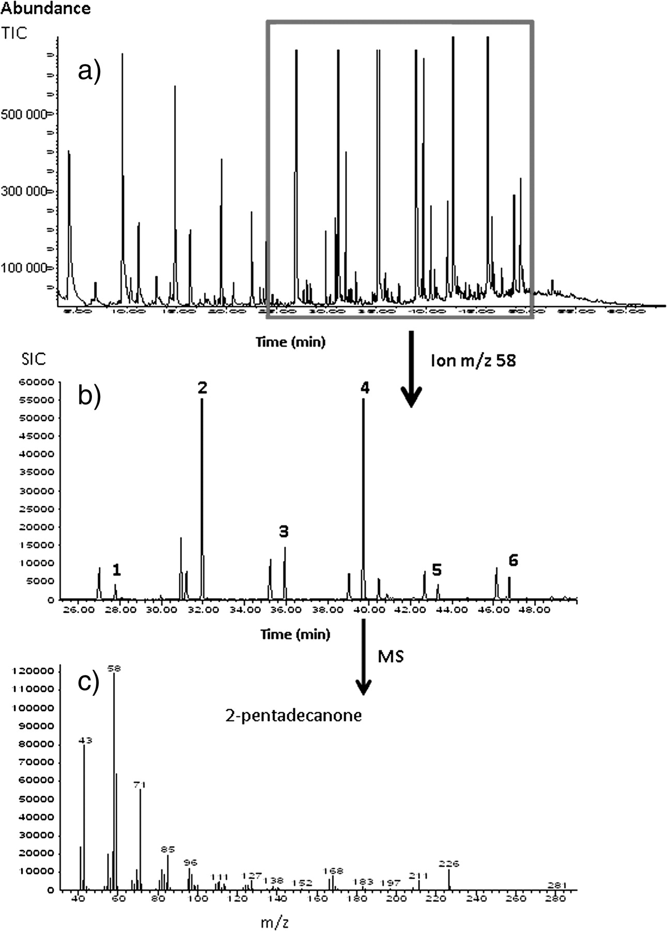
Figure 1 (A) A TIC profile obtained from male UCSD junco preen oil, (B) a corresponding postrun single ion current ...
Notes:
Figure 1 (A) A TIC profile obtained from male UCSD junco preen oil, (B) a corresponding postrun single ion current (SIC) profile of methyl ketones (m/z 58) from the time range 25–50 min (1: 2-dodecanone, 2: 2-tridecanone, 3: 2-tetradecanone, 4: 2-pentadecanone, 5: 2-hexadecanone, 5: 2-heptadecanone), and (C) the mass spectrum of 2-pentadecanone from the SIC profile (B).
Unless provided in the caption above, the following copyright applies to the content of this slide: © The Author 2010. Published by Oxford University Press on behalf of the International Society for Behavioral Ecology. All rights reserved. For permissions, please e-mail: journals.permissions@oxfordjournals.org

Slide 2
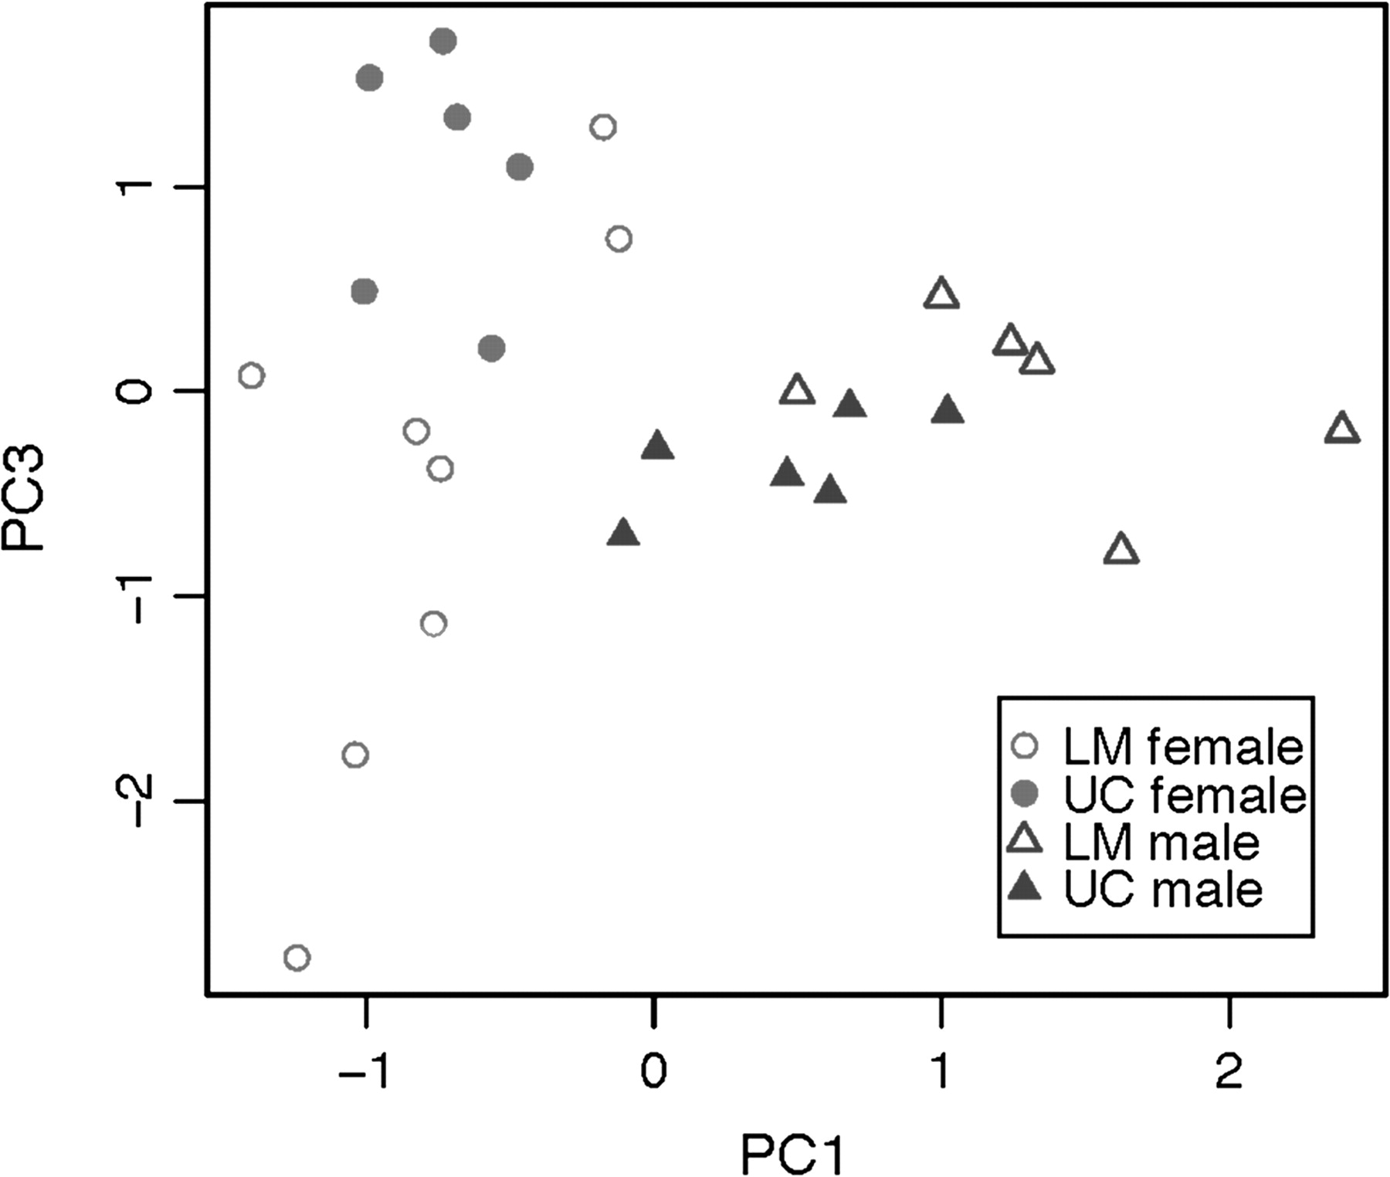
Figure 2 Principal component 1 and principal component 3 scores derived from relative proportions of volatile ...
Notes:
Figure 2 Principal component 1 and principal component 3 scores derived from relative proportions of volatile compounds. (See Table 2 for principal component loadings.)
Unless provided in the caption above, the following copyright applies to the content of this slide: © The Author 2010. Published by Oxford University Press on behalf of the International Society for Behavioral Ecology. All rights reserved. For permissions, please e-mail: journals.permissions@oxfordjournals.org

